Slide 1
School-Based Services
Schools and Parents Amplifying Resources for Kids (SPARK)
Learning Experience
June 26, 2024
Notes:
Leah will open

Slide 2
Agenda
Welcome
DOH update
DEED presentation
DEED Q&A
Anchorage School District SHARS Presentation
ASD Q&A
Notes:
Christal go through agenda

Slide 3
Areas of Opportunity
CMS flexibilities for School-Based Services
Legislative efforts
UPDATE: HB 344 passed; awaiting transmittal to Governor
Grant opportunity from CMS
UPDATE: Alaska awarded $2.5 million grant for implementation of School-Based Services
School Based Services
CMS Flexibilities
Legislative Efforts
CMS Grant Opportunity
Notes:
Christal
HB 344
Governor Mike Dunleavy’s House Bill 344, passed on May 15, 2024, removes the statutory requirement that school-based services are only eligible for Medicaid reimbursement if the child receiving them has a diagnosed disability and if the services are specified in the child’s Individualized Education Plan (IEP).
HB 344 allows schools to seek Medicaid reimbursement for services provided to any child enrolled in Medicaid and increases opportunities to leverage federal match.
Upon the Governor’s signature, HB 344’s SBS-related provisions will take effect on July 1, 2025.
Note: The SBS provisions were originally introduced in HB 343/SB 240. The provisions of those bills were amended into HB 344.
SBS Grant
On June 25, 2024, DOH received notice that Alaska was awarded a $2.5 million CMS grant for implementation of School-Based Services.
Proposed grant activities include:
Providing startup funds for districts to adopt integrated data management systems for student records and Medicaid billing.
Exploring the feasibility of establishing a centralized billing entity.
Evaluating and potentially revising SBS billing structures, with funding to support implementation.
Enhancing technical assistance for districts navigating SBS billing.
Reviewing state plan services to align Medicaid-eligible service codes with services offered in schools.
Immediate next steps involve contracting with a consultant to finalize the needs and infrastructure assessments, engage stakeholders, and develop a detailed project plan within six months of receiving the grant.

Slide 4
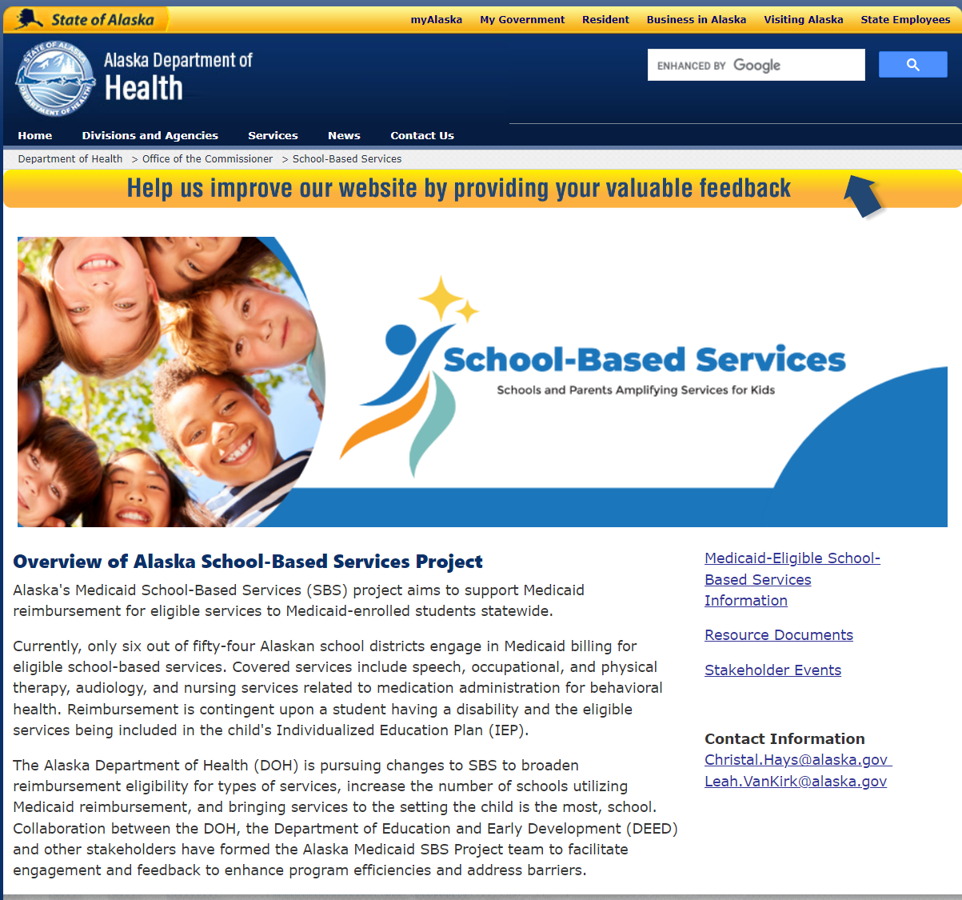
Next Steps
Attend our next stakeholder meeting in August.
Update on CMS Grant activities.
Discuss needs assessment process.
Stay connected!
Visit our website! Link is included in the meeting invitation.
https://health.alaska.gov/Commissioner/Pages/SBS/default.aspx
Questions or follow-up suggestions? Let us know!

Slide 5
Questions slide
Questions?
Please contact:
Christal Hays
christal.hays@alaska.gov
Leah Van Kirk
leah.vankirk@alaska.gov

Slide 6
Health in Alaskan Schools The Department of Education and Early Development Supports June 26, 2024 Patrick Sidmore

Slide 7
Mission, Vision, and Purpose
Mission | Vision | Purpose
An excellent education for every student every day. | All students will succeed in their education and work, shape worthwhile and satisfying lives for themselves, exemplify the best values of society, and be effective in improving the character and quality of the world about them. - Alaska Statute 14.03.015 | DEED exists to provide information, resources, and leadership to support an excellent education for every student every day.
Notes:
Sharon

Slide 8
Strategic Priorities: Alaska’s Education Challenge
Five Shared Priorities:
Support all students to read at grade level by the end of third grade.
Increase career, technical, and culturally relevant education to meet student and workforce needs.
Close the achievement gap by ensuring equitable educational rigor and resources.
Prepare, attract, and retain effective education professionals.
Improve the safety and well-being of students through school partnerships with families, communities, and tribes.
education.alaska.gov/akedchallenge
Notes:
Sharon

Slide 9
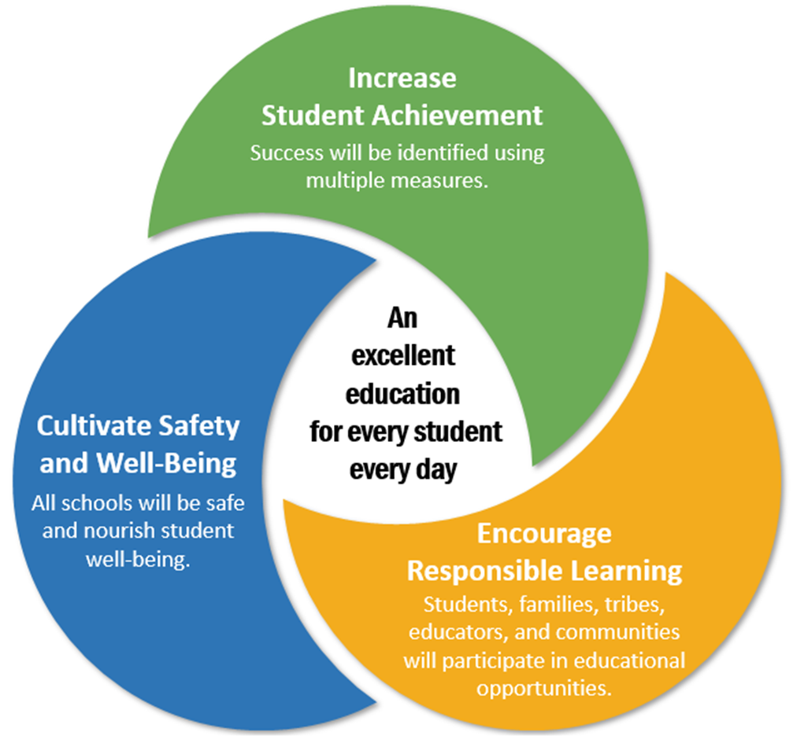
Alaska’s Education Challenge
Alaska's Education Challenge
Safety & Well-Being
Improve the safety and well-being of students through school partnerships with families, communities, and tribes
Strategy 1: Create a sustainable and positive school climate
Strategy 2: Building Trauma Engaged Schools
Strategy 3: Increasing access to student health through counselors, nurses, and school social workers
Three Commitments
Notes:
Sharon
Alaskans made clear that there are three primary COMMITMENTS we expect to make for Alaskan’s students:
Alaskans are making a commitment to STUDENT SUCCESS
Alaskans are making a commitment to the SAFETY AND WELL-BEING of our students;
Alaskans are making a commitment to SUPPORT RESPONSIBLE LEARNERS.
Let me say just a word about each of these:
Student Success – Alaskans want students to succeed, not just in reading and math, but in multiple areas that show their strengths and character. Student success is more than academic achievement, but it is not less than academic achievement. This is where we will focus on student learning and measuring it.
Safety and Well-being – This was something we heard loud and clear throughout the committee process. Parents expect us to prioritize the safety and well-being of their students…and we know that in order to learn well, students must be and feel safe, as well as be in a healthy context.
Support for Responsible Learners – This is a very exciting focal point of the challenge – this includes tribal compacting, a focus on our educators, as well as the steps we need to take to modernize and personalize instruction and the learning process.

Slide 10
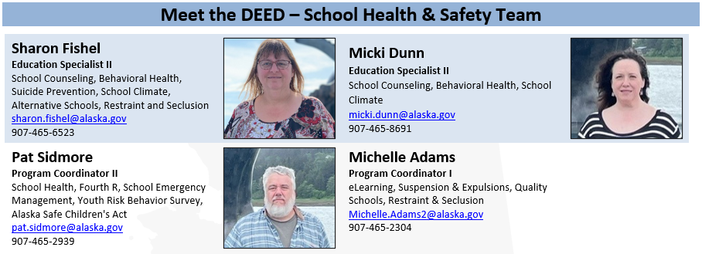
Meet the DEED School Health & Safety Team

Slide 11
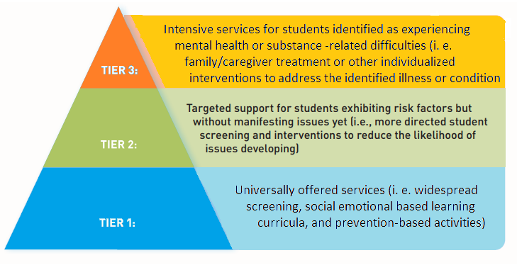
Multi Tiered System of Support (MTSS)
Notes:
Sharon

Slide 12
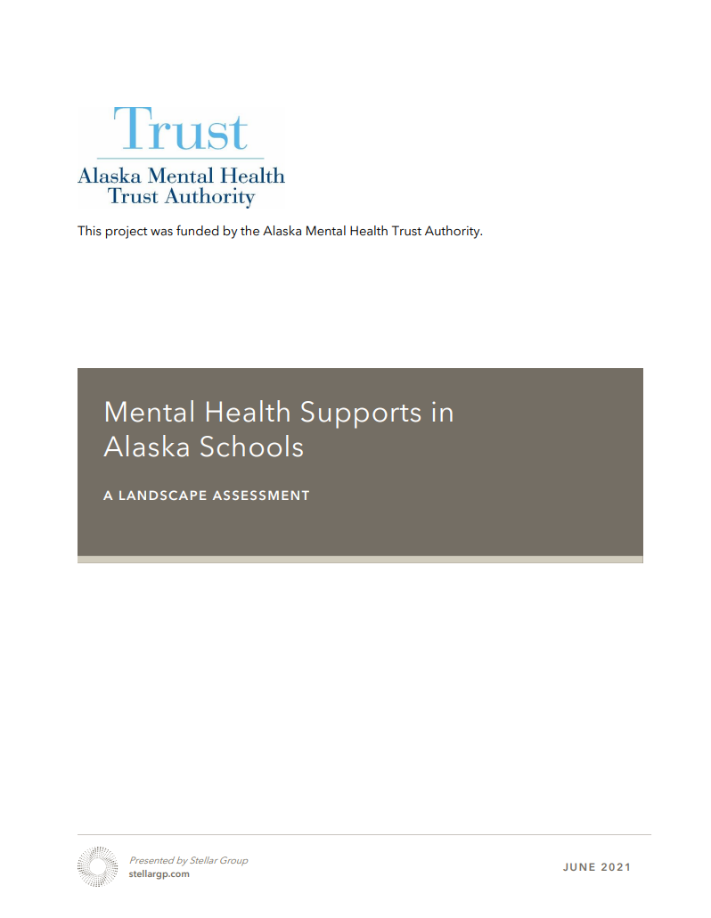
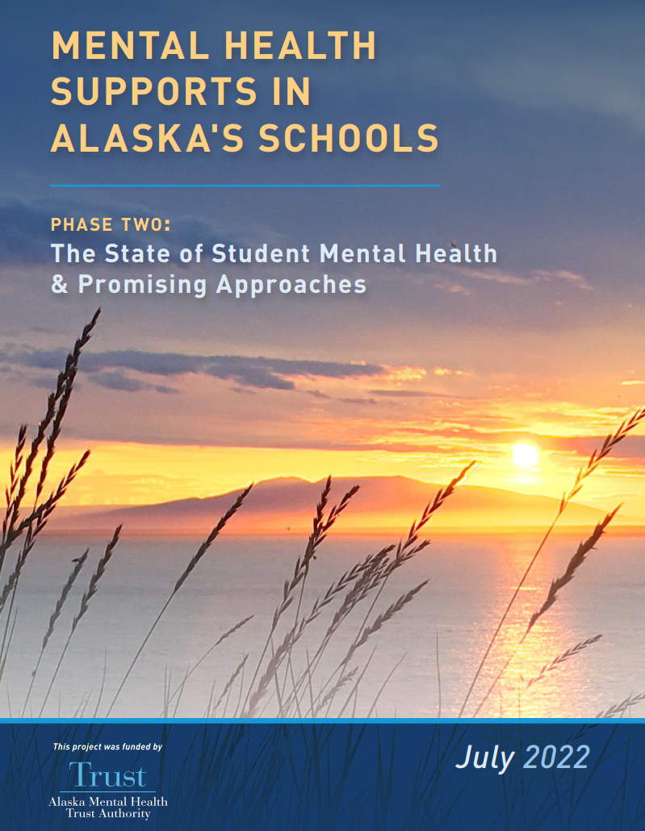
Collaborations with AMHT
Collaborations
School Behavioral Health - with Alaska Mental Health Board, Advisory Board on Alcoholism and Drug Abuse, Statewide Suicide Prevention Council, Alaska Mental Health Trust Authority, Division of Behavioral Health, Public Health
https://alaskamentalhealthtrust.org/alaska-mental-health-trust-authority/resources/
https://alaskamentalhealthtrust.org/alaska-mental-health-trust-authority/resources/

Slide 13
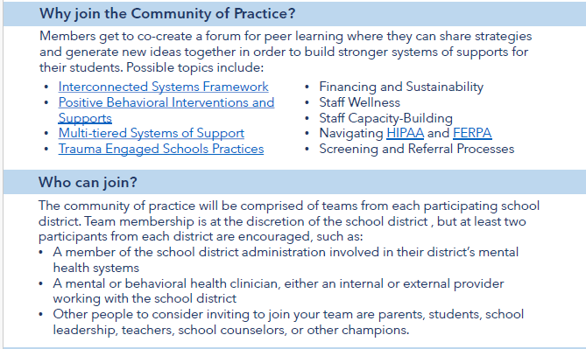
Mental Health Supports in Schools: Community of Practice

Slide 14
Collaborations with statewide/local organizations
Collaborations
Association of AK School Boards, Department of Health, and University of Alaska Anchorage
Shared Use of Data Examples:
Youth Risk Behavior Survey
School Health Profiles
Suspension and Expulsion Data
ALCANLink
School Climate and Connectedness Survey
Professional Development and Planning
School Health ECHOs
Healthy Schools Learning Collaborative
School Health Collaborative
PAL-PAK – Rural and Itinerant School Counselor Support
Center for Human Development

Slide 15
Other grants and ad hoc district support
Collaborations
Others grants we support:
Anchorage School District Aware Grant
Association of Alaska School Boards’ Family Engagement Grant
Public Health’s CDC Healthy School Grant
Ketchikan’s Trauma Engaged Grant
Association of Alaska School Boards’ Project Transform
Ad Hoc School District Support
Crises
Resources
Staff Professional Development

Slide 16
Suicide Awareness Prevention in Schools and Grants
Suicide Awareness Prevention in Schools
Annual Funding from the Statewide Suicide Prevention Council to Department of Education and Early Development - $400k
Districts include, North Slope Petersburg Juneau Anchorage, Mat-Su, Kenai, Nenana, and Fairbanks
Funding provided through this agreement is the primary funding source for suicide and trauma work accomplished through DEED. Also provides direct grant to school districts
Stronger Connections Grant
Under Title IV, Part A of the Elementary and Secondary Education Act from U.S. Depart. Of Ed. - $4.5 Million
Districts include, Nenana, Kuspuk, Kenai, Anchorage, Kodiak, Galena, Dillingham, Fairbanks, and
Hydaburg (with Craig and Klawock)
Bipartisan Safer Communities Act (BSCA) is described as “an important first step toward reducing the risk of gun violence in our schools and communities”.
PBIS Positive Behavior Interventions & Supports
FY25 forward $500,000 Special Education discretionary funding.
Districts (# of schools) include, Alaska Gateway (3), Bristol Bay (1), Kodiak Island (1), Kuspuk (4),
Lower Kuskokwim (3), Nome (1), Northwest Arctic (1), Yukon Flats (1), and Yupiit (3), Kashunamiut (1)
For students to be able to learn effectively, they need to feel safe, respected, and be responsive to their teachers and peers. PBIS provides the routines and systems to provide this solid foundation

Slide 17
Grant awards to Alaska for Behavioral Health support
AK Rises – U.S. Department of Education Grant to DEED
A five-year (2019-2024) federal grant by the U.S. Department of Education - $5 Million
Alaska Child Trauma Center and the Fairbanks North Star Borough School District
Expand delivering mental health services to students who have experienced trauma and are struggling in school as a result
AWARE – Substance Abuse and Mental Health Administration Grant to DEED
Project AWARE five year (2020-2025) – $1.8 Million
3 School Districts: Juneau, Fairbanks, and Bering Strait
Develop a sustainable infrastructure for school-based mental health programs and services
Alaska Trauma-Engaged Alternative School Initiative – DBH Funds to DEED
Annual funds from Division of Behavioral Health to Department of Education and Early Development - $450 K
Districts (# of schools) include, Anchorage (2), Juneau (1), Mat-Su (3), North Slope (1), Kenai (2), Sitka (1), Ketchikan (1),
Alaska’s Alternative Schools are a safety net for the most at-risk students in the communities they serve.

Slide 18
Safe Children’s Act
Safe Children’s Act (Bree’s Law 14.30.355 – Erin’s Law AS 14.30.356)
State developed curriculum for 7-12 grades is managed through the states eLearning system and is in review now after having been launched in 2020.
Fourth R – The program focuses on building healthy relationships and decision-making skills through interactive teaching methods such as role play.
ESEA Elementary and Secondary Education Act
Migrant Education
Homeless Student Support
School Health and Safety
School Improvement

Slide 19
Elearning system description
eLearning System
The Department of Education and Early Development has 83 courses in the Department’s eLearning system for educators. *
Categories Number of Courses Courses Completed as of 11-2023
Assessment 2
Child Nutrition 36
Healthy and Safety 18
Related to Substance Misuse 3 1,363
Mandatory Training for Teacher Certification 7
Reading 1
Special Education 20
Suicide Awareness 4 57,267
Trauma-Engaged Schools 13 18,610
Other Mandatory Courses 3 105,489
* Duplicates courses in different categories

Slide 20
Trauma-Engaged Schools
Developed with multiple partners
https://education.alaska.gov/apps/traumawebtoolkit/new-framework-page.html
Notes:
Sharon

Slide 21
Trauma-Engaged Schools – Education Innovation and Research
Trauma-Engaged School Technical Assistance – NW Regional Education Laboratory
In 2022, REL Northwest launched the Alaska Trauma-Engaged Schools Partnership with AK DEED as well as representatives from the Alaska Department of Health and Social Services, Alaska Mental Health Trust, Association of Alaska School Boards and the University of Alaska Anchorage. The partnership will conduct research to understand how schools and districts are implementing recommendations from the Transforming Schools Framework and to identify additional supports that would improve the uptake of trauma-engaged best practices.
Project Transform – Association of Alaska School Boards
Project Transform supports schools to use a trauma-engaged approach through incentivized, ongoing professional development for all staff, school-based trauma-engaged teams, and support and guidance from AASB and DEED. Three cohorts of schools will participate in project activities for 2-year periods. This project is funded through a 5-year grant awarded to AASB through the US Department of Education’s EIR grant program and the Alaska Mental Health Trust Authority.

Slide 22
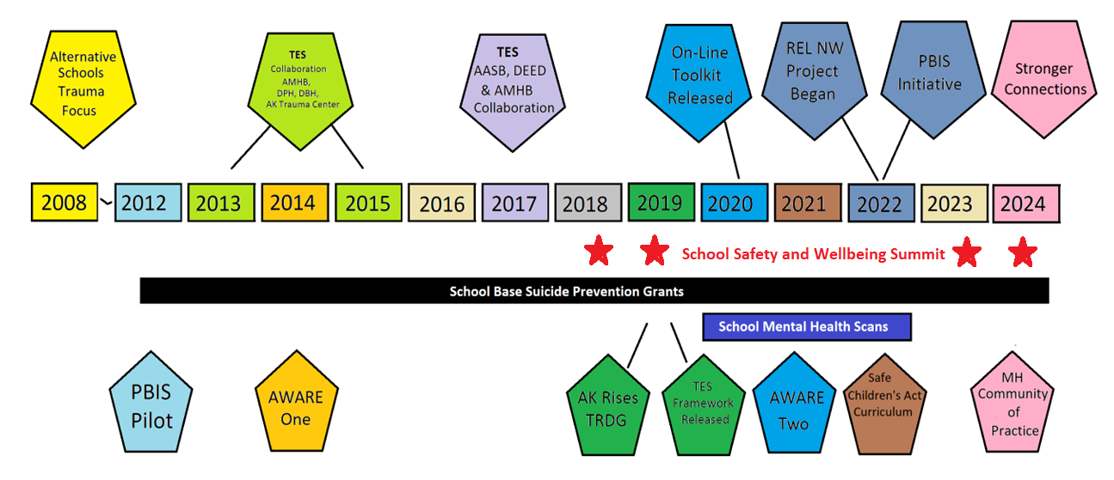
History of Mental Health supports in Alaska Schools
History of MH Supports in Alaska Schools

Slide 23
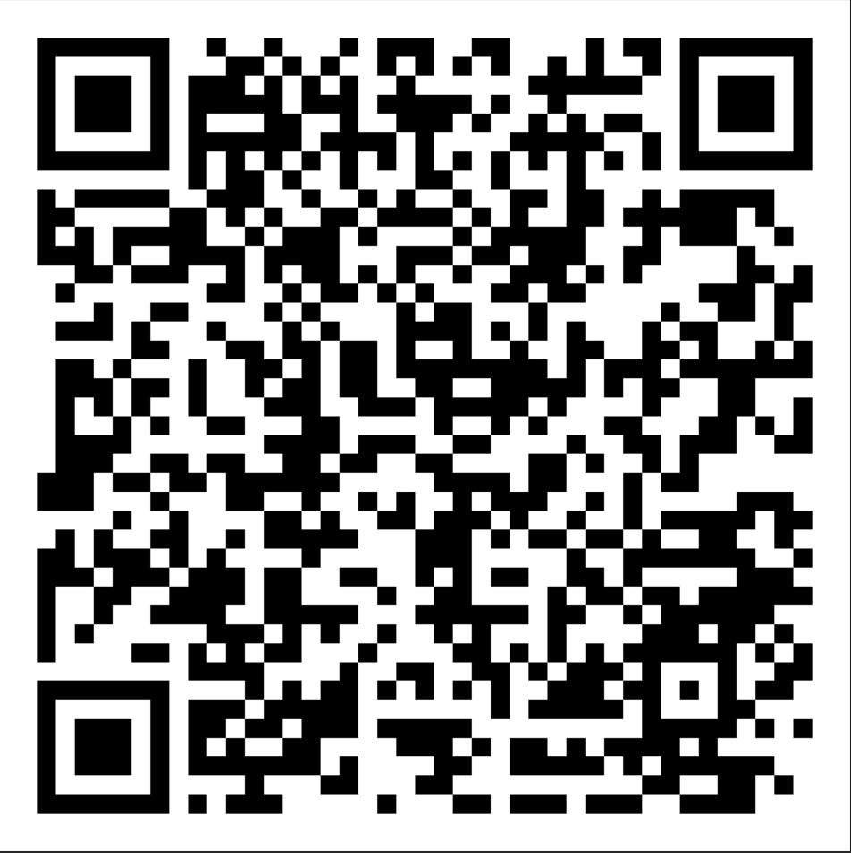
Finding Our Anchors

Slide 24
Thank you

