Slide 1
Health Information Infrastructure Plan
Workgroup Session #5
February 13, 2018

Slide 2
Agenda
Role Call
Brief Overview
Workgroup Discussion
Coordinated Care Demonstration (CCD) Project
Accountable Services Organization (ASO)
Other Medicaid Redesign Initiatives
Next Steps

Slide 3
Purpose
Development of the DHSS Health Information Infrastructure Plan to transform the health care system in Alaska by providing:
The data required by health care providers for care coordination and quality improvement
The information support required by DHSS and health care providers to enable development and implementation of Senate Bill 74 – Medicaid Redesign Initiatives
Development of the Health Information Infrastructure Plan includes six stakeholder work group sessions to determine areas of necessary infrastructure improvement and to capture use cases for the implementation

Slide 4
Measures of success of the Plan
Measurable health infrastructure outcomes based on SB 74
Alignment of state technology standards and identified critical areas where standards are needed
Leveraging of existing and emerging technologies with a resultant HIPAA compliant framework
Recommend a streamlined approach to a complex technology environment
Methods to measure compliance with the plan developed
The plan is implemented with a phased and scalable approach

Slide 5
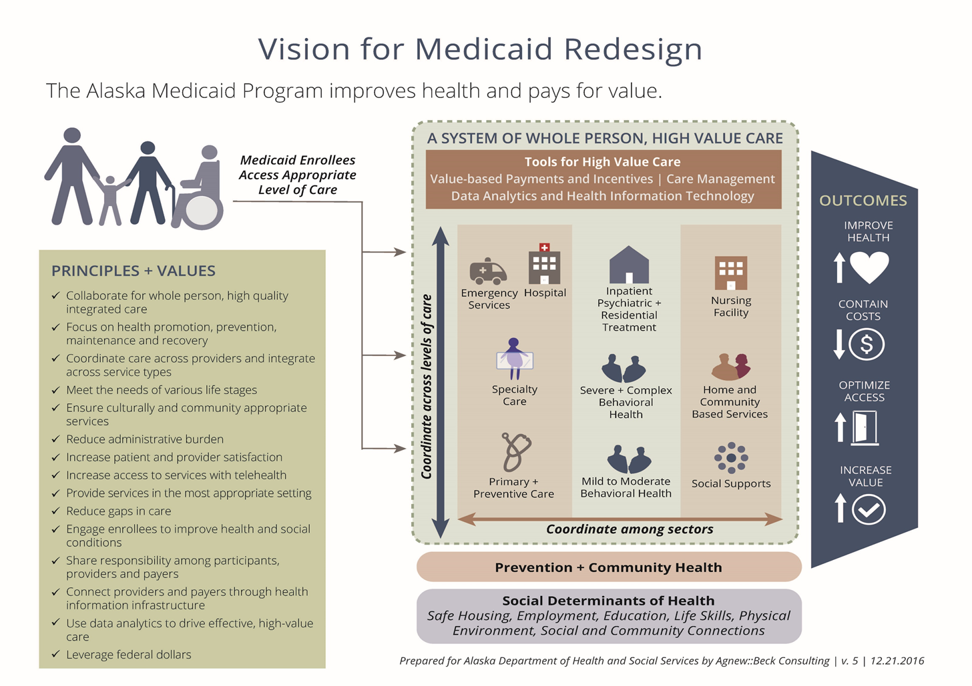

Slide 6
Sessions - Timeline
# | Description | Date
1 | Claims/Pharmacy/Program Integrity | 03/06/2017
2 | Member/Provider Eligibility & Management | 05/09/2017
3 | Care Management/Public Health Registry/TeleHealth | 09/19/2017
4 | HIE | 11/14/2017
5 | Coordinated Care Demonstration/ASO/Other Medicaid Redesign | 02/13/2018
6 | Data Management & Interfaces | TBD

Slide 7
Common Issues/Opportunities
Data Governance
Common definitions/terminology
Data Dictionary and Reporting
Data Availability
Use of HIE (bi-directional)
Better integration with Registries
Lack of Automation
Siloed Systems
Too many system issues causing manual interventions
Data Quality and Standardization
Interoperability

Slide 8
Workgroup -1 – High Level
Too many penny claim adjustments
Lack of incentive for providers to connect to HIE
Reduction in # of Medicaid Providers
Electronic Referrals Improvement
Duplicative Data Entry
No/limited Social Determinants of Health Data
No/limited Presumptive Eligibility Automation

Slide 9
Workgroup -2 – High Level
ARIES/EIS issues
Provider Credentialing/Enrollment issues (Non-Medicaid)
Care Coordination
MMIS post-implementation issues
Policy/System not in alignment
Provider tools for eligibility search are lacking in functionality (name search etc)

Slide 10
Workgroup -3 – High Level
Lack of Statewide Telehealth Infrastructure
Limited automation with registries from EHRs or HIE
Multiple assessment tools are in place and data is not shared
No ability to tie household members to an assessment
Bandwidth, cost, software, HIPAA compliance and technical support issues for Telehealth
MPI/MCI ( Master Client Index) accuracy

Slide 11
Workgroup -4 – High Level
Lack of awareness, adoption of AeHN and understanding the value of an HIE.
Due to lack of progress, providers have sought other solutions which circumvent HIE and reduce its value proposition.
Small footprint with limited data.
Slow pace of work and responsiveness.
Multiple log-in locations, need single sign on.
52 different EHRs, creates challenges for interoperability and data flow.
Confusion and misunderstand of AeHN goals.

Slide 12
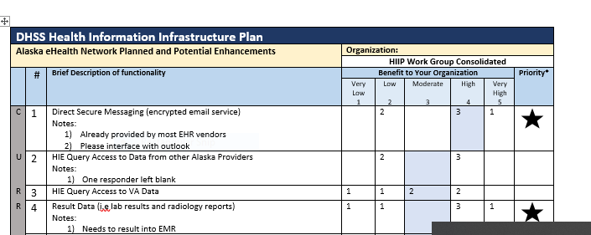
HIE Prioritization and Functionality Survey Ratings
Workgroup Consolidated Priority Functionality Findings
Direct secure messaging
Result data (lab, radiology, etc.)
Prescription Drug Monitoring Program
Analytics capabilities
HIE incorporation of Tribal Health Information
HIE incorporation of behavioral health information
*These functions were identified within the top 10 of half the survey respondents
Notes:
An HIE prioritization and functionality survey was provided at the HIE stakeholder meeting. Based on the survey results, 6 functions were identified within the top 10 of half the survey respondents and include (read functions).

Slide 13
Stakeholder Workgroup 5 Discussion
Workgroup 5 Topics
Coordinated Care Demonstration Project
Accountable Services Organization
To-Be Outcomes for Medicaid Redesign Initiatives
Notes:
In the workgroup today, we will be discussing SB 74 initiatives which include the Coordinated Care Demonstration Project,
Accountable Services Organization and other Medicaid Redesign Initiatives.

Slide 14
Coordinated Care Demonstration Project Background
SB 74 requires DHSS to implement a Coordinated Care Demonstration (CCD) Project to assess the efficacy of care models regarding cost, access and quality of care for Medicaid enrollees.
Based on a September 15, 2016 Request for Information, DHSS selected 3 Care Models:
Managed Care Organization (MCO)
Care Management Entity (CME)
Provider-Based Reform (PBR)
RFP
An RFP was released on December 30, 2016.
DHSS staff reviewed the proposals.
The DHSS review findings were provided to the proposal review committee for a formal recommendation to the Commissioner.
DHSS is currently in negotiation with 3 offerors which represent each of the care models.
Notes:
MCO- under this model DHSS would contract with a licensed health insurer to enroll Medicaid beneficiaries and provide Medicaid-covered services under a capitated PMPM (per member per month) payment arrangement.
CME- under this model, DHSS would contract with an administrative entity to perform care and disease management for Medicaid beneficiaries and coordinate with existing Medicaid providers.
PBR- under this model, DHSS would contract with a provider-sponsored organization to perform care and disease management for Medicaid beneficiaries through the organization’s provider network
9 RFP proposals were received.
DHSS staff reviewed the proposals for feasibility , cost savings, integration with other SB 74 initiatives, federal and state requirements, and technology requirements.
Contracts are expected to be awarded by ????????? .

Slide 15
Coordinated Care Demonstration Project
Proposals for the CCD must include information on how additional cost savings will be achieved, including reduced cost through increased use of telehealth for primary care, urgent care and behavioral health.
After 2 years, the CCD Projects will be reviewed and evaluated by an actuary based on:
Cost savings
Health outcomes
Ability to expand statewide
Notes:
Proposals for the Demonstration Project must include information demonstrating how additional cost savings measures will be achieved, including innovation to reduce cost through expanded use of telehealth for primary care, urgent care and behavioral health.
After a 2 year implementation period , the Demonstration Projects will be reviewed and evaluated by an actuary on :
Medicaid Program cost savings;
Participant health outcomes; and
Ability to achieve similar results statewide
Based on the actuary’s recommendations, DHSS will prepare a plan for a regional or statewide implementation of a Coordinated Care Demonstration based on the result of the 3 demonstration projects and submit the plan to the legislature prior to November 16, 2019.

Slide 16
Coordinated Care Demonstration Project
The CCD care models are required to include at least 3 of the following components:
Comprehensive primary care
Care coordination
Health Promotion
Comprehensive transitional care
Referral to community and social support services
Sustainability and the ability to achieve results in other state regions
Integration and coordination of benefits, services, and utilization management
Local accountability for health and resource allocation
Innovative payment processes
Food for Thought:
1. Is your organization’s operations currently impacted by any of these specific components?
2. Any suggestions/ideas for rollout/implementation?
Notes:
Comprehensive primary care, including behavioral health and coordination of long-term services and supports
Care coordination , including assignment of a Primary Care Provider in geographic area if practical
Health Promotion
Comprehensive transitional care and follow-up after inpatient treatment
Referral to community and social support services, including career and education training
Sustainability and the ability to achieve results in other regions of the state
Integration and coordination of benefits, services, and utilization management
Local accountability for health and resource allocation
Innovative payment process, including, bundle payments, global payments, capitated payments, shared savings and risk
Discuss questions

Slide 17
Stakeholder Workgroup 5 Questions
CCD Project
What factors other then cost, quality and “state-wideness” should be considered for continuation of a CCD project ?
What information should be evaluated to determine cost savings and health outcomes ?
What quality measures and health outcomes should be targeted ?
What are your technology needs ?
Notes:
Discuss questions.

Slide 18
Administrative Services Organization Background
SB 74 requires DHSS to redesign and reform the State’s Behavioral Health (BH) system by:
Reviewing staff and provider readiness to implement a new system of BH services;
Developing and applying to CMS for a Medicaid 1115 Behavioral Health Waiver ; and
Contracting with an ASO to manage the 1115 Behavioral Health Waiver.
The Waiver must include grant-funded CMHCs and DATCs that have provided care to recipients of BH services.
Waiver goals:
Expansion of treatment capacity and improved access to services;
Integration of care;
Cost and outcomes reform;
Provider payment and accountability reform; and
Delivery system reform.
Notes:
SB 74 requires DHSS to develop and implement a comprehensive redesign and reform of the state’s behavioral health system of care. The redesign includes:
a review of staff and provider readiness to implement a new system of behavioral health services;
the development and application to CMS for a Medicaid 1115 Behavioral Health Waiver ; and
a contract with an ASO to manage the 1115 Behavioral Health Waiver
The Waiver must be consistent with the comprehensive and integrated behavioral health program required under AK law, and include continuing cooperation with the grant-funded community mental health clinics and drug and alcohol treatment centers that have provided care to recipients of behavioral health services.
The 1115 Waiver will focus on 5 goals:
Expansion of treatment capacity and improved access to services;
Integration of care;
Cost and outcomes reform;
Provider payment and accountability reform; and
Delivery system reform.
.

Slide 19
Administrative Services Organization Requirements
ASO must be a third-party organization with expertise in integrated BH systems management.
ASO Goals:
Increasing access;
Improving health outcomes;
Managing the cost of BH.
Notes:
Under the waiver, DHSS will contract with an ASO to manage the enhanced behavioral health system through a competitive bid process.
The ASO is required to be a third-party organization with specialized expertise in integrated behavioral health systems management.
Specific goals for the ASO include:
Increasing regional access to appropriate behavioral health services;
Improving health outcomes for all publicly funded beneficiaries of behavioral health services (i.e., Medicaid and non-Medicaid (state and federal grant funded behavioral health programs); and
More efficiently and effectively managing the cost of behavioral health service delivery in Alaska.
Services provided by the ASO under the waiver are being finalized. The following administrative support services are being considered:
Participant Eligibility and Enrollment;
Utilization Management;
Provider Network Capacity Development and Support;
Participant Outreach, Communication, and Support;
Quality and Outcomes Management;
Data Management;
Claims Processing; and
IT System Requirements

Slide 20
Administrative Services Organization Considered Services
Services provided by the ASO under the waiver are being finalized. The following administrative support services are being considered:
Participant eligibility and enrollment;
Utilization management;
Provider network capacity development and support;
Participant outreach, communication, and support;
Quality and outcomes management;
Data management;
Claims processing; and
IT system requirements
Notes:
Services provided by the ASO under the waiver are being finalized. The following administrative support services are being considered:
Participant Eligibility and Enrollment;
Utilization Management;
Provider Network Capacity Development and Support;
Participant Outreach, Communication, and Support;
Quality and Outcomes Management;
Data Management;
Claims Processing; and
IT System Requirements

Slide 21
Administrative Services Organization
RFI Issued Feb. 2017
Development & Drafting of RFP June-October 2017
Finalize RFP Nov. 2017- Jan. 2018
RFI Responses Released May 2017
Issue RFP March/April. 2018
RFP Responses Due June/July2018
Contract Award Aug/Sep 2018
ASO Fully Operational FY 2019
Notes:
RFI was issued on February 27, 2017 to solicit information for creating and implementing Alaska ASO.
DHSS received 10 responses, 6 from tribal heath organizations and 4 from national health care management entities.
RFI ASO responses released to the public in May 2017.
Development and drafting of ASO RFP, June –October 2017.
Finalize ASO RFP, November 2017- January 2018.
Issue ASO RFP, February 2018.
ASO RFP responses due, April - May 2018.
Award ASO contract, May - June 2018.
ASO fully operational, January 2019.

Slide 22
Stakeholder Workgroup 5 Questions
ASO Key Questions:
Suggestions for administrative simplification/streamline/reduction of burden
What potential impact will the ASO have on your organization's current operations ?
What are your technology needs?
Business Intelligence data needs?
Notes:
Discuss Questions

Slide 23
Other Medicaid Initiatives – Coming in 2018
Explanation of Benefits (EOBs)
Electronically distribute EOBs to Medicaid recipients for health care service.
Decision Support System
Turn Disconnected Data Into Actionable Information — and a Single Source of Truth. Planning to get a CMS certified solution from another state.

Slide 24
Next Steps and Conclusion
Workgroup 6
Date: TBD
Data Management – including the triple aim, data warehouse, data governance/data management strategy, and technical management strategy
Interfaces – existing and gaps
Notes:
Discuss next steps and future workgroup 6 meeting on data management and interfaces.

