Slide 1

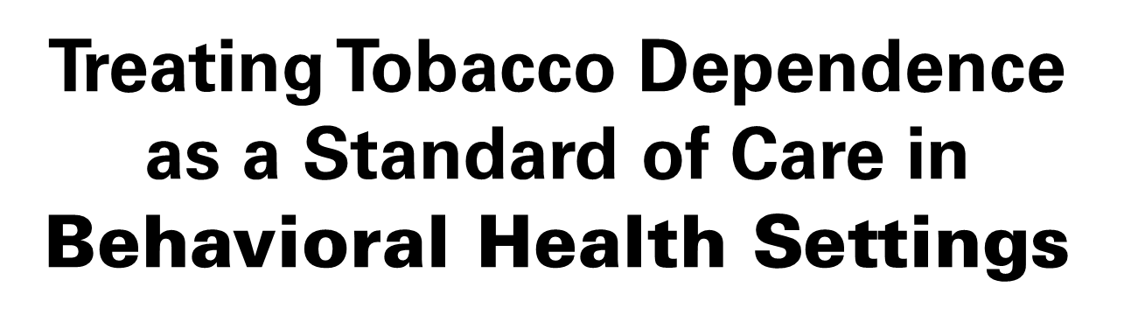
Best Practices in Alaska
Insert presenter’s name, location and date of presentation

Slide 2

Overview
Tobacco Prevention + Control: how does it work?
Tobacco Use in Alaska among people with behavioral health and substance abuse disorders
Why Address Tobacco Use in behavioral health settings?
Best Practices for treating tobacco dependence in behavioral health settings
Current Practices based on survey results of Alaska behavioral health providers
How to Get There
Questions or comments?
Notes:
Physical/behavioral aspects of addiction
Survey information about barriers/provider attitudes
Treatment plan
Treatment interventions
Campus policy
Policy change (how to make policy change – see change team)
Make it geared toward providers, but have leadership level stuff in there too re: policies
Help staff quit as well
Keep at it!

Slide 3
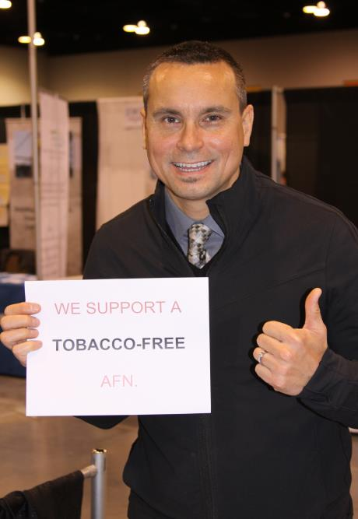
Tobacco Prevention & Control Program
Vision:
For All Alaskans to Live Healthy and Tobacco-free Lives!

Slide 4
TPC Program Goals
Four goals guide a comprehensive program:
Prevent the initiation of tobacco use
Help tobacco users quit their addiction
Eliminate exposure to secondhand smoke
Eliminate tobacco-related health disparities among population groups

Slide 5
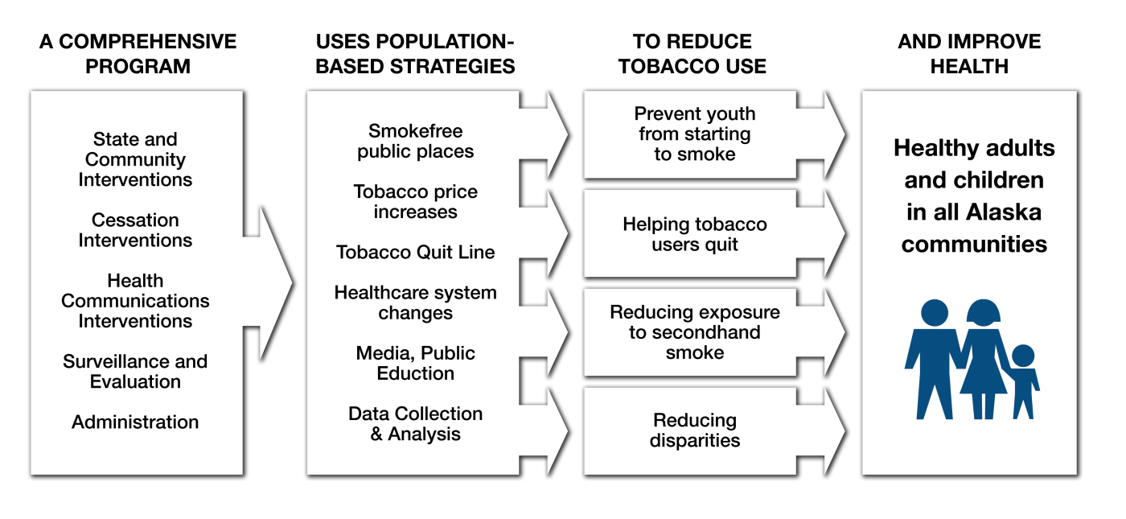
Public Health Model of Tobacco Prevention & Control
Notes:
Bridge to next slide:
TPC accomplished its work through supporting and reaching approximately 220 communities across Alaska.

Slide 6
A Comprehensive Program Saves Lives!
Percent of Adults Who Smoke, Alaska & US, 1996 – 2012
Sources: Alaska Behavioral Risk Factor Surveillance System; National Health Interview Survey.
BRFSS estimates for 2007 and later use a new weighting method.
Notes:
For more than a decade, Alaska’s commitment to a sustained, comprehensive tobacco prevention and control program has demonstrated significant progress in reducing tobacco use and minimizing related harms and health care costs.
Smoking prevalence has declined significantly from 27.7% in 1996 to 22.6% in 2011. Using the 2010 population information for Alaska, this represents about 27,000 fewer adult smokers in 2011 than in 1996.

Slide 7
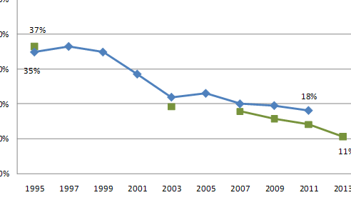
A Comprehensive Program Saves Lives!
Percent of High School Students Who Smoke, Alaska& US, 1995 – 2013
Source: Alaska Youth Risk Behavior Survey and National Youth Risk Behavior Survey.
Alaska YRBS data are only available for 1995, 2003, and 2007 to present. National 2013 data available in summer 2014.
Notes:
Smoking among high school students dropped from 37% in 1995 to 10.6% in 2013. This decrease means that there are more than 9,800 fewer youth smokers in 2013 than there were in 1995. The newest 2013 YRBS data shows that we have reduced this from 14 % in 2011 to 10.6% in 2013. This means that only one in 10 Alaska high school students reported smoking at least one cigarette during the past 30 days.
These significant declines are exciting and show in numbers that comprehensive programs work… however there is still much more work to do.

Slide 8
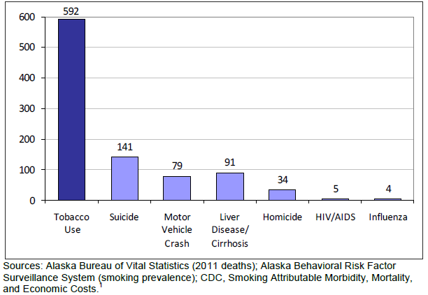
Impact of Tobacco Use in Alaska
Selected Causes of Death in Alaska, 2011
Notes:
More Alaskans die annually from the direct effects of tobacco use than from suicide, motor vehicle crashes, chronic liver disease and cirrhosis, homicide, HIV/AIDS and influenza combined.
Nationally, exposure to secondhand smoke kills more than 49,000 adult non-smokers from coronary heart disease and lung cancer each year.
This sums to an astounding $563 million, yet it underestimates total costs; lost productivity from tobacco-related illness and costs due to second-hand smoke exposure-related illness or death are not included.

Slide 9
Our Work is Not Done
Percent of Adults Who Smoke by Select Demographic Factors, Alaska, 2012
Source: Alaska Behavioral Health Risk Factor Surveillance System (BRFSS)
Notes:
The graph above shows that adult smoking is significantly higher among non-Native adults of low SES (38.1%) and among Alaska Native adults (36.4%), than their counterparts.
Among non-Native adults age 25 to 64, those of low SES are more than twice as likely as those of higher SES to be smokers.

Slide 10
Why Treat Tobacco Dependence in Behavioral Health Settings?

Slide 11
Why Treat Tobacco Dependence in Behavioral Health Settings?
Tobacco use disparately impacts this population.
People with mental illness smoke 44% of all cigarettes produced in the U.S.¹
Almost half (200,000) of the 443,000 deaths that occur each year from smoking are among people with mental illness and/or substance use disorders²
Up to 75% of individuals with serious mental illnesses or addictions smoke cigarettes³
Lasser, K., Boyd, J. W., Woolhandler, S., Himmelstein, D. U., McCormmick, D., & Bor, D. H. (2000). Smoking and mental illness: A population-based prevalence study. Journal of the American Medical Association, 284(20), 2606-2610.
Centers for Disease Control and Prevention. Smoking-Attributable Mortality, Years of Potential Life Lost, and Productivity Losses—United States, 2000–2004. Morbidity and Mortality Weekly Report 2008;57(45):1226–8.
Centers for Disease Control and Prevention. (2007). Cigarette Smoking Among Adults—United States, 2006. Morbidity and Mortality Weekly Report [serial online], 56(44), 1157–1161. Available from: http://www.cdc.gov/mmwr/ preview/mmwrhtml/mm5644a2.htm.
Notes:
Those with serious mental illness are estimated to be about 6% of the U.S. population (13.6 million)
It is estimated that over a quarter of the adult (18+) U.S. population (61.5 million) suffers from a diagnosable mental illness in the course of a year. “Serious” mental illness includes major depression, bipolar disorder and schizophrenia, as defined in the DSM-IV.
NIMH, “The Number Counts: Mental Disorders in America”
http://www.nimh.nih.gov/health/publications/the-numbers-count-mental-disorders-in-america/index.shtml#Intro
NAMI, “Mental Illness: Facts and Numbers”
http://www.nami.org/factsheets/mentalillness_factsheet.pdf

Slide 12
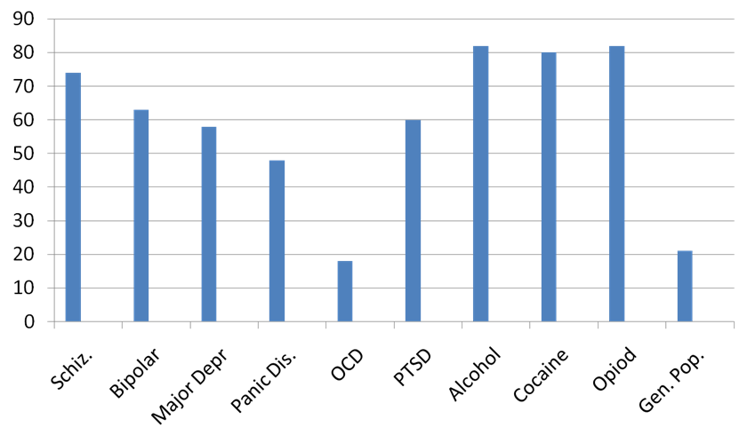
Smoking Prevalence Rates Among Populations with Specified Diagnoses
Aggregated findings of several studies: Beckham et al., 1995; Boyd et al., 1996; Budney et al., 1993; Burling et al., 1988; Clemmey et al., 1997; de Leon et al., 1995; Grant et al., 2004; Hughes, 1996; Istvan & Matarazzo, 1984; Lasser et al., 2000; Morris et al., 2006; Pomerleaue et al., 1995; Snow et al., 1992; Stark & Campbell, 1993; Ziedonis et al., 1994. Cited in Morris, C. et al, Smoking Cessation for Persons with Mental Illness: a Toolkit for Mental Health Providers. Updated January 2009.
Notes:
Those with many typical behavioral health diagnoses (particuarly schizophrenia, bipolar disorder, major depression, panic disorders, alcohol use, cocaine use, and opoid use disorders) smoke at much higher rates than the general population (about 21%).

Slide 13
Why Treat Tobacco Dependence in Behavioral Health Settings?
Persons with mental illness and addictions want to quit smoking and can successfully quit.
In a review of clinical trials, 50-77% of smokers in substance abuse facilities were interested in quitting tobacco¹
Up to 80% of behavioral health clients want to quit smoking²
Smoking cessation can enhance long term recovery for persons with substance use disorders³
Joseph, A. M., Willenbring, M. L., & Nugent, S. M. (2004). A randomized trial of concurrent versus delayed smoking intervention for patients in alcohol dependence treatment. Journal of Studies on Alcohol, 65(6), 681-691
Sullivan, M.A., Covey, L.S. (2002). Current perspectives on smoking cessation among substance abusers. Current Psychiatry Reports 4:388-396.
Prochaska, J. J., Delucchi, K., & Hall, S. M. (2004). A meta-analysis of smoking cessation interventions with individuals in substance abuse treatment or recovery. Journal of Consulting and Clinical Psychology, 72(6), 1144-1156. doi:10.1037/0022-006X.72.6.1144
Notes:
3rd bullet - A systematic review of 17 studies found that concurrent tobacco cessation treatment with individuals in addictions treatment was associated with 25 percent increased abstinence from alcohol and illicit drugs six months or longer after treatment.

Slide 14
Why Treat Tobacco Dependence in Behavioral Health Settings?
Quitting tobacco is difficult but feasible… if assistance is provided
  Quit rates with willpower alone: 4%
  Pharmacotherapy (NRT) alone: 22%
  QuitLine counseling plus NRT: 36%
  Chantix: 44%
Source: Gonzales, David; Bjornson, Wendy; Markin, Catherine J. More Than Brief Intervention: Updating Smoking Cessation Treatment for Pulmonary Patients | CSU Article, 04.15.08
http://69.36.35.38/accp/pccsu/more-brief-intervention-updating-smoking-cessation-treatment-pulmonary-patients?page=0,3

Slide 15
Why Treat Tobacco Dependence in Behavioral Health Settings?
Tobacco shortens and diminishes quality of life.
Tobacco-related deaths are greater than alcohol or drug-related deaths among people treated for chemical dependence
For every person who dies from their tobacco use, there are twenty people living with serious health problems caused by their tobacco use (about 8.6 million people in the U.S. overall).¹
Source: Centers for Disease Control and Prevention. Cigarette Smoking Attributable Morbidity — U.S., 2000. Morbidity and Mortality Weekly Report. 2003 Sept; 52(35): 842-844.

Slide 16
Why Treat Tobacco Dependence in Behavioral Health Settings?
Tobacco dependence is an addiction.
Treating tobacco dependence is consistent with the mission and purpose of behavioral health services
Requires the skills and knowledge that counselors and therapists are uniquely trained to deliver
Tobacco dependence often co-occurs with other chemical dependence and mental illnesses

Slide 17
Why Treat Tobacco Dependence in Behavioral Health Settings?
Quitting tobacco can aid treatment.
Smoking cessation treatment does not necessarily have negative impacts on psychiatric symptoms (depending on the diagnosis)
Smoking cessation may even lead to better mental health and overall functioning
Source: Baker et al., 2006; Lawn & Pols, 2005; Morris et al., Unpublished data; Prochaska et al., 2008

Slide 18
Why Treat Tobacco Dependence in Behavioral Health Settings?
Quitting tobacco helps people stay sober.
Participation in smoking cessation efforts while engaged in other substance abuse treatment has been associated with a 25% greater likelihood of long-term abstinence from alcohol and other drugs.
Bobo et al., 1995; Burling et al., 2001; Hughes, 1996; Hughes et al., 2003; Hurt et al., 1993; Pletcher, 1993; Prochaska et al., 2004; Rustin, 1998; Saxon, 2003; Taylor et al., 2000)
Notes:
Prochaska, J. J., Delucchi, K., & Hall, S. M. (2004). Journal of Consulting and Clinical Psychology, 72(6), 1144-1156. doi:10.1037/0022-006X.72.6.1144

Slide 19
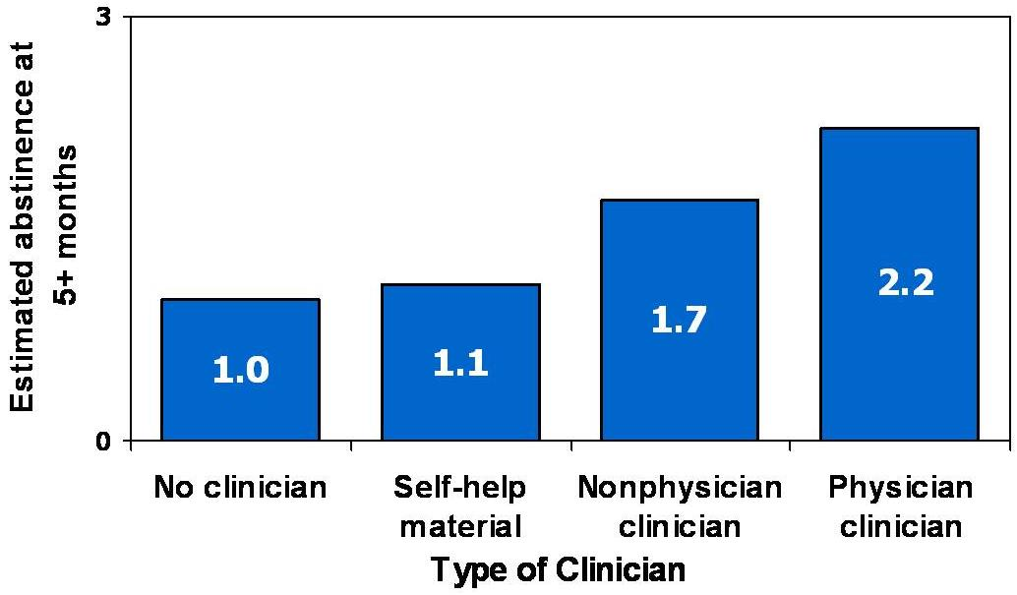
Why Treat Tobacco Dependence in Behavioral Health Settings?
Compared to people who smoke who do not get help from a clinician, those who get help are 1.7 to 2.2 times as likely to successfully quit for 5 or more months.
(Fiore et. al., 2008)
Notes:
Advice Can Improve Chances of Quitting

Slide 20
Why Treat Tobacco Dependence in Behavioral Health Settings?
Source: DH Taylor et al., 2002 American Journal of Public Health

Slide 21
Best Practices for Treating Tobacco Dependence in Behavioral Health Settings

Slide 22
Assessment,
Treatment Planning, and Continuity of Care
Notes:
Respiratory disease (e.g., COPD) *Pulmonology
Cardiovascular disease (e.g., CHD) *Cardiology
Cancers (e.g., lung, colon, bladder, kidney) *Oncology
Osteoporosis *Orthopedics
Infertility, Pregnancy, Postpartum problems *OB/GYN
Lowers medication blood levels *Psychiatry, others
Prolonged wound healing *Surgery, Infectious Disease
Vision problems (e.g. macular degeneration, cataracts) *Ophthalmology
Pregnant and postpartum women
Smoking while pregnant can cause adverse health complications such as intrauterine growth retardation, low birth weight, congenital malformations, pre-mature births, and fetal mortality¹. Source: USDHHS, 2001
Approximately 20-30% of women continue to smoke for the duration of their pregnancy despite these risks^{1,2}. Source: LeClere et al., 1997; Fingerhut et al., 1990; Husten et al., 1996
Review the following group instructions:
Illustrate to participants the different areas of the body that are hurt by tobacco. Review from the handout the kinds of illnesses that can be caused by smoking.

Slide 23
Integration into Standard Practice
Assess tobacco as part of normal assessment and screening procedures
Add tobacco to treatment plan with goals and objectives specific to tobacco
Provide educational materials related to tobacco
Address tobacco use in individual and group sessions
Notes:
Respiratory disease (e.g., COPD) *Pulmonology
Cardiovascular disease (e.g., CHD) *Cardiology
Cancers (e.g., lung, colon, bladder, kidney) *Oncology
Osteoporosis *Orthopedics
Infertility, Pregnancy, Postpartum problems *OB/GYN
Lowers medication blood levels *Psychiatry, others
Prolonged wound healing *Surgery, Infectious Disease
Vision problems (e.g. macular degeneration, cataracts) *Ophthalmology
Pregnant and postpartum women
Smoking while pregnant can cause adverse health complications such as intrauterine growth retardation, low birth weight, congenital malformations, pre-mature births, and fetal mortality¹. Source: USDHHS, 2001
Approximately 20-30% of women continue to smoke for the duration of their pregnancy despite these risks^{1,2}. Source: LeClere et al., 1997; Fingerhut et al., 1990; Husten et al., 1996
Review the following group instructions:
Illustrate to participants the different areas of the body that are hurt by tobacco. Review from the handout the kinds of illnesses that can be caused by smoking.

Slide 24
Assessment and the 5A’s
ASK
about tobacco USE
ADVISE
tobacco users to QUIT
ASSESS
READINESS to quit
ASSIST
with the QUIT ATTEMPT
ARRANGE
FOLLOW-UP care

Slide 25
2 A’s and R Model
ASK: Determine tobacco use status
ADVISE: “Quitting is very important to improving your health. I can refer you to people who can help you”
REFER:
  To the Alaska Quit Line (1-800-QUIT-NOW)
  To Cessation and/or Wellness Group
  To Peer Support Group

Slide 26
Example:
AKEELA’s assessment protocols

Slide 27
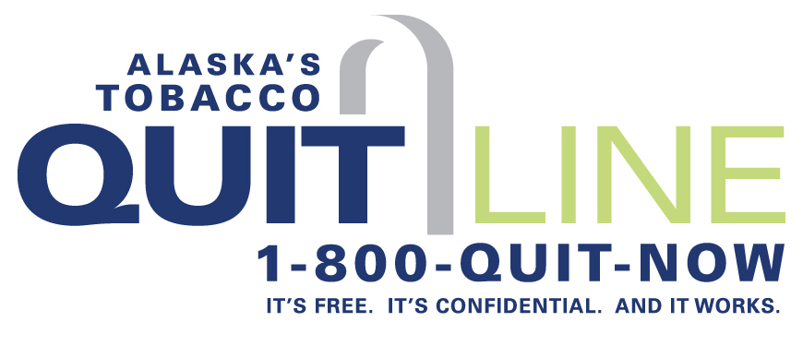
Alaska’s Tobacco Quitline
(1-800-784-8669)
Source: Behavioral Health and Wellness Program

Slide 28
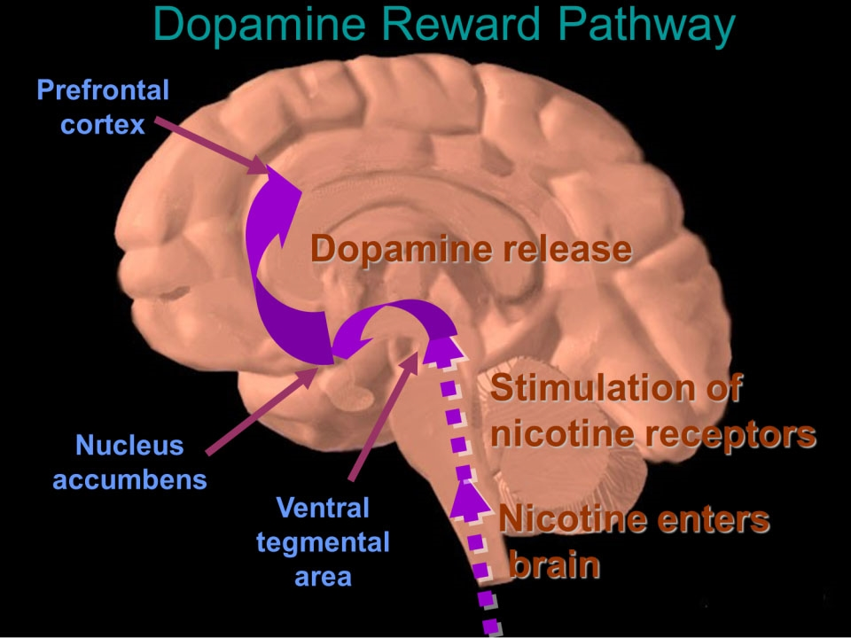
This slide is made available to the public through the National Institute on Drug Abuse Web page (link). Adapted with permission by Dr. Rochelle D. Schwartz-Bloom, Duke University
Notes:
Nicotine is the major pharmacologically active alkaloid in tobacco.
Drugs such as cocaine, heroin, amphetamine, and nicotine exert profound effects on the brain. These agents have in common the ability to stimulate the release of the neurotransmitter dopamine in the midbrain. Dopamine induces feelings of euphoria and pleasure and is responsible for activating the dopamine reward pathway (Leshner, 1997).
The dopamine reward pathway, as depicted in this simplified diagram, is a network of nervous tissue in the middle of the brain that elicits feelings of pleasure in response to certain stimuli. The important interconnected structures of the reward pathway include the ventral tegmental area (VTA), the nucleus accumbens, and the prefrontal cortex (area of the brain responsible for thinking and judgment). The neurons of the VTA contain the neurotransmitter dopamine, which is released in the nucleus accumbens and in the prefrontal cortex.
Behaviors that naturally stimulate the reward pathway include eating to relieve hunger, drinking to alleviate thirst, or engaging in sexual activity. On a primitive, neurochemical level, stimulation of the reward pathway reinforces the behavior so that it will be repeated. Obviously these behaviors are necessary for continued survival of the organism. The reward pathway can also be stimulated by drugs of abuse such as cocaine, opiates, amphetamine, and nicotine. When these unnatural stimuli trigger the reward pathway the same pleasurable feelings are elicited. Researchers believe that, with chronic drug use, the brain becomes chemically altered—transforming a drug user into a drug addict (Leshner, 1997).
Consider cigarette smoking as an example. Immediately following inhalation, a bolus of nicotine enters the brain, stimulating the release of dopamine, which induces nearly immediate feelings of pleasure and relief of symptoms of nicotine withdrawal. This rapid dose-response reinforces and perpetuates the smoking behavior.
This slide is made available to the public through the National Institute on Drug Abuse Web page, at http://www.nida.nih.gov/Teaching/largegifs/slide-9.gif. Adapted with permission by Dr. Rochelle D. Schwartz-Bloom, Duke University.
Leshner Al. Drug abuse and addiction are biomedical problems. Hosp Pract (special report) April 1997:2–4.
Nicotine stimulates release of dopamine from nucleus accumbens (brain reward center)
Dopamine enhances feelings of reward and pleasure
Nicotine increases serotonin levels, mostly in the amygdala (brain emotional response center)
Serotonin can relieve depression and anxiety

Slide 29
Nicotine Addiction Cycle
Notes:
To alleviate the symptoms of withdrawal, smokers re-dose themselves throughout the day. This figure depicts the typical nicotine addiction cycle a cigarette smoker experiences on a daily basis.
Note to instructor(s): Orient the students to the following elements on this figure:
The jagged line represents venous plasma concentrations of nicotine as a cigarette is smoked every 40 minutes from 8 am to 9 pm.
The upper solid line indicates the threshold concentration for nicotine to produce pleasure or arousal.
The lower solid line indicates the concentrations at which symptoms of abstinence (i.e., withdrawal symptoms) from nicotine occur.
The shaded area represents the zone of nicotine concentrations (neutral zone) in which the smoker is comfortable without experiencing either pleasure/arousal or abstinence symptoms.
After smoking the first cigarette of the day, the smoker experiences marked pharmacologic effects, particularly arousal. No other cigarette throughout the day produces the same degree of pleasure/arousal. For this reason, many smokers describe the first cigarette as the most important one of the day. Shortly after the initial cigarette, tolerance begins to develop. Accordingly, the threshold levels for both pleasure/arousal and abstinence rise progressively throughout the day as the smoker becomes tolerant to the effects of nicotine.
With continued smoking, nicotine accumulates, leading to an even greater degree of tolerance. As a result, the smoker experiences greater withdrawal symptoms between successive cigarettes. Late in the day, each individual cigarette produces only limited pleasure/arousal; instead, smoking primarily alleviates nicotine withdrawal symptoms.
Cessation of smoking overnight allows resensitization of drug responses (i.e., loss of tolerance). Most dependent smokers tend to smoke a certain number of cigarettes per day (usually more than 10) and tend to consume 10–40 mg of nicotine per day to achieve the desired effects of cigarette smoking and minimize the symptoms of nicotine withdrawal (Benowitz, 1992).
Benowitz NL. Cigarette smoking and nicotine addiction. Med Clin N Am 1992;76:415–437.

Slide 30
Tobacco Dependence is a 2-Part Problem
Physical
Behavior
The addiction to nicotine
Treatment
Medications for cessation
The habit of using tobacco
Treatment
Behavior change program
Treatment should address both the addiction
and the habit.
Source: Behavioral Health and Wellness Program
Courtesy of the University of California, San Francisco

Slide 31
Resources + Tools for
Behavior Change
Cognitive-Behavioral Therapy
Motivational enhancement
Individual counseling >4 sessions
Groups meeting 7-10 weeks
Individualized treatments
Peer-to-peer support
Referral to the Quit Line

Slide 32
Motivational Intervention
30 minute session
Motivate smokers with mental health/ substance use disorders to seek tobacco dependence treatment
Provides brief, personalized feedback about impact of tobacco use
  Carbon Monoxide (CO)
  Money spent on tobacco
Notes:
Afterward, smokers should be able to:
Know what CO is and why it is dangerous
Know their own CO level
Understand that quitting smoking will reduce CO to a safe level
Know that a pack/day smoker spends $2000 per year on cigarettes
Know how much $ they will save if they quit

Slide 33
Peer to Peer Tobacco Dependence Recovery Program
Sustainable train-the-trainer model
Active in 7 states
Positive social networking
Education and Awareness Building
One-on-One Motivational Interviews
Tobacco Dependence Support Groups

Slide 34
Tobacco Dependence is a 2-Part Problem
Physical
Behavior
The addiction to nicotine
Treatment
Medications for cessation
The habit of using tobacco
Treatment
Behavior change program
Treatment should address both the addiction
and the habit.
Source: Behavioral Health and Wellness Program
Courtesy of the University of California, San Francisco

Slide 35
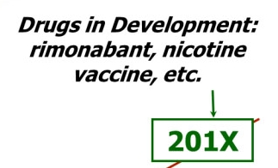
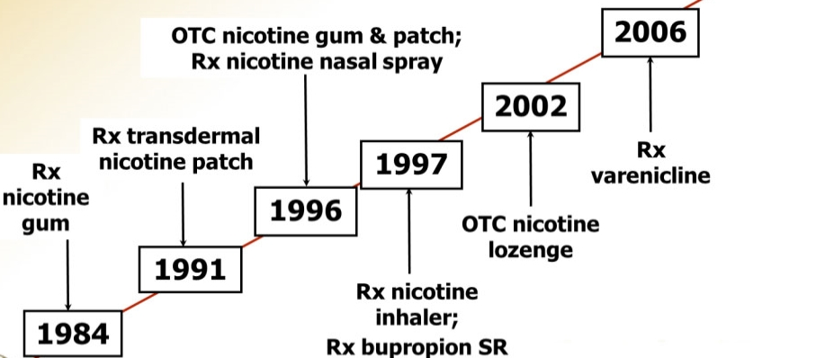
FDA Approvals for Smoking Cessation
Source: Behavioral Health and Wellness Program
Notes:
35
Bupropion (BUP)
Contraindicated in seizure and eating disorders
No recommended
Alcohol abuse/dependence
Bipolar disorder
Extended sleep deprivation
Past head trauma
Interferes with efficacy of protease inhibitors used for HIV/AIDS treatment
Varenicline- recent safety concerns
Rare isolated reports of suicidal ideation in depressed patients taking varenicline
FDA clinician alert
Hard to distinguish from natural symptoms of nicotine withdrawal or natural course of depression
Hard to assess risk of increased number of rare events
New industry trial planned on CMI population
Stay tuned for further surveillance and results of new trials.

Slide 36
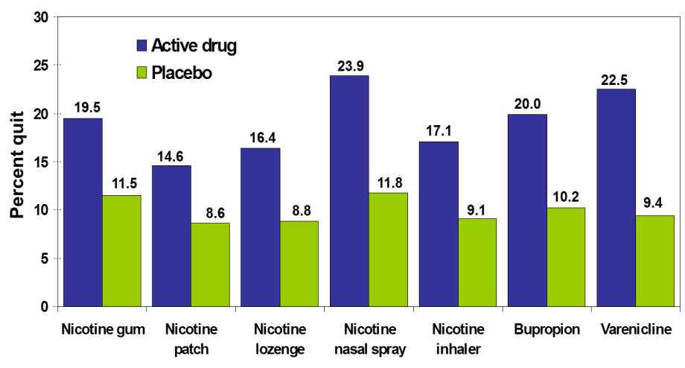
Long-term (36 month) Quit Rates for Cessation Medications
Data adapted from Silagy et al. (2004). Cochrane Database Syst Rev; Hughes et al., (2004). Cochrane Database Syst Rev.; Gonzales et al., (2006). JAMA and Jorenby et al., (2006). JAMA
Source: Behavioral Health and Wellness Program

Slide 37

Nicotine Patch
ADVANTAGES
DISADVANTAGES
Provides consistent nicotine levels
Easy to use and conceal
Fewer compliance issues
Safe in presence of C-V disease
Clients cannot titrate the dose
Allergic reactions to adhesive may occur
Taking patch off to sleep may lead to nicotine cravings in the morning
Source: Behavioral Health and Wellness Program
Notes:
Decreases nicotine withdrawal symptoms
Lessens negative mood states in early abstinence
No interactions with other psychiatric medications
No effect on psychiatric medication blood levels
Safe in presence of C-V disease (do not use within 2 weeks of MI, serious arrythmia or severe/worsening angina)
Safe with concomitant smoking—harm reduction

Slide 38

Bupropion SR Tablets
Does not contain nicotine
Tablet that is swallowed whole, and the medication is released over time
Same medication as Wellbutrin, which is used to treat depression
Sold with a prescription
Source: Behavioral Health and Wellness Program
Courtesy of the University of California, San Francisco

Slide 39
Varenicline
ADVANTAGES
DISADVANTAGES
Oral formulation with twice-a-day dosing
Offers a new mechanism of action for persons who previously failed using other medications
Early trials suggest this agent is superior to bupropion SR
Common side effects:
  Nausea (in up to 33% of clients)
  Sleep disturbances (insomnia, abnormal dreams)
  Constipation
  Flatulence
  Vomiting
NOTE: Patients have reported changes in behavior, agitation, depressed mood, suicidal thoughts or actions while taking or after stopping Varenicline.
Source: Behavioral Health and Wellness Program

Slide 40
Combination Therapy
Long-acting formulation (patch, bupropion, vareincline), which produces relatively constant levels of nicotine
PLUS
Short-acting formulation (gum, lozenge, inhaler, nasal spray), which permits acute dose titration as needed for withdrawal symptoms
Ebbert et al, 2009; Hurt et al., 2009; Piper et al., 2009; Schneider et al., 2006; Steinberg et al., 2006
Source: Behavioral Health and Wellness Program

Slide 41
Current Practices:
Survey Results of Alaska Behavioral Health Providers

Slide 42
Survey Results:
Alaska Behavioral Health Practices
How do Alaska organizations currently measure up?
Notes:
In 2013, TPC conducted a baseline survey of 80 Alaska behavioral health organizations about current practices for treating tobacco dependence.
39 organizations across the state provided information about their own protocols, and whether they are interested in implementing best practices.
The graph indicates where behavioral health organizations are already following best practices, and where there needs to be big improvement.
“Ask” means they screen clients for tobacco use at every visit. Others only screen periodically or at intake.
“Advise” means advising the client to quit
“Refer” means providing a referral to the Quit Line, in-house cessation services or other services
“Document in EHR” means that the organization uses electronic health records and consistently documents the client’s use, as well as any services provided
“Campus policy” means a 100% tobacco-free or smoke-free campus policy, including clients, staff and visitors.

Slide 43
Survey Results:
Alaska Behavioral Health Practices
Organizations recognize the need for tobacco treatment, but need support to implement systems change
90% of respondents say treating tobacco dependence is a high priority
Half of the organizations recently conducted staff trainings for tobacco cessation interventions
Providers are interested in implementing tobacco cessation interventions, but feel that they face some barriers:
  Half of respondents do not feel that they have enough training
  One third believe they do not have time
  One third believe they are not adequately reimbursed for tobacco cessation services

Slide 44
How to Get There?
Notes:
Why integrate tobacco cessation into behavioral health services?
Access to the highest risk population
Experts in behavioral change
Duration of treatment and ability to monitor
Therapeutic alliances
Integrated and co-occurring philosophies and models
Increased treatment effectiveness
Integration with wellness programs and initiatives

Slide 45
Step #1: Acknowledge
Challenges & Barriers
Tobacco use has been accepted in the culture of addiction and mental health treatment
Myths and misperceptions persist about why tobacco use should be tolerated
Staff and client attitudes
Lack of staff training
Fears of negative impact resulting from limiting access to tobacco
Notes:
Providers’ concerns
“They can’t” or “They don’t want to”
“It isn’t relevant”
“I don’t have time to do this on top of everything else”
“I’ve always heard smoking helps symptoms. I don’t want to make their symptoms worse.”
“They will lose their sobriety if they also try to quit smoking or lose weight”
“I don’t have the training necessary”
“Why spend time on this? There are more important psychiatric, substance abuse, and medical issues”
“The issues we face are unique”
Providers themselves may be tobacco users, and express ambivalence about or no interest in quitting.

Slide 46
Step #2: Establish a
Change Team
Identify and educate champion high-level decision maker that can give go ahead to begin change process
Leadership with the ability to make policy and financial decisions need to be on the team
The leadership committee needs to represent all staff at the organization – administration, clinical, support, union leaders, and medical staff
Make sure not to exclude tobacco users from joining team

Slide 47
Step #3: Create a Change Plan
Identify short, medium and long term goals
Identify timeline, with measurable objectives for short, medium and long term
Timelines need to be realistic

Slide 48
Step #4: Start with
Easy Changes
Use the phrase "alcohol, tobacco, and other drugs" when discussing substance use disorders and include tobacco dependence in co-occurring disorders
Make sure tobacco dependence is on the problem list
Provide educational materials about tobacco dependence and treatment – hang posters
Provide quit line materials
Re-label "smoke breaks" to just "breaks”
Ban sales of cigarettes
Notes:
Starting the conversation about tobacco as an addiction is one of the first steps. At first, not everyone is willing to consider quitting, whether they are a patient or a staff member.

Slide 49
Step #4: Start with
Easy Changes
Do not allow staff to smoke with patients
Limit hours and places for smoking
Provide educational materials about tobacco dependence and treatment
If not requiring smoke-free grounds, create less visible places where smoking is permitted
Smoking staff should not give the appearance of smoking (i.e. smelling of smoke)

Slide 50
Step #5: Conduct Staff Training
Provide ongoing training and clinical supervision on:
Screening, assessing and developing treatment plans
Motivation and staged based treatment
Psychosocial and pharmacological treatment options
Local and web-based resources
Recommend all-staff training to get everyone on the same page

Slide 51
Step #6: Encourage and Support Staff in Quitting Tobacco Use
Must provide sensitivity and compassion to staff struggling with their own use
Tobacco-free campus policies can encourage quitting, but should be implemented only with NRT or cessation treatment options available
Explore with current users what kind of agency support would be helpful
Work with agency health insurance provider to make sure they offer a comprehensive cessation benefit
Explore with insurance provider what assistance they can offer on site
Notes:
Most tobacco users express a desire to quit – but not all.

Slide 52
Step #7: Begin Assessing
Client Use of Tobacco
Change intake/assessment
Resources include DSM IV codes, Fagerstrom assessment tools
All tobacco-dependent clients should have this problem listed on their treatment plan
Assess their stage of readiness

Slide 53
Step #8: Provide Medications for Tobacco Treatment
From the Clinical Practice Guidelines:
“All patients attempting to quit should be encouraged to use effective pharmacotherapies for cessation except in the presence of special circumstances.”
Make NRT and cessation support available to all patients and staff who attempt to quit, especially if a tobacco-free campus policy is implemented.
Fiore et al. Treating Tobacco Use and Dependence. Clinical Practice Guideline.
Rockville, MD: USDHHS, PHS, 2000.

Slide 54
Step #9: Integrate Motivation-Based Treatment for Tobacco Throughout the Organization
Motivation-based and stage-based treatment
- Ready to quit get support for their quitting
- Lower motivated clients get more of an educational model to move to readiness to quit (ex. LAHL)
Relapse prevention
Consider 12 step Nicotine Anonymous groups

Slide 55
Step #10: Develop Policies Addressing Tobacco Use
Agencies should have written policies on tobacco use by staff, clients, and visitors
Policies should address tobacco use on agency facilities and grounds
  Minimum standard: Compliance with local law, if relevant
  Recommendation: Tobacco free facilities and grounds
  Should be implemented with cessation treatment and support available for patients and staff
Policies should address staff use of tobacco
  Recommendation: Staff should have no evidence of tobacco use on agency premises (even during breaks) or while engaged in job-related activities

Slide 56
Step #11: Communicate Agency Changes with Community, Colleagues and Referral Sources
Treatment starts with referral. Provide education to referral sources about change and let them know how to assist
Promote the changes as a benefit
Brag about the work you are doing and why you are doing it!

Slide 57
Questions or comments?
Thank you!
Insert presenter’s name and contact info (email and/or phone) for followup

