Slide 1
HIV Epidemiologic profile –Alaska, 1982-2015
Prepared by the State of Alaska Department of Health and Social Services, Division of Public Health, HIV/STD Program, Section of Epidemiology. For questions about this presentation please visit http://www.epi.hss.state.ak.us/hivstd/default.stm or call the Alaska Section of Epidemiology at (907) 269-8000.

Slide 2
Structure of the Slide Deck
To summarize the epidemic in Alaska and highlight emerging trends, there are three sections of the Epidemiologic Profile Slide Deck:
All Reported Cases of HIV, 1982-2015
Cumulative, 1982-2010 and Recent, 2011-2015
People Living with HIV and the HIV Care Continuum, 2015
The complete Epidemiologic Profile may be found online at:
http://dhss.alaska.gov/dph/Epi/hivstd/Pages/hivdata.aspx

Slide 3
Important Note
When interpreting data in this presentation, it is important to consider that Alaska is a low incidence jurisdiction, meaning that there are relatively few new diagnoses of HIV each year as compared to other parts of the U.S., and many subgroups have a small number of events each year. Small numerators and denominators can make interpretation of data difficult, particularly the interpretation of trends over time. Therefore, many changes in percentages and rates presented in this slide deck should be interpreted with caution and some of the data may be statistically unreliable.

Slide 4
All Reported Cases of HIV, 1982-2015
Section I

Slide 5
Section I Highlights
From January 1, 1982 through December 31, 2015, 1,680 cases of HIV infection were reported to the Alaska Section of Epidemiology.
Of those cases 1,157 had an initial diagnosis in Alaska, and 523 were previously diagnosed out-of-state but are known to have lived in Alaska.
67% (n=1,128) ever had a diagnosis of AIDS.
35% (n=586) are known to have died.
81% (n=1,353) were male.
840 (50%) were men who Have sex with men (MSM); 318 (19%) were heterosexual (hetero).
901 (54%) were White; 336 (20%) were Alaska Native/American Indian; 220 (13%) were Black.

Slide 6
Reported Cases of HIV by Gender
Males are over-represented in the reported cases of HIV first diagnosed in Alaska.
While 52% of the overall Alaska population is male, they make up 79% (n=910) of the 1,157 HIV cases first diagnosed in Alaska.
Summary of Reported Cases of HIV by Gender — Alaska, 1982-2015
 | All Reported Cases N=1,680 |  | Reported Cases First Diagnosed in Alaska n=1,157
 | Male | Female | Male | Female
HIV (non–AIDS) | 422 | 130 | 268 | 97
HIV with AIDS | 931 | 197 | 642 | 150
TOTAL # | 1,353 | 327 | 910 | 247

Slide 7
Reported Cases of HIV by Age
The majority (1,126/1,680; 67%) of cases of HIV reported in Alaska 1982-2015, were in persons aged 25 to 44 years.
Among the 1,157 reported cases first diagnosed in Alaska, 66% (n=762) of persons were 25 to 44 years of age when first diagnosed with HIV.
The majority of cases among children aged <14 years were foreign born persons, mostly attributed to perinatal exposure.
Summary of Reported Cases of HIV by Age — Alaska, 1982-2015
Age (Years) | All Reported Cases N=1,680 |  | Reported Cases First Diagnosed in Alaska n=1,157
 | Male | Female | Male | Female
<14 | 11 | 11 | 8 | 5
15–24 | 191 | 64 | 108 | 42
25–34 | 522 | 116 | 328 | 88
35–44 | 413 | 75 | 286 | 60
45–54 | 160 | 48 | 130 | 40
55–64 | 43 | 11 | 38 | 10
≥65 | 13 | 2 | 12 | 2

Slide 8
Reported Cases of HIV by Age
Persons aged 25-44 years are over-represented in reported cases of HIV; making up 66% of diagnoses, but only 28% of the Alaska population.
Percentage of Reported HIV Cases with an Initial Diagnosis in Alaska, by Age at Diagnosis (1982–2015) and Percentage of the Alaska Population by Age (2015)

Slide 9
Reported Cases of HIV by Race and Ethnicity
The majority of reported cases first diagnosed in Alaska were among:
Whites (596/1,157)
AI/AN (299/1,157)
Blacks (129/1,157)
Summary of Reported Cases of HIV by Race and Ethnicity — Alaska, 1982-2015
 | All Reported Cases N=1,680 |  | Reported Cases First Diagnosed in Alaska n=1,157
 | Male | Female | Male | Female
American Indian/ Alaska Native (AI/AN) | 225 | 111 | 194 | 105
Asian | 18 | 16 | 10 | 11
Black | 167 | 53 | 100 | 29
Hispanic | 125 | 23 | 74 | 17
Native Hawaiian/ Pacific Islander (NH/PI) | 8 | 2 | 7 | 1
White | 784 | 117 | 515 | 81
Multi–race | 26 | 5 | 10 | 3

Slide 10
Reported Cases of HIV by Race and Ethnicity
AI/AN make up ~15% of the Alaska population but 26% of the reported cases of HIV first diagnosed in Alaska.
Similarly, Blacks make up ~4% of the Alaska population but 11% of reported HIV cases diagnosed in Alaska.
Percentage of Reported Cases of HIV with an Initial Diagnosis in Alaska by Race/Ethnicity (1982–2015) and Percentage of Alaska Population by Race and Hispanic Origin (July 2015)

Slide 11
Reported Cases of HIV by Transmission Category
The most frequently reported transmission category in Alaska is male-to-male sexual contact (MSM).
Among females it is heterosexual contact.
Summary of Reported Cases of HIV by Transmission Category — Alaska, 1982-2015
 | All Reported Cases N=1,680 |  | Reported Cases First Diagnosed in Alaska n=1,157
 | Male | Female | Male | Female
MSM | 840 | 0 | 568 | 0
Injection Drug Use (IDU) | 133 | 62 | 90 | 42
MSM and IDU | 135 | 0 | 64 | 0
Heterosexual Contact | 92 | 226 | 71 | 176
Perinatal | 6 | 11 | 4 | 5
Other/No Indicated Risk (NIR) | 147 | 28 | 113 | 24

Slide 12
Reported Cases of HIV by Transmission Category
Due to the large number of cases with a reported transmission category of male-to-male sex, it is important to review transmission categories for males and females separately.
Cumulative Reported Cases of HIV in Males by Transmission Category, Alaska ― 1982–2015
Cumulative Reported Cases of HIV in Females by Transmission Category, Alaska ― 1982–2015

Slide 13
Reported Cases of HIV by Residence at Time of Diagnosis
The majority of reported cases first diagnosed in Alaska are from the Anchorage/Matanuska-Susitna (Mat-Su) region, the most populous area of the state.
It is important to note that residence at diagnosis is assigned based on the address given by the patient on the date of their first positive test for HIV or AIDS.
This region is not necessarily the area where infection initially occurred or the area where the infected individual currently resides or seeks care, if still living and residing in Alaska.

Slide 14
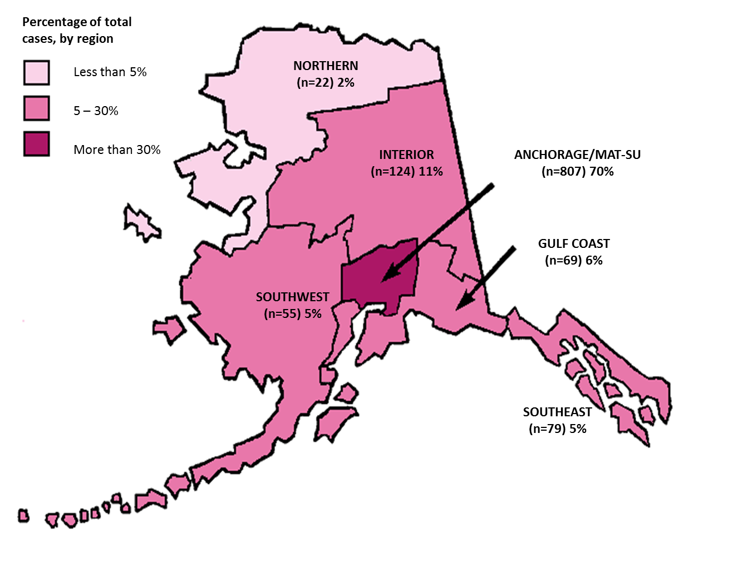
Reported Cases of HIV by Residence at Time of Diagnosis
Cumulative HIV Cases First Diagnosed in Alaska by Economic Region at Diagnosis, Alaska ― 1982–2015

Slide 15
Reported hiv cases: Cumulative, 1982-2010 Versus Recent, 2011-2015
Section II

Slide 16
Section II Highlights
This section compares trends among persons newly diagnosed in Alaska cumulatively from 1982-2010 (n=1,019) to persons newly diagnosed in Alaska more recently, 2011-2015 (n=138). This comparison shows:
Increases in cases among females
Significant increase in the number of cases among heterosexuals, while cases among MSM remained steady and cases in IDU decreased
Increases in all minority groups, most notably among blacks; and
Increases in cases in persons younger than 25 and older than 45 years of age

Slide 17
Reported Cases of HIV Diagnosed in Alaska by Gender — Cumulative versus Recent
Cumulatively from 1982-2010, 79% (n=807) of HIV cases diagnosed in Alaska were among males and 21% (n=212) were among females.
Among persons more recently diagnosed with HIV in Alaska, from 2011-2015, 75% (n=103) were among males and 25% (n=35) were among females.
Summary of Reported Cases of HIV Diagnosed in Alaska (N=1,157) by Gender — Cumulative 1982-2010 and Recent 2011-2015
 | Cumulative through 2010 (n=1,019) |  | 2011 (n=24) |  | 2012 (n=30) |  | 2013 (n=22) |  | 2014 (n=40) |  | 2015 (n=22)
 | # | (%) | # | (%) | # | (%) | # | (%) | # | (%) | # | (%)
Female | 212 | (21) | 7 | (29) | 10 | (33) | 6 | (27) | 7 | (18) | 5 | (23)
Male | 807 | (79) | 17 | (71) | 20 | (67) | 16 | (73) | 33 | (82) | 17 | (77)

Slide 18
Reported Cases of HIV Diagnosed in Alaska by Gender — Cumulative versus Recent
From both 1982-2010 and 2011-2015 the majority of HIV cases newly diagnosed in Alaska were among men.
The percentage of females newly diagnosed with HIV increased from 1982-2010 to 2011-2015 by 4%.
Increases among females are largely due to an increase in heterosexual transmission.
Percentage of Newly Diagnosed Cases of HIV in Alaska by Sex, Cumulative 1982-2010 and Recent 2011-2015

Slide 19
Reported Cases of HIV Diagnosed in Alaska by Age— Cumulative versus Recent
Both cumulative 1982-2010 and recent 2011-2015, the majority of HIV cases newly diagnosed in Alaska were among persons aged 25-34 years (37%; n=375 and 30%; n=41)
Summary of Reported Cases of HIV Diagnosed in Alaska (N=1,157) by Age — Cumulative 1982-2010 and Recent 2011-2015
 | Cumulative through 2010 (n=1,019) |  | 2011 (n=24) |  | 2012 (n=30) |  | 2013 (n=22) |  | 2014 (n=40) |  | 2015 (n=22)
 | # | (%) | # | (%) | # | (%) | # | (%) | # | (%) | # | (%)
<14 | 11 | (1) | 0 | - | 2 | (7) | 0 | - | 0 | - | 0 | -
15–24 | 120 | (12) | 8 | (33) | 5 | (17) | 3 | (14) | 10 | (25) | 4 | (18)
25–34 | 375 | (37) | 6 | (25) | 5 | (17) | 10 | (45) | 16 | (40) | 4 | (18)
35–44 | 323 | (32) | 5 | (21) | 7 | (23) | 2 | (9) | 5 | (13) | 4 | (18)
45–54 | 145 | (14) | 3 | (13) | 9 | (30) | 2 | (9) | 6 | (15) | 5 | (23)
55–64 | 33 | (3) | 2 | (8) | 2 | (7) | 3 | (14) | 3 | (8) | 5 | (23)
≥65 | 12 | (1) | 0 | - | 0 | - | 2 | (9) | 0 | - | 0 | -

Slide 20
Reported Cases of HIV Diagnosed in Alaska by Age— Cumulative versus Recent
Although 25-34 year olds continue to account for the largest number of new diagnosis, the range has shifted to include a wider age distribution across the lifespan, with increases in new diagnosis among persons aged 15-24 years, 45-54 years, and 55-64 years.
Percentage of Newly Diagnosed Cases of HIV in Alaska by Age at Diagnosis, Cumulative 1982-2010 and Recent 2011-2015

Slide 21
Reported Cases of HIV Diagnosed in Alaska by Race and Ethnicity— Cumulative versus Recent
Both 1982-2010 and 2011-2015 White and Alaska Native/American Indian persons account for the largest number of new diagnoses.
Recently, there is a notable increase in the number of new diagnoses among other non-White populations.
Black persons make up ~10% of the Alaska population but 19% of new diagnosis 2011-2015.
Percentage of Newly Diagnosed Cases of HIV in Alaska by Race/Ethnicity Category, Cumulative 1982-2010 and Recent 2011-2015

Slide 22
Reported Cases of HIV Diagnosed in Alaska by Transmission Category — Cumulative versus Recent
Male-to-male sexual contact was the most commonly reported HIV transmission category both 1982-2010 (49%; n=498) and 2011-2015 (51%; n=70).
Perinatal transmission remains rare in Alaska. All perinatal cases reported 2011-2015 were foreign born adoptees with no verification of initial out-of-country diagnosis.
Summary of Reported Cases of HIV Diagnosed in Alaska (N=1,157) by Transmission Category — Cumulative 1982-2010 and Recent 2011-2015
 | Cumulative through 2010 (n=1,019) |  | 2011 (n=24) |  | 2012 (n=30) |  | 2013 (n=22) |  | 2014 (n=40) |  | 2015 (n=22)
 | # | (%) | # | (%) | # | (%) | # | (%) | # | (%) | # | (%)
MSM | 498 | (49) | 12 | (50) | 13 | (43) | 11 | (50) | 24 | (60) | 10 | (45)
IDU | 126 | (12) | 3 | (13) | 2 | (7) | 1 | (5) | 0 | - | 0 | -
MSM/IDU | 60 | (6) | 0 | - | 1 | (3) | 1 | (5) | 1 | (2) | 1 | (5)
Heterosexual | 198 | (19) | 7 | (29) | 11 | (37) | 9 | (41) | 13 | (33) | 9 | (41)
Perinatal | 7 | (<1) | 0 | - | 2 | (7) | 0 | - | 0 | - | 0 | -
Other/NIR | 130 | (13) | 2 | (8) | 1 | (3) | 0 | - | 2 | (5) | 2 | (9)

Slide 23
Reported Cases of HIV Diagnosed in Alaska by Transmission Category — Cumulative versus Recent
1982-2010 to 2011-2015 there are notable increases in the percentage of persons with reported heterosexual transmission.
There have also been decreases in persons whose reported transmission category is injection drug use and in persons with no indicated risk or other risk.
Percentage of Newly Diagnosed Cases of HIV in Alaska by Transmission Category, Cumulative 1982-2010 and Recent 2011-2015

Slide 24
People Living with HIV and the HIV Care Continuum, 2015
Section III

Slide 25
Section III Highlights
As of December 31, 2015, an estimated 671 persons living with HIV (PLWH) are currently residing in Alaska.
The majority (67%; n=338) of people living with HIV in Alaska are males between the ages of 25 and 44 years.
Of the people believed to be living with HIV in Alaska, 587 (87%) are believed to be engaged in HIV medical care (defined as having received at least one CD4 or HIV viral load (VL) laboratory test in 2015.
Of the 587 PLWH in Alaska who are engaged in HIV medical care, 517 (88%) have laboratory test results which indicate they have achieved viral suppression (defined as a viral load equal to or less than 200 copies/mL).
Approximately 77% of the PLWH in Alaska have achieved viral suppression.

Slide 26
Persons Living with HIV/AIDS by Age at Diagnosis and Gender
Of the 671 people living with HIV (PLWH) currently believed to be alive and residing in Alaska as of December 31, 2015, 75% (n=506) are males and 25% (n=165) are females.
Of the males living with HIV in Alaska, the majority (67%; n=338) are between the ages of 25 and 44 years.
Persons Living with HIV/AIDS in Alaska by Age at Diagnosis and Gender at Birth ― As of December 31, 2015 (N=671)

Slide 27
Persons Living with HIV/AIDS by Gender and Race/Ethnicity
White males (n=254) and Alaska Native/American Indian males (n=104) are the two largest groups of persons living with HIV in Alaska, based on reported gender and race/ethnicity.
Persons Living with HIV/AIDS in Alaska by Race/Ethnicity and Gender at Birth ― As of December 31, 2015 (N=671)
 | Male # (%) | Female # (%) | Total # (%)
American Indian/ Alaska Native (AI/AN) | 104 (15) | 64 (10) | 168 (25)
Asian | 13 (2) | 10 (1) | 23 (3)
Black | 64 (10) | 28 (4) | 92 (14)
Hispanic | 52 (8) | 11 (2) | 63 (9)
Native Hawaiian/ Pacific Islander (NH/PI) | 1 (<1) | 1 (<1) | 2 (<1)
White | 254 (38) | 47 (7) | 301 (45)
Multi–race | 18 (3) | 4 (<1) | 22 (3)

Slide 28
Persons Living with HIV/AIDS by Transmission Category
Male-to-male sexual contact is the most reported transmission category among PLWH in Alaska (45%).
Heterosexual exposure is the second most common transmission category (27%).
Injection drug users account for 11% of all PLWH in the state.
Persons Living with HIV/AIDS in Alaska by Transmission Category ― As of December 31, 2015 (N=671)

Slide 29
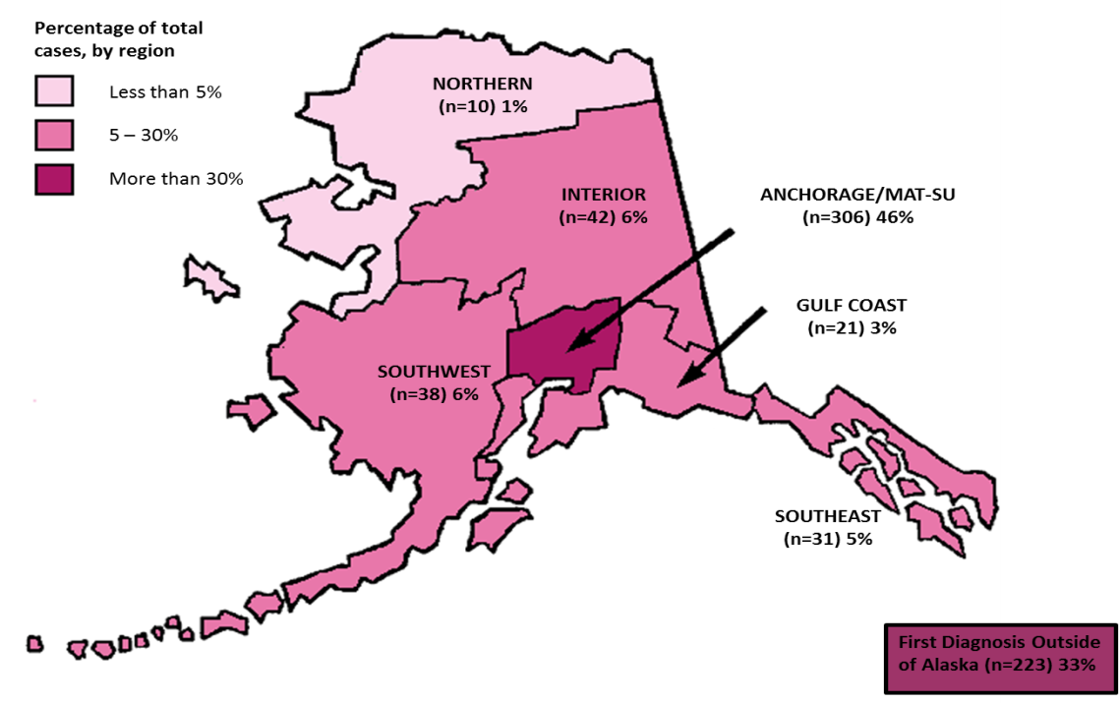
Persons Living with HIV/AIDS by Region at Diagnosis
The majority (46%; n=306) of PLWH in Alaska reported residence in Anchorage/Mat-Su area at the time of their HIV diagnosis.
33% (n=223) of PLWH in Alaska were initially diagnosed with HIV outside the state.
People Living with HIV/AIDS by Economic Region at First Diagnosis, Alaska ― As of December 31, 2015

Slide 30
HIV Care Continuum
Ensuring that persons living with HIV receive appropriate medical care is an effective tool for preventing disease progression and reducing HIV transmission within the community.
The model that outlines the sequential steps a person living with HIV must go through, from the time of their HIV diagnosis through successful treatment of their infection, is called the HIV Care Continuum.
HIV surveillance data collected by the Alaska Section of Epidemiology are used to monitor linkage and retention in care for person living with HIV in Alaska throughout the Care Continuum.

Slide 31
HIV Care Continuum
Of the 1,680 persons ever reported to the Alaska HIV surveillance system, 671 were believed to still be alive and living in Alaska as of December 31, 2015.
Of the 671 persons living with HIV in Alaska, 87% (n=587) were known to have been linked to HIV care and 77% (n=517) are known to be virally suppressed as of December 31, 2015.
HIV Care Continuum, Alaska ― As of December 31, 2015

Slide 32
Additional Resources
Additional information on HIV in Alaska may be found on the Alaska Section of Epidemiology, HIV/STD Program Data and Statistics page located at: http://dhss.alaska.gov/dph/Epi/hivstd/Pages/hivdata.aspx
OR
You may contact the Alaska Section of Epidemiology, HIV/STD Program at (907) 269-8000.
Slide deck last update November 30, 2016.

