Slide 1

Breast & Cervical
Health Check
State of Alaska
Division of Public Health
Women’s, Children’s & Family Health
3601 C Street, Suite 322
Anchorage, AK 99503
1-800-410-6266

Slide 2
What is BCHC?
Part of the NBCCEDP — National Breast & Cervical Cancer Early Detection Program
1 of 70 programs in the U.S.
(50 States, District of Columbia, 6 U.S. Territories and 13 Tribes)
Funded by the Centers for Disease Control & Prevention

Slide 3
What do we do?
We pay BCHC providers for approved breast and cervical health screening services, appropriate to a woman’s age and clinical history:
Clinical Breast Exam
Pap Test
Mammogram
Diagnostic Work Up

Slide 4
How do we do it?
We establish agreements with primary care clinician offices, labs, hospitals, imaging centers and specialist offices state wide.
On a fee for service basis, clinicians see eligible women and bill BCHC.
Currently, there are over 140 providers, including Public Health Centers, screening and diagnosing women through BCHC.

Slide 5
What women are eligible?
Any woman age 21–64, with a family income below program limits; income is assessed annually
Uninsured or under-insured women

Slide 6
Program Accomplishments
1995 – 2017
62,000+ Individual Women Screened
148,000+ Cancer Screenings
585 Cases of Breast Cancer Diagnosed
62 Cases of Cervical Cancer Diagnosed
4,316+ Pre-Cancerous Cervical Conditions Diagnosed

Slide 7
Which providers are eligible?
Physicians
Osteopathic Physicians
Certified Physician Assistants
Advanced Nurse Practitioners
Certified Nurse Midwives
Diagnostic service providers licensed or certified to perform specific medical tasks (e.g., Mammography, pathology, etc.)

Slide 8
What are the benefits of becoming a provider?
Women diagnosed by a BCHC provider with breast or cervical cancer, or a pre-cancerous condition requiring treatment are eligible to be referred to the Division of Public Assistance to access special “B&C Medicaid” funds.
Ongoing program support and technical assistance
Referrals into your practice (if desired)
Breast and cervical patient education materials for distribution in your clinic (if desired)

Slide 9
BCHC Operations in Your Clinic
The following sections are designed to provide more detailed information about specific operational matters: Provider Agreements, client enrollment and eligibility, data collection forms and methods, billing and reimbursement, and referral to treatment if a cancer diagnosis is made.

Slide 10
BCHC Providers
State of Alaska, Department of Health and Social Services
Division of Public Health
Grants & Contracts Support Team
P.O. Box 110650, Juneau, AK 99811-0650
BREAST & CERVICAL HEALTH CHECK
SCREENING PROVIDER AGREEMENT
____________________, (Provider) enters into a Provider Agreement with the State of Alaska, Department of Health & Social Services (DHSS) for the purpose of providing breast and cervical cancer screening and diagnostic services (referred to herein as clinical services) to age and income eligible women for the State of Alaska’s Breast & Cervical Health Check (BCHC) program. By entering into this Provider Agreement, the Provider agrees to the following, including all applicable provisions of Appendices A – D and Enclosures:
APPENDICES:
A. 7 AAC 81, Grant Services for Individuals, Revised 6/24/04
B. Privacy & Security Procedures for Providers
C. Federal Assurances & Certifications
Provider Profile
ENCLOSURES:
“BCHC Basics” – a Service Delivery Guide
Clinical Guidelines for Breast Cancer and Cervical Cancer Screening (“Clinical Guidelines”)‏
BCHC Listing of Approved CPT Codes
BCHC Screening & Enrollment Forms
I. PROVIDER ELIGIBILTY
The Provider agrees to the provisions of 7 AAC 81, Grant Services for Individuals (Appendix A), as well as all other applicable state and federal law; and declares and represents that it meets the eligibility requirements for a Service Provider for this Agreement by meeting the established criteria:
1. Has an Employer Identification Number (EIN); and
2. Has a current Alaska Business License (please submit copy) or is a
The State of Alaska requires a written agreement be signed between BCHC and any provider seeking payment for BCHC services.
BCHC has two kinds of Provider Agreements:
Screening Provider Agreement
Clinical Consultant/ Resource Provider Agreement

Slide 11
Screening Providers are those who routinely do women’s annual exams. Screening Provider responsibilities include:
Screening Providers
  Determining eligibility and ideally serving as the woman’s medical home
  Referring women to appropriate BCHC providers (imaging centers and specialists) for additional services when necessary
  Providing BCHC with data about women they have screened
“Good news – those lumps
were just coal.”

Slide 12
Clinical Consultant & Resource Providers
Clinical Consultants are OB-GYN’s and/or breast surgeons and specialists. Their responsibilities include:
Accepting referrals from BCHC Screening Providers for further diagnostic testing and consultation
Notifying BCHC and the Screening Provider of results of any consultations, examinations or diagnostic work done

Slide 13
Clinical Consultant & Resource Providers
Resource Providers include laboratories and imaging centers. Their responsibility is to perform necessary tests at the request of a Screening Provider or Clinical Consultant.
I’d like you to have a
CAT scan.”

Slide 14
All BCHC Providers…
Agree to accept the BCHC Medicare–based reimbursement rate.
Agree to write off the difference between what is billed, and what BCHC reimburses, for any procedure that BCHC can pay for.
Agree to share with BCHC any requested clinical information about BCHC clients.

Slide 15
BCHC Provider Agreements
If you wish to become a BCHC Provider, please contact Bobbi Unger, Provider Support, at 269-4662 for the latest version of the agreement.
Upon receipt of your signed agreement, Bobbi will contact you to arrange a program orientation.
Questions about becoming a BCHC provider?
Call 269-4662.

Slide 16
Client Eligibility & Enrollment
Eligibility is determined using the BCHC Enrollment Form.
It is the Screening Provider’s responsibility to have clients complete this form. Having a completed Enrollment Form at the time of the exam ensures that clients are eligible to receive BCHC services.
Clinical Consultant and Resource Providers can call the Screening Provider or BCHC to verify client eligibility. They can also access the information online with a username and password to the BCHC web-based database.

Slide 17
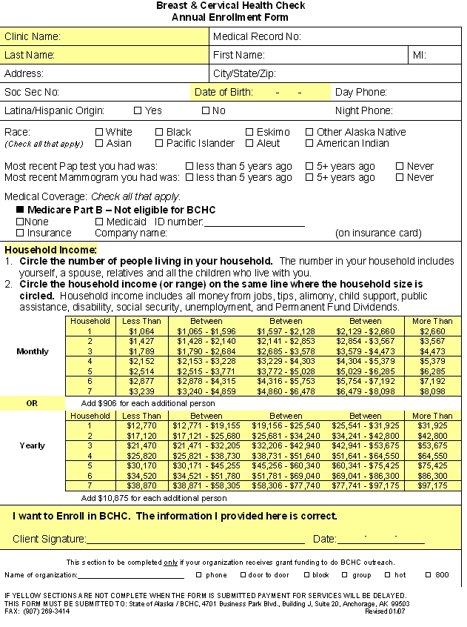
Client Eligibility & Enrollment
Age: Women aged 21–64 are eligible for enrollment into BCHC.
Income: Women with a family income at or below 250% of the federal poverty level are eligible for enrollment. Income eligibility is determined by circling either the client’s monthly or yearly income on the grid on the Annual Enrollment Form.
A woman with a family income falling in the “More Than” column on the grid is not eligible for BCHC.

Slide 18
Client Eligibility & Enrollment
Women with insurance are eligible to be enrolled in BCHC, provided they meet age and income guidelines.
Women whose insurance pays for BCHC services at a rate greater than, or equal to, the BCHC (Medicare) reimbursement rate may still be enrolled in BCHC. If necessary, these women are eligible for travel support to access diagnostic services not available in their home community, even if the services themselves are paid for by their other health care coverage.

Slide 19
Client Eligibility & Enrollment
Women with Medicare Part B are not eligible to be enrolled, as Medicare pays for these services.
All BCHC clients are enrolled in BCHC for one year, following the date the form is signed.
Completed forms must be sent to BCHC. Claims submitted by a Clinical Consultant or Resource Provider will be pended until the Screening Provider has sent a completed Enrollment Form to BCHC.

Slide 20
Delivery of Clinical Services
BCHC requires that clinicians follow current, professional organization (e.g., ASCCP, ACS, USPSTF) endorsed approaches to breast and cervical cancer screening and diagnosis.
Even though described in BCHC’s “Clinical Guidelines,” some limited cancer screening services may not be paid for based on instruction by CDC. For payment limitation please refer to the CPT code list before services are provided or call 269-4662 for more information.

Slide 21
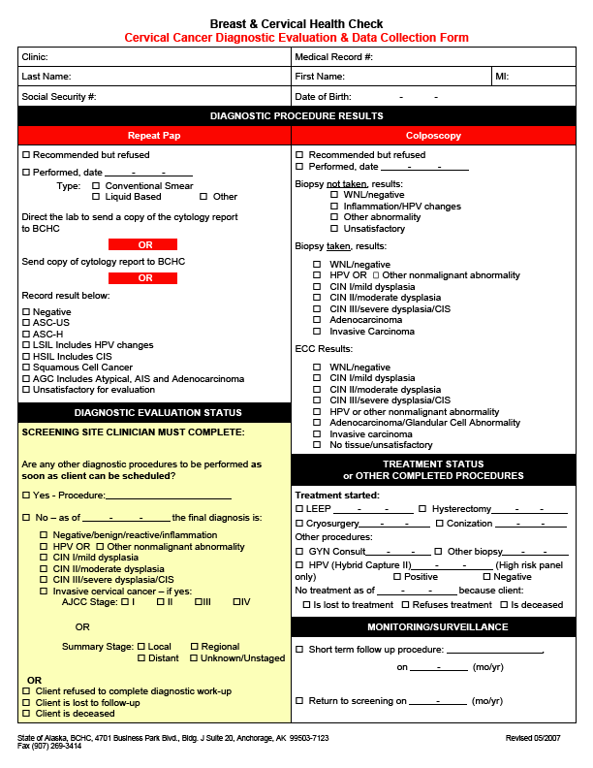
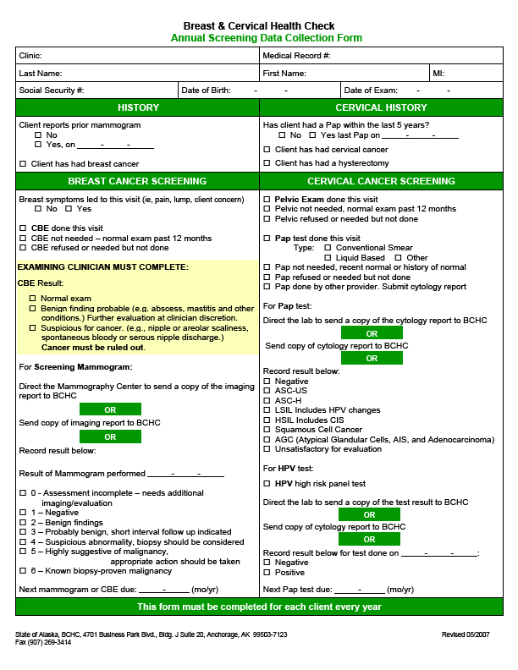
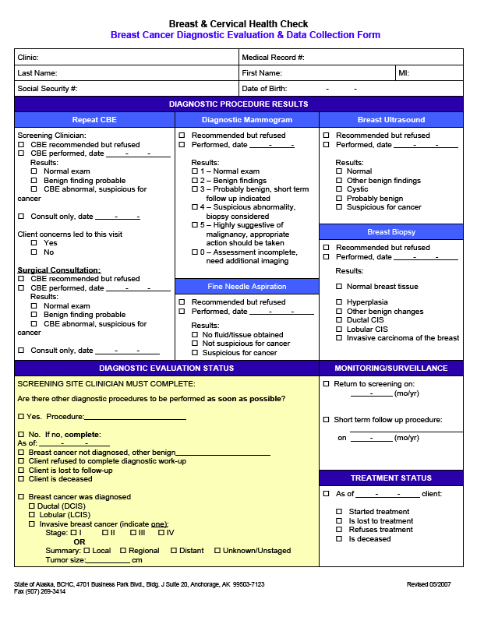
Data Forms & Chart Notes
BCHC distributes data reporting forms to providers to help communicate clinical information back to BCHC. These include:
Annual Screening Form Diagnostic Cervical Form Diagnostic Breast Form
These forms were designed to collect specific data that BCHC is required to report to the Centers for Disease Control & Prevention.
If preferred, Providers can send chart notes or reports in lieu of BCHC forms.

Slide 22
Data Forms & Chart Notes
The Annual Screening Data Collection Form is for reporting on a woman’s annual exam. This form includes CBE, pelvic exam and Pap test information.
The history section of this form is one way BCHC collects information about a client’s clinical history.
The clinical breast exam result should be reported here. Note that a result of “benign finding probable” may be worked up at the clinician's discretion.

Slide 23
Data Forms & Chart Notes
There are three ways to report Pap, HPV and mammogram results:
1. Direct the lab or imaging center to send results directly to BCHC
- or -
2. Forward the results to BCHC once you receive them
- or -
3. Report them using this form

Slide 24
Data Forms & Chart Notes
The Breast Cancer Diagnostic Evaluation Form is used by the Provider to notify BCHC about results of any diagnostic tests or exams that have been performed.
As an alternative to submitting this form, Providers may also notify BCHC of these results by sending a copy of the pathology or radiology report received from the Clinical Consultant or Resource Provider.

Slide 25
Data Forms & Chart Notes
The Cervical Cancer Diagnostic Evaluation Form is used by the Provider to notify BCHC about results of any diagnostic tests or exams that have been performed.
As an alternative to submitting this form, Providers may also notify BCHC of these results by sending a copy of the pathology or radiology report received from the Clinical Consultant or Resource Provider.

Slide 26
Billing & Reimbursement
Each claim received by BCHC must be matched against the following documents or information before it can be paid:
A signed Provider Agreement
A current Enrollment Form showing that the woman is eligible
Chart notes or BCHC forms with results for the date of service being billed
A CPT code from the approved BCHC CPT code list

Slide 27
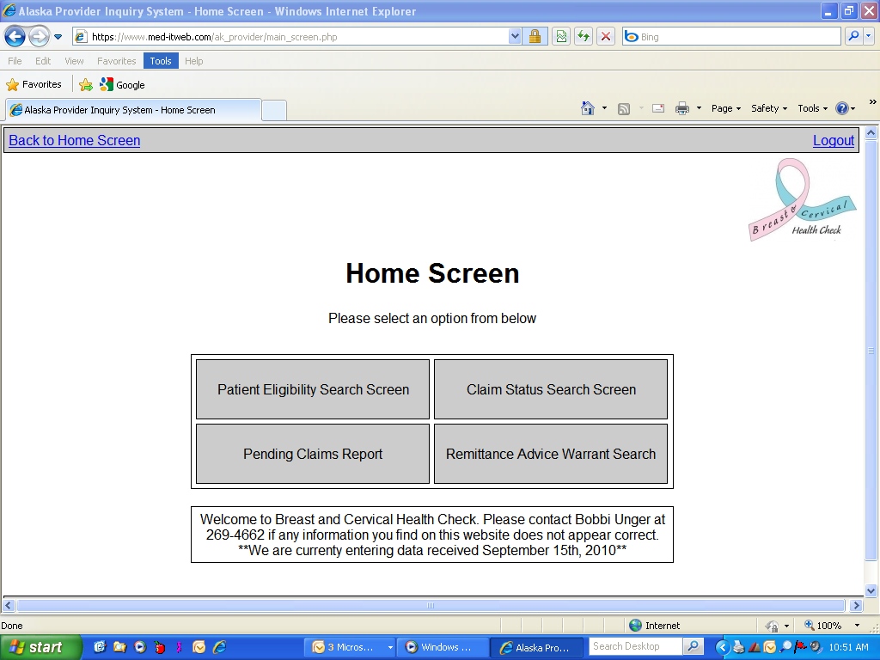
Billing & Reimbursement
Providers are given usernames and passwords to BCHC Provider site. This site allows the provider four functions:
Verify eligibility
Print pended claims report
Check claim status
Or print remittance advice
Providers have 24 hour access to this website.

Slide 28
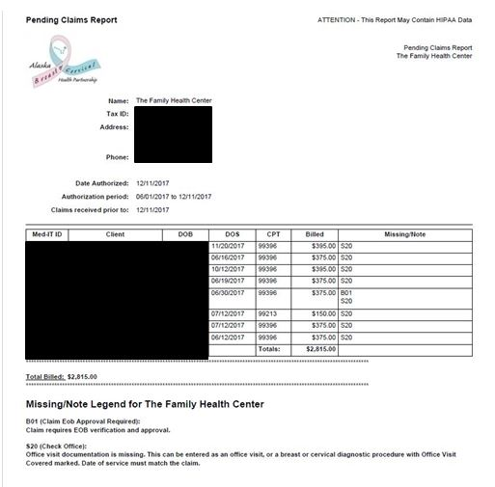
A Guide to Pended Claims Reports
Pended claims report gives the provider information on claims that we have received but are unable to process due to a lack of information.
This report will show you all the claims your facility has pending with us and why they are pending. On the bottom of your report, there will be a legend with what the pending codes mean.
The report is generated by the provider through the website.

Slide 29
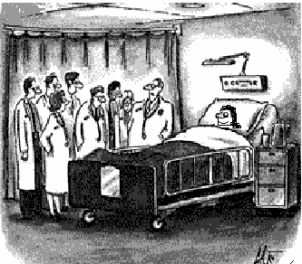
Billing & Reimbursement
Women with Insurance
“This client has a rare form of medical insurance.”
Women with insurance are eligible to be enrolled in BCHC.
BCHC collects insurance information from the client’s Annual Enrollment Form.

Slide 30
Billing & Reimbursement
Women with Insurance
BCHC must have an Explanation of Benefits (EOB) on file which shows denial of, or payment for, BCHC-approved services before the claim can be processed.
Claims pending for EOB are listed on the Pended Claims Report. This report is available on the provider website. The Eligibility screen lists any insurance information the client has put on her enrollment form.
If insurance has paid the claim, providers can simply mark that on the report and fax it back to BCHC, and it will be removed from any future reports.

Slide 31

Billing & Reimbursement
BCHC is the payer of last resort!
BCHC
Medicaid
Private Insurance

Slide 32
Referring Clients for Treatment Coverage
Women diagnosed with breast or cervical cancer, or a pre-cancerous condition¹ requiring treatment are eligible to be referred to the Division of Public Assistance (DPA) for Medicaid treatment coverage.
When treatment is necessary², BCHC staff follow a standard process for referring clients to DPA. Only clients screened by a BCHC provider will be referred using this process.
¹ A CIN I result does not automatically generate a referral to Medicaid. Providers must call 269-4662 and notify BCHC of their intent to treat a CIN I before a referral will be sent.
² Clients who require only routine monitoring services for a pre-cancerous breast or cervical condition (e.g., follow up breast examinations or mammograms, 6 month re-Pap) are not considered to need treatment.

Slide 33
Treatment Coverage
When BCHC receives a report indicating a diagnosis of breast or cervical cancer or CIN II or III in a BCHC enrolled client, the following are automatically generated:
1. A Medicaid application packet which is mailed to the woman. The application packet includes a self-addressed envelope so the woman can return the application to the Anchorage DPA “Coastal Field Office.” This office is the only one in the state which processes BC Medicaid Applications. Please advise the patient to mail her application to the enclosed address and do not take to the regular Medicaid office.
2. A referral to BC Medicaid Eligibility Technicians. They accept this notification as confirmation that the client is income eligible for BC Medicaid.
3. A letter to the Screening Provider notifying them that the Medicaid referral has been made. The letter includes the address that BCHC has on file for that woman. It is helpful to have the provider verify the address on the referral and notify BCHC if they have a more current address for the client.

Slide 34
Treatment Coverage
Screening Providers can call 269-4662 to verify that a Medicaid referral has been made if they don’t receive written notification after having sent in a pathology report that would warrant a referral.
Application to Medicaid does not guarantee enrollment or coverage. DPA makes all eligibility determinations for Medicaid.
Clients who have questions about the application process may call the Coastal Field Office of DPA in Anchorage at 269-8960, or 1-800-478-4364 from outside the Anchorage area.

Slide 35
We hope this PowerPoint Presentation has been helpful for you.
If you have questions about BCHC, our operations or any of the material presented here, please don’t hesitate to call our office at 269-4662 or 1-800-410-6266.
BCHC Staff
~ Jessica Quinn, Program Director
~ Bobbi Unger, Provider Support
~ Rasheeda Jamison, Data & Systems Manager
~ Tanya Anderson, Accounting Technician
~ Anne Remick, Outreach Manager
~ Kellie Doherty, Office Assistant

