Slide 1
CE Lesson 4 The Vocational Profile
Compiling and Organizing
Information & Insights

Slide 2
What is a Profile?
A Profile is a descriptive picture of a person with a disability developed through the process of discovery.
Marc Gold & Associates©
4101 Gautier-Vancleave Rd. Ste. 102
Gautier, MS 39553 (228) 497-6999

Slide 3
What is a Profile?
A Profile involves the development of:
a) positive and useful information,
b) a form that delineates the information and
c) a relationship with the person which allows access into the personal information of life.
Marc Gold & Associates©
4101 Gautier-Vancleave Rd. Ste. 102
Gautier, MS 39553 (228) 497-6999

Slide 4
What is a Profile?
A Profile is an alternative to the traditional ways of testing and evaluating persons with disabilities that involved comparison and competition.
Marc Gold & Associates©
4101 Gautier-Vancleave Rd. Ste. 102
Gautier, MS 39553 (228) 497-6999

Slide 5
Purpose of Profile:
Students under age 16- to guide work experiences most likely in the school which are unpaid.
Age 16 and up- to guide paid community job development and the structuring of experiences.
Exit year- to develop the job that the student will transition into post graduation.

Slide 6
Why do a Profile?
To capture all relevant aspects of the applicant’s life, including the complexity of their disability.
To find the passion that propels job development efforts.
To identify potential contributions for employment.
Marc Gold & Associates©
4101 Gautier-Vancleave Rd. Ste. 102
Gautier, MS 39553 (228) 497-6999

Slide 7
Why do a Profile?
To determine the applicant’s conditions for employment.
To capture the applicant’s range of preferences and any specific employment outcomes.
Marc Gold & Associates©
4101 Gautier-Vancleave Rd. Ste. 102
Gautier, MS 39553 (228) 497-6999

Slide 8
Why do a Profile?
To describe the applicant in a manner which prepares the job developer to effectively negotiate personalized job descriptions with employers.
To provide the foundation for employment planning by “putting together the puzzle pieces” in a manner so that the applicant can be understood by all who participate in the planning process.
Marc Gold & Associates©
4101 Gautier-Vancleave Rd. Ste. 102
Gautier, MS 39553 (228) 497-6999

Slide 9
If you do not choose to write a complete profile
Use the profile form as a guide for informal note taking.
Take pictures – useful for the portfolio.
Develop a narrative vignette that describes the person.
Marc Gold & Associates©
4101 Gautier-Vancleave Rd. Ste. 102
Gautier, MS 39553 (228) 497-6999

Slide 10
If you do not choose to write a complete profile
Use graphics or mapping strategies to describe the person.
Write only the most critically important aspects of the person.
Marc Gold & Associates©
4101 Gautier-Vancleave Rd. Ste. 102
Gautier, MS 39553 (228) 497-6999

Slide 11
If you do not choose to write a complete profile:
Hold a Discovery Meeting prior to planning that creates a kind of oral history of the individual.
Develop a presentation portfolio for representing the person to employers and community members.
Marc Gold & Associates©
4101 Gautier-Vancleave Rd. Ste. 102
Gautier, MS 39553 (228) 497-6999

Slide 12
Integrated Personal Report Organization
12 topics concerning the person are addressed:
Interests
Talents
Skills
Tasks as observed
Better/best ecological fit

Slide 13
Integrated Personal Report Organization
Best Learning mode/methodology, environment
Personal Resources(benefits, family support, savings, transportation)
Most engaging qualities
Situations to be avoided
Other skills that may be marketed

Slide 14
What are the Ideal Conditions of Employment?
Inside/Outside Work?
Morning/Afternoon/Evening
Clean/Not so Clean?
Equipment?
Team/Alone?
Noisy/Quiet?
Mentoring Opportunities?

Slide 15
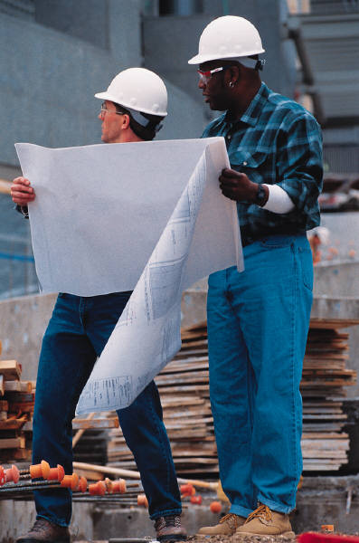
What “Off the Job” Supports Needed?
Often called “Job Related” Supports
May include:
Transport
Wearing clothes that are approprite
Laundry
Lunches
Budgeting

Slide 16
Specify the Person’s Ideal Work Schedule
As she can define it at this time
When is she most productive at work
What events during the week are important for her to attend? Month?
Will family vacations be a consideration?
Can the team specify her best days and hours for work at this time?

Slide 17
Example Vocational Profile
Civa’s Profile Blank
Dave’s Vocational Profile Sample
Key for Completing the Vocational Profile

Slide 18
Lesson 4 Goals to Be Accomplished
3-4 page Vocational Profile
Please e-mail to:
Roger@alaskachd.org

