Slide 1
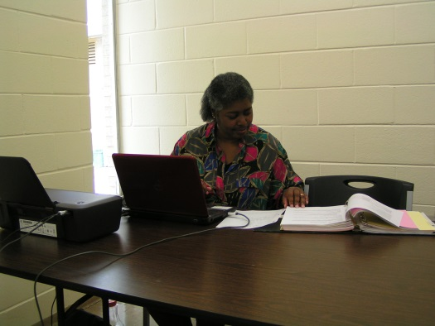
CE Lesson 5
Stage 4
Job or Business Development Plan
Employment Portfolios

Slide 2
Lists of 20*

Slide 3
List of 20 Rationale
20 worksites/employer for each theme renders a very good sample of people and businesses doing various tasks, using a variety of skills that correspond to aspects of the person’s various “Themes”
Remember that “Themes” are umbrellas of employment opportunities, not specific jobs
In combining skills, interests and abilities plus potential to create “themes”, the facilitator and person must now investigate several instances of where they may be best used

Slide 4
Lists of 20
Try not to “short change” this activity!
Make sure you are looking at “artesanal” businesses that may exist in the neighborhood, in another town or village or on the internet
When developing a self-employment opportunity, communicate with at least 20 businesses or business owners in person, on the phone or by email

Slide 5
Self-Employment or Job: How to Gather Information
Based upon the Vocational Profile, Ideal Conditions of Employment and Informational Interviews

Slide 6
Creation of Representation Materials
Contents of these vehicles:
Community and family involvement
Skills and talents representation
If possible, recommendations by community friends, former teachers, family members, in order to illustrate social capital
Any certificates of completion, service, etc.

Slide 7
Forms of Materials
Portfolio
Picture Book
Video Resume
Written Resume

Slide 8
Video Resumes
Kent Vincent.mpg
mcddmakeyour own portfolio.mpg

Slide 9
Portfolios/Picturebooks
Gather pictures of family, friends, fellow students, and community groups where the person is an active member
Caption pictures with “stories”
Include hard copies of certificate of appreciation, graduation, etc.
Make sure that the person can present it, herself

Slide 10
Lesson 5 Goals to Be Accomplished
Complete and report on lists of 20 results, places, and information gained
Begin work and complete representational portfolio or video (2 min.)

