Slide 1
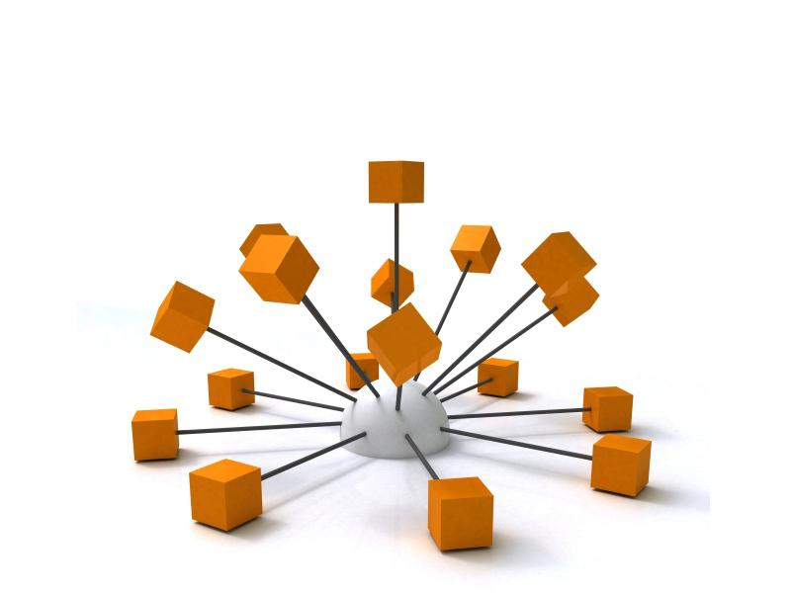
Customized Employment – Lesson I
Initial Information Gathering, Team Development &
Environmental Observations
Roger Shelley, Alaska Integrated Employment Initiative
Powerpoint Templates

Slide 2
The Discovery Staging Record
Who wants to go to work?
Name, contact information, contact information for family members, and any additional contact information
List of additional primary team members
List of initial responsibilities of the team members

Slide 3
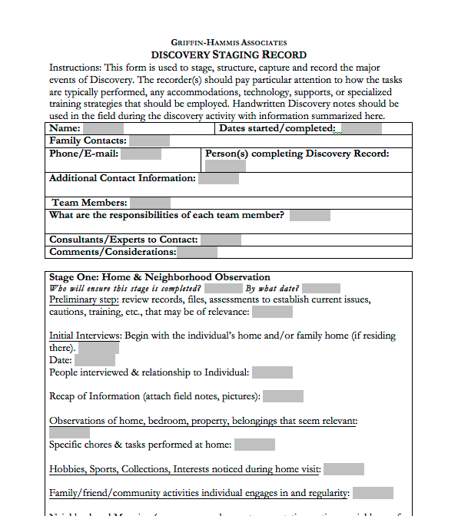
Discovery Staging Record

Slide 4
The Discovery Staging Record
Date started/completed
Name of the person completing the DSR
Consultants/experts to contact
Comments or considerations for initial information gathering

Slide 5

DSR Stage One:
Beginning Community-based Information Gathering
1st Consideration!: Who is responsible to complete this stage? By when?
Preliminary Step: Briefly review pertinent and recent information, including current issues, cautions, training, etc.

Slide 6
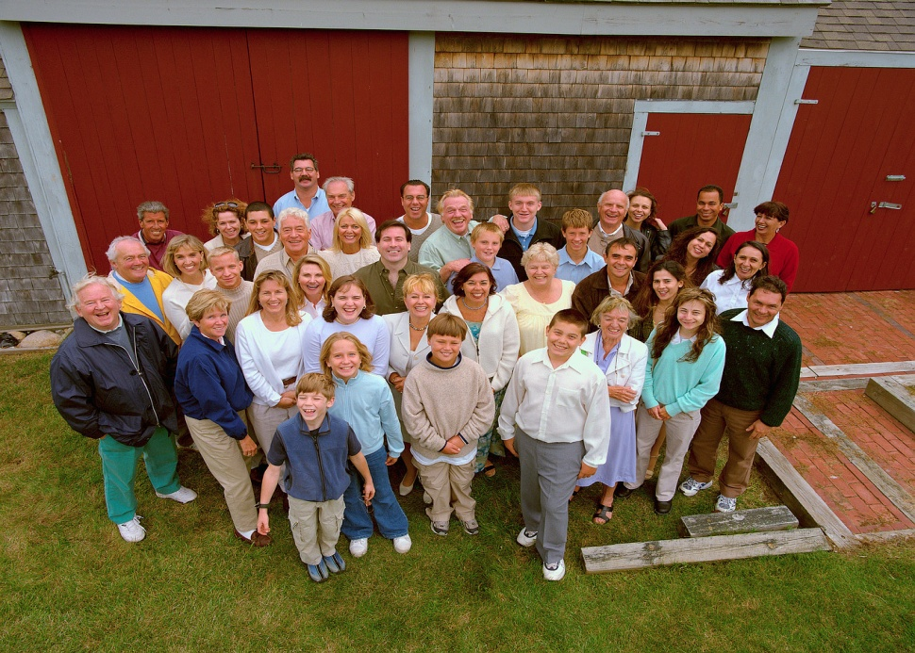
DSR Stage One:
Beginning Community-based Information Gathering
Initial Interviews: to be conducted by the jobseeker and employment facilitator
  Begin in the jobseeker’s home, if possible or in a place chosen by them
  Include the following information:
    The date of the interview
    People interviewed and their
    relationship to the person
    Recap of information (attached
    field notes, pictures, etc.)

Slide 7
DSR Stage One:
Beginning Community-based Information Gathering
Observations of person’s home:
  Specific chores or tasks performed at home
  Hobbies, sports, collections, interests noticed during the home visit
  Friend, family or community activities the person engages in, and their regularity

Slide 8
DSR Stage One:
Beginning Community-based Information Gathering
Observing and “mapping” the neighborhood:
  Places of business/employers nearby
  Transportation options
  Team member homes, neighbors who are connected to the person or family, neighborhood social activities, civic engagements (parks, gardens, play areas, etc.)

Slide 9
DSR Stage One:
Beginning Community-based Information Gathering
Observe and investigate any interests, skills, talents or performed tasks (take pictures or videos of any observed)
Discern and list any and all activities or situations /locations to be avoided
Use the “My ideal conditions of employment” Exercise or the “What works/what doesn’t” map

Slide 10
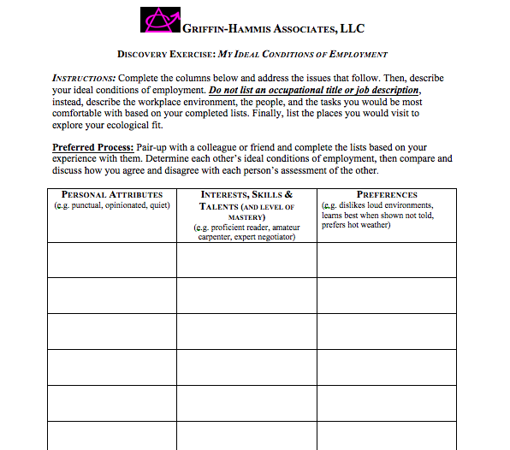
Discovery Exercise Form:
“Ideal” Conditions

Slide 11
DSR Stage 2:
Others to be interviewed
Name/Relationship/Role
Identify person responsible for each interview and completion date
Interview former school and/or rehab staff. List person responsible and completion date
List and interview any other family members and friends to be interviewed and what was learned from each

Slide 12
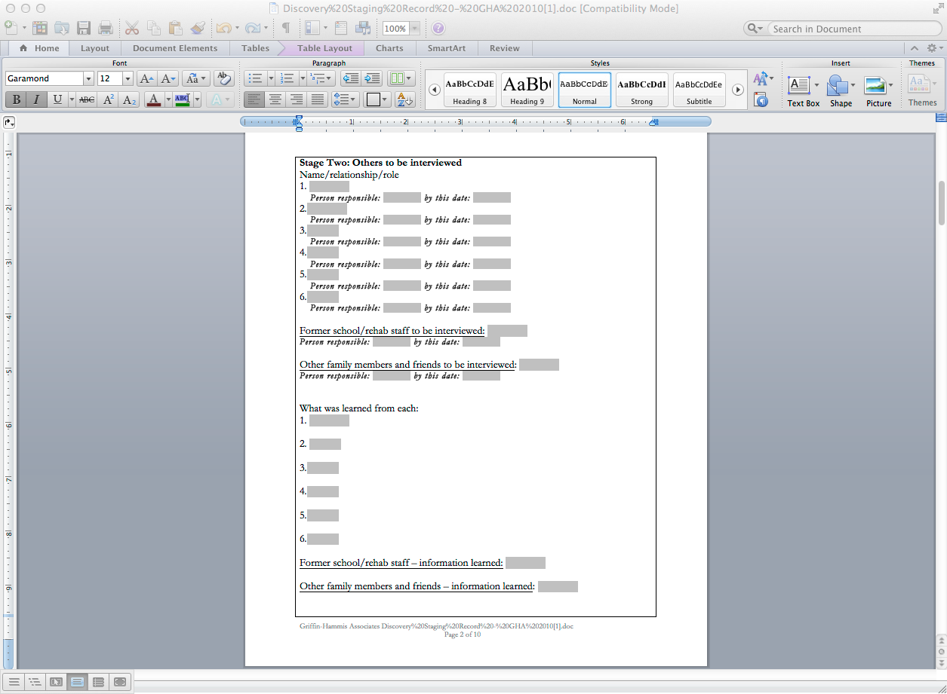
Discovery Staging Record
Page 2/Stage 2

Slide 13

Lesson 1
Goals to Be Accomplished
Introduce Customized Employment to family and/or local provider and community resource vendors
Obtain and list preliminary information, family members, group members, contact information, other team members, consultants, and considerations

Slide 14
Lesson 1
Goals to Be Accomplished
Begin Stage 1, interview, observe, and report
Stage 2, Others to be interviewed, what was learned from each, and report

Slide 15
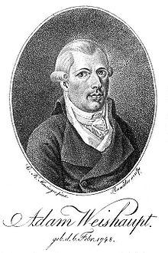
“And of all illumination which human reason can give, none is comparable to the discovery of what we are, our nature, our obligations, what happiness we are capable of, and what are the means of attaining it.”
Adam Weishaupt – German Philosopher

