Slide 1
Tools for Transitioning to Employment
Governor’s Council on Disabilities and Special Education

Slide 2
Employment First Concept
“Employment in the general workforce is the first and preferred outcome in the provision of publicly funded services for all working age citizens with disabilities, regardless of level of disability.”
Employment First Definition taken from Association for People Supporting Employment First, www.apse.org

Slide 3
Employment First - Why?
The employment rate of citizens with disabilities in the workforce is unacceptable
Access to “real jobs with real wages” helps avoid lives of poverty, dependence and isolation
It is presumed that all working age adults and youths with disabilities can work in jobs fully integrated within the community
working side-by-side with co-workers without disabilities earning minimum wage or higher

Slide 4
Employment First - Why?
As with all other individuals, employees with disabilities require assistance and support to ensure job success and should have access to those supports necessary to succeed in the workplace
All citizens, regardless of disability, have the right to:
pursue the full range of available employment opportunities
earn a living wage in a job of their choosing
based on their talents, skills, and interests

Slide 5
Characteristics of Employment First
Increase in the number of individuals with disabilities in the workforce:
in the community
earning minimum wage or higher with benefits
Increase opportunities to pursue self-employment
Employment is the first and preferred option when exploring goals and a life path for citizens with disabilities

Slide 6
More Characteristics
The expectation is that everyone will have the opportunity to work regardless of the severity of disability and assistance required.
Young people with disabilities have work experiences that are typical of other teenagers and young adults.
Employers value individuals with disabilities as an integral part of their workforce.
Individuals with disabilities have increased income, financial assets and economic wealth.

Slide 7
More Characteristics
Increase opportunities for employees with disabilities to advance in their careers.
Funding is sufficient to ensure quality services and supports are available as needed for long-term employment success.
A decision not to consider employment in the community for an individual is re-evaluated and documented on a regular basis.

Slide 8
How do we get there?
One of our Council Members, Rep. Millett is introducing an Employment First Bill for Alaska this session, House Bill 211.
This bill will require The Department of Health & Social Services, Department of Labor and Workforce Development, and Department of Education to make the prime objective in their provision of services to people with disabilities, becoming gainfully employed in an integrated setting.
Each department will also submit an annual progress report to the Alaska Mental Health Trust Authority.

Slide 9
Employment First
Employment First is not saying that people with disabilities have to be employed.
It does; however, presume that all people with disabilities can be employed in a competitive community environment and that such employment is the preferred outcome.
People with Disabilities…In Regular Jobs with Regular Wages!

Slide 10
Benefits of Employment for People with Disabilities:
Economic Self-Sufficiency:
“Working age people with disabilities are 2.8 times more likely to live in poverty than those without disabilities.” 2011 data for Alaska shows, only 47% of people with disabilities were employed as compared with 80% of the general population.
U.S. Department of Health and Human Services, Public Health Service . Healthy People 2010 Progress Review: Disability and Secondary Conditions. Washington, DC: Author; 2006.
Community employment gives people with disabilities an opportunity to earn a living wage and increase their self-sufficiency and independence.

Slide 11
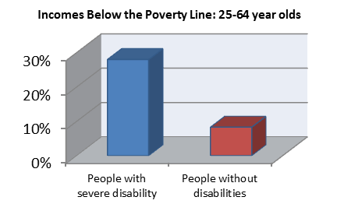
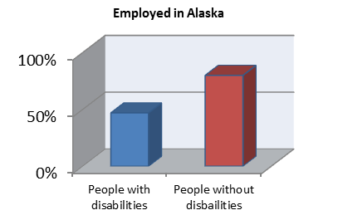
Benefits of Employment for People with Disabilities:
Economic Self-Sufficiency Continued:
World Institute on Disability, A Perfect Fit: People with Disabilities Building Assets. Accessed: August 1, 2011. http://wid.org/employment-and-economic-equity/access-to-assets/equity/equity-e-newsletter-october-2005/aperfect-fit-people-with-disabilities-building-assets
Source: American Community Survey, 2011

Slide 12
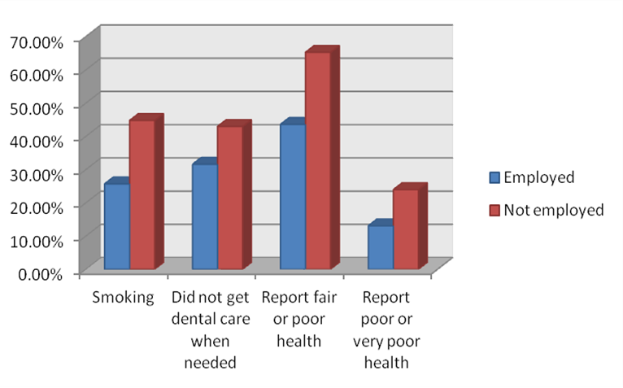
Benefits of Employment for People with Disabilities:
Better Health: Research finds that people with disabilities “…with any level of paid employment had significantly lower rates of smoking and better quality of life; self-reported health status was significantly higher…” “Employment, even at low levels, was associated with better health and health behaviors…”
Health Related Information of People with Disabilities by Employment Status:
“Employment as a health determinant for working-age, dually-eligible people with disabilities” Hall, Kurth, and Hunt (Disability and Health Journal) 2013.

Slide 13
The Facts Regarding Benefits, Services, & Employment:
How will my benefits be impacted by employment?
Through Ticket to Work and Medicaid Buy-In programs, people with disabilities can be employed and thus increase their income without losing their Medicaid benefits.
It is important to note that Alaska has both of these options for its citizens with disabilities to utilize and become employed while at the same time allowing the reassurance of not losing their benefits.
To learn more about these programs, visit http://jobs.alaska.gov/t2w/m and contact your local Alaska Job Center Ticket to Work Employment Network.
Can I get other services besides employment services?
Yes! Employment First does not mean that you can only receive employment services and it does not change or take away services you have, it merely makes employment a prime focus to be addressed and considered for working age Alaskans with disabilities.

Slide 14
How can you help your child be employable?
Partners in Employment has a free online self-study course developed by the MN Governor’s Council on Developmental Disabilities to assist people with disabilities who want to become employed.
http://mn.gov/mnddc/pipm/employment/
“Today, over 105,000 individuals with significant disabilities are experiencing more independence and inclusion through competitive, community-based careers.”
This can be your child!
“The only disability in life is a bad attitude.” – Scott Hamilton

Slide 15
Other national factors
National Governor’s Association Blue Print
“A Better Bottom Line: Employing Persons with Disabilities”
Sponsored by Governor Markell of Delaware- As chair of NGA asked all Governor’s to join him on this one initiative
Governor Parnell sent team from Alaska to Seattle workshop
The report talks about Alaska and our “State as Model Employer” initiative
Project SEARCH

Slide 16
Alaska’s Governor, Sean Parnell, has given an Executive Proclamation regarding Disability Employment Awareness Month!

Slide 17
State as a Model Employer (S.A.M.E.)
Work group partners with the Council include:
Division of Vocational Rehabilitation
Personnel & Labor Relations
the State ADA Coordinator’s office
2011 survey of state employees:
Voluntary self identification
16% of respondents said they experienced a disability
What is working well
Barriers
Improvements needed

Slide 18
S.A.M.E.
Provisional Hire
Hiring managers can hire DVR clients without going through the long hiring process
DVR can place qualified candidate in position for 4 months
If candidate works out well, they change from “provisional” to permanent

Slide 19
Project SEARCH
Students with intellectual or developmental disabilities:
age 18-21
in their last year of high school
on-the-job work experience for 9 months
Collaboration between:
the Council
Division of Vocational Rehabilitation (DVR)
local school districts
Dept. of Education and Early Development (DEED)
local businesses

Slide 20
Project SEARCH
Current Alaska sites:
Providence Hospital in Anchorage
Regional Hospital in Mat-Su
Hospital in Fairbanks
Hospital in Soldotna
Next target area is in Juneau.
There is an 87% employment rate after leaving the program, with jobs that primarily pay far better than minimum wage

Slide 21
Trust Beneficiaries Employment
In September 2013, Trustees voted to create a Beneficiary Employment focus area
FY14 funding
$188,000 in Trust funding (MHTAAR)
$150,000 to the Council to facilitate focus area and support the Disability Employment Initiative
FY15 funding (ongoing for up to 5 years)
$1 million in Trust funding
$200,000 to the Council

Slide 22
Alaska Integrated Employment Initiative
Goals are to:
Increase the number of youth and young adults with intellectual or developmental disabilities (I/DD) who are employed or self-employed in the community
Increase the percent of youth and young adults with I/DD served by DVR from 20% to 25%
Increase the hours worked by DVR participants with I/DD from 13 to 20 hours per week.
Double the number of youth and young adults with I/DD served by SDS who are employed or self-employed from 139 to 278

Slide 23
What is Customized Employment?
U.S. Department of Labor: “a flexible process designed to personalize the employment relationship between a job candidate and an employer in a way that meets the needs of both”
http://www.dol.gov/dol/media/webcast/20110610-odep-ce/20110610-odep-ce-3.htm

Slide 24
Who Benefits?
Employers
Individuals with disabilities
Service providers
Educational institutions
Government agencies
Families
Society as a whole

Slide 25
The Basics of Customized Employment
Discovery
Job Search Planning
Job Development & Negotiation
Post-Employment Support

Slide 26
The Mythical “Discovery”

Slide 27
The Mythical “Discovery” Process
“Discovering Personal Genius”TM
Home & Neighborhood Observation
Interviewing Others
Skills & Ecological fit
Review
Vocational Themes
Descriptive Narrative
Career Development
TM – Griffin Hammis & Associates, LLC

Slide 28
Starting at Home: A Discovery of Life at Home
Daily routines
Chores
Activities
History of the family
and individual
Get names of others
to interview

Slide 29
Tour the Neighborhood
Neighborhood
Surroundings
Safety concerns
Businesses
Culture
Transportation
Services

Slide 30
Interviewing Others (conversations)
Parents
Siblings
Teachers
Neighbors
Providers
(We’re looking for themes here…)

Slide 31
Skills & “Ecological” Fit
Interest levels
Performance
Demonstrated Skills
“Connections”
Relationships
Supports

Slide 32
Other Things to Review
Files
Memorabilia
Records
“Discovering Personal Genius” TM notes

Slide 33
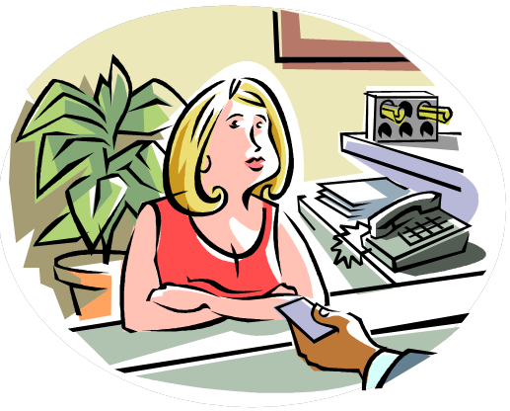
Vocational Themes
Shoot for a minimum of 3
Broad in scope

Slide 34
Descriptive Narrative: The Vocational Profile
“Ideal” conditions of employment
Skills
Interests
Culture
Environment
Work schedule
Supports
Equipment
Adaptations
3 “themes” & “60 jobs”

Slide 35
Job / Career Development
Approach specific employers
They’re always hiring!
Information interviews (I mean conversations) with employers
Ask them about their business
Tour the business
Thank them

Slide 36
Job Search / Planning
Align skills / interests with employer needs
Allow them to represent themselves!
Create a list of skills the job seeker can exhibit for the employer
Always expect employment!
Living wage
Production hours
Social hour
Integrated settings

Slide 37
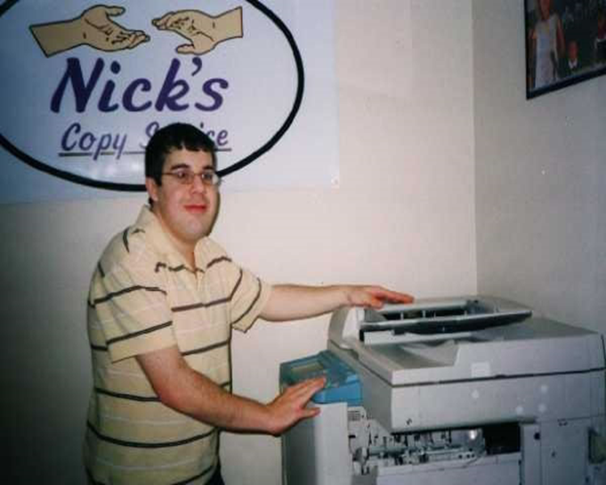
Customized Self-Employment
Nick’s Copy Service
mms://stream.ruralinstitute.umt.edu/broadband/cary/nick.wmv

Slide 38
What’s Happening Now with Customized Employment (CE)?
Training (on a smaller scale) has taken place via seminars over the past 10 years
DVR has a certification process for providers that want to bill for Discovery and CE services
The Disability Employment Initiative and the Alaska Integrated Employment Initiative are providing a two day “foundations” seminar in CE
July, 2013 – Anchorage & Fairbanks
November, 2013 – Juneau
February, 2013 – Kenai/Soldotna
May, 2013 – Rural site to be determined

Slide 39
What’s Happening now with Customized Employment?
AIEI staff are collaborating with other state and non-profit agencies on a comprehensive employment services system that addresses:
Social Security Work Incentives
The Ticket to Work program
Discovery and Customized Employment
Customized Self-Employment (microenterprise)
Long term employment supports
Assistive technologies needed for employment

Slide 40
Customize
Merriam Webster: to change (something) in order to fit the needs or requirements of a person, business, etc.
Customized Employment does both… at the same time!

Slide 41
Biggest questions and concerns
Will I lose my benefits?
Cash payments?
Health care?
How do I get the skills and experience I need?
What if I have to stop working?

Slide 42
Ticket to Work
Employment Counselors
Answers your questions about returning to work
Community Work Incentive Coordinators (CWICs)
Answers your questions about how work will impact your Social Security disability benefits

Slide 43
Social Security Disability Benefit Programs
Social Security Disability Insurance (SSDI)
Supplemental Security Income (SSI)
Both SSDI and SSI – “concurrent” benefits
*These programs should not be confused with non-disability benefits, which are called Social Security Retirement Benefits

Slide 44
What are Social Security Work Incentives?
Think of them as lifejackets. They help keep an individual “afloat” as you make your way towards self-sufficiency.

Slide 45
SSDI Work Incentives
SSA counts less than half of your earned income
$85 exclusions
After the first $85 are excluded, SSA counts half of your earnings against your SSI rate
You’re SSI will be reduced to zero if your earnings are high enough to reach the break-even point

Slide 46
SSI Work Incentives
Example:
$885 in wages
- 85 exclusions
$800
Half of $800 is $400
$400 counts against SSI
$710 your SSI rate
- 400
$310 adjusted SSI
Total Financial Outcome:
$ 885 wages
+ 310 SSI check
$1,195
You actually have more income when you go to work!

Slide 47
Concurrent Benefits Work Incentives
If you get both SSDI and SSI
All of the work incentives plus more that are not mentioned here apply to you

Slide 48
What is Asset Building???
Financial Literacy
Banking the “unbanked”
Acquiring Assets
Individual Development Accounts
Education
Homeownership
Economic Development (Small Businesses)
Equipment needed for Education and Small Businesses
Earned Income Tax Credit
Other?

Slide 49
Anchorage Financial Partnerships Network
Primary Strategies:
Free tax preparation
Financial “fitness”
Individual Development Accounts

Slide 50
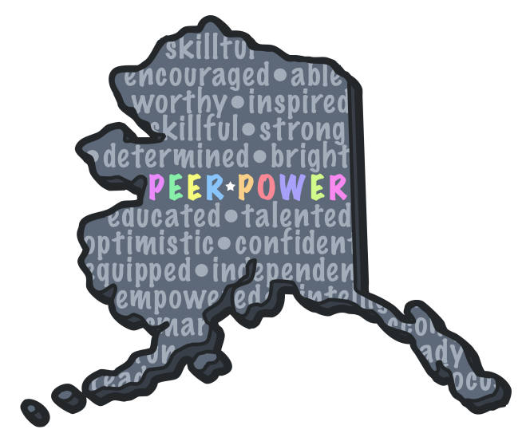
Peer Power
Peer Power is a self-advocacy group supported by the Governor's Council on Disabilities and Special Education, the Center for Human Development, and the Disability Law Center of Alaska.
The goal and purpose of the organization is to help self-advocates become empowered.
We work on such issues as:
employment for people with a disability,
self-advocate mentoring opportunities,
funding resources for the group,
and raising disability awareness throughout the community.
The group is comprised of elected board members, all of whom have an intellectual or developmental disability and area regional representatives throughout the State of Alaska.

Slide 51
Peer Power
Mission:
Peer Power educates, promotes, and advances the empowerment of disability self-advocates.
Working together, we can make a difference.
Empower and be empowered!

Slide 52
Join Peer Power
We are currently recruiting for new members.
Meetings are held monthly at the Governor's Council office via tele-conference statewide.
Contact Peer Power Advisor,
Tracy Golly, to get involved.
Governor’s Council on Disabilities & Special Education
Phone: 907-269-6972
Fax: 907-269-8995
Email: tracy.golly@alaska.gov
peerpower907@gmail.com
Address: 3601 C Street, Suite 740
Anchorage, AK 99503
Website: https://sites.google.com/site/peerpoweralaska/
Like Us on Facebook! https://www.facebook.com/pages/Peer-Power-of-Alaska/1404232596476441

Slide 53
Questions?

