Slide 1
Disability History
Governor’s Council for Disability and Special Education (GCDSE)
550 West 7th Ave. Suite 1230, Anchorage, AK 99501
Phone: 907-269-8462, Fax: 907-269-8995
Email: GCDSE@alaska.gov
Website: http://dhss.alaska.gov/gcdse

Slide 2
Work attribution
These slides were developed by GCDSE with the content adapted from the Disability History Exhibit by Advocating Change Together ACT (https://www.selfadvocacy.org/). Special appreciation is extended to the Portland Community College and the University of Alaska Anchorage for providing HTML* copies of the Exhibit and permission to use it online.
* ̶ language used to create electronic documents called pages that are displayed on the World Wide Web

Slide 3
3500 B.C.– 1000 A.D.
First written record of prosthesis (ancient sacred poem of India Rig-Veda, 3500 B.C.)
First recorded reference to developmental delay (obscure document “Therapeutic Papyrus of Thebes,” 1552 B.C.)
First consideration of what constitutes a good quality of life (philosopher Socrates challenges Athenian citizens, 470-399 B.C.)
“Born deaf become senseless and incapable of reason" (Aristotle, 355 B.C.)

Slide 4
3500 B.C.–1000 A.D. ̶ continued
Earliest medical schools in Alexandria (physician Herophilus founds one of the schools and finds connections between brain defects and disability)
Brain recognized as central organ of the nervous system and the seat of intellect (Greek physician and scholar Galen)

Slide 5
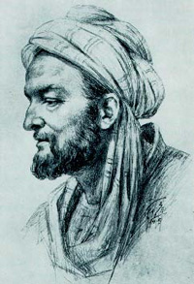
787 A.D.–1601 A.D.
Treatments for meningitis and hydrocephalus and levels of intellectual functioning (Physician Avicenna, 980-1037)
First asylum for abandoned infants (Datheus, archbishop of Milan, 787)
Laws requiring the state to take care of the "poor and disadvantaged” (Queen Elizabeth, between 1563-1601)

Slide 6
Religion in providing basic services and shaping attitudes toward people with disabilities
Fear and obsession with God; belief that people with disabilities get what they deserve; the notion of predestination
Exile; refuge in leper colonies or church shelters; establishing orphanages, hospitals, and homes for the blind and the aged

Slide 7
Renaissance (1300–1600)
Disability becomes a medical issue requiring the services of trained professionals
A gradual understanding of science leads to new and often painful treatments for persons with disabilities
Social reform and new ideas in education offer opportunities for people with developmental disabilities

Slide 8
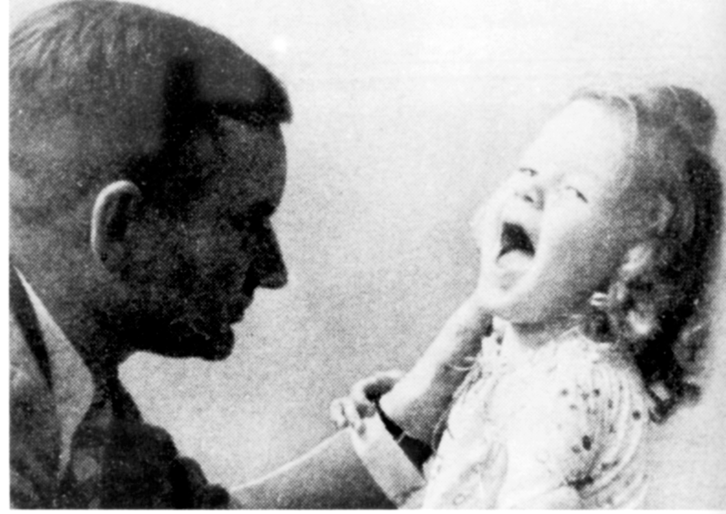
1800s–1930s
Quality of education and services decline as demand for institutional placement increases
Quality of services further declines as suspicion of all people who are different grows
Persons with developmental disabilities blamed for many of society's problems and are the first victims of the holocaust (over 200,000)

Slide 9
1900s
Disability no longer limited to moral or medical definitions; now viewed by many as a social construct
People with disabilities face new opportunities and threats as America's largest minority
Persons with intellectual disabilities advocate for themselves and others with disabilities, proclaiming “We are people first!"

Slide 10
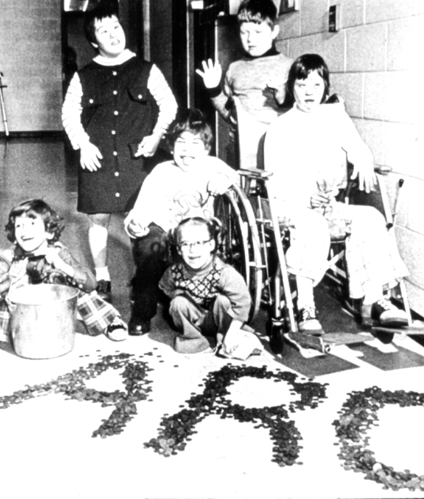
1911–1945
Services slowly available to persons with physical disabilities; many with developmental disabilities largely forgotten
Parents assert their leadership and begin to organize; parent advocacy leads to increased funding, better community services and larger institutions
Influenced by the civil and human rights struggles of the 1950s and 1960s, people with disabilities begin to fight for their rights

Slide 11
1946–Present
Activists remember the past and work to ensure that mistakes are not repeated
Naming and claiming of who we are, where we come from and where we want to go; disability culture
Seeking full participation
Community integration for everyone

Slide 12
More recourses to explore
Respect Ability: https://www.respectability.org/resources/education-resources-disability-issues/ (Education Resources on Disability Issues)
EveryBody: An Artifact History of Disability in America https://everybody.si.edu/
Pics4Learning: http://www.pics4learning.com (A copyright-friendly image library with content-related pictures)
World Health Organization. (2001). International Classification of Functioning, Disability and Health. Geneva, Switzerland: World Health Organization.

