Slide 1
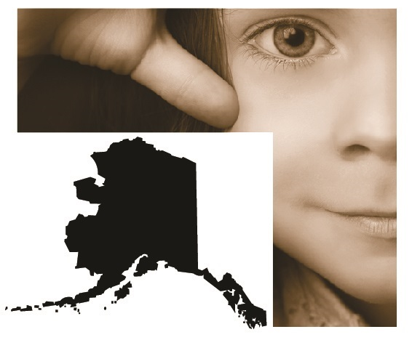
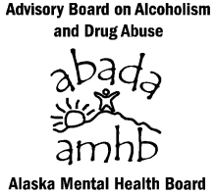
2011 & 2013
Youth Risk
Behavior Survey
Protective Factors
of Alaskan High
School Students
Alaska
Notes:
For more than 20 years Alaskans have been talking about “Assets”, Protective Factors”, “Resilience” and other strength that Alaska’s young people need to be successful. The Alaska Mental Health Board and Advisory Board on Alcoholism and Drug Abuse in an effort to support the many efforts across the state are providing this analysis to gain insight into what works.
Questions contact patrick.sidmore@alaska.gov

Slide 2
The Youth Risk Behavior Survey
The Youth Risk Behavior Survey (YRBS) is part of an epidemiological surveillance system that was established in 1990 by the Centers for Disease Control and Prevention (CDC).
This anonymous survey examines a minimum of six categories of adolescent behavior:
behaviors that result in unintentional and intentional injuries
tobacco use
alcohol and other drug use
sexual behaviors that can result in HIV infection, other sexually transmitted diseases (STD’s) and unintended pregnancies
dietary behaviors
physical activity
http://dhss.alaska.gov/dph/Chronic/Pages/yrbs/yrbs.aspx
Notes:
This analysis of the YRBS was done by the Alaska Mental Health Board & Advisory Board on Alcoholism and Drug Abuse Staff. The YRBS staff at the Chronic Disease Prevention and Health Promotion Section of the Division of Public Health manages this important survey along with The Centers for Disease Control and Prevention. They do amazing work and without their diligent efforts our state would not be able to monitor our young people.
The YRBS survey is supported by many major national organizations interested in the health of youth. The American Academy of Pediatrics, the American Association for Health Education, the American Association of School Administrators, the American Cancer Society, the American Medical Association, the National Association of Chronic Disease Directors, the Association of State and Territorial Health Officials, the Council of Chief State School Officers, the Institute for Youth Development, the National Association of State Boards of Education, the National Education Association, the National PTA, the National School Boards Association, and the Society of State Directors of Health, Physical Education and Recreation have provided letters of support.
Questions contact patrick.sidmore@alaska.gov

Slide 3
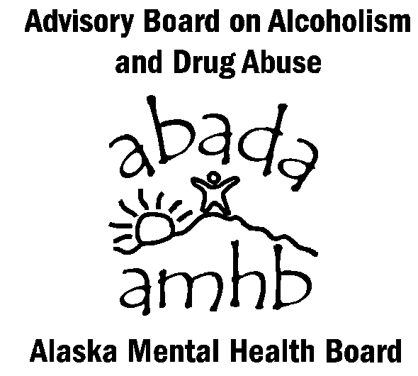
Just Some who Use the YRBS
Notes:
The Youth Risk Behavior Survey is conducted every two years in Alaskan high schools. The results are used in a variety of setting for making policy and for academic research. While no health survey is perfect the YRBS has been subjected to many different tests of validity and reliability and has been judged as a meaningful tool for use.
Frequently Asked Questions
Do students tell the truth on the YRBS questionnaire?
Research indicates data of this nature may be gathered as credibly from adolescents as from adults. Internal reliability checks help identify the small percentage of students who falsify their answers. To obtain truthful answers, students must perceive the survey as important and know procedures have been developed to protect their privacy and allow for anonymous participation.
In Alaska, the YRBS is supported by the Association of Alaska School Boards, the Alaska Association of School Administrators, the Alaska Association of Secondary School Principals, the Alaska Action for Healthy Kids, the Alaska Parent Teacher Association (PTA), the Alaska School Nurses Association, the All Alaska Pediatric Partnership, the American Heart Association, the American Lung Association, the American Cancer Society, the Alaska Health Education Consortium, the Alaska Tobacco Alliance, the Alaska Native Tribal Health Consortium, the Alaska Public Health Association, the Alaska Mental Health Trust Authority, the Alaska Mental Health Board, the United Way of Anchorage, United Way of Mat-Su, United Way of the Tanana Valley, United Way of Southeast Alaska, the Governor’s Advisory Board on Alcoholism and Drug Abuse, and others.

Slide 4
The Youth Risk Behavior Survey
The YRBS asks about other important part of young Alaskans’ lives:
Do you agree or disagree that you feel alone in your life?
Do you agree or disagree that in your community you feel like you matter to people?
How often does one of your parents talk with you about what you are doing in school?
Do you agree or disagree that your teachers really care about you and give you a lot of encouragement?
During an average week, on how many days do you take part in organized after school, evening, or weekend activities?
http://dhss.alaska.gov/dph/Chronic/Pages/yrbs/yrbs.aspx
Notes:
The results of student’s answers to these questions will be compared with some of the health risk responses from the broader survey. They will show how these questions are correlated or not with young Alaskans health.
Questions contact patrick.sidmore@alaska.gov

Slide 5
Resilience and Alaska’s Young People
What allows for one young Alaskan to succeed while another one struggles? We know from the Adverse Childhood Experiences Study that a rough start in life may lead to some very negative outcomes. This series of slides looks at questions of resilience or protective factors that the data demonstrate has a link to our young peoples outcomes.
Some of the efforts we do to support youth are better at protecting them from harmful behaviors than others. What can we do that will have the most impact on our young people and will help them develop themselves into the adults we need in our communities - where we live, work, and play?
Notes:
Adverse Childhood Experiences have been linked to all sorts of poor physical and behavioral health outcomes as well as lower economic and educational achievement. The vast majority of Alaskan teenagers are doing great! What can parents and communities do to get Alaska’s young people who are struggling on the right track?
Questions contact patrick.sidmore@alaska.gov

Slide 6
One Protective Factor Youth Risk Behavior Survey
Do teachers really care about you and encourage you?
Unless otherwise noted the data used for these analyses are the combined 2011 & 2013 data. The survey responses were analyzed from all traditional high school students who responded rather than a weighted sample because the analysis is examining the prevalence of one outcome within the context of, the presence or absence, of a specific protective factor. Though the combined local data sample was not scientifically selected and is also not weighted (as is the statewide sample), the large number of responses collected from a broad cross-section of traditional schools in both urban and rural school districts allows us the reasonable expectation that these data are representative of Alaska’s traditional high school students. Additionally, the large sample size of the local sample allows us to look at the finer gradations of the different response categories for the selected measures.
Source: State of Alaska Department of Health and Social Services, Division of Public Health, Chronic Disease & Health Promotion. Youth Risk Behavior Survey [YRBS] 2011 &/or 2013 data, http://dhss.alaska.gov/dph/Chronic/Pages/yrbs/yrbs.aspx . These results are from thousands of Alaska High School Students responses to the YRBS. These slides were prepared by the Alaska Mental Health Board and Advisory Board on Alcoholism and Drug Abuse. Contact patrick.sidmore@alaska.gov for questions.
Notes:
When using these data for 2011 & 2013 in each analysis the number of students answers used was over 12,000 responses. If only 2013 data were used than the number of student’s answers used was approximately 5,000. The most recent report from the Department of Education and Early Development is that there were more than 38,500 students in high schools across the state.
Questions contact patrick.sidmore@alaska.gov

Slide 7
Academic Achievement
Self Reported Grades and Students’ Perception of Their Teachers Caring and Encouraging Them
Notes:
Questions Asked
During the past 12 months, how would you describe your grades in school?
Mostly A's, Mostly B’s, Mostly C’s, Mostly D’s, Mostly F’s, None of these grades, Not sure
Do you agree or disagree that your teachers really care about you and give you a lot of encouragement?
Strongly Agree, Agree, Unsure, Disagree, Strongly Disagree
Answers were collapsed into three categories: Agree, Unsure and Disagree
Questions contact patrick.sidmore@alaska.gov

Slide 8
Source: State of Alaska Department of Health and Social Services, Division of Public Health, Chronic Disease & Health Promotion. Youth Risk Behavior Survey [YRBS] 2011 & 2013 data, http://dhss.alaska.gov/dph/Chronic/Pages/yrbs/yrbs.aspx. These results are from 13,333 Alaska High School Students responses to the YRBS.
Notes:
These columns each represent the universe of those Alaskan young people who reported their grades as mostly A’s, mostly B’s etc. Student’s who reported mostly F’s were more than three times as likely to also report that the think their teachers don’t care about them compared to the A’s group (29.3% and 8.8% respectively).
Questions contact patrick.sidmore@alaska.gov

Slide 9
Source: State of Alaska Department of Health and Social Services, Division of Public Health, Chronic Disease & Health Promotion. Youth Risk Behavior Survey [YRBS] 2011 & 2013 data, http://dhss.alaska.gov/dph/Chronic/Pages/yrbs/yrbs.aspx. These results are from 13,333 Alaska High School Students responses to the YRBS.
Notes:
These columns show the three different groups whose responses are positive, unsure and negative regarding their perceptions of their teachers support of them. The group where students report that “teachers care” demonstrate a higher percentage of Alaskans who also report A’s and B’s than the other two categories where they are unsure or don’t think their teachers care.
Questions contact patrick.sidmore@alaska.gov

Slide 10
Another way to look at it
What follows is drawn from the answers of Alaskan high school students to the biennial Youth Risk Behavior Survey (YRBS).
Slides show an hypothetical classroom of 30 students with and without a specific protective factor. In each case the YRBS data are used to display the array of possibilities for an outcome one would expect given the presents (or absence) of the protective factor.
For each comparison there are two slides which show what it would look like with the protective factor and without it using the Alaskan data. The third slide compares the two side by side.
Notes:
Some people do better with a different representation of the data. The following slides show them in a different way.
Questions contact patrick.sidmore@alaska.gov

Slide 11
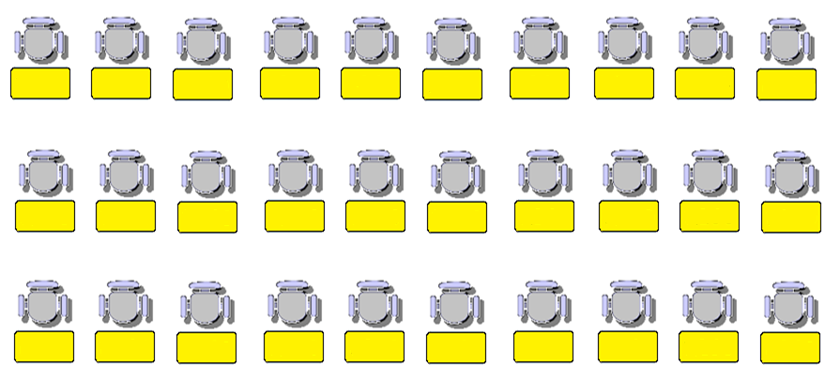
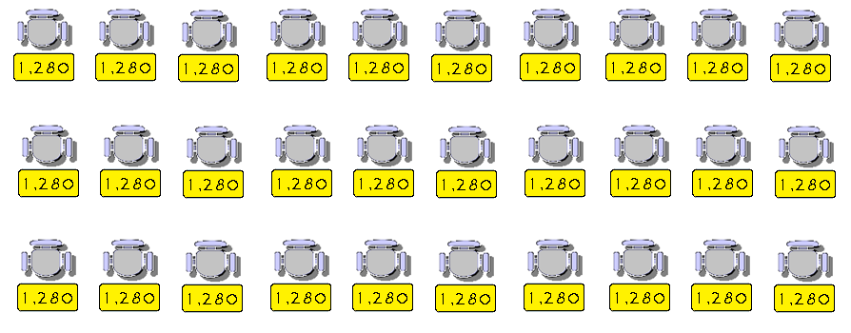
A Typical Alaskan High School Classroom of 30
Approximately 38,600 Alaskan Young People
Notes:
Animation in this slide - First click adds numbers into the desks showing that each desk represents about 1300 students. The second click pops up the estimated total of students in Alaskan High Schools
For the next several slides a classroom graphic will be used to display the data. This is a way for some people to better understand what these data mean in an individual classroom of 30. It is less precise but still allows for the general trends of the data to be fairly represented. Each desk represents about 1,300 students. This is estimate of Alaskan high school students is from October 1, 2013.
Questions contact patrick.sidmore@alaska.gov

Slide 12
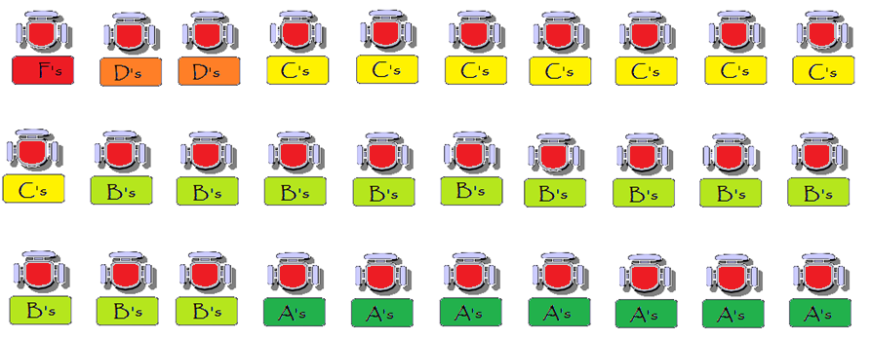
An Alaskan High School Classroom Filled with Students who Think That Their Teachers Don’t Care
Estimated Grade Point Average – 2.72
Source: State of Alaska Department of Health and Social Services, Division of Public Health, Chronic Disease & Health Promotion. Youth Risk Behavior Survey [YRBS] 2011 & 2013 data, http://dhss.alaska.gov/dph/Chronic/Pages/yrbs/yrbs.aspx.
Notes:
Using the answers for more than 13,000 Alaskan young people (un-weighted sample) this slides shows how those that reported thinking that their teachers don’t care have an estimated grade point average of 2.72 based on the students reported grades. An assumption was made that if they had mostly A’s than all their grades were A’s etc. This was done consistently across analyses for comparison purposes.
Questions contact patrick.sidmore@alaska.gov

Slide 13
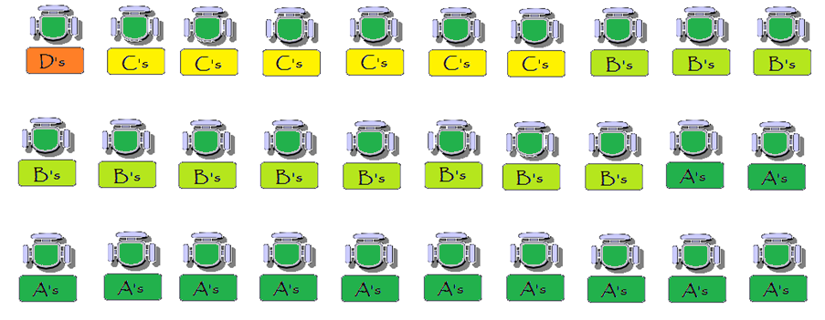
An Alaskan High School Classroom Filled with Students who Think That Their Teachers Care
Estimated Grade Point Average – 3.10
Source: State of Alaska Department of Health and Social Services, Division of Public Health, Chronic Disease & Health Promotion. Youth Risk Behavior Survey [YRBS] 2011 & 2013 data, http://dhss.alaska.gov/dph/Chronic/Pages/yrbs/yrbs.aspx.
Notes:
Using the answers for more than 13,000 Alaskan young people (un-weighted sample) this slides shows how those that reported thinking that their teachers don’t care have an estimated grade point average of 3.10 based on the students reported grades. An assumption was made that if they had mostly A’s than all their grades were A’s etc. This was done consistently across analyses for comparison purposes.
Questions contact patrick.sidmore@alaska.gov

Slide 14
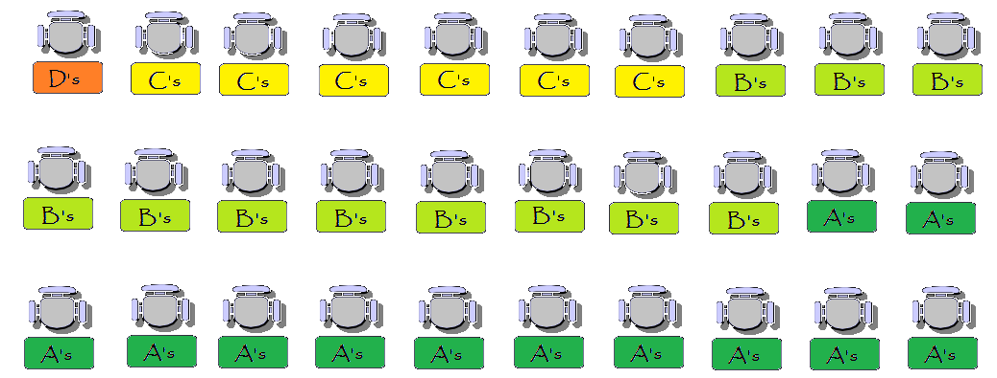
Don’t Care
Does it Matter if a Student Thinks Their Teachers Care?
Est.
GPA
2.72
Care
Est.
GPA
3.10
Source: State of Alaska Department of Health and Social Services, Division of Public Health, Chronic Disease & Health Promotion. Youth Risk Behavior Survey [YRBS] 2011 & 2013 data, http://dhss.alaska.gov/dph/Chronic/Pages/yrbs/yrbs.aspx.
Notes:
This slide compares the two hypothetical classrooms. One has students who don’t think their teachers care and their self reported grade point average is 2.72 while the second hypothetical classroom with 3.10 GPA is made up of students who think their teachers care. These analyses are based on the Alaskan YRBS data.
Questions contact patrick.sidmore@alaska.gov

Slide 15
Is it because students have good grades that
they are more likely to think their teachers care?
Or
Is it because students think teachers care that
they are more likely to have good grades?
Notes:
Correlation and causality are not the same thing. These data are demonstrating a link between self reported grades and Alaskan young people’s feelings about their teachers caring about them. A linear causality is not always easy to find, however, when we combine this analysis with what we know about how people think and feel and behave we can see how this link can help us be better as community members in support of young Alaskans. See next slide.
Questions contact patrick.sidmore@alaska.gov

Slide 16
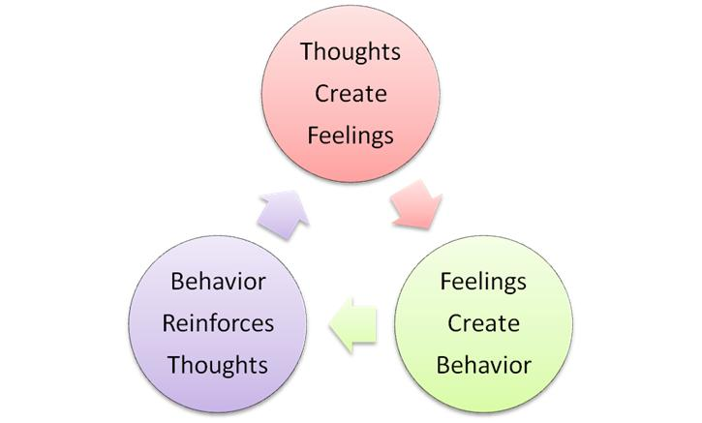
Cognitive Behavioral Therapy (CBT) is the most widely researched and evidence-based form of therapy. CBT has been shown in more than one thousand studies to be effective in treating a wide range of psychiatric disorders and psychological problems. In contrast to other forms of psychotherapy, cognitive therapy is focused on the present, practical and problem-solving oriented. http://www.nyccognitivetherapy.com/
Notes:
Cognitive Behavioral Therapy helps us to see that when we want to see changes in behavior we can intervene in how someone thinks about themselves and their world. These interventions can lead to a change in how people feel and finally behave. This model which is tested in numerous settings is both well researched and a common sense approach. We want Alaskan youth to make this cycle a positive one which both helps them to be successful as well as our communities stronger.
Questions contact patrick.sidmore@alaska.gov

Slide 17
Violence
Students in a Physical Fight in the Past Year by Whether or Not The Student Thinks Teachers Care
Notes:
Questions Asked
During the past 12 months, how many times were you in a physical fight?
O times, 1 Time, 2 or 3 times, 4 or 5 times, 6 or 7 times, 8 or 9 times, 10 or 11 times, 12 or more times
Answers were collapsed to: 0 times, 1 time, 2 or 3 times, 4 or 5 times, 6 or more times
Do you agree or disagree that your teachers really care about you and give you a lot of encouragement?
Strongly Agree, Agree, Unsure, Disagree, Strongly Disagree
Answers were collapsed into three categories: Agree, Unsure and Disagree
Questions contact patrick.sidmore@alaska.gov

Slide 18
Source: State of Alaska Department of Health and Social Services, Division of Public Health, Chronic Disease & Health Promotion. Youth Risk Behavior Survey [YRBS] 2011 & 2013 data, http://dhss.alaska.gov/dph/Chronic/Pages/yrbs/yrbs.aspx. These results are from 13,234 Alaska High School Students responses to the YRBS. This slide was prepared by the Alaska Mental Health Board and Advisory Board on Alcoholism and Drug Abuse.
Notes:
The first column represents all the students who didn’t get into a fight in the previous year – with percentages of whether or not they thought their teachers cared about them. In general as student’s reported more fights they also reported higher rates of thinking their teachers don’t care about them.
Questions contact patrick.sidmore@alaska.gov

Slide 19
Source: State of Alaska Department of Health and Social Services, Division of Public Health, Chronic Disease & Health Promotion. Youth Risk Behavior Survey [YRBS] 2011 & 2013 data, http://dhss.alaska.gov/dph/Chronic/Pages/yrbs/yrbs.aspx. These results are from 13,234 Alaska High School Students responses to the YRBS. This slide was prepared by the Alaska Mental Health Board and Advisory Board on Alcoholism and Drug Abuse.
Notes:
The left column represents all the Alaskan high school students who thought that their teachers cared about them and the right column represents those who thought that their teachers don’t care about them. The young Alaskans who thought their teachers cared were more likely to have no fights or fewer fights in the previous year.
Questions contact patrick.sidmore@alaska.gov

Slide 20
Another way to look at it
What follows is drawn from the answers of Alaskan high school students to the biennial Youth Risk Behavior Survey (YRBS).
Slides show an hypothetical classroom of 30 students with and without a specific protective factor. In each case the YRBS data are used to display the array of possibilities for an outcome one would expect given the presents (or absence) of the protective factor.
For each comparison there are two slides which show what it would look like with the protective factor and without it using the Alaskan data. The third slide compares the two side by side.
Notes:
Some people do better with a different representation of the data. The following slides show them in a different way.
Questions contact patrick.sidmore@alaska.gov

Slide 21
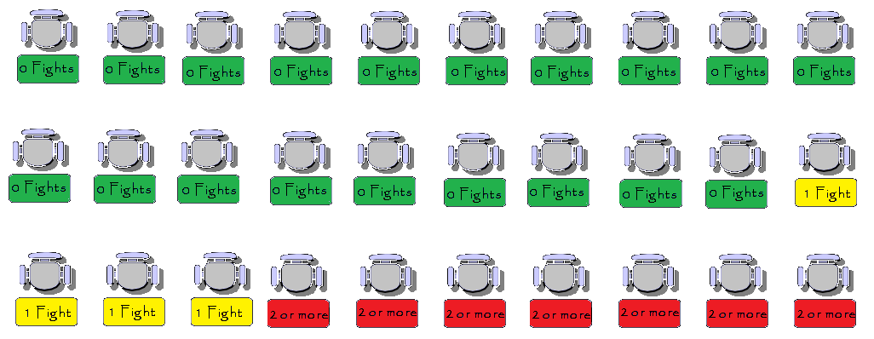
An Alaskan High School Classroom Filled with Students who Think That Their Teachers Don’t Care
Number of Physical Fights in the Past Year
Source: State of Alaska Department of Health and Social Services, Division of Public Health, Chronic Disease & Health Promotion. Youth Risk Behavior Survey [YRBS] 2011 & 2013 data, http://dhss.alaska.gov/dph/Chronic/Pages/yrbs/yrbs.aspx.
Notes:
A hypothetical classroom filled with Alaskan students who think that their teachers don’t care would look like this in terms of number of fights in the previous year.
Questions contact patrick.sidmore@alaska.gov

Slide 22
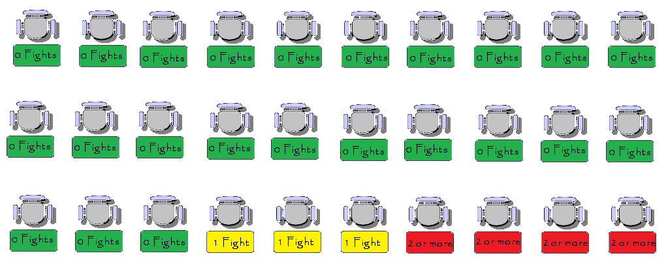
An Alaskan High School Classroom Filled with Students who Think That Their Teachers Care
Number of Physical Fights in the Past Year
Source: State of Alaska Department of Health and Social Services, Division of Public Health, Chronic Disease & Health Promotion. Youth Risk Behavior Survey [YRBS] 2011 & 2013 data, http://dhss.alaska.gov/dph/Chronic/Pages/yrbs/yrbs.aspx.
Notes:
A hypothetical classroom filled with Alaskan students who think that their teachers care would look like this in terms of number of fights in the previous year.
Questions contact patrick.sidmore@alaska.gov

Slide 23
Don’t Care
Does it Matter if a Student Thinks His/Her Teachers Care?
62% Were
Not in a
Fight in
the Past
Year
Care
77% Were
Not in a
Fight in
the Past
Year
Source: State of Alaska Department of Health and Social Services, Division of Public Health, Chronic Disease & Health Promotion. Youth Risk Behavior Survey [YRBS] 2011 & 2013 data, http://dhss.alaska.gov/dph/Chronic/Pages/yrbs/yrbs.aspx.
Notes:
The difference in percentages between those students who don’t think their teachers care and those who think their teachers care for participating in fights is large. These different scenarios represent a difference of approximately 5,800 Alaskan high school students fighting.
Questions contact patrick.sidmore@alaska.gov

Slide 24
Is it because students who don’t get into fights
are more likely to think their teachers care?
Or
Is it because students think teachers care that
they are more likely to not get into fights?
Notes:
Students who report fighting in the previous year are also more likely to report that they perceive that their teachers don’t care. Causality and correlation are not the same thing. We don’t know which came first from these data but using the framework outlined in the next slide we may be able to get a better outcome from each question through a plan of action to address both issues.
Questions contact patrick.sidmore@alaska.gov

Slide 25
Cognitive Behavioral Therapy (CBT) is the most widely researched and evidence-based form of therapy. CBT has been shown in more than one thousand studies to be effective in treating a wide range of psychiatric disorders and psychological problems. In contrast to other forms of psychotherapy, cognitive therapy is focused on the present, practical and problem-solving oriented. http://www.nyccognitivetherapy.com/
Notes:
Cognitive Behavioral Therapy helps us to see that when we want to see changes in behavior we can intervene in how someone thinks about themselves and their world. These interventions can lead to a change in how people feel and finally behave. This model which is tested in numerous settings is both well researched and a common sense approach. We want Alaskan youth to make this cycle a positive one which both helps them to be successful as well as our communities stronger.
Questions contact patrick.sidmore@alaska.gov

Slide 26
One Protective Factor Youth Risk Behavior Survey
Do you feel you matter in your community?
Unless otherwise noted the data used for these analyses are the combined 2011 & 2013 data. The survey responses were analyzed from all traditional high school students who responded rather than a weighted sample because the analysis is examining the prevalence of one outcome within the context of, the presence or absence, of a specific protective factor. Though the combined local data sample was not scientifically selected and is also not weighted (as is the statewide sample), the large number of responses collected from a broad cross-section of traditional schools in both urban and rural school districts allows us the reasonable expectation that these data are representative of Alaska’s traditional high school students. Additionally, the large sample size of the local sample allows us to look at the finer gradations of the different response categories for the selected measures.
Source: State of Alaska Department of Health and Social Services, Division of Public Health, Chronic Disease & Health Promotion. Youth Risk Behavior Survey [YRBS] 2011 &/or 2013 data, http://dhss.alaska.gov/dph/Chronic/Pages/yrbs/yrbs.aspx . These results are from thousands of Alaska High School Students responses to the YRBS. These slides were prepared by the Alaska Mental Health Board and Advisory Board on Alcoholism and Drug Abuse. Contact patrick.sidmore@alaska.gov for questions.
Notes:
When using these data for 2011 & 2013 in each analysis the number of students answers used was over 12,000 responses. If only 2013 data were used than the number of student’s answers used was approximately 5,000. The most recent report from the Department of Education and Early Development is that there were more than 38,500 students in high schools across the state.
Questions contact patrick.sidmore@alaska.gov

Slide 27
Mental Health
Students Who Considered Suicide in The Previous Year by Whether They Perceive They Matter in Their Community
Notes:
Questions Asked
During the past 12 months, did you ever seriously consider attempting suicide?
Answer – Yes, No
Do you feel like you matter to people in your community?
Answers - Strongly Agree, Agree, Not Sure, Disagree, Strongly Disagree
The answers were collapsed down into three categories: Matter, Not Sure, Doesn’t Matter
Questions contact patrick.sidmore@alaska.gov

Slide 28
Source: State of Alaska Department of Health and Social Services, Division of Public Health, Chronic Disease & Health Promotion. Youth Risk Behavior Survey [YRBS] 2011 & 2013 data, http://dhss.alaska.gov/dph/Chronic/Pages/yrbs/yrbs.aspx. These results are from 13,256 Alaska High School Students responses to the YRBS. This slide was prepared by the Alaska Mental Health Board and Advisory Board on Alcoholism and Drug Abuse.
Notes:
The column on the left represent all the students who answered yes to the question about whether or not they considered suicide in the past year. The one on the right has the results for those who answered no. Students who answered yes were nearly 3 times as likely to say that they feel they don’t matter in their communities then those who answered no.
Questions contact patrick.sidmore@alaska.gov

Slide 29
Source: State of Alaska Department of Health and Social Services, Division of Public Health, Chronic Disease & Health Promotion. Youth Risk Behavior Survey [YRBS] 2011 & 2013 data, http://dhss.alaska.gov/dph/Chronic/Pages/yrbs/yrbs.aspx. These results are from 13,256 Alaska High School Students responses to the YRBS. This slide was prepared by the Alaska Mental Health Board and Advisory Board on Alcoholism and Drug Abuse.
Notes:
The column on the left represents all the students who reported that they mattered to their communities. The other columns are labeled accordingly. Alaska young people who think they matter were more than three times less likely to report they considered suicide in the previous year then those who think they don’t matter.
Questions contact patrick.sidmore@alaska.gov

Slide 30
Another way to look at it
What follows is drawn from the answers of Alaskan high school students to the biennial Youth Risk Behavior Survey (YRBS).
Slides show an hypothetical classroom of 30 students with and without a specific protective factor. In each case the YRBS data are used to display the array of possibilities for an outcome one would expect given the presents (or absence) of the protective factor.
For each comparison there are two slides which show what it would look like with the protective factor and without it using the Alaskan data. The third slide compares the two side by side.
Notes:
Some people do better with a different representation of the data. The following slides show them in a different way.
Questions contact patrick.sidmore@alaska.gov

Slide 31
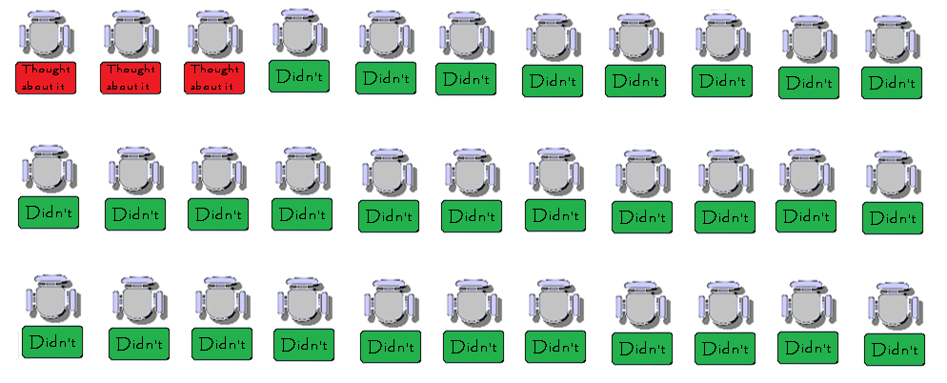
An Alaskan High School Classroom Filled with Students Who Think They Matter in Their Community
11% Considered Suicide in a Year
Source: State of Alaska Department of Health and Social Services, Division of Public Health, Chronic Disease & Health Promotion. Youth Risk Behavior Survey [YRBS] 2011 & 2013 data, http://dhss.alaska.gov/dph/Chronic/Pages/yrbs/yrbs.aspx.
Notes:
In a hypothetical classroom with young Alaskans who all think that they matter in their communities the data suggests that 89% would not consider suicide in the previous year if asked.
Questions contact patrick.sidmore@alaska.gov

Slide 32
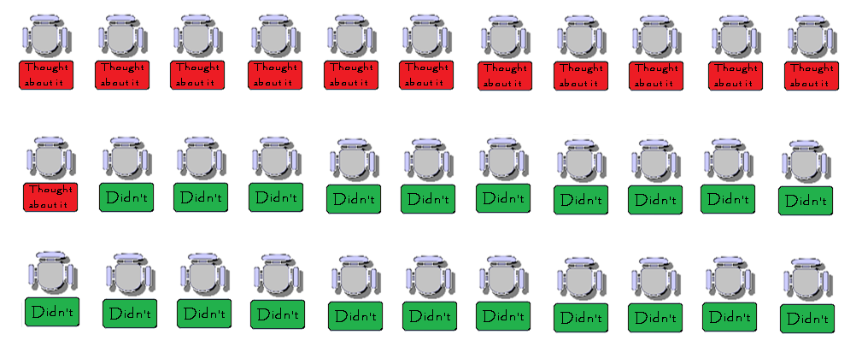
An Alaskan High School Classroom Filled with Students Who Don’t Think They Matter in Their Community
35% Considered Suicide in a Year
Source: State of Alaska Department of Health and Social Services, Division of Public Health, Chronic Disease & Health Promotion. Youth Risk Behavior Survey [YRBS] 2011 & 2013 data, http://dhss.alaska.gov/dph/Chronic/Pages/yrbs/yrbs.aspx.
Notes:
In a hypothetical classroom with young Alaskans who all think that they don’t matter in their communities the data suggests that 65% would not consider suicide in the previous year if asked.
Questions contact patrick.sidmore@alaska.gov

Slide 33
They Don’t Think They Matter
Does it Make a Difference if a Student Thinks
He or She Matters in Their Communities?
35%
Considered
Suicide
They Think They Matter
11%
Considered
Suicide
Source: State of Alaska Department of Health and Social Services, Division of Public Health, Chronic Disease & Health Promotion. Youth Risk Behavior Survey [YRBS] 2011 & 2013 data, http://dhss.alaska.gov/dph/Chronic/Pages/yrbs/yrbs.aspx.
Notes:
The difference between these two scenarios represents approximately 9,200 Alaskan students annually
Questions contact patrick.sidmore@alaska.gov

Slide 34
Is it because students think they matter in their
communities that they are less likely to consider
suicide?
Or
Is it because students have considered suicide in
the past year that they are less likely to think they matter in their communities?
Notes:
Clearly students feeling like they matter in their communities is linked with whether or not they considered suicide in the past year and visa versa. What are thoughts about this comparison of Alaskan young people’s answers
Questions contact patrick.sidmore@alaska.gov

Slide 35
Cognitive Behavioral Therapy (CBT) is the most widely researched and evidence-based form of therapy. CBT has been shown in more than one thousand studies to be effective in treating a wide range of psychiatric disorders and psychological problems. In contrast to other forms of psychotherapy, cognitive therapy is focused on the present, practical and problem-solving oriented. http://www.nyccognitivetherapy.com/
Notes:
Cognitive Behavioral Therapy helps us to see that when we want to see changes in behavior we can intervene in how someone thinks about themselves and their world. These interventions can lead to a change in how people feel and finally behave. This model which is tested in numerous settings is both well researched and a common sense approach. We want Alaskan youth to make this cycle a positive one which both helps them to be successful as well as our communities stronger.
Questions contact patrick.sidmore@alaska.gov

Slide 36
Substance Abuse
Past Month Drinking by Perception of Whether Students Think They Matter to Their Communities
Notes:
Questions Asked
During the past 30 days, on how many days did you have at least one drink of alcohol?
0 days, 1 day, 2 days, 3 to 5 days, 6 to 9 days, 10 to 19 days, 20 or more days
Answers were collapsed to 0 days, 1 to 2 days, 3 to 5 days, 6 or more days
Do you feel like you matter to people in your community?
Answers - Strongly Agree, Agree, Not Sure, Disagree, Strongly Disagree
The answers were collapsed down into three categories: Matter, Not Sure, Doesn’t Matter
Questions contact patrick.sidmore@alaska.gov

Slide 37
Source: State of Alaska Department of Health and Social Services, Division of Public Health, Chronic Disease & Health Promotion. Youth Risk Behavior Survey [YRBS] 2011 & 2013 data, http://dhss.alaska.gov/dph/Chronic/Pages/yrbs/yrbs.aspx. These results are from 12,107 Alaska High School Students responses to the YRBS. This slide was prepared by the Alaska Mental Health Board and Advisory Board on Alcoholism and Drug Abuse.
Notes:
The column on the left represents all Alaskan students who reported no drinking in the previous 30 days and indicates that about 14% of them think they don’t matter in their communities. The columns to the right represent those students who did report drinking in the previous 30 days and as the number of reported days of drinking rises so does the rate of students who think they don’t matter in their communities.
Questions contact patrick.sidmore@alaska.gov

Slide 38
Source: State of Alaska Department of Health and Social Services, Division of Public Health, Chronic Disease & Health Promotion. Youth Risk Behavior Survey [YRBS] 2011 & 2013 data, http://dhss.alaska.gov/dph/Chronic/Pages/yrbs/yrbs.aspx. These results are from 12,107 Alaska High School Students responses to the YRBS. This slide was prepared by the Alaska Mental Health Board and Advisory Board on Alcoholism and Drug Abuse.
Notes:
The column on the left represents all the students who think they matter in their communities and they are more likely to report no drinking than their peers who think they don’t matter.
Questions contact patrick.sidmore@alaska.gov

Slide 39
Another way to look at it
What follows is drawn from the answers of Alaskan high school students to the biennial Youth Risk Behavior Survey (YRBS).
Slides show an hypothetical classroom of 30 students with and without a specific protective factor. In each case the YRBS data are used to display the array of possibilities for an outcome one would expect given the presents (or absence) of the protective factor.
For each comparison there are two slides which show what it would look like with the protective factor and without it using the Alaskan data. The third slide compares the two side by side.
Notes:
Some people do better with a different representation of the data. The following slides show them in a different way.
Questions contact patrick.sidmore@alaska.gov

Slide 40
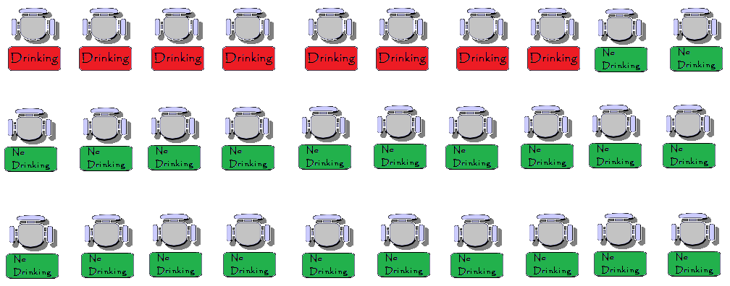
An Alaskan High School Classroom Filled with Students Who Do Think They Matter in Their Community
73% Didn’t Drink - 27% Did Drink
Source: State of Alaska Department of Health and Social Services, Division of Public Health, Chronic Disease & Health Promotion. Youth Risk Behavior Survey [YRBS] 2011 & 2013 data, http://dhss.alaska.gov/dph/Chronic/Pages/yrbs/yrbs.aspx.
Notes:
In this hypothetical classroom all students think they matter in their community. The Alaskan data was used to create it.
Questions contact patrick.sidmore@alaska.gov

Slide 41
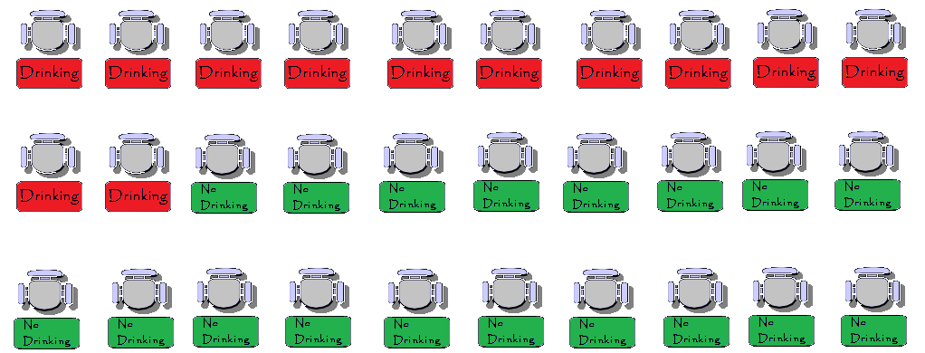
An Alaskan High School Classroom Filled with Students Who Don’t Think They Matter in Their Community
60% Didn’t Drink - 40% Did Drink
Source: State of Alaska Department of Health and Social Services, Division of Public Health, Chronic Disease & Health Promotion. Youth Risk Behavior Survey [YRBS] 2011 & 2013 data, http://dhss.alaska.gov/dph/Chronic/Pages/yrbs/yrbs.aspx.
Notes:
In this hypothetical classroom all students think they don’t matter in their community. The Alaskan data was used to create it.
Questions contact patrick.sidmore@alaska.gov

Slide 42
Students Don’t Think They Matter
Does it Make a Difference if a Student Thinks He/She Matters to The Community?
60% of
Students
Are Not
Drinking
Students Think They Matter
73% of
Students
Are Not
Drinking
Source: State of Alaska Department of Health and Social Services, Division of Public Health, Chronic Disease & Health Promotion. Youth Risk Behavior Survey [YRBS] 2011 & 2013 data, http://dhss.alaska.gov/dph/Chronic/Pages/yrbs/yrbs.aspx.
Notes:
It appears from this data that if we are using the method to get more students to feel like they matter to reduce underage drinking and our rates are similar to the state rate we might need to look for a different intervention. That doesn’t mean that this protective factor is not valuable for other important health outcome we might want for our youth (see “considered suicide analysis above).
Questions contact patrick.sidmore@alaska.gov

Slide 43
Is it because students think they matter in their
communities that they are less likely to be
drinking in the past month?
Or
Is it because students have been drinking in
the past month that they are less likely to
think they matter in their communities?
Notes:
There is a link between these two measures but when we look at it’s potential impact assuming our community has state levels of answers to these two question we probably would want to pursue another “protective factor” to impact drinking. If however, our rate of students who feel they matter in the community is very low than this might prove to be helpful in reducing drinking. Feeling that they matter does seem to have a strong link to other health matters.
Questions contact patrick.sidmore@alaska.gov

Slide 44
Cognitive Behavioral Therapy (CBT) is the most widely researched and evidence-based form of therapy. CBT has been shown in more than one thousand studies to be effective in treating a wide range of psychiatric disorders and psychological problems. In contrast to other forms of psychotherapy, cognitive therapy is focused on the present, practical and problem-solving oriented. http://www.nyccognitivetherapy.com/
Notes:
Cognitive Behavioral Therapy helps us to see that when we want to see changes in behavior we can intervene in how someone thinks about themselves and their world. These interventions can lead to a change in how people feel and finally behave. This model which is tested in numerous settings is both well researched and a common sense approach. We want Alaskan youth to make this cycle a positive one which both helps them to be successful as well as our communities stronger.
Questions contact patrick.sidmore@alaska.gov

Slide 45
Mental Health
Students who Felt So Sad and Hopeless in the Past Year for Two Weeks or More That They Stopped Doing Regular Activities
by
Whether or Not The Student Feels They Matter to Their Community
Notes:
Questions Asked
During the past 12 months, did you ever feel so sad or hopeless almost every day for two weeks or more in a row that you stopped doing some usual activities?
Yes, No
Do you feel like you matter to people in your community?
Answers - Strongly Agree, Agree, Not Sure, Disagree, Strongly Disagree
The answers were collapsed down into three categories: Matter, Not Sure, Doesn’t Matter
Questions contact patrick.sidmore@alaska.gov

Slide 46
Source: State of Alaska Department of Health and Social Services, Division of Public Health, Chronic Disease & Health Promotion. Youth Risk Behavior Survey [YRBS] 2011 & 2013 data, http://dhss.alaska.gov/dph/Chronic/Pages/yrbs/yrbs.aspx. These results are from 12,995 Alaska High School Students responses to the YRBS. This slide was prepared by the Alaska Mental Health Board and Advisory Board on Alcoholism and Drug Abuse.
Notes:
The column on the left displays the responses from those Alaskan high school students who reported that they had shown depressive symptoms in the previous year and they were significantly more likely to feel they didn’t matter in their community than their peers who answered no to depressive symptoms.
Questions contact patrick.sidmore@alaska.gov

Slide 47
Source: State of Alaska Department of Health and Social Services, Division of Public Health, Chronic Disease & Health Promotion. Youth Risk Behavior Survey [YRBS] 2011 & 2013 data, http://dhss.alaska.gov/dph/Chronic/Pages/yrbs/yrbs.aspx. These results are from 12,995 Alaska High School Students responses to the YRBS. This slide was prepared by the Alaska Mental Health Board and Advisory Board on Alcoholism and Drug Abuse.
Notes:
The column on the left represents all the students who reported that they thought they mattered in their communities. They reported much lower rates of reporting yes to having depressive symptoms in the previous year than those who feel they don’t matter in their communities.
Questions contact patrick.sidmore@alaska.gov

Slide 48
Another way to look at it
What follows is drawn from the answers of Alaskan high school students to the biennial Youth Risk Behavior Survey (YRBS).
Slides show an hypothetical classroom of 30 students with and without a specific protective factor. In each case the YRBS data are used to display the array of possibilities for an outcome one would expect given the presents (or absence) of the protective factor.
For each comparison there are two slides which show what it would look like with the protective factor and without it using the Alaskan data. The third slide compares the two side by side.
Notes:
Some people do better with a different representation of the data. The following slides show them in a different way.
Questions contact patrick.sidmore@alaska.gov

Slide 49
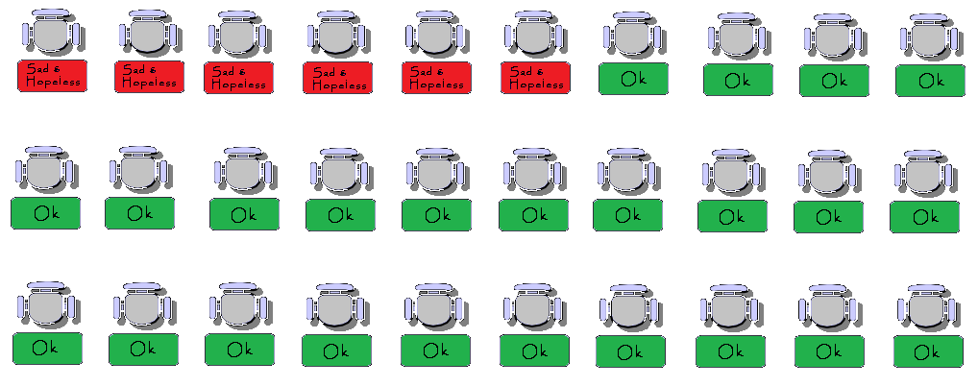
An Alaskan High School Classroom Filled with Students Who Do Think They Matter in Their Community
Students who Felt So Sad and Hopeless in the Past Year for Two Weeks or More That They Stopped Doing Regular Activities
Source: State of Alaska Department of Health and Social Services, Division of Public Health, Chronic Disease & Health Promotion. Youth Risk Behavior Survey [YRBS] 2011 & 2013 data, http://dhss.alaska.gov/dph/Chronic/Pages/yrbs/yrbs.aspx.
Notes:
This hypothetical classroom represents the level of depressive symptoms we would expect if it was filled with Alaskan high school students who think they matter in their communities.
Questions contact patrick.sidmore@alaska.gov

Slide 50
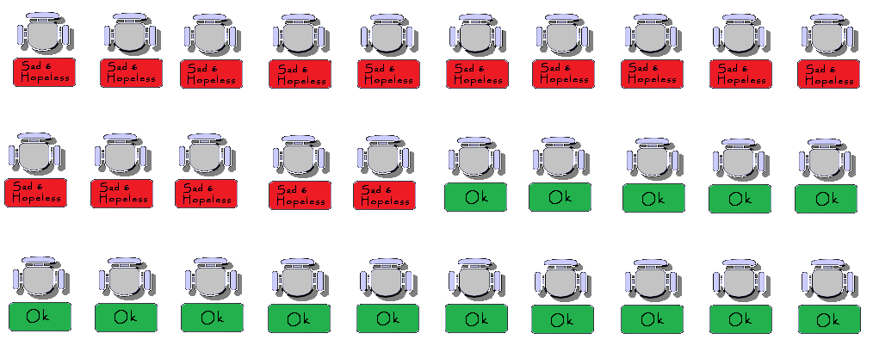
An Alaskan High School Classroom Filled with Students Who Don’t Think They Matter in Their Community
Students who Felt So Sad and Hopeless in the Past Year for Two Weeks or More That They Stopped Doing Regular Activities
Source: State of Alaska Department of Health and Social Services, Division of Public Health, Chronic Disease & Health Promotion. Youth Risk Behavior Survey [YRBS] 2011 & 2013 data, http://dhss.alaska.gov/dph/Chronic/Pages/yrbs/yrbs.aspx.
Notes:
This hypothetical classroom represents the level of depressive symptoms we would expect if it was filled with Alaskan high school students who think they don’t matter in their communities.
Questions contact patrick.sidmore@alaska.gov

Slide 51
Students Don’t Think They Matter
Does it Make a Difference if a Student Thinks He/She Matters to The Community?
51% Felt
OK
Students Think They Matter
80% Felt
Ok
Source: State of Alaska Department of Health and Social Services, Division of Public Health, Chronic Disease & Health Promotion. Youth Risk Behavior Survey [YRBS] 2011 & 2013 data, http://dhss.alaska.gov/dph/Chronic/Pages/yrbs/yrbs.aspx.
Notes:
This slide suggest that feeling alone in one’s community is linked with depressive symptoms. The difference between these two classroom scenarios is 11,100 Alaskan students
Questions contact patrick.sidmore@alaska.gov

Slide 52
Is it because students think they matter in their
communities that they are less likely to have
experienced depressive symptoms in the past year?
Or
Is it because students have been experiencing
depressive symptoms in the past year that they are
less likely to think they matter in their communities?
Notes:
Which comes first? People who have depression can feel isolated even if they actually matter in their communities. This link should be explored in depth in order to break through depression and engage people.
Questions contact patrick.sidmore@alaska.gov

Slide 53
Cognitive Behavioral Therapy (CBT) is the most widely researched and evidence-based form of therapy. CBT has been shown in more than one thousand studies to be effective in treating a wide range of psychiatric disorders and psychological problems. In contrast to other forms of psychotherapy, cognitive therapy is focused on the present, practical and problem-solving oriented. http://www.nyccognitivetherapy.com/
Notes:
Cognitive Behavioral Therapy helps us to see that when we want to see changes in behavior we can intervene in how someone thinks about themselves and their world. These interventions can lead to a change in how people feel and finally behave. This model which is tested in numerous settings is both well researched and a common sense approach. We want Alaskan youth to make this cycle a positive one which both helps them to be successful as well as our communities stronger.
Questions contact patrick.sidmore@alaska.gov

Slide 54
One Protective Factor Youth Risk Behavior Survey
Do you feel alone in your life?
Unless otherwise noted the data used for these analyses are the combined 2011 & 2013 data. The survey responses were analyzed from all traditional high school students who responded rather than a weighted sample because the analysis is examining the prevalence of one outcome within the context of, the presence or absence, of a specific protective factor. Though the combined local data sample was not scientifically selected and is also not weighted (as is the statewide sample), the large number of responses collected from a broad cross-section of traditional schools in both urban and rural school districts allows us the reasonable expectation that these data are representative of Alaska’s traditional high school students. Additionally, the large sample size of the local sample allows us to look at the finer gradations of the different response categories for the selected measures.
Source: State of Alaska Department of Health and Social Services, Division of Public Health, Chronic Disease & Health Promotion. Youth Risk Behavior Survey [YRBS] 2011 &/or 2013 data, http://dhss.alaska.gov/dph/Chronic/Pages/yrbs/yrbs.aspx . These results are from thousands of Alaska High School Students responses to the YRBS. These slides were prepared by the Alaska Mental Health Board and Advisory Board on Alcoholism and Drug Abuse. Contact patrick.sidmore@alaska.gov for questions.
Notes:
When using these data for 2011 & 2013 in each analysis the number of students answers used was over 12,000 responses. If only 2013 data were used than the number of student’s answers used was approximately 5,000. The most recent report from the Department of Education and Early Development is that there were more than 38,500 students in high schools across the state.
Questions contact patrick.sidmore@alaska.gov

Slide 55
Violence
Alaskan Students Who Report Ever Having Being Forced to Have Sex by Whether or Not They Feel Alone in Their Lives
Notes:
Questions Asked
Have you ever been physically forced to have sexual intercourse when you did not want to?
Answers - Yes or No
Do you agree or disagree that you feel alone in your life?
Answers - Strongly Agree, Agree, Not Sure, Disagree, Strongly Disagree
The answers were collapsed down into three categories: Felt Alone, Not Sure, Didn’t Feel Alone
Questions contact patrick.sidmore@alaska.gov

Slide 56
Source: State of Alaska Department of Health and Social Services, Division of Public Health, Chronic Disease & Health Promotion. Youth Risk Behavior Survey [YRBS] 2011 & 2013 data, http://dhss.alaska.gov/dph/Chronic/Pages/yrbs/yrbs.aspx. These results are from 13,215 Alaska High School Students responses to the YRBS. This slide was prepared by the Alaska Mental Health Board and Advisory Board on Alcoholism and Drug Abuse.
Notes:
The column on the left displays the responses from Alaskan young people who reported that they had been forced to have sexual intercourse in their lives. They were significantly more likely to report that they felt alone in their lives then their peers represented in the right column who hadn’t been forced to have sex.
Questions contact patrick.sidmore@alaska.gov

Slide 57
Source: State of Alaska Department of Health and Social Services, Division of Public Health, Chronic Disease & Health Promotion. Youth Risk Behavior Survey [YRBS] 2011 & 2013 data, http://dhss.alaska.gov/dph/Chronic/Pages/yrbs/yrbs.aspx. These results are from 13,215 Alaska High School Students responses to the YRBS. This slide was prepared by the Alaska Mental Health Board and Advisory Board on Alcoholism and Drug Abuse.
Notes:
The column on the right displays the results of Alaskan high school students who reported that they feel alone in their lives. They were more than twice as likely to report having been forced to have sex then their peers who said they didn’t feel alone.
Questions contact patrick.sidmore@alaska.gov

Slide 58
Another way to look at it
What follows is drawn from the answers of Alaskan high school students to the biennial Youth Risk Behavior Survey (YRBS).
Slides show an hypothetical classroom of 30 students with and without a specific protective factor. In each case the YRBS data are used to display the array of possibilities for an outcome one would expect given the presents (or absence) of the protective factor.
For each comparison there are two slides which show what it would look like with the protective factor and without it using the Alaskan data. The third slide compares the two side by side.
Notes:
Some people do better with a different representation of the data. The following slides show them in a different way.
Questions contact patrick.sidmore@alaska.gov

Slide 59
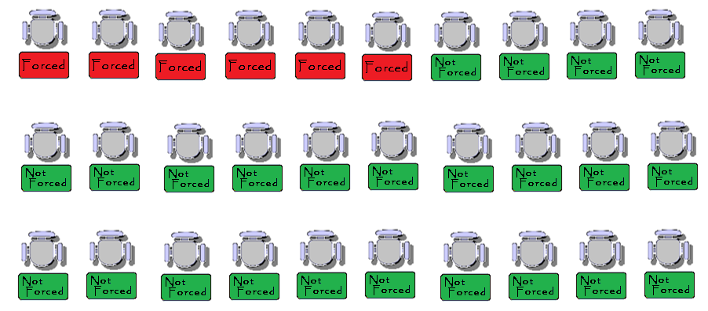
An Alaskan High School Classroom Filled with Students Who Feel Alone in Their Lives
19% Had been Forced to Have Sex
81% Had not Been Forced to Have Sex
Source: State of Alaska Department of Health and Social Services, Division of Public Health, Chronic Disease & Health Promotion. Youth Risk Behavior Survey [YRBS] 2011 & 2013 data, http://dhss.alaska.gov/dph/Chronic/Pages/yrbs/yrbs.aspx.
Notes:
This hypothetical classroom displays what we would expect to see if all the students felt alone in their lives.
Questions contact patrick.sidmore@alaska.gov

Slide 60
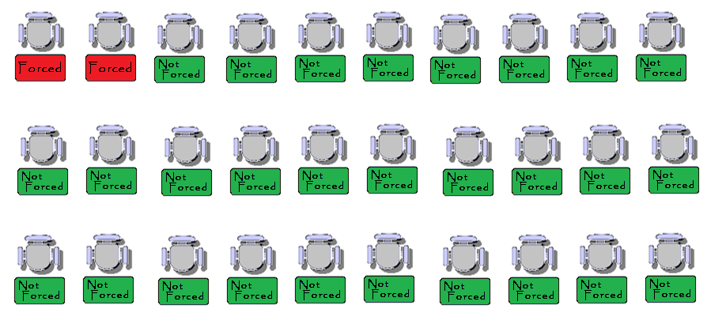
An Alaskan High School Classroom Filled with Students Who Don’t Feel Alone in Their Lives
7% Had been Forced to Have Sex
94% Had not Been Forced to Have Sex
Source: State of Alaska Department of Health and Social Services, Division of Public Health, Chronic Disease & Health Promotion. Youth Risk Behavior Survey [YRBS] 2011 & 2013 data, http://dhss.alaska.gov/dph/Chronic/Pages/yrbs/yrbs.aspx.
Notes:
This hypothetical classroom displays what we would expect to see if all the students didn’t feel alone in their lives.
Questions contact patrick.sidmore@alaska.gov

Slide 61
They Feel Alone
Does it Make a Difference if a Student Feels Alone in His/Her Life?
19% Have
Been
Forced to
Have Sex
They Don’t Feel Alone
7% Have
Been
Forced to
Have Sex
Source: State of Alaska Department of Health and Social Services, Division of Public Health, Chronic Disease & Health Promotion. Youth Risk Behavior Survey [YRBS] 2011 & 2013 data, http://dhss.alaska.gov/dph/Chronic/Pages/yrbs/yrbs.aspx.
Notes:
The difference between these two scenarios represents approximately 4,600 Alaskan students.
Questions contact patrick.sidmore@alaska.gov

Slide 62
Is it because students to have been forced to have
sex that they are more likely to feel alone?
Or
Is it because students feel alone that they are more likely to have been forced to have sex?
Notes:
These questions need to be explored in the context of the community and its strengths and weaknesses. Are students who have been sexually abused in this manner more likely to feel alone – most likely yes. Could a school, church or other group watch for signs and reach out? What else could be done?
Questions contact patrick.sidmore@alaska.gov

Slide 63
Cognitive Behavioral Therapy (CBT) is the most widely researched and evidence-based form of therapy. CBT has been shown in more than one thousand studies to be effective in treating a wide range of psychiatric disorders and psychological problems. In contrast to other forms of psychotherapy, cognitive therapy is focused on the present, practical and problem-solving oriented. http://www.nyccognitivetherapy.com/
Notes:
Cognitive Behavioral Therapy helps us to see that when we want to see changes in behavior we can intervene in how someone thinks about themselves and their world. These interventions can lead to a change in how people feel and finally behave. This model which is tested in numerous settings is both well researched and a common sense approach. We want Alaskan youth to make this cycle a positive one which both helps them to be successful as well as our communities stronger.
Questions contact patrick.sidmore@alaska.gov

Slide 64
Violence
Experienced Physical Dating Violence by Whether or Not The Student Feels Alone in His or Her Life
Notes:
Questions Asked
During the past 12 months, how many times did someone you were dating or going out with physically hurt you on purpose?
I did not date, 0 times, 1 time, 2 or 3 times, 4 or 5 times, 6 or more times
Do you agree or disagree that you feel alone in your life?
Answers - Strongly Agree, Agree, Not Sure, Disagree, Strongly Disagree
The answers were collapsed down into three categories: Felt Alone, Not Sure, Didn’t Feel Alone
Questions contact patrick.sidmore@alaska.gov

Slide 65
Source: State of Alaska Department of Health and Social Services, Division of Public Health, Chronic Disease & Health Promotion. Youth Risk Behavior Survey [YRBS] 2013 data, http://dhss.alaska.gov/dph/Chronic/Pages/yrbs/yrbs.aspx. These results are from 5,865 Alaska High School Students responses to the YRBS. This slide was prepared by the Alaska Mental Health Board and Advisory Board on Alcoholism and Drug Abuse.
Notes:
The column on the right represents all the student’s who had two or more incidents of physical dating violence in the past year. They were significantly more likely to report feeling alone than those students who reported no dating violence.
Questions contact patrick.sidmore@alaska.gov

Slide 66
Source: State of Alaska Department of Health and Social Services, Division of Public Health, Chronic Disease & Health Promotion. Youth Risk Behavior Survey [YRBS] 2013 data, http://dhss.alaska.gov/dph/Chronic/Pages/yrbs/yrbs.aspx. These results are from 5,865 Alaska High School Students responses to the YRBS. This slide was prepared by the Alaska Mental Health Board and Advisory Board on Alcoholism and Drug Abuse.
Notes:
The column on the left represents all the student’s who said they felt alone. They were more likely to report physical dating violence then their peers who didn’t feel alone.
Questions contact patrick.sidmore@alaska.gov

Slide 67
Another way to look at it
What follows is drawn from the answers of Alaskan high school students to the biennial Youth Risk Behavior Survey (YRBS).
Slides show an hypothetical classroom of 30 students with and without a specific protective factor. In each case the YRBS data are used to display the array of possibilities for an outcome one would expect given the presents (or absence) of the protective factor.
For each comparison there are two slides which show what it would look like with the protective factor and without it using the Alaskan data. The third slide compares the two side by side.
Notes:
Some people do better with a different representation of the data. The following slides show them in a different way.
Questions contact patrick.sidmore@alaska.gov

Slide 68
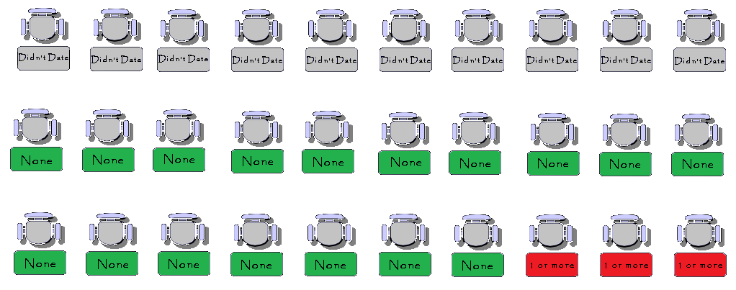
An Alaskan High School Classroom Filled with Students Who Feel Alone in Their Lives
Experienced Physical Dating Violence
Source: State of Alaska Department of Health and Social Services, Division of Public Health, Chronic Disease & Health Promotion. Youth Risk Behavior Survey [YRBS] 2011 & 2013 data, http://dhss.alaska.gov/dph/Chronic/Pages/yrbs/yrbs.aspx.
Notes:
In this hypothetical classroom scenario all the students feel alone in their lives.
Questions contact patrick.sidmore@alaska.gov

Slide 69
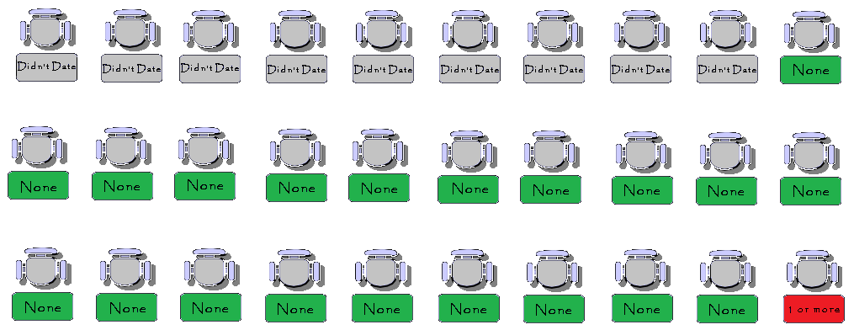
An Alaskan High School Classroom Filled with Students Who Don’t Feel Alone in Their Lives
Experienced Physical Dating Violence
Source: State of Alaska Department of Health and Social Services, Division of Public Health, Chronic Disease & Health Promotion. Youth Risk Behavior Survey [YRBS] 2011 & 2013 data, http://dhss.alaska.gov/dph/Chronic/Pages/yrbs/yrbs.aspx.
Notes:
In this hypothetical classroom scenario none of the students feel alone in their lives.
Questions contact patrick.sidmore@alaska.gov

Slide 70
They Feel Alone
Does it Make a Difference if a Student Feels Alone in His/Her Life?
12.1% Have
Experienced
Physical
Dating
Violence
They Don’t Feel Alone
4.5% Have
Experienced
Physical
Dating
Violence
Source: State of Alaska Department of Health and Social Services, Division of Public Health, Chronic Disease & Health Promotion. Youth Risk Behavior Survey [YRBS] 2011 & 2013 data, http://dhss.alaska.gov/dph/Chronic/Pages/yrbs/yrbs.aspx.
Notes:
These difference between these two scenarios represent about 2,900 Alaskan high school students.
Questions contact patrick.sidmore@alaska.gov

Slide 71
Is it because students report not feeling alone in
their lives that report lower dating violence?
Or
Is it because students report lower dating
Violence that they report not feeling alone?
Notes:
These questions need to be explored in the context of the community and its strengths and weaknesses. Are there efforts to address dating violence? What are communities doing to reach out to all their young people? Is there a peer group working on inclusiveness?
Questions contact patrick.sidmore@alaska.gov

Slide 72
Cognitive Behavioral Therapy (CBT) is the most widely researched and evidence-based form of therapy. CBT has been shown in more than one thousand studies to be effective in treating a wide range of psychiatric disorders and psychological problems. In contrast to other forms of psychotherapy, cognitive therapy is focused on the present, practical and problem-solving oriented. http://www.nyccognitivetherapy.com/
Notes:
Cognitive Behavioral Therapy helps us to see that when we want to see changes in behavior we can intervene in how someone thinks about themselves and their world. These interventions can lead to a change in how people feel and finally behave. This model which is tested in numerous settings is both well researched and a common sense approach. We want Alaskan youth to make this cycle a positive one which both helps them to be successful as well as our communities stronger.
Questions contact patrick.sidmore@alaska.gov

Slide 73
One Protective Factor Youth Risk Behavior Survey
How often do your parents ask you about school?
Unless otherwise noted the data used for these analyses are the combined 2011 & 2013 data. The survey responses were analyzed from all traditional high school students who responded rather than a weighted sample because the analysis is examining the prevalence of one outcome within the context of, the presence or absence, of a specific protective factor. Though the combined local data sample was not scientifically selected and is also not weighted (as is the statewide sample), the large number of responses collected from a broad cross-section of traditional schools in both urban and rural school districts allows us the reasonable expectation that these data are representative of Alaska’s traditional high school students. Additionally, the large sample size of the local sample allows us to look at the finer gradations of the different response categories for the selected measures.
Source: State of Alaska Department of Health and Social Services, Division of Public Health, Chronic Disease & Health Promotion. Youth Risk Behavior Survey [YRBS] 2011 &/or 2013 data, http://dhss.alaska.gov/dph/Chronic/Pages/yrbs/yrbs.aspx . These results are from thousands of Alaska High School Students responses to the YRBS. These slides were prepared by the Alaska Mental Health Board and Advisory Board on Alcoholism and Drug Abuse. Contact patrick.sidmore@alaska.gov for questions.
Notes:
When using these data for 2011 & 2013 in each analysis the number of students answers used was over 12,000 responses. If only 2013 data were used than the number of student’s answers used was approximately 5,000. The most recent report from the Department of Education and Early Development is that there were more than 38,500 students in high schools across the state.
Questions contact patrick.sidmore@alaska.gov

Slide 74
Substance Abuse
Perceptions of the Risk of Weekly Marijuana Use by How Often Parents Ask Students About School
Notes:
Questions Asked
How much do you think people risk harming themselves (physically or in other ways) if they smoke marijuana once or twice a week?
No Risk, Slight Risk, Moderate Risk, Great Risk
How often does one of your parents talk with you about what you are doing in school?
Never, Less than once a month, About once or twice a month, About once or twice a week, About every day
In some analysis the two answers of “Never” and “About all the time were used”
Questions contact patrick.sidmore@alaska.gov

Slide 75
Source: State of Alaska Department of Health and Social Services, Division of Public Health, Chronic Disease & Health Promotion. Youth Risk Behavior Survey [YRBS] 2013 data, http://dhss.alaska.gov/dph/Chronic/Pages/yrbs/yrbs.aspx. These results are from 6,124 Alaska High School Students responses to the YRBS. This slide was prepared by the Alaska Mental Health Board and Advisory Board on Alcoholism and Drug Abuse.
Notes:
The column on the left displays the students who see no risk in smoking marijuana and they report higher rates of their parents never talking to them about school than their peers who are asked about school more often.
Questions contact patrick.sidmore@alaska.gov

Slide 76
Source: State of Alaska Department of Health and Social Services, Division of Public Health, Chronic Disease & Health Promotion. Youth Risk Behavior Survey [YRBS] 2013 data, http://dhss.alaska.gov/dph/Chronic/Pages/yrbs/yrbs.aspx. These results are from 6,124 Alaska High School Students responses to the YRBS. This slide was prepared by the Alaska Mental Health Board and Advisory Board on Alcoholism and Drug Abuse.
Notes:
The column on the left displays the students who report that their parents never talk to them about school and they are more likely to report than their peers that weekly smoking of marijuana has no risk.
Questions contact patrick.sidmore@alaska.gov

Slide 77
Another way to look at it
What follows is drawn from the answers of Alaskan high school students to the biennial Youth Risk Behavior Survey (YRBS).
Slides show an hypothetical classroom of 30 students with and without a specific protective factor. In each case the YRBS data are used to display the array of possibilities for an outcome one would expect given the presents (or absence) of the protective factor.
For each comparison there are two slides which show what it would look like with the protective factor and without it using the Alaskan data. The third slide compares the two side by side.
Notes:
Some people do better with a different representation of the data. The following slides show them in a different way.
Questions contact patrick.sidmore@alaska.gov

Slide 78
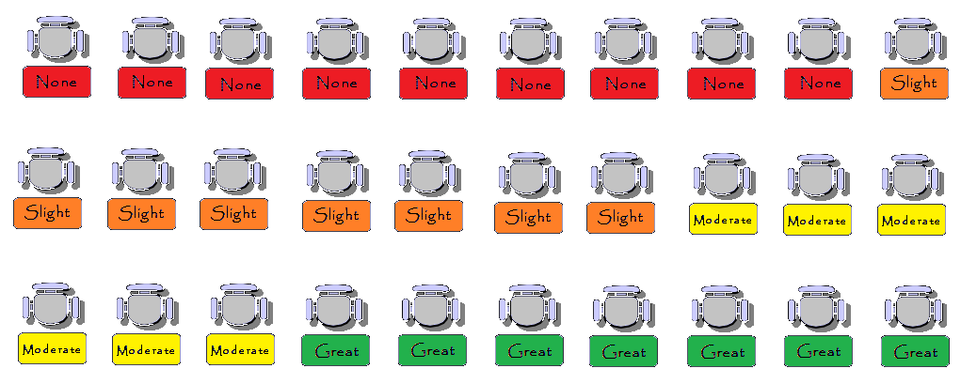
An Alaskan High School Classroom Filled with Students Whose Parents Ask Them About School Nearly Every Day
What Students Think About the Risk of
Smoking Marijuana Every Week
Source: State of Alaska Department of Health and Social Services, Division of Public Health, Chronic Disease & Health Promotion. Youth Risk Behavior Survey [YRBS] 2011 & 2013 data, http://dhss.alaska.gov/dph/Chronic/Pages/yrbs/yrbs.aspx.
Notes:
In this hypothetical classroom the data from those students who reported that their parents spoke to them about every day regarding school was used.
Questions contact patrick.sidmore@alaska.gov

Slide 79
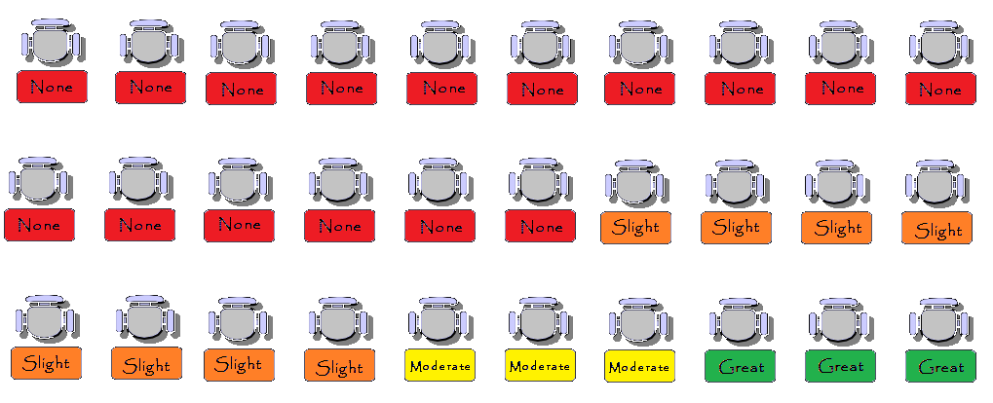
An Alaskan High School Classroom Filled with Students Whose Parents Never Ask Their Children About School
What Students Think About the Risk of
Smoking Marijuana Every Week
Source: State of Alaska Department of Health and Social Services, Division of Public Health, Chronic Disease & Health Promotion. Youth Risk Behavior Survey [YRBS] 2011 & 2013 data, http://dhss.alaska.gov/dph/Chronic/Pages/yrbs/yrbs.aspx.
Notes:
In this hypothetical classroom the data from those students who reported that there parents spoke to them about every day regarding school was used.
Questions contact patrick.sidmore@alaska.gov

Slide 80
Parents Never Ask
Does it Make a Difference if a Parent Regularly Asks About School?
77% Think
Smoking
Marijuana
Regularly
Is Slightly
Or Not
Risky
Parents Ask About Every Day
58% Think
Smoking
Marijuana
Regularly
Is Slightly
Or Not
Risky
Source: State of Alaska Department of Health and Social Services, Division of Public Health, Chronic Disease & Health Promotion. Youth Risk Behavior Survey [YRBS] 2011 & 2013 data, http://dhss.alaska.gov/dph/Chronic/Pages/yrbs/yrbs.aspx.
Notes:
The difference between these two scenarios is approximately 7,300 Alaskan students.
Questions contact patrick.sidmore@alaska.gov

Slide 81
Is it because students report their parents ask
about school more often that they perceive greater
risk from smoking marijuana
Or
Is it because students feel greater risk from smoking marijuana that they are more likely
to be asked by their parents about school?
Notes:
These questions need to be explored in the context of the community and its strengths and weaknesses. Is this a placeholder for just general parental involvement in a student’s life? What else may be going on?
Questions contact patrick.sidmore@alaska.gov

Slide 82
Cognitive Behavioral Therapy (CBT) is the most widely researched and evidence-based form of therapy. CBT has been shown in more than one thousand studies to be effective in treating a wide range of psychiatric disorders and psychological problems. In contrast to other forms of psychotherapy, cognitive therapy is focused on the present, practical and problem-solving oriented. http://www.nyccognitivetherapy.com/
Notes:
Cognitive Behavioral Therapy helps us to see that when we want to see changes in behavior we can intervene in how someone thinks about themselves and their world. These interventions can lead to a change in how people feel and finally behave. This model which is tested in numerous settings is both well researched and a common sense approach. We want Alaskan youth to make this cycle a positive one which both helps them to be successful as well as our communities stronger.
Questions contact patrick.sidmore@alaska.gov

Slide 83
Sexuality
Number of Sexual Partners by How Often Parents Ask About School
Notes:
Questions asked
During your life, with how many people have you had sexual intercourse?
I have never had sexual intercourse
1 person, 2 people, 3 people, 4 people, 5 people, 6 or more people
How often does one of your parents talk with you about what you are doing in school?
Never, Less than once a month, About once or twice a month, About once or twice a week, About every day
In some analysis the two answers of “Never” and “About all the time were used”
Questions contact patrick.sidmore@alaska.gov

Slide 84
Source: State of Alaska Department of Health and Social Services, Division of Public Health, Chronic Disease & Health Promotion. Youth Risk Behavior Survey [YRBS] 2011 & 2013 data, http://dhss.alaska.gov/dph/Chronic/Pages/yrbs/yrbs.aspx. These results are from 12,154 Alaska High School Students responses to the YRBS. This slide was prepared by the Alaska Mental Health Board and Advisory Board on Alcoholism and Drug Abuse.
Notes:
In this graph the column on the left represents all those Alaskan students who reported never having had sexual intercourse. The were more likely to have had their parents talk to them every day than those who had sex.
Questions contact patrick.sidmore@alaska.gov

Slide 85
Source: State of Alaska Department of Health and Social Services, Division of Public Health, Chronic Disease & Health Promotion. Youth Risk Behavior Survey [YRBS] 2011 & 2013 data, http://dhss.alaska.gov/dph/Chronic/Pages/yrbs/yrbs.aspx. These results are from 12,154 Alaska High School Students responses to the YRBS. This slide was prepared by the Alaska Mental Health Board and Advisory Board on Alcoholism and Drug Abuse.
Notes:
The first column on the left represents those Alaskan young people who report that their parents never talk to them about school. The are less likely to have not had sexual intercourse than those students who report some questioning from their parents.
Questions contact patrick.sidmore@alaska.gov

Slide 86
Another way to look at it
What follows is drawn from the answers of Alaskan high school students to the biennial Youth Risk Behavior Survey (YRBS).
Slides show an hypothetical classroom of 30 students with and without a specific protective factor. In each case the YRBS data are used to display the array of possibilities for an outcome one would expect given the presents (or absence) of the protective factor.
For each comparison there are two slides which show what it would look like with the protective factor and without it using the Alaskan data. The third slide compares the two side by side.
Notes:
Some people do better with a different representation of the data. The following slides show them in a different way.
Questions contact patrick.sidmore@alaska.gov

Slide 87
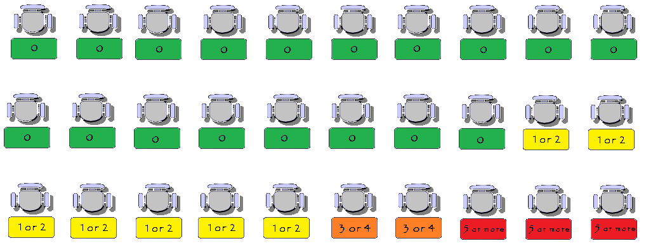
An Alaskan High School Classroom Filled with Students Whose Parents Ask Them About School Nearly Every Day
Number of Sexual Partners
Source: State of Alaska Department of Health and Social Services, Division of Public Health, Chronic Disease & Health Promotion. Youth Risk Behavior Survey [YRBS] 2011 & 2013 data, http://dhss.alaska.gov/dph/Chronic/Pages/yrbs/yrbs.aspx.
Notes:
In this hypothetical classroom students report that their parents ask them about school most every day.
Questions contact patrick.sidmore@alaska.gov

Slide 88
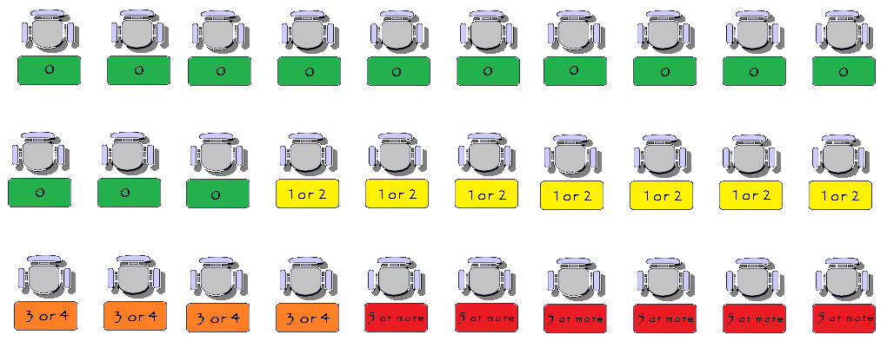
An Alaskan High School Classroom Filled with Students Whose Parents Never Ask Their Children About School
Number of Sexual Partners
Source: State of Alaska Department of Health and Social Services, Division of Public Health, Chronic Disease & Health Promotion. Youth Risk Behavior Survey [YRBS] 2011 & 2013 data, http://dhss.alaska.gov/dph/Chronic/Pages/yrbs/yrbs.aspx.
Notes:
In this hypothetical classroom students report their parents never ask them about school.
Questions contact patrick.sidmore@alaska.gov

Slide 89
Parents Never Ask
Does it Make a Difference if a Parent Regularly Asks About School?
34% Have
Had Three
Or More
Sexual
Partners
Parents Ask About Every Day
17% Have
Had Three
Or More
Sexual
Partners
Source: State of Alaska Department of Health and Social Services, Division of Public Health, Chronic Disease & Health Promotion. Youth Risk Behavior Survey [YRBS] 2011 & 2013 data, http://dhss.alaska.gov/dph/Chronic/Pages/yrbs/yrbs.aspx.
Notes:
The difference between these two scenarios is approximately 6,500 students in Alaskan high schools.
Questions contact patrick.sidmore@alaska.gov

Slide 90
Is it because students report their parents ask
about school more often that they have fewer
sexual partners
Or
Is it because students have fewer sexual partners that they are more likely
to be asked by their parents about school?
Notes:
These questions need to be explored in the context of the community and its strengths and weaknesses. Is teen pregnancy or STD’s a problem in the community. Is there an effort to get parents involved in the kids lives?
Questions contact patrick.sidmore@alaska.gov

Slide 91
Cognitive Behavioral Therapy (CBT) is the most widely researched and evidence-based form of therapy. CBT has been shown in more than one thousand studies to be effective in treating a wide range of psychiatric disorders and psychological problems. In contrast to other forms of psychotherapy, cognitive therapy is focused on the present, practical and problem-solving oriented. http://www.nyccognitivetherapy.com/
Notes:
Cognitive Behavioral Therapy helps us to see that when we want to see changes in behavior we can intervene in how someone thinks about themselves and their world. These interventions can lead to a change in how people feel and finally behave. This model which is tested in numerous settings is both well researched and a common sense approach. We want Alaskan youth to make this cycle a positive one which both helps them to be successful as well as our communities stronger.
Questions contact patrick.sidmore@alaska.gov

Slide 92
One Protective Factor Youth Risk Behavior Survey
How many days a week do you participate in after school activities?
Unless otherwise noted the data used for these analyses are the combined 2011 & 2013 data. The survey responses were analyzed from all traditional high school students who responded rather than a weighted sample because the analysis is examining the prevalence of one outcome within the context of, the presence or absence, of a specific protective factor. Though the combined local data sample was not scientifically selected and is also not weighted (as is the statewide sample), the large number of responses collected from a broad cross-section of traditional schools in both urban and rural school districts allows us the reasonable expectation that these data are representative of Alaska’s traditional high school students. Additionally, the large sample size of the local sample allows us to look at the finer gradations of the different response categories for the selected measures.
Source: State of Alaska Department of Health and Social Services, Division of Public Health, Chronic Disease & Health Promotion. Youth Risk Behavior Survey [YRBS] 2011 &/or 2013 data, http://dhss.alaska.gov/dph/Chronic/Pages/yrbs/yrbs.aspx . These results are from thousands of Alaska High School Students responses to the YRBS. These slides were prepared by the Alaska Mental Health Board and Advisory Board on Alcoholism and Drug Abuse. Contact patrick.sidmore@alaska.gov for questions.
Notes:
When using these data for 2011 & 2013 in each analysis the number of students answers used was over 12,000 responses. If only 2013 data were used than the number of student’s answers used was approximately 5,000. The most recent report from the Department of Education and Early Development is that there were more than 38,500 students in high schools across the state.
Questions contact patrick.sidmore@alaska.gov

Slide 93
Substance Abuse
Past Month Marijuana Use by Zero or Three or More Days per Week of Supervised After School Activities
Notes:
Questions Asked
During the past 30 days, how many times did you use marijuana?
0 times, 1 or 2 times, 3 to 9 times, 10 to 19 times, 20 to 39 times, 40 times or more
During an average week, on how many days do you take part in organized after school, evening, or weekend activities (such as school clubs; community center groups; music, art, or dance lessons; drama; church; or cultural or other supervised activities)?
0 days, 1 day, 2 days, 3 days, 4 days, 5 days, 6 days, 7 days
Questions contact patrick.sidmore@alaska.gov

Slide 94
Source: State of Alaska Department of Health and Social Services, Division of Public Health, Chronic Disease & Health Promotion. Youth Risk Behavior Survey [YRBS] 2011 & 2013 data http://dhss.alaska.gov/dph/Chronic/Pages/yrbs/yrbs.aspx. These results are from 13,011 Alaska High School Students responses to the YRBS. This slide was prepared by the Alaska Mental Health Board and Advisory Board on Alcoholism and Drug Abuse.
Notes:
The column to the left represents all the students who did not smoke marijuana in the previous 30 days and they are more likely to have been involved with school activities than their peers who did smoke marijuana.
Questions contact patrick.sidmore@alaska.gov

Slide 95
Source: State of Alaska Department of Health and Social Services, Division of Public Health, Chronic Disease & Health Promotion. Youth Risk Behavior Survey [YRBS] 2011 & 2013 data http://dhss.alaska.gov/dph/Chronic/Pages/yrbs/yrbs.aspx. These results are from 13,011 Alaska High School Students responses to the YRBS. This slide was prepared by the Alaska Mental Health Board and Advisory Board on Alcoholism and Drug Abuse.
Notes:
The column to the left represents all the students who did not participate in after school activities and they were more likely to smoke marijuana than their peers who were participating.
Questions contact patrick.sidmore@alaska.gov

Slide 96
Another way to look at it
What follows is drawn from the answers of Alaskan high school students to the biennial Youth Risk Behavior Survey (YRBS).
Slides show an hypothetical classroom of 30 students with and without a specific protective factor. In each case the YRBS data are used to display the array of possibilities for an outcome one would expect given the presents (or absence) of the protective factor.
For each comparison there are two slides which show what it would look like with the protective factor and without it using the Alaskan data. The third slide compares the two side by side.
Notes:
Some people do better with a different representation of the data. The following slides show them in a different way.
Questions contact patrick.sidmore@alaska.gov

Slide 97
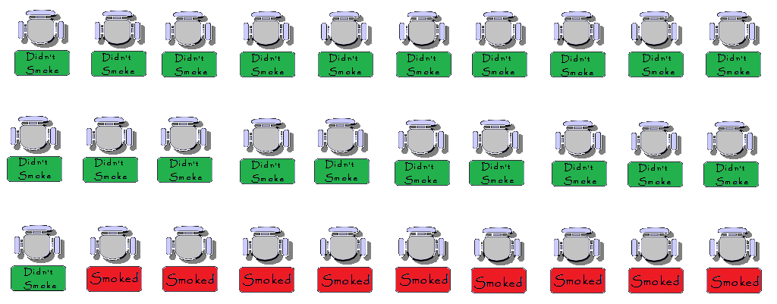
An Alaskan High School Classroom Filled with Students Who Participated in Zero Days of Supervised After School Activities
Marijuana Use in The Past Month
Source: State of Alaska Department of Health and Social Services, Division of Public Health, Chronic Disease & Health Promotion. Youth Risk Behavior Survey [YRBS] 2011 & 2013 data, http://dhss.alaska.gov/dph/Chronic/Pages/yrbs/yrbs.aspx.
Notes:
In this hypothetical classroom Alaskan students have zero days each week of supervised afterschool activities.
Questions contact patrick.sidmore@alaska.gov

Slide 98
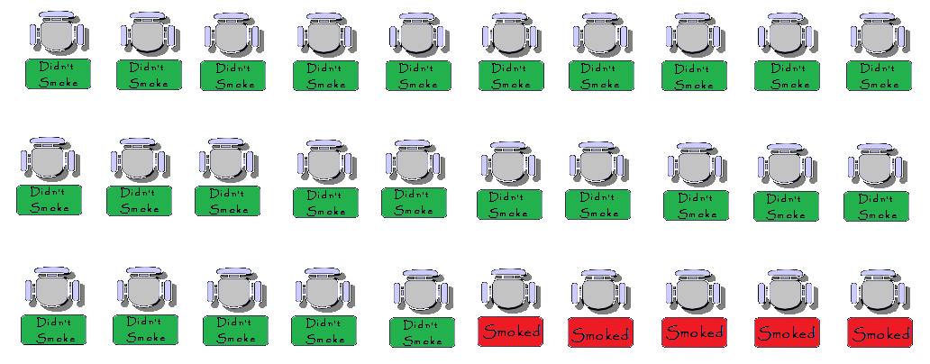
An Alaskan High School Classroom Filled with Students Who Participated in Three or More Days of Supervised After School Activities
Marijuana Use in The Past Month
Source: State of Alaska Department of Health and Social Services, Division of Public Health, Chronic Disease & Health Promotion. Youth Risk Behavior Survey [YRBS] 2011 & 2013 data, http://dhss.alaska.gov/dph/Chronic/Pages/yrbs/yrbs.aspx.
Notes:
In this hypothetical classroom Alaskan students have three or more days each week of supervised afterschool activities.
Questions contact patrick.sidmore@alaska.gov

Slide 99
Zero Days Of Activities
Does it Make a Difference if a Student Participates in After School Activities?
69% Didn’t
Smoke
Marijuana
Three or More Days of Activities
82% Didn’t
Smoke
Marijuana
Source: State of Alaska Department of Health and Social Services, Division of Public Health, Chronic Disease & Health Promotion. Youth Risk Behavior Survey [YRBS] 2011 & 2013 data, http://dhss.alaska.gov/dph/Chronic/Pages/yrbs/yrbs.aspx.
Notes:
The difference between these two scenarios represents about 5,000 Alaskan high school students.
Questions contact patrick.sidmore@alaska.gov

Slide 100
Is it because students report being in more after
school activities that they smoke less marijuana?
Or
Is it because students have smoked less marijuana that they are more likely
to report more after school activities?
Notes:
These questions need to be explored in the context of the community and its strengths and weaknesses. What are the adult attitudes about marijuana? What are the schools practices around extra curricular activities and substance abuse?
Questions contact patrick.sidmore@alaska.gov

Slide 101
Cognitive Behavioral Therapy (CBT) is the most widely researched and evidence-based form of therapy. CBT has been shown in more than one thousand studies to be effective in treating a wide range of psychiatric disorders and psychological problems. In contrast to other forms of psychotherapy, cognitive therapy is focused on the present, practical and problem-solving oriented. http://www.nyccognitivetherapy.com/
Notes:
Cognitive Behavioral Therapy helps us to see that when we want to see changes in behavior we can intervene in how someone thinks about themselves and their world. These interventions can lead to a change in how people feel and finally behave. This model which is tested in numerous settings is both well researched and a common sense approach. We want Alaskan youth to make this cycle a positive one which both helps them to be successful as well as our communities stronger.
Questions contact patrick.sidmore@alaska.gov

