Slide 1
Division of Senior & Disabilities Services
Director Duane Mayes

Slide 2
Alaska’s Aging Services Network includes:
Administration on Community Living
DHSS/Division of Senior and Disabilities Services
Tribal Partners
Alaska Commission on Aging (ACOA)
Local providers
Caregivers
Older Alaskans

Slide 3
Goals:
Maintain Independence
Remain in own home and community
Services for:
Age 60 and older
Priority: Most Vulnerable Elderly
Notes:
Alaska’s Senior grant programs provide services to older Alaskan’s helping them maintain independence and remain in their homes.
Services are available to individuals 60 and older, through delivery is targeted to the most vulnerable elderly.
The program targets adults who are 60 years of age or older in greatest economic and/or social need attention to low-income minorities, those in rural areas
are targeted for need, age is the only requirement for the congregate nutrition program; those receiving home meals must also be homebound.
The Aging Services Network provides a range of community based services designed to enhance both the quality of life and social intersection and reduce the effects of disability for homebound and more active seniors.

Slide 4
Services help Older Alaskans remain
in their homes and communities
Priority Groups-
75 and over
Live alone
Low income
Rural
Difficulty performing activities of
daily living due to certain
health conditions
Notes:
Senior Grant programs provide support to older Alaskan’s and their caregivers who may not qualify for other programs, but still need support to remain in their homes and communities.
Services are targeted to older Alaskan’s who are at risk for nursing home placement.
Nursing Home predictors include: Live alone, 75 and over, low income, rural, difficulty performing activities of daily living because of certain health conditions.

Slide 5
Programs and Funding
> $13 million in State and Federal funds
Adult Day Care
Aging and Disability Resource Centers
Alzheimer’s Disease and Related Disorders Education and Support
Health Promotion and Disease Prevention
Medicare Information Office
National Family Caregiver Support Program
Nutrition, Transportation and Support Services
Senior In-Home
Senior Residential Services
Notes:
Programs and Funding
Over $13 million in State and Federal funds are awarded annually to local providers through the Senior Grants program.
This slides shows the range of grant services supported.. In the following slides, I”ll be giving some of the details about each.
Briefly: Grant programs include:
Adult Day Care
Aging and Disability Resource Centers
Alzheimer’s Disease and Related Disorders Education and Support
Health Promotion and Disease Prevention
Medicare Information Office
Nursing Facility Transition Program
National Family Caregiver Support Program
Nutrition, Transportation and Support Services
Senior In-Home
Senior Residential Services

Slide 6
Nutrition, Transportation,
and Support Services
Congregate meals
Home delivered meals
Nutrition education, counseling
Transportation
Assisted transportation
Legal Services
Senior Volunteer, Senior Companion, Foster Grandparents
Outreach, information and assistance
Media – Senior Voice newspaper
Homemaker
Quick Facts:
NTS Grants include state and federal funding.
$6,621,729 in FY2016.
Notes:
Nutrition, Transportation and Support Services program provides a range of community based services to Alaskan’s 60 and over including: home delivered and congregate meals, nutrition education and counseling, transportation, homemaker services, legal assistance, media, volunteer opportunities, information and assistance and outreach.
Many of our NTS grantees deliver services through local Senior Center’s which serve as a focal point in the community for Older Alaskans to engage in healthy meaningful activities.

Slide 7
Senior In-Home Services
Case management
Chore
Respite for caregivers
Supplemental services
Quick Facts:
FY2016 Funding: $2,851,868
# served in FY2015: 1560
Notes:
Senior In-Home Services program provides case management (includes….) , chore, ( includes…. Respite (examples: ) and supplemental services (examples…) to vulnerable seniors 60 and over who need assistance in order to remain in their homes. Services are targeted to individuals who are low income, experience Alzheimer’s Disease or Related Disorders, frailty due to aging or other cognitive or physically disabling conditions.

Slide 8
Adult Day Care
Center- based program that provides
therapeutic activities in a secure
environment
For individuals who experience Alzheimer’s Disease or related disorders, physical, emotional and/or other cognitive impairments.
Quick Facts:
FY2016 Funding: $1,724,490
# served in FY2015: 430
Individuals with ADRD: 70%
Notes:
Adult Day Care is a center based program that provides supervision and a secure environment for individuals experience Alzheimer’s Disease or Related Disorders, physical, emotional and/or other cognitive impairments. A variety of therapeutic activities are provided to support optimal mental and physical functioning.
The program also provides an alternative for caregivers who need to work during the day. Increasing numbers of programs are providing some weekend services.

Slide 9
National Family Caregiver Support Program
Services to :
Unpaid caregivers of individuals 60 and over
Grandparents raising grandchildren
Services include:
Information about available services
Assistance in gaining access to services
Support groups
Training
Counseling
Respite
Supplemental services
Quick Facts:
Includes State and Federal Funding
FY2016: $1,002,804
# Caregivers Served FY2015: 1118
Notes:
National Family Caregiver Support Program provides support and assistance to unpaid caregivers of individuals 60 and over and to Grandparents raising grandchildren to provide relief from emotional, physical, and financial stress. Services include information about available services, assistance in gaining access to services, support groups, training, counseling, respite and supplemental services.

Slide 10
ADRD Education and Support program
Statewide Resource Center serving:
Individuals who experience dementia
Family members
Care providers
Services include:
Training for family and professional care providers
Information, education and support
Counseling
Social events
Community outreach
Quick Facts:
FY2016: $346,036
# Trainings statewide: 214
Notes:
The ADRD Education and Support program is a statewide resource center that provides training, information, education and support to individuals who experience dementia, family members, and care providers throughout the state.
Quick facts:
One agency
Statewide education and training by the Alzheimer’s Disease Resource Agency

Slide 11
Senior Residential Services
Residential living services
(Assisted Living) for frail elders
in rural and remote areas
Quick Facts:
FY2016 Funding: $584,000
# of Providers: 3
# served: 28
Notes:
Senior Residential Services program provides grant funding to support residential living services (Assisted Living) to frail elders in rural and remote areas - these are people who do not have access to the State system of Pioneer Homes or other Long Term care facilities in their communities or regions. Assisted living facilities allow elders to remain with their families and communities.
Residents receive individual support in a residential setting that includes social and cultural activities. For example,
In .. Elders were included in the traditional subsistence fishing activities- managing the smoking of fish in a site next to the home [supervised by local fire department!]

Slide 12
Health Promotion and Disease Prevention
Adopting Evidence-based programs
Chronic Disease Self Management,
Tai Chi,
Falls Prevention ,
other physical activity
Building health self-management skills among participants
Quick Facts:
FY2016 Funding: $143,661
# served FY2015: 299
Notes:
Quick Facts:
FY2013 Funding: $123,000- $93,000 for grants, $ 20,000 for Medication Education Program..
Per new congressional requirements, this years RFP was withdrawn and revised to meet the evidence-based programming requirement.
This is a challenge for Alaska as many require professional facilitation = which is lacking in most communities, and a ‘critical mass’ for sustainability.
Despite very limited funding, Alaska Senior Centers have provided a large ‘match’ to provide the important physical activity programs for Older adults.
New medication education program – on-line and hard copy- 4 sessions aimed at helping Older Alaskans avoid medication error, get maximum benefit from medications.
# of Providers: 5
# served (FY2012): this is a best estimate. These are unregistered services. Until 2013, the majority of activities have been counted under ‘nutrition education’ with others reported under health education or health services to individuals.

Slide 13
ADRC network serves Alaskan’s statewide, regardless of age, disability or income level
Regional network connects seniors, people with disabilities, and caregivers with long-term services and supports of
their choice
Funding FY2016: $1,087,785
# of Providers: 5
# served in FY2015: 15,909
# served in ADRC First Pilot Project: 291
Notes:
Aging and Disability Resource Centers (ADRC)
Alaska’s ADRC’s provides information, assistance and options counseling to connect seniors, people with disabilities, and caregivers with long-term services and supports of their choice. The ADRC network serves Alaskan’s statewide , regardless of age, disability or income level, through regional sites.

Slide 14
One-on-one counseling and public education on Medicare
Assist with enrollment, coordination of benefits:
Choosing a prescription drug plan, Part B and Medi-gap plan
Understanding Medicare premiums, and co-insurance
costs
Additional benefits: Medicaid, Disability, and Social Security
# Served by the Medicare Information Office and Medicare Counseling Grantees: 8987
Notes:
Medicare Information Office:
Provides one-on–one counseling and public education to Alaskan’s and their caregivers about Medicare. Assists with enrollment, coordination of benefits, choosing a prescription drug plan, and understanding Medicare premiums, and co-insurance costs and related Medicare, Medicaid, Disability and Social Security Issues.
The volunteer staff also teach how to spot and report Medicare errors, waste and fraud.
The Medicare Information Office has two full time state staff who provide direct assistance to beneficiaries as well as provide training to volunteers and grantees throughout the state.
Judith Bendersky is the manager of this program.

Slide 15
Delivering Services in Alaska
Notes:
Service Delivery Challenges in Alaska
Size – see the comparison map
Distance
-Transportation -
-Weather (obviously)
-Lack of infrastructure
-Workforce – Direct Care Personnel, health care providers
-Cost of living -

Slide 16
Notes:
Getting around..
The road system is limited… many communities are ‘off the road’ and can only be reached by air or boat.
The yellow is state ferry system which serves then southern coastal communities.
Cross-hatched line is pipeline.
Railway running from Fairbanks to Seward [parallel the road
The distances and isolation add to costs, particularly as supply barges can not reach northern communities during winter.
For example: quart of milk: Bethel, Barrow, Unalekleet
Gas: Bethel, Barrow, Unalekleet

Slide 17
Notes:
Many small, isolated communities: accessible only by air or boat.
Economies of scale are not possible and many of these communities lack trained personnel to manage and provide services.
The distances and isolation add to costs of basic necessities, particularly as supply barges can not reach western communities during winter – from around late march to October.
For example: A gallon of milk: Bethel, A gallon of milk that costs $3.00 in Anchorage can cost $6.89 in Bethel, around $ 9.00 in Barrow, $7.30 in Nome and $9.49 in Kotzebue
In January 2012, Heating fuel – which is one of the main sources of heat- averaged from a subsidized $1.74 /gallon in north slope region, to more than $6.50 /gallon in western Alaska.
Click for next picture:
Gasoline ranged from $4.10 to $9.65/gallon.
You can imagine how this affects the needs of older Alaskans on fixed incomes- and our service providers.

Slide 18
SDS’ APS Unit: Guiding Principles
The adult client makes decisions
Freedom is more important than safety
Every adult has the right to make bad choices
Seek to achieve: freedom, safety, least disruption of lifestyle, and least restrictive care alternatives.
Notes:
The adult client is in charge of decision making
Freedom is more important than safety
Every adult has the right to make bad choices
Seek to achieve: freedom, safety, least disruption of lifestyle, and least restrictive care alternatives

Slide 19
Elder Abuse Prevention Grant Award
Adult Protective Services awarded $1,004,605 – 3 year period
One of 8 awards nationwide
APS will develop and operate an Elder Services Case Management section within APS to determine if Critical Time Intervention (CTI) prevents elder abuse, neglect and exploitation.
Population to be served: elders 60 years and older identified as high risk for abuse, neglect or exploitation in future
Notes:
The U.S. Administration on Aging awarded the Elder Abuse Prevention Interventions Program grant to the State of Alaska Adult Protective Services (APS) unit. The amount awarded is $1,004.605.00 over a 3-year period. This is the first ever grant applied for by APS and is one of only eight award recipients across the United States. Under this grant, APS will develop and operate an Elder Services Case Management section within APS to determine if Critical Time Intervention (CTI), an evidenced based case management model, prevents elder abuse, neglect and exploitation.
This project will focus on implementing and testing the CTI intervention with a selected target population residing in Anchorage. The population to be served are elders 60 years are older that have been identified as high risk for experiencing abuse, neglect or exploitation in the future and those elders who have been found to have experienced abuse, neglect and exploitation through an APS investigation and require case management services to prevent future reoccurrence of maltreatment. The APS Elder Services Case Management section will consist of three case managers. The case managers will work in conjunction with APS Protective Service Specialists (Investigators) to ensure the health, safety and well-being of vulnerable adults.

Slide 20
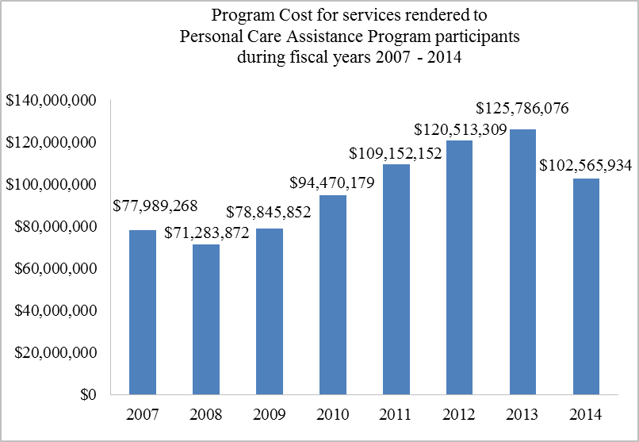
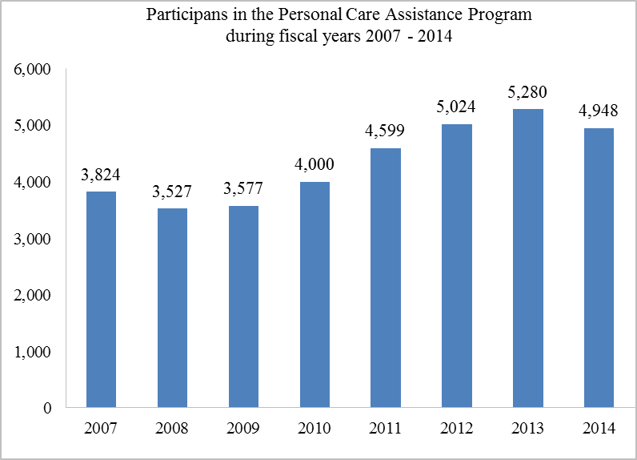
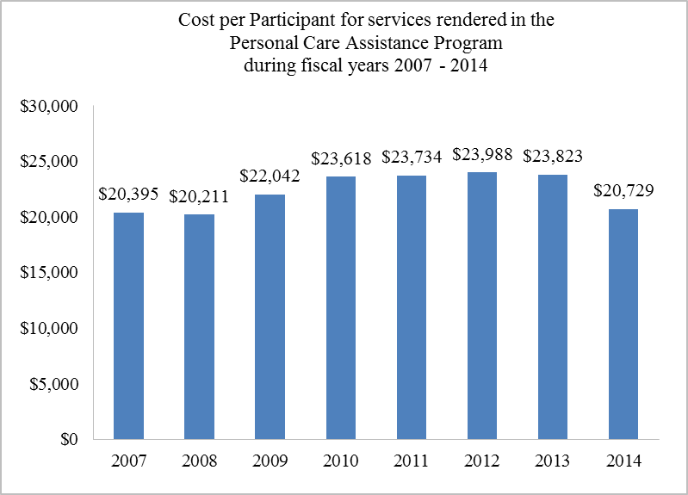
Personal Care Assistance Program
FY2007 - FY2014
Notes:
Personal Care Assistance Program in Alaska 2007-2012 –6 years
From FY2007 through 2014 the program costs increased by 31.5%; we served 29.4% more individuals; and cost per participant rose by 1.6%.

Slide 21
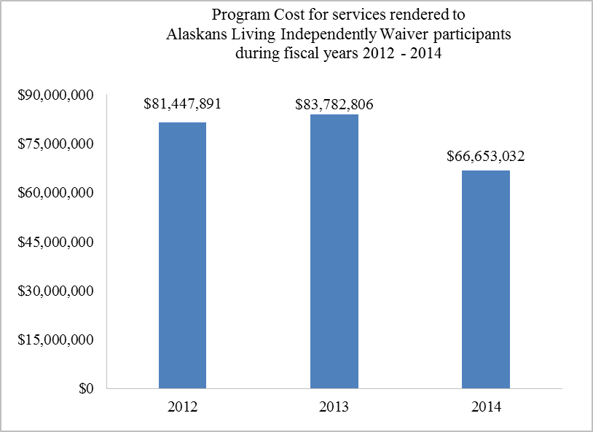
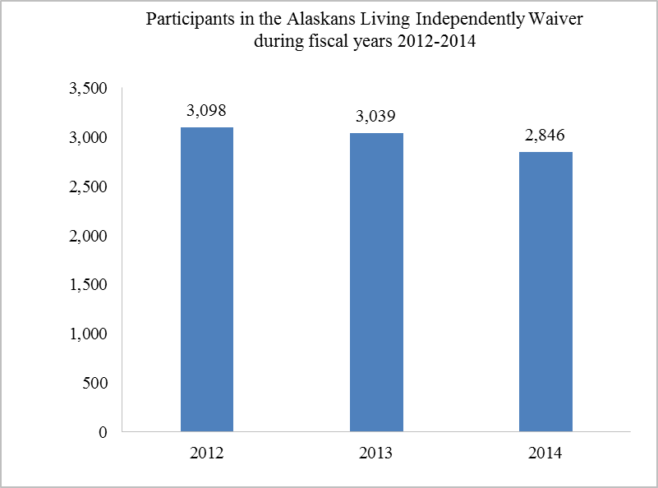
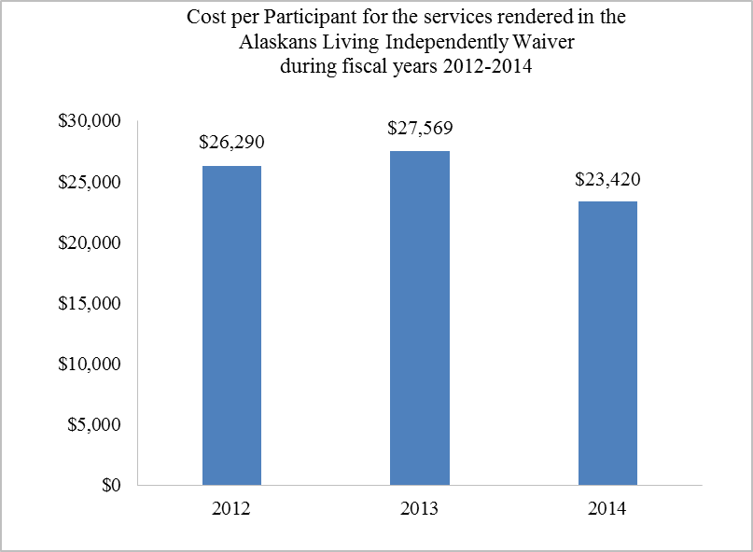
Alaskans Living Independently FY2012 - FY2014
Notes:
ALI Waiver Program
From FY2012 through 2014 the program costs decreased by 18.2%; serve 8.1% fewer individuals; and cost per participant decreased by 10.9%.
Do not have numbers for 60 and older broken out at this time.

Slide 22
DSDS Quality Improvement Priorities
Automated Service Plan
Conflict Free Care Coordination
ADRC First Pilot Project – Phase II
Medicaid Reform – 1915i and 1915k
Telehealth
Acuity Rate project

Slide 23
Thank you
Notes:
We provide data re: numbers served and costs of these important services. But it’s in the stories from our grantees that we really understand the meaning of these services in the lives of older Alaskans, their caregivers and their communities:
Each quarter we receive stories from grantees, illustrating the difference that grant services have made in the wellbeing of their clients and caregivers.
We hear that ‘services assist them to live independently, avoid or delay placing aged family members into nursing care facilities – which often means leaving the community in which they've spent their lives.
We hear that legal services prevent loss of homes, financial abuse, and help clients to obtain benefits essential to independence and wellbeing.
We hear that services improve the health status of clients, through better nutrition, physical activity and creative cognitive engagement, through transportation that ensures access to needed services and decreases social isolation.
We hear that the congregate meals provide important nutrition, social sharing, .. And even decrease in blood pressure and cholesterol! Home delivered meals not only provide food to those unable to leave their homes: the delivery drivers also provide important personal contact and an eye on the welfare of clients.
We hear how the many many hours of service provided by Senior Volunteers benefit their communities and provide a sense of pride and continuing contribution.

