Slide 1


PROTECTING
OUR PEOPLE
Making the Workplace Tobacco Free

Slide 2

^{TALK TO STAFF}
Staff preparation is one of the most important steps in ensuring a smooth transition to become a tobacco-free workplace. These steps will help your employees understand and deal with the transition.
Hold an informal meeting to overview the details of the resolution/policy passed on (insert date).
Discuss employees’ attitudes toward tobacco restrictions and the dangers of secondhand smoke/vapor.
Involve staff in preparing the worksite and property and allow them to have a sense of responsibility with the resolution.
Remind employees that a positive mindset and message should be sent to customers to ensure a smooth transition.
Focus on the health aspects and benefits of becoming tobacco free. Provide staff with resources and incentives to quit tobacco.
Contact (insert name) for more information (phone number).

Slide 3

^{TALK TO CUSTOMERS}
It’s important for staff to know the basic facts about the resolution/policy and be able to answer customer questions. Here are some respectful and polite phrases to use with customers using tobacco on your property.
“I’m sorry, but you’ll have to put out your cigarette. We are covered by a tobacco-free workplace resolution.”
“Our policy requires that no smoking or chew tobacco be allowed on workplace property. Your cooperation is appreciated.”
“Excuse me, did you know that we have a tobacco-free workplace? Thank you for respecting this policy.”
“This worksite has a tobacco-free policy. Please remember to leave tobacco behind when coming here.”
“Thank you for not smoking. Smoke-free air protects the health of our youth and Tribal members.”
Contact (insert name) for more information (phone number).

Slide 4
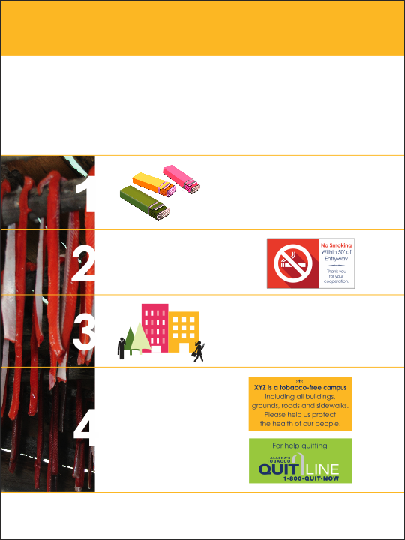
^{PREPARE THE PROPERTY}
It may seem obvious, but preparing your Tribal worksite is one of the first steps in creating a tobacco-free environment. Here are four easy steps to make your workplace tobacco free.
Remove all ashtrays, matchbooks and other tobacco paraphernalia. Offer gum or mints!
^{Post, “No Tobacco” or}
“No Smoking” signs. If your policy covers e-cigarettes, include this on your signs.
Practice respectfully asking customers to not use tobacco on workplace property.
Create cards with your tobacco-free policy
and tobacco quit information to hand
^{out to tobacco users.}
Contact (insert name) for more information (phone number).

