Slide 1
UPDATE to the Alaska Strategic Plan for Eliminating Tobacco-Related Disparities
LEAD
Leadership for
Eliminating
Alaskan Disparities
Prepared for: State of Alaska Tobacco Prevention and Control Program
LEAD is a Statewide workgroup that represents and advocates for disparate populations in partnership with the Alaska Tobacco Control Alliance (ATCA) and the State of Alaska Tobacco Prevention and Control Program (TPC).

Slide 2
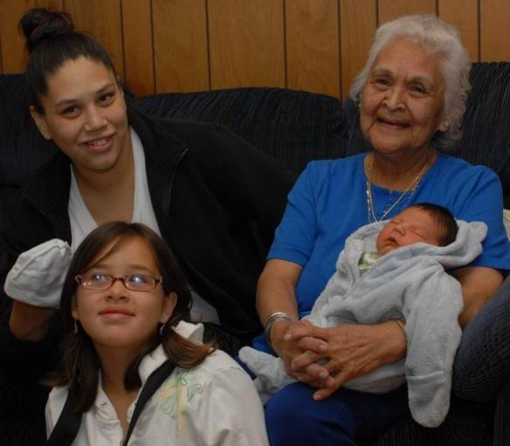
In This Presentation
About LEAD
The Planning Process
Health Disparities + Data
Goals + Strategies
Taking Action
Prepared for the Leadership for Eliminating Alaskan Disparities (LEAD) Workgroup and
the State of Alaska Tobacco Prevention and Control Program by Agnew::Beck Consulting

Slide 3
ABOUT LEAD
Leadership for Eliminating Alaskan Disparities
Addresses tobacco-related disparities in Alaskan populations
Developed the Alaska Strategic Plan for Eliminating Tobacco-Related Disparities in 2007
In 2010, the Alaska Tobacco Prevention and Control (TPC) Program reconvened a LEAD strategic planning team
Planning Team built on the work of the original plan, focusing on the development of detailed strategies and action steps to move the LEAD workgroup to implementation.

Slide 4
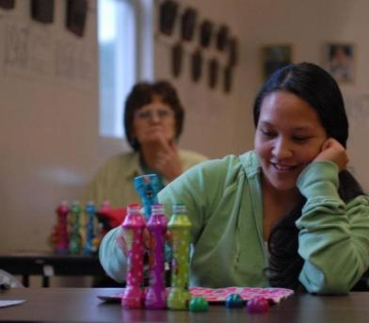
Vision of LEAD Workgroup
Equal opportunity for good health, freedom from tobacco use and its consequences, and improved quality of life.

Slide 5
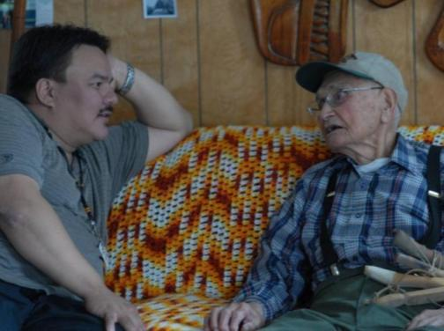
Mission of LEAD Workgroup
Use and institutionalize the strategic plan as a framework to identify actions that will positively impact disparate groups.

Slide 6
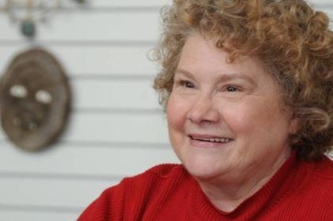
Values of LEAD Workgroup
Tobacco-free
Health Equity
Cultural Humility
Social Justice
Leadership
Education
Scientifically-driven
Accountable
Grassroots
Action-oriented
Collaborative-spirit
Strategic

Slide 7
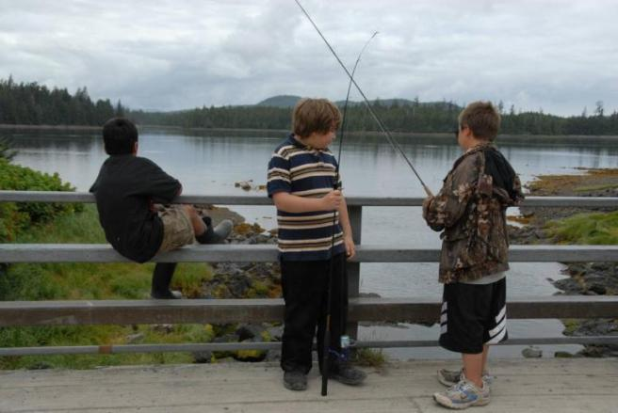
PLAN PROCESS

Slide 8
Strategic Planning Approach
Taking Stock Assessment was foundation of approach
Extensive interview process included previous LEAD workgroup members, national experts, program staff, and partners
Identified need for action-oriented, representative approach
Built on statewide, ongoing efforts, such as…
A broadly representative Planning Team and Executive Committee were formed to advise, review and endorse plan

Slide 9
Guiding Principles
#1 Be representative. Members of disparately affected groups must be part of the planning team and assist with implementation.
#2 Be action-oriented and efficient. Preemptively address “planning fatigue” by developing clear, time-framed, concrete steps for taking action.
#3 Identify target populations and focus for implementation. Focused efforts and clearly defined strategies must be a key outcome of the process.
#4 Use data to drive planning efforts. Include measures for accountability in the revised plan.

Slide 10
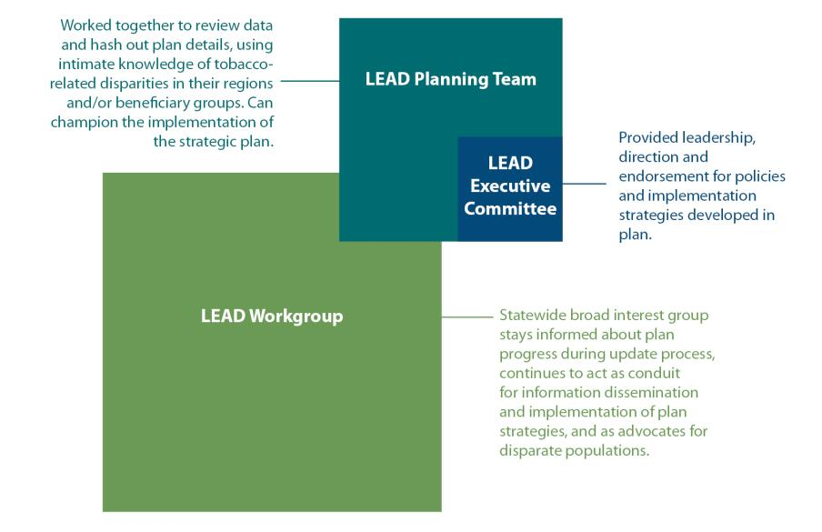
Strategic Plan Participants
Notes:
LEAD Executive Committee: This leadership group is made up of high-level decision-makers who ultimately sign off on the direction of the strategic plan, endorse the effort and champion the implementation plan.
LEAD Planning Team: This team focuses on the efficient revision of the Alaska Strategic Plan for Eliminating Tobacco-related Disparities. The team has a strong understanding of tobacco-related disparities in their regions or beneficiary groups and can champion the implementation of the strategic plan.
LEAD Workgroup: This broad interest group addresses disparities in tobacco use by helping implement the disparities plan. The group stays informed throughout the process through e-newsletters, monthly teleconferences, webpage, etc. The LEAD workgroup remains a statewide workgroup that represents and advocates for disparate populations.

Slide 11
Guiding Principle #1
Be representative. Members of disparately affected groups must be part of the planning team and assist with implementation.
The planning team consists of:
Organizations primarily representing Alaska Native people and low socioeconomic status target populations
Organizations representing young adults
Behavioral health community
Head Start and early childhood programs for low income Alaskans
evaluation and data specialists
Staff from the Tobacco Prevention and Control Program and the Section of Chronic Disease Prevention and Health Promotion.

Slide 12
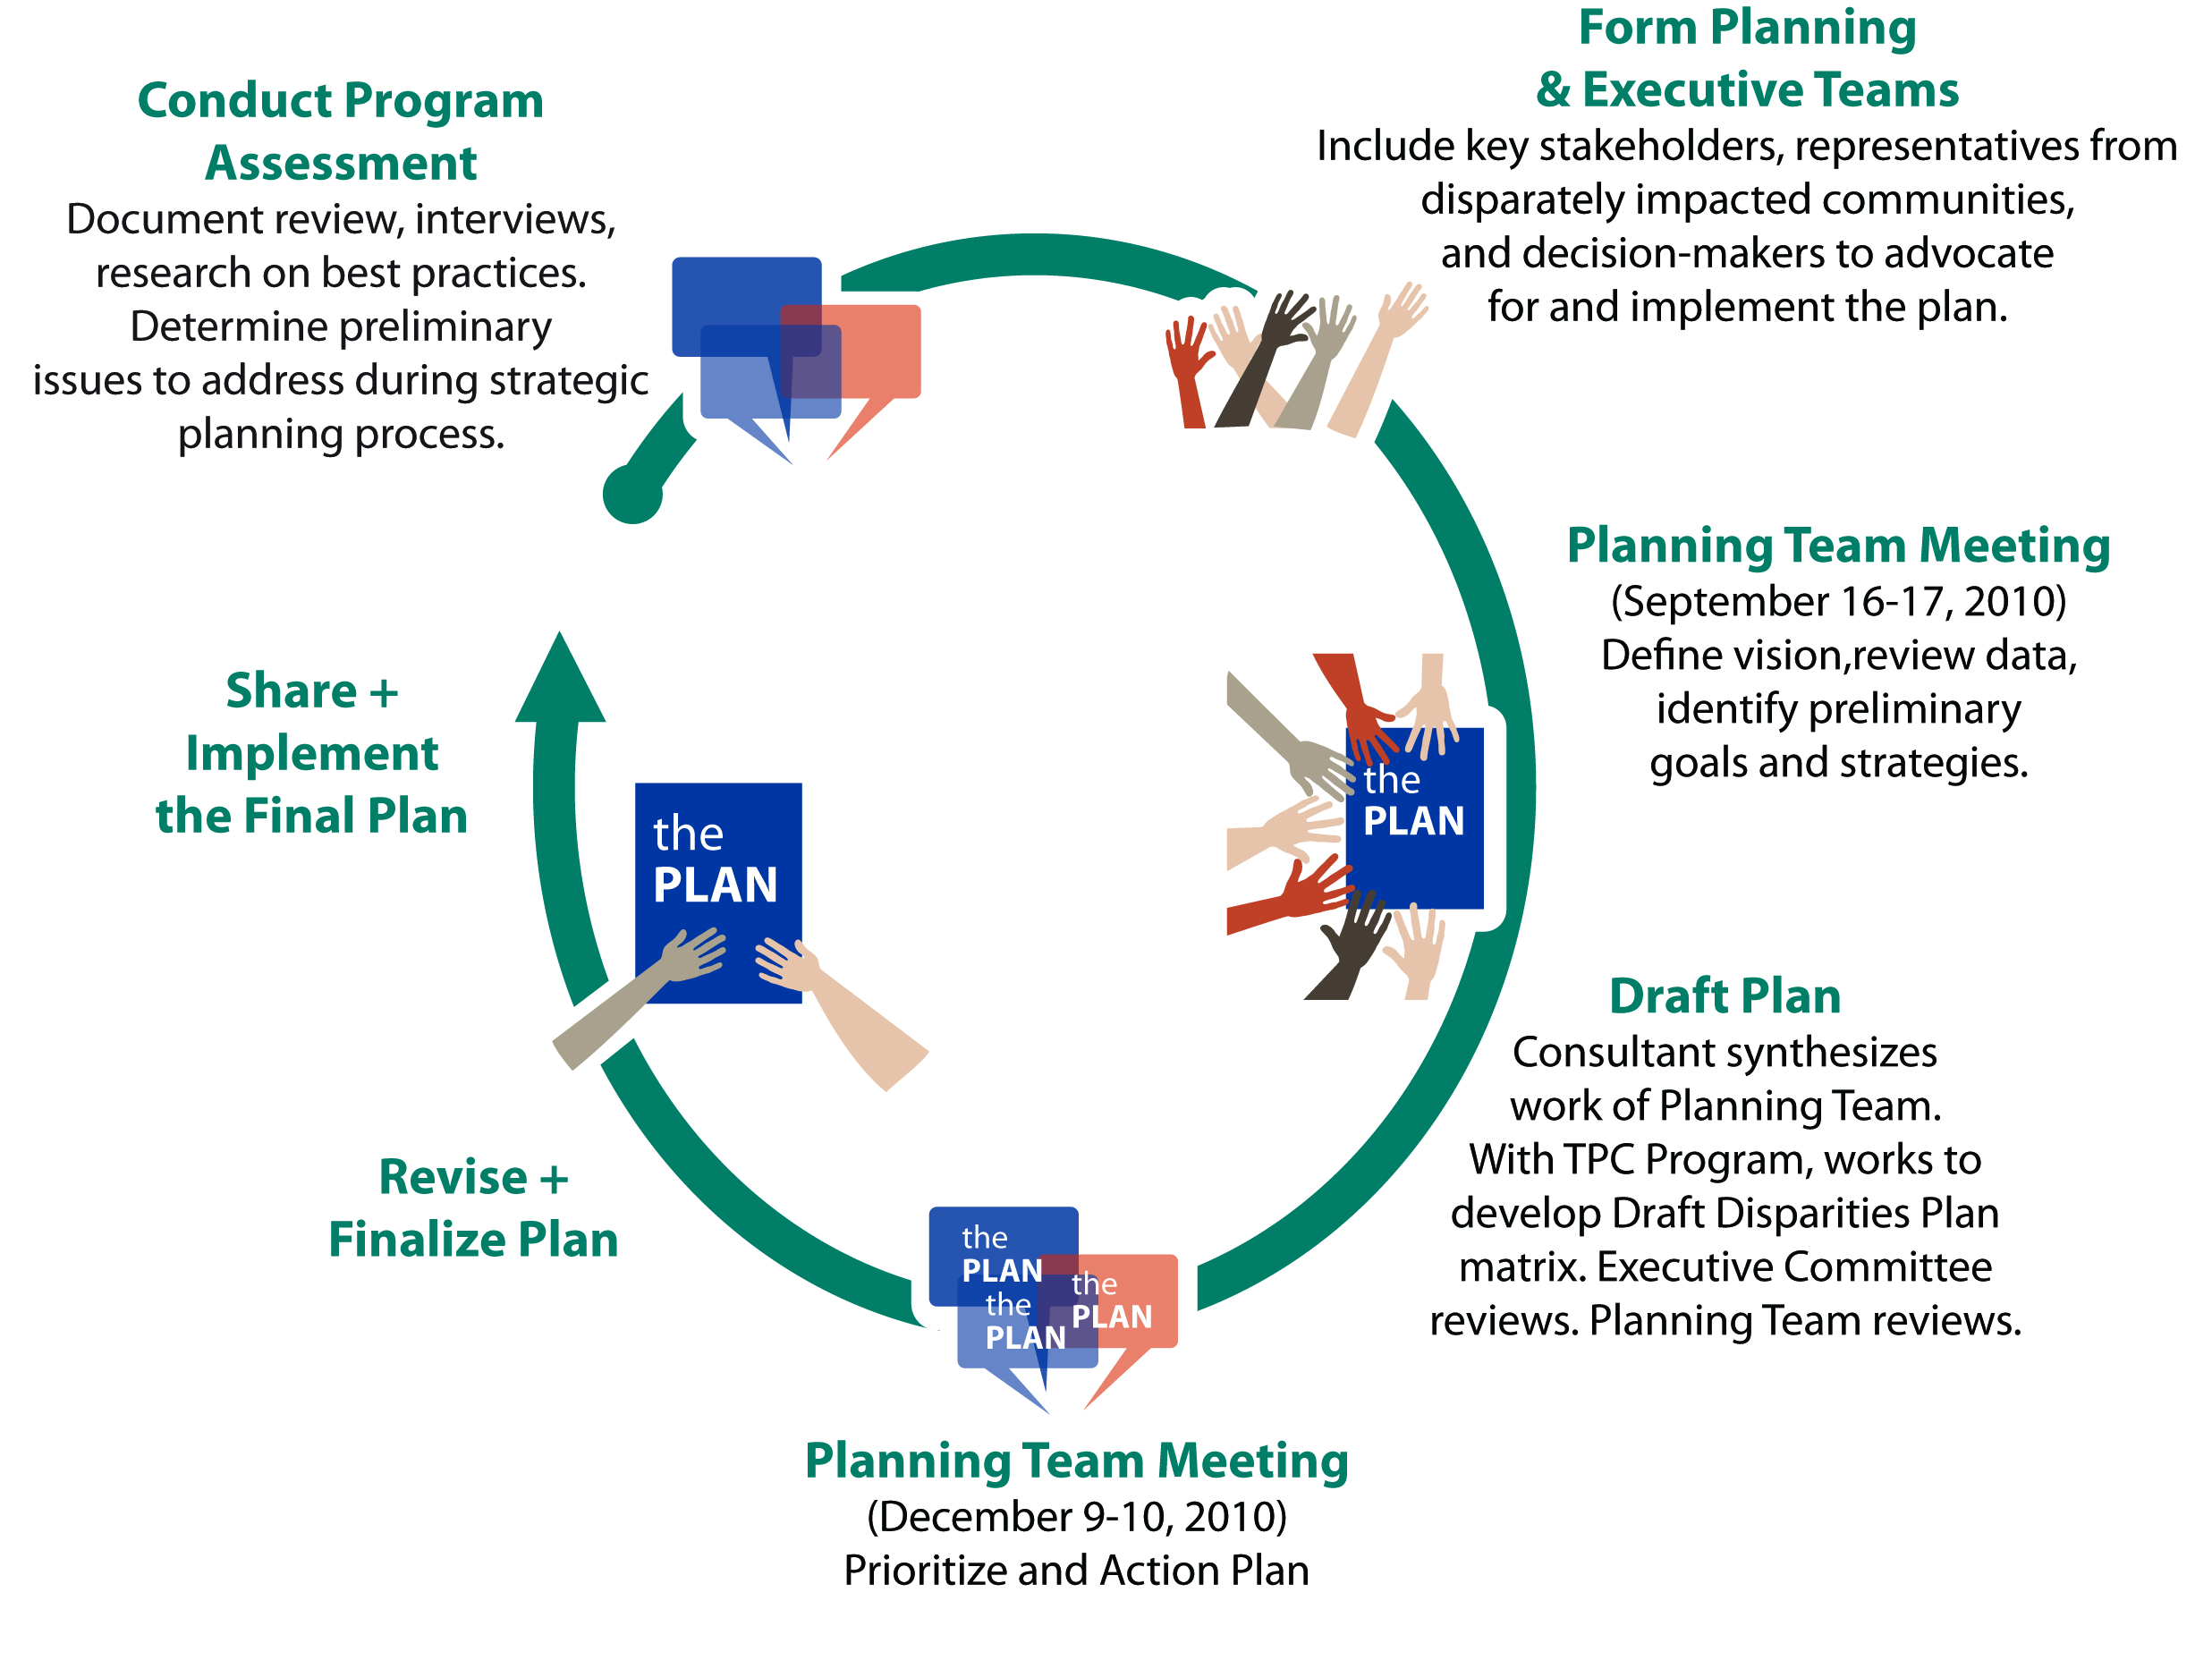
Strategic Plan Process
Notes:
The planning process began in September 2010. Over the course of the planning process, the planning team had two in-person intensive workshops and three teleconferences. The Executive Committee met twice to review plan drafts and evaluate the process. The planning team consists of people from organizations that represent disparate populations primarily from the Alaska Native and low socioeconomic status target populations. Other members represent the behavioral health community, Head Start and early childhood programs for low income Alaskans, LBGT community, evaluation and data specialists, and key staff from the Tobacco Prevention and Control Program and the Section of Chronic Disease Prevention and Health Promotion.

Slide 13
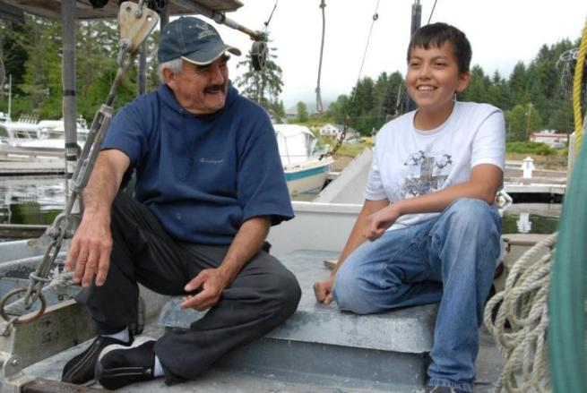
DISPARITIES + DATA

Slide 14
Defining Health Disparities
Health disparities are differences in the incidence, prevalence, mortality, and burden of diseases and other adverse health conditions that exist among specific population groups in the United States.
– National Institutes of Health (NIH)

Slide 15
Defining Disparities
Factors Contributing to Tobacco-Related Health Disparities
Tobacco Company Targeting
Culture
Work Environment
Access to Treatment
Type of Tobacco

Slide 16
Factors Used to Identify Priority Populations
Prevalence the rate of tobacco use Example: young adults aged 18-29 smoke at higher rates compared to the general population
Morbidity/Mortality illness and death from tobacco use Example: Alaska Natives have higher rates of cancer
Increased Vulnerability populations that are particularly impacted by smoking Example: pregnant women have increased vulnerability
Notes:
Prevalence is the rate of tobacco use. Prevalence rates demonstrate which groups use tobacco compared to others. In Alaska, Alaska Native people, people with low socioeconomic status, and young adults aged 18-29 use tobacco at much higher rates than the general population.
Morbidity/Mortality refers to the impact of illness and death from tobacco use. Morbidity and Mortality can increase due to factors such as access to health care, interactions with risk factors that may be more prevalent in specific populations, the type of cigarette smoked, and type and amount of tobacco used. For instance, Alaska Natives have higher rates of mortality compared to US whites for tobacco-related conditions, including cancer, heart disease, stroke and Chronic Obstructive Pulmonary Disease (COPD).
Increased Vulnerability relates to populations that are particularly impacted by smoking. For example, pregnant women have increased vulnerability because tobacco use burdens the developing child with increased risk of low birth rate, fetal death, and early childhood disease.

Slide 17
Guiding Principle #3 and #4
Identify target populations and focus for implementation.
Use data to drive planning efforts.
Plan used data to determine focus on 3 populations in Alaska which are known to have the highest tobacco use prevalence rates:
Alaska Native adults,
Adults of low socioeconomic status (Low SES), and
Young adults aged 18-29.
Notes:
It is important to note the LEAD workgroup will continue tobacco prevention and control efforts that also impact other population groups (e.g. behavioral health clients, Lesbian, Gay, Bisexual, Transgender, refugee populations, etc.). The current planning effort is a building block to develop strategies and concrete action steps that lead to reducing tobacco use among disparate populations in Alaska.

Slide 18
Data Illustrates Need
Disparities in Adult Smoking, 2008
Source: Alaska Behavioral Risk Factor Surveillance System (AK BRFSS)

Slide 19
Data Illustrates Need
Disparities in Adult Smokeless Use, AK BRFSS 2008

Slide 20
Data Illustrates Need
Disparities in Youth Smokeless Use, AK YRBS 2009

Slide 21
Data Illustrates Need
High School Smoking Prevalence by Race and Year
1995-2009 Source: Youth Risk Behavior Survey

Slide 22
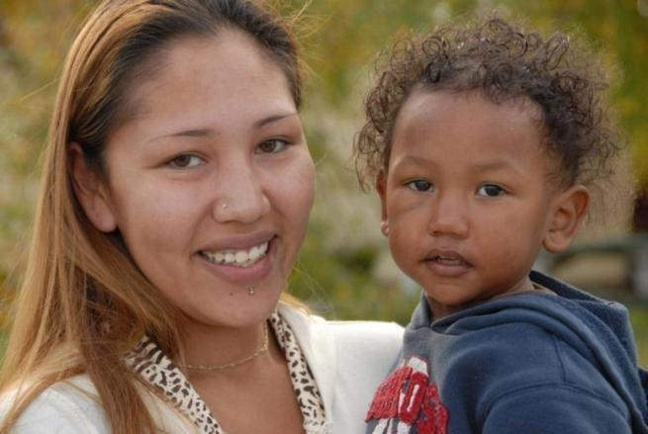
GOALS + STRATEGIES

Slide 23
Intervention Pyramid
Working at the population level – the “changing the context” level – affords the greatest impact for the least cost.
Graphic adapted from US Centers for Disease Control (CDC) by Agnew::Beck
Notes:
The LEAD planning team used a number of criteria to identify strategies relevant to Alaska communities and proven to have the greatest impact on a population as a whole. As the diagram below shows, working at this population level – the “changing the context”
level – affords the greatest impact for the least cost. Primary among those is prioritizing population-based public health strategies that fit within this “changing the context” category, in order to achieve the greatest impact for the least cost.

Slide 24
Alignment with Existing Efforts
The plan is designed to compliment and strengthen existing efforts.
Organized around the goals of the Alaska Tobacco Prevention and Control (TPC) Program and the statewide Alaska Tobacco Control Alliance (ATCA).

Slide 25
LEAD Plan Goals
GOAL 1: Prevent initiation of tobacco use among young people.
GOAL 2: Promote cessation of tobacco use among youth and adults.
GOAL 3: Protect the public from exposure to secondhand smoke.
GOAL 4: Identify and eliminate tobacco-related disparities.

Slide 26
How Goals, Strategies + Actions Fit Together
Strategic planning entailed:
Build from 4 goals.
Create “on the ground” strategies for each goal.
Prioritize strategies.
Refine and rank strategies.
Develop detailed action plans for top priority strategies.
GOAL
Strategy
Action

Slide 27
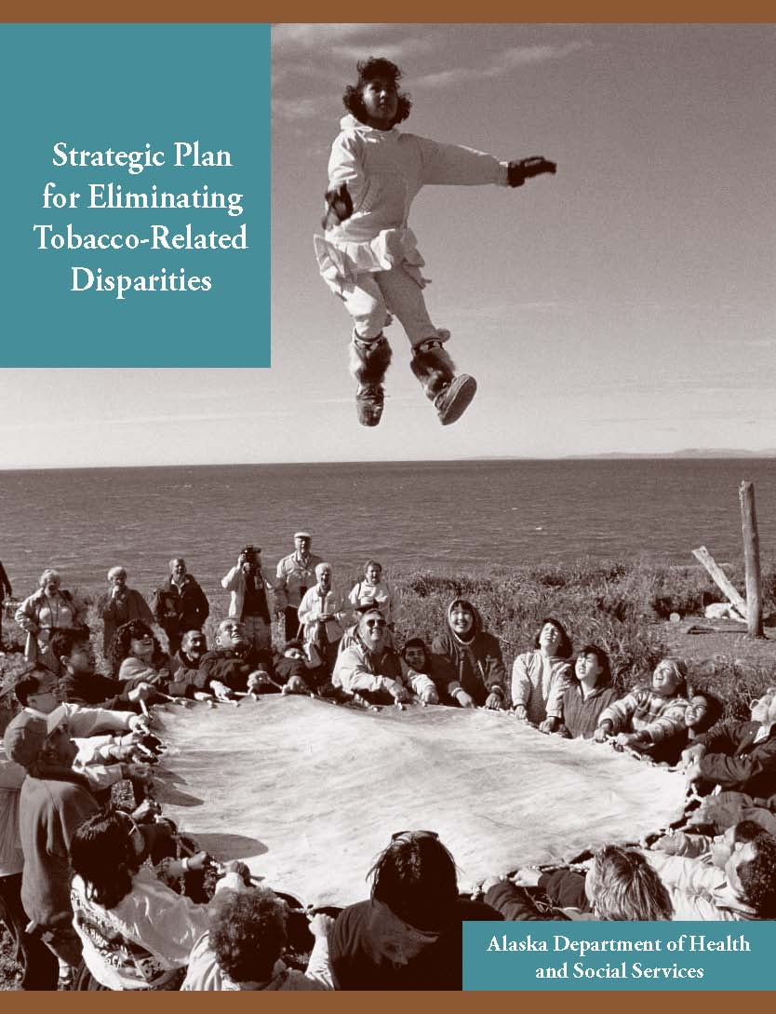
High Level Strategies
In addition to “On the Ground” strategies
Broad-based, management-level strategies
Based on 2007 LEAD Strategic Plan
Implemented by:
State agencies
Tribal health networks
Advocacy groups
Notes:
Expand Partnerships to include…
Individuals, organizations, and institutions that represent and work with the priority populations identified in this plan, specifically:
Alaska Native people and organizations serving Alaska Native people.
People of low socioeconomic status and organizations serving people of low socioeconomic status.
Young adults and organizations serving young adults.
Alaska Native Tobacco Advisory Group (ANTAG) to provide a quarterly or bi-annual tobacco prevention update to Alaska Native Health Board (ANHB) Regional Health Directors
Representation from the priority populations identified in this plan to join the LEAD workgroup.
Targeted Media + Outreach
Data, Evaluation + Best Practices
Policy
Funding + Capacity Building

Slide 28
High Level Strategies
Expand Partnerships
Targeted Media + Outreach
Data, Evaluation + Best Practices
Policy
Funding + Capacity Building
Notes:
Expand Partnerships to include…
Individuals, organizations, and institutions that represent and work with the priority populations identified in this plan, specifically:
Alaska Native people and organizations serving Alaska Native people.
People of low socioeconomic status and organizations serving people of low socioeconomic status.
Young adults and organizations serving young adults.
Alaska Native Tobacco Advisory Group (ANTAG) to provide a quarterly or bi-annual tobacco prevention update to Alaska Native Health Board (ANHB) Regional Health Directors
Representation from the priority populations identified in this plan to join the LEAD workgroup.
Targeted Media + Outreach
Data, Evaluation + Best Practices
Policy
Funding + Capacity Building

Slide 29
On the Ground Strategies
Goal 1 (Youth Prevention) Increase the number of leaders in the Alaska Native community that support, role model, and promote tobacco-free and smokefree lifestyles, primarily by implementing tobacco-free policies at events with an extensive participation of Alaska Native people.
Goal 2 (Cessation) Work with community health centers and other health professionals who serve low-income patients to institute “Ask – Advise – Refer” for tobacco use at every visit.
Goal 3 (Smokefree Air) Expand comprehensive tobacco-free campus policies among colleges, community colleges and vocational schools campuses.
Goal 4 (Identify Disparities) Change policies for state-funded substance abuse and behavioral health providers and correctional facilities to:
Make tobacco cessation treatment a reimbursable service
Implement comprehensive tobacco-free policies.
Notes:
Expand Partnerships to include…
Individuals, organizations, and institutions that represent and work with the priority populations identified in this plan, specifically:
Alaska Native people and organizations serving Alaska Native people.
People of low socioeconomic status and organizations serving people of low socioeconomic status.
Young adults and organizations serving young adults.
Alaska Native Tobacco Advisory Group (ANTAG) to provide a quarterly or bi-annual tobacco prevention update to Alaska Native Health Board (ANHB) Regional Health Directors
Representation from the priority populations identified in this plan to join the LEAD workgroup.
Targeted Media + Outreach
Data, Evaluation + Best Practices
Policy
Funding + Capacity Building

Slide 30
On the Ground Strategies
GOAL 1: Prevent initiation of tobacco use among young people.
Top Strategy:
Increase the number of leaders in the Alaska Native community that support, role model, and promote tobacco-free and smokefree lifestyles, primarily by implementing tobacco-free policies at events with an extensive participation of Alaska Native people.
Distribute tobacco education materials with all low-income assistance programs.
Strengthen and enforce tobacco-free alternative school policies .
Use social networking sites to convey tobacco prevention messages.
Identify and encourage Alaska Native youth role models.
Notes:
Ranking of Top Strategies
Alaska Native: Increase the number of leaders in the Alaska Native community that support, role model, and promote tobacco-free and smokefree lifestyles, primarily by implementing comprehensive tobacco-free policies at events where there is a large participation of Alaska Natives.
People of low socioeconomic status: Distribute tobacco education materials with all low-income assistance programs (e.g. WIC, TANF, Medicaid, and energy assistance mailings and publications).
People of low socioeconomic status: Strengthen and enforce tobacco-free alternative school policies – smokeless and smokefree campuses, school grounds, parking lots.
Young Adults aged18-29: Develop web-based tobacco prevention messaging using social networking sites.
Alaska Native: Identify and encourage Alaska Native youth role models to speak out against tobacco use and lead by example.

Slide 31
On the Ground Strategies
GOAL 2: Promote cessation of tobacco use among youth and adults.
Strategies:
Work with community health centers and other health professionals who serve low-income patients to institute “Ask – Advise – Refer” for tobacco use at every visit.
Institute worksite programs to incentivize quitting among employers of Alaska Native people.
Increase tobacco cessation messaging, resources, and interventions for disparate populations.
Increase use of Alaska’s Tobacco Quit Line among disparate populations.
Notes:
Ranking of Top Strategies
People of low socioeconomic status: Work with Community Health Centers and other health professionals who serve low-income patients to institute ‘Ask, Advise, Refer’ for tobacco use at every visit. Track and increase the rate of health care provider advice and referral for intensive tobacco cessation counseling.
Alaska Native: Engage Alaska Native regional and village corporations and other major employers of Alaska Native adults to implement worksite programs to incentivize quitting, specifically targeting tribal leadership.
Cross-cutting/affects all priority populations: Increase tobacco cessation messaging, resources, and interventions for disparate populations.
Cross-cutting/affects all priority populations: Increase use of Alaska’s Tobacco Quit Line among disparate populations.

Slide 32
On the Ground Strategies
GOAL 3: Protect the public from exposure to secondhand smoke.
Strategies:
Expand comprehensive tobacco-free campus policies among colleges, community colleges and vocational schools campuses.
Initiate tobacco-free policies at Alaska Native employer worksites.
Increase smokefree housing policies in low income housing.
Increase reach of smokefree media to disparate groups.
Implement and enforce comprehensive tobacco-free campus policies in alternatives schools.
Notes:
Ranking of Top Strategies
Young Adults aged 18-29 Implement, enforce, and expand comprehensive tobacco-free campus policies among colleges, community colleges, and vocational school campuses.
Alaska Native People Implement and enforce comprehensive tobacco-free campus policies among Alaska Native Regional and Village Corporations, Regional Housing Authorities, Tribal Health Corporations, Tribal Council Chambers, etc.
People of low SES Work with low income housing providers, and transitional housing providers to establish and enforce smokefree housing policies.
Cross-cutting/affects all priority populations: Increase the reach of smokefree media to all disparate groups.
Young Adults aged 18-29 Implement and enforce comprehensive tobacco-free campus policies in alternatives schools.

Slide 33
On the Ground Strategies
GOAL 4: Identify tobacco-related disparities for the following populations.
Strategies:
Change policies for state-funded substance abuse and behavioral health providers and correctional facilities to:
Make tobacco cessation treatment a reimbursable service, and
Implement comprehensive tobacco-free policies.
Gather data.
Target outreach to LGBT events and organizations.
Increase reach of smokefree media to disparate groups.
Implement comprehensive tobacco-free campus policies at private behavioral health, substance abuse and correctional facility treatment sites.
Notes:
Ranking of Top Strategies:
People in Behavioral Health/Substance Abuse/Correctional Institutions: Integrate language into State Division of Behavioral Health regulations to: 1st allow tobacco cessation treatment to be a reimbursable service for substance abuse and behavioral health providers and 2nd require that state funded substance abuse and behavioral health facilities and correctional facility programs implement and enforce comprehensive tobacco-free campus policies.
Other groups with suspected disparities (e.g. ethnic minorities, immigrant populations, etc.): Determine method for gathering data and add new data sets to BRFSS.
LGBT People: Targeted public outreach at events and venues statewide that have a high participation of LGBT people (e.g. Pride Fest, World AIDS Day, etc.) and work with organizations serving LGBT people.
People in Behavioral Health/Substance Abuse/Correctional Institutions: Implement and enforce comprehensive tobacco-free campus policies at private behavioral health, substance abuse and correctional facility treatment sites.

Slide 34
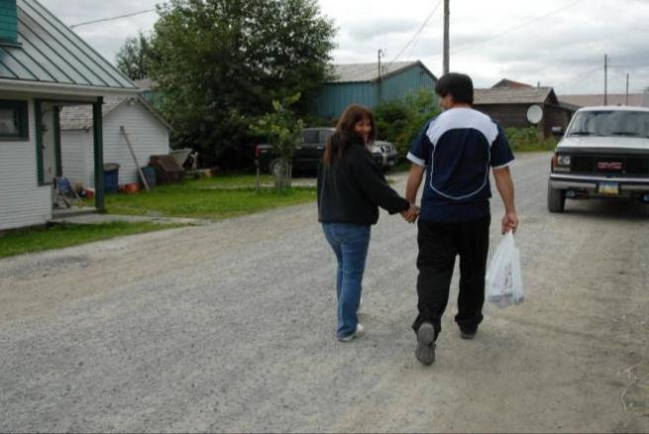
TAKING ACTION

Slide 35
Guiding Principle #2: Taking Action
Be action-oriented and efficient.
Action plans were created for the top strategy under each goal and include clear, time-framed, concrete steps for taking action
Each action plan includes: Action Item, Who’s Responsible, By When, Cost + Available Resources, Progress Measures, Collaborators + Key Contacts
GOAL
Top Strategy
Action Plan
Notes:
The LEAD Planning Team developed action plans for the top strategy in each goal area. Top strategies will remain in place until each strategy has been fully implemented and sustained. Action plans for each top strategy will be reviewed and updated as progress is made.
While multiple strategies developed for each goal only the top strategy was action planned.

Slide 36
Sample Action Plan

Slide 37
Taking Action
Goal 1: Prevent initiation of tobacco use among young people.
Priority Population: Alaska Native People
Priority Strategy:
Increase the number of leaders in the Alaska Native community that support, role model, and promote tobacco-free and smokefree lifestyles, primarily by implementing comprehensive tobacco-free policies at events where there is a large participation of Alaska Natives.

Slide 38
Goal 1: Action Steps
Identify target events and dates, e.g. Elders & Youth Conference at Alaska Federation of Natives Convention, Southeast Alaska Grand Camp, Indian Education Conference, Rural Providers Conference, NYLC.
Get on the agendas of identified/targeted events.
Determine which messages resonate with the population we’re trying to reach – Alaska Native leadership.
Develop materials for presenters that share the following: rationale for implementing tobacco-free policies, importance of role modeling tobacco-free and smoke free lifestyles, disparities data and goals of the LEAD workgroup.
Work with event organizers, leadership & youth to draft written tobacco-free campus policies.
Assist event organizers, leadership & youth in passing and enforcing comprehensive tobacco- free campus policies.

Slide 39
Taking Action
Goal 2: Promote cessation of tobacco use among youth and adults.
Priority Population: People of Low Socioeconomic Status (SES)
Priority Strategy:
Work with Community Health Centers and other health professionals who serve low-income individuals to institute Ask, Advise, Refer (AAR) for tobacco use at every visit. Track and increase the rate of health care provider advice and referral for intensive tobacco cessation counseling.
Notes:
Establish LEAD subgroup.
Engage the Alaska Primary Care Association. Inventory CHCs and other health professionals who serve low-income individuals outside of the tribal health network.
Determine mechanism for identifying which CHCs to target in year one outside of tribal health.
Inventory electronic health record (EHR)/AAR capacity.
Investigate successful models (KANA) to replicate/adapt.
Advocate – meet with CHC leaders/Alaska Primary Care Association.
Expand online training (akbriefintervention.org) for providers, i.e. CHC specific, dental & behavioral health.

Slide 40
Goal 2: Action Steps
Establish LEAD subgroup.
Engage the Alaska Primary Care Association. Inventory CHCs and other health professionals who serve low-income individuals outside of the tribal health network.
Determine mechanism for identifying which CHCs to target in year one outside of tribal health.
Inventory electronic health record (EHR)/AAR capacity.
Investigate successful models (KANA) to replicate/adapt.
Advocate – meet with CHC leaders/Alaska Primary Care Association.
Expand online training (akbriefintervention.org) for providers, i.e. CHC specific, dental & behavioral health.

Slide 41
Taking Action
Goal 3: Protect the public from exposure to secondhand smoke.
Priority Population: Young adults aged 18-29
Priority Strategy:
Implement, enforce, and expand comprehensive tobacco-free campus policies among colleges, community colleges, and vocational school campuses.
Notes:
Establish a LEAD subgroup
Identify/Inventory vocational schools in Alaska
Inventory tobacco free campus policies at identified schools
Determine which schools to target in year one and which might have assistance from a community grantee or a student/staff champion
Supply educational services and cessation services (or materials)
Assist school leadership in developing and enforcing tobacco free campus policies

Slide 42
Goal 3: Action Steps
Establish a LEAD subgroup.
Identify/Inventory vocational schools in Alaska.
Inventory tobacco free campus policies at identified schools.
Determine which schools to target in year one and which might have assistance from a community grantee or a student/staff champion.
Supply educational services and cessation services (or materials).
Assist school leadership in developing and enforcing tobacco free campus policies.

Slide 43
Taking Action
Goal 4: Identify tobacco-related disparities.
Priority Population: People in behavioral health, substance abuse and correctional programs and institutions
Priority Strategy:
Integrate language into State Division of Behavioral Health regulations to:
Allow tobacco cessation treatment to be a reimbursable service for substance abuse and behavioral health providers and
Require that state funded substance abuse and behavioral health facilities and correctional facility programs implement and enforce comprehensive tobacco-free campus policies
Notes:
Propose action plan to existing LEAD Nicotine Addiction in Behavioral Health (NABH) subgroup
Meet with DBH leaders to get buy-in
Adoption of curriculum into counselor certification (Alaska Commission on Behavioral Health Certification Board + CDC)
Develop curriculum dissemination plan – Present at the Annual School on Addictions Conference
Inventory reimbursement + current smokefree policies of state funded facilities
Determine mechanism for identifying which state funded substance abuse/behavioral health facilities to target in year one
Investigate successful models (Rainforest Recovery) to replicate/adapt

Slide 44
Goal 4: Action Steps
Propose action plan to existing LEAD Nicotine Addiction in Behavioral Health (NABH) subgroup.
Meet with DBH leaders to get buy-in.
Adoption of curriculum into counselor certification (Alaska Commission on Behavioral Health Certification Board + CDC).
Develop curriculum dissemination plan – Present at the Annual School on Addictions Conference.
Inventory reimbursement + current smokefree policies of state funded facilities.
Determine mechanism for identifying which state funded substance abuse/behavioral health facilities to target in year one.
Investigate successful models (Rainforest Recovery) to replicate/adapt.

Slide 45
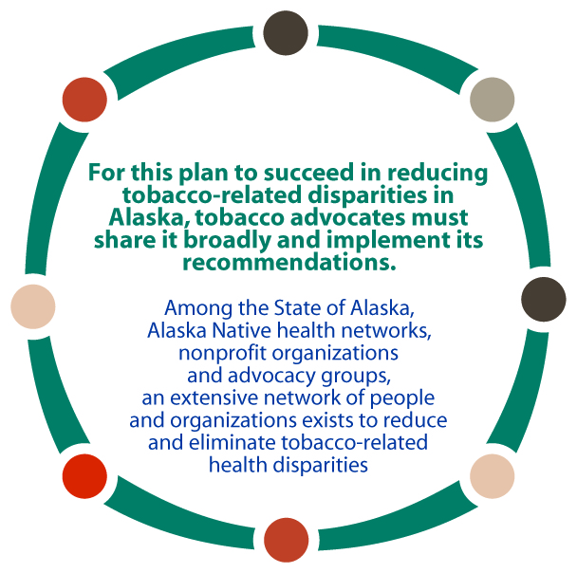
Collaboration

Slide 46
Implementation
The LEAD workgroup and the TPC Disparities Coordinator will assist with and track implementation
Encourage TPC grantees to implement LEAD strategies in their own communities.
Create and maintain LEAD sub groups.
Promote and educate stakeholders about LEAD strategies.
Monitor action plan progress.
Collaborate with existing local and regional coalitions to implement LEAD strategies and ailor strategies for different regions of Alaska.
Work with chronic disease programs that share LEAD’s priority populations.
Work closely with the Alaska Native Tribal Health Consortium (ANTHC), regional health corporations, ANHB, and ANTAG implement LEAD’s systems-change approaches.

Slide 47
Acknowledgements
Executive Committee
Brandon Biddle, Alaska Native Health Board
Dr. Gary Ferguson, Alaska Native Tribal Health Consortium and Alaska Native Tobacco Advisory Group
Emily Nenon, American Cancer Society Cancer Action Network
Andrea Fenaughty, PhD, State of Alaska Section of Chronic Disease Prevention and Health Promotion
Planning Team
Pearl Brower, Ilisagvik College
Joie Brown, RurAL CAP
Dana Diehl, Alaska Tobacco Prevention & Control Program
Erin Edin, Kids’ Corps Inc.
Bette Fenn, University of Alaska Anchorage Student Health Clinic
Gabriel Garcia, PhD, University of Alaska Anchorage Department of Health Sciences
Kelly Keyes, RN, Norton Sound Health Corporation
LaRita Laktonen, Southcentral Foundation and Cook Inlet Native Head Start
Connie Markis, Anchorage Neighborhood Health Center, Healthcare for the Homeless
Ella Morris, RurAL CAP
Laura Muller, American Lung Association-Alaska
Caroline Nevak, Aleutian Pribilof Islands Association, Inc.
Danya Olson, Galena Clinic
Michael Powell, State of Alaska Division of Behavioral Health
Andrea Thomas, Southeast Alaska Regional Health Consortium
State of Alaska Tobacco Prevention and Control Program Staff
Matthew Bobo
Dana Diehl
Jessica Harvill
Alexandria Modigh-Hicks
Lauren Kelsey
Alison Kulas
Erin Peterson
Joanne Zito-Brause

Slide 48
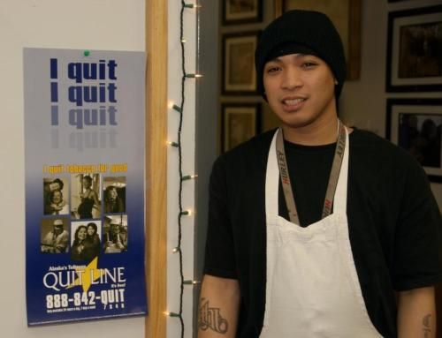
Thank You for Assisting this Effort!
For a copy of this Presentation or to participate in the LEAD effort, please contact:
Dana Diehl, Disparities Coordinator
dana.diehl@alaska.gov
907-334-2226
Notes:
The LEAD Planning Team developed action plans for the top strategy in each goal area. Top strategies will remain in place until each strategy has been fully implemented and sustained. Action plans for each top strategy will be reviewed and updated as progress is made.
While multiple strategies developed for each goal only the top strategy was action planned. 4 more slides with all the action plans.
The Following groups and individuals participated in the update of the Alaska Strategic Plan for Eliminating Tobacco-Related Disparities
Executive Committee
Brandon Biddle, Alaska Native Health Board
Dr. Gary Ferguson, Alaska Native Tribal Health Consortium and Alaska Native Tobacco Advisory Group
Emily Nenon, American Cancer Society Cancer Action Network
Andrea Fenaughty, State of Alaska Section of Chronic Disease Prevention and Health Promotion
Planning Team
Pearl Brower, Ilisagvik College
Joie Brown, RurAL CAP
Dana Diehl, Alaska Tobacco Prevention & Control Program
Erin Edin, Kids’ Corps Inc.
Bette Fenn, University of Alaska Anchorage Student Health Clinic
Gabriel Garcia, PhD, University of Alaska Anchorage Department of Health Sciences
Kelly Keyes, RN, Norton Sound Health Corporation
LaRita Laktonen, Southcentral Foundation and Cook Inlet Native Head Start
Connie Markis, Anchorage Neighborhood Health Center, Healthcare for the Homeless
Ella Morris, RurAL CAP
Laura Muller, American Lung Association-Alaska
Caroline Nevak, Aleutian Pribilof Islands Association, Inc.
Danya Olson, Galena Clinic
Michael Powell, State of Alaska Division of Behavioral Health
Andrea Thomas, Southeast Alaska Regional Health Consortium
Persons Interviewed
Joie Brown, Rural Alaska Community Action Program, Inc.
Susan Brown, Centers for Disease Control and Prevention
Andrea Fenaughty, State of Alaska Section of Chronic Disease Prevention and Health Promotion
Gary Ferguson, Alaska Native Tribal Health Consortium
Gabriel Garcia, University of Alaska Anchorage
Wendy Hamilton, National Council on Alcoholism and Drug Dependence
LaRita Laktonen, Southcentral Foundation-Health Education
Luci Longoria, State of Oregon Public Health Division
Connie Markis, Anchorage Neighborhood Health Center, Healthcare for the Homeless
Laura Muller, American Lung Association-Alaska
Emily Nenon, American Cancer Society
Erin Peterson, State of Alaska Tobacco Prevention and Control Program
Barbara Pizacani, Program Design & Evaluation Services
Tom Rachal, Community Member
Andrea Thomas, Southeast Alaska Regional Health Consortium
Marilynn Thorson, Bristol Bay Area Health Corporation
Laurie Weise, Southcentral Foundation-Health Education
Consultants
Agnew::Beck
Program Design and Evaluation Services
State of Alaska Tobacco Prevention and Control Program Staff
Matthew Bobo
Dana Diehl
Jessica Harvill
Alexandria Modigh-Hicks
Lauren Kelsey
Alison Kulas
Erin Peterson
Joanne Zito-Brause
Maybe we don’t have to include all these names on the ppt or they could just be the final slide that we don’t talk about much.

