Slide 1
Guidelines for the Management of Acute Blunt Head Trauma in Alaska 2017
Frank Sacco MD FACS
11/2017

Slide 2
Isolated Blunt Head Injury in Alaska 2011-2015
1873 Isolated blunt head injuries.
About half (966) taken care in Anchorage/Seattle , Half (907) at hospital without neurosurgical capability
74.5% (1397) GCS of 14,15
10.2% (191) GCS 9-13
15.2% (285) GCS 3-8
About one patient /day admitted with isolated blunt head trauma. Many more patients when you consider patients seen and discharged from EDs and patients with TBI and multisystem trauma are not included in these numbers

Slide 3
Transferred Patients from Non-neurosurgical Facilities Sample 600pts with CT report and entered in state trauma registry
Mild 44% transfer rate Transferred patients CT scans 82% abnormal 18% normal
Moderate 66% transfer rate
Severe 70% transfer rate

Slide 4
Patients kept in Non-neurosurgical facilities with GCS 14-15 (sample 260)
260 patients with GCS 14 or 15 initially admitted non-neurosurgical facilities.
6.5% Secondary transfer rate (Transfer to another facility after initial admission at another hospital)
There were no deaths in this group of 260 patients initially admitted to non-neurosurgical facilities.

Slide 5
Natural History of Minor and Moderate Head Injury

Slide 6
Teleradiology and Neurosurgical consults
Head injured patients can be managed using teleradiology with neurosurgeon review.
Telehealth consultations reduce patient transfers with subsequent low rates of late transfer due to either clinical or radiological deterioration.
Ashkenazi I, Zeina AR, Kessel B, Peleg K, Givon A, Khashan T, Dudkiewicz M, Oren M, Alfici R, Olsha O. Effect of teleradiology upon pattern of transfer of head injured patients from a rural general hospital to a neurosurgical referral centre: follow-up study. Journal of Emergency Medicine. 2015;32(12):946-50.
Moya M, Valdez J, Yonas H, Alverson D. The impact of a telehealth web-based solution on neurosurgery triage and consultation. Telemedicine Journal and E-Health. 2010;16:945-949.

Slide 7
Teleradiology for Head Injury
Italy
Germany
Israel
All with extensive use and experience with Teleradiology for TBI.
All showed 60-70% reduction in need for transfer

Slide 8
Results of UNM Gallup Teleradiology Pilot
42% (11) patients were treated locally
58% (15) patients were transferred to UNMH or elsewhere

Slide 9
2003 Alaska Head Injury Guidelines
Guidelines developed when many rural facilities did not have CT scan on site.
Question in 2003 “Which patients with blunt head trauma need to be transferred for Neurosurgical care or CT imaging?”
Since then many rural facilities have acquired CT scan availability
Neurosurgery still only consistently available in Anchorage or Seattle.
The additional Question today 2017 is “Which patients with blunt head trauma and abnormal head CT scans need to be transferred to a facility with neurosurgical capabilities ?”

Slide 10
Medevac Safety and Availability
(NIOSH) reported that commercial pilots flying on commuter airlines or charters in Alaska have a mortality rate five times that of pilots in the rest of the United States.²
Although the safety of aeromedical evacuation services has improved over time, the risk to patients and flight crews remains an important factor in deciding to transfer patients.
Despite increased availability of medevacs it is still a limited resource and if it is activated the region may be uncovered for time critical emergencies .

Slide 11
Medevac Costs
The cost of aeromedical transportation varies greatly across the state.
Fixed wing transportation costs to Anchorage ranges from $19,000 from the Mat-Su Valley to $82,000 from Barrow.
Transport costs to Seattle, average approximately $160,000 per transport.
Aeromedical evacuation costs in the Southeast region are similar to Anchorage or Seattle .
These risks and costs must be weighed when considering patient transport.

Slide 12
Medivac Cost by City Transfer to Anchorage vs Seattle

Slide 13
2017 Management of Head Injured Patients
Since 2003 many rural facilities have acquired CT scan availability.
Neurosurgery still only consistently available in Anchorage or Seattle.
The dominant Question today 2017 is:
“Which patients with blunt head trauma and abnormal head CT scans need to be transferred to a facility with neurosurgical capabilities ?”

Slide 14
Head Trauma Guideline Task Force
Frank Sacco M.D. Chair. General Surgery. Anchorage. Trauma Director, Alaska Native Medical Center.
Cody Augdahl M.D. Family Medicine. Nome. Norton Sound Health Corporation.
Elisha Brownson M.D. General Surgery. Anchorage. Alaska Native Medical Center.
Suzanne Fix M.D. Neurosurgery. Anchorage. Coastal Neurology and Neurosurgery.
Ellen Hodges M.D. Family Medicine. Bethel. Yukon-Kuskokwim Health Corporation.
Rick Janik R.N. Juneau. Bartlett Regional Hospital.
Maria Mandich M.D. Emergency Medicine. Fairbanks. Fairbanks Memorial Hospital.
Darrell Mathieu I.D.M.T. Elmendorf Air Force Base.
Ryan McGhan M.D. Intensive Care. Anchorage. Providence Alaska Medical Center.
William Montano M.D. General Surgery. Fairbanks.
Patti Paris M.D. Emergency Medicine. Anchorage. Alaska Native Medical Center.
Julie Rabeau R.N. Anchorage. Department of Health and Social Services.
Ambrosia Romig M.P.H. Anchorage. Department of Health and Social Services.
Ben Rosenbaum M.D. Neurosurgery. Anchorage. Anchorage Neurosurgical Associates.
Ryan Urbonas M.D. Neurosurgery. Anchorage. Alaska Native Medical Center.
Joel Verbrugge M.D. Radiology. Anchorage. Alaska Native Medical Center.
Anne Zink M.D. Emergency Medicine. Mat-Su Regional Medical Center.

Slide 15
Methods
Ad Hoc committee formed comprised of Neurosurgeons, Trauma surgeons, ED physicians, Hospitalist/Critical Care, Radiology and prehospital representation.
Anchorage
Fairbanks
Nome
Bethel
Juneau
JBER
MatSu

Slide 16
Methods
The literature on evaluating head injured patients was reviewed by a subgroup of providers.
Special attention to guidelines from other organizations and from prospective or high volume retrospective studies.
Synopsis of pertinent literature and references for these studies sent out to participants prior to the meeting.
Previous guidelines included for review.
Meeting convened on February 2017
Guidelines approved and disseminated October 1 2017.
Will do interim review Spring 2018.

Slide 17
Limitations-Small Children and Infants
Evaluation of head trauma in infants and small children presents challenges. These guidelines apply to clinical practice for children over the age of five.
Issues include:
Younger children are at higher risk for reactive cerebral edema.
Sedation is required for CT in the very young and carries a small but significant risk.
Lifetime radiation risk from CT is theoretically higher. 1 fatal malignancy /1000-10000 scans.
Availability of skilled medical personnel with training to monitor the very young patient.
(Alaska Guidelines for under 5yo to be developed in 2018)

Slide 18
Limitations –Alcohol and Drug Use.
GCS utility is limited as triage tool however presence of risk factors still suggests need for CT in severely impaired patients.
If no signs of trauma, but GCS ≤13
Patients should be monitored by a healthcare provider with hourly neurochecks.
If clinical deterioration, head CT scan should be obtained or the patient should be transferred for CT imaging.
If there no clinical improvement (return to GCS 15) after six hours, a head CT scan should be obtained or the patient should be transferred for CT imaging.

Slide 19
Limitations- other conditions
These guidelines do not apply to strokes or hemorrhage not associated with trauma.
- apply for blunt head trauma and are not recommended for penetrating head trauma.
- apply to isolated head injury and are not recommended for patients with significant multi-trauma injuries.

Slide 20
Definitions-Acute Blunt Head Trauma
Blunt traumatic brain injury (TBI) is a disruption in the normal function of the brain that can be caused by a bump, blow, or jolt to the head.
Includes falls that lead to head strike, including ground level.
An acute injury is one that is evaluated within 24 hours of the traumatic event.

Slide 21
Definitions-Medical observation
Neuro checks performed by a health care provider, at least hourly for a minimum of six hours.
The patient should remain at the facility for a health care provider to perform these checks.
Medical observation may be liberalized if the patient returns to GCS 14-15.

Slide 22
Definitions-Glasgow Coma Scale
Eye(s) Opening
Spontaneous 4
To speech 3
To pain 2
No response 1
Verbal Response
Oriented to time, place, person 5
Confused/disoriented 4
Inappropriate words 3
Incomprehensible sounds 2
No response 1
Best Motor Response
Obeys commands 6
Moves to localized pain 5
Flexion withdraws from pain 4
Abnormal flexion 3
Abnormal extension 2
No response 1

Slide 23
Definition-Patients on Anti-coagulant and anti-platelet therapy
Patients who are on anti-coagulants or anti-platelet therapy pre-injury have been found to be at increased risk of intracranial hemorrhage following blunt head trauma.¹²⁻¹⁵
Anti-coagulants
warfarin
direct oral anticoagulants (DOACs).
Anti-platelet therapy includes clopidogrel and aspirin.
excluding aspirin therapy alone up to 325mg/day.

Slide 24
Risk Factors
*** RISK FACTORS
Clinical or radiographic signs of skull fracture
Fracture on skull x-ray
Hemotympanum
Battle’s sign
Raccoon eyes
CSF leak
***RISK FACTORS
Age > 65
Anticoagulation/Coagulopathy
Focal neurologic deficit
New onset seizures
Vomiting > 2 episodes
Amnesia > 30 minutes
High energy mechanism

Slide 25
Definitions-Abnormal CT findings not requiring neurosurgical consultation or transfer:
Several imaging abnormalities have been found to have no clinical significance or risk for deterioration in the setting of isolated blunt head trauma.^{3,11}
Non-depressed skull fracture, open or closed
Isolated pneumocephalus
Solitary cerebral contusion < 10mm
Multiple cerebral contusions < 5mm
Subarachnoid hemorrhage < 5mm
Subdural hemorrhage < 5 mm
These exceptions do not apply to patients who are on anti-coagulant or anti-platelet therapy.

Slide 26
Guidelines for the Management of Acute Blunt Head Trauma in Alaska

Slide 27
GCS 15 without risk factors
Canadian CT Head Rule:
A non-contrast head CT should be considered in head trauma patients with no LOC or post-traumatic amnesia if there is any of the following factors present:
Suspected open or depressed skull fracture
Signs of basilar skull fracture (hemotympanum, raccoon eyes, Battle’s sign, oto-/rhinorrhea)
2 or more episodes of vomiting
Age ≥ 65
Failure to reach GCS 15 within 2 hours of injury
Retrograde amnesia to the event ≥30 minutes
Dangerous mechanism of injury (pedestrian struck, ejected from MVC, fall from > 3 feet)
**These criteria exclude age < 16, use of blood thinners, or patients with seizure after injury or neurologic deficit.

Slide 28
GCS 14 without risk factors
GCS 14 without risk factors
Medical observation for 2 hrs.
If GCS improves to 15 NO CT and discharge home with head injury patient education sheet.
If no improvement CT scan head and cspine
Normal CT – observe until GCS 15
Repeat CT if deterioration or no clinical improvement in 23 hrs.
GCS drop 2 is significant
Abnormal CT findings -Neurosurgical Teleradiology Consult
Send images for review.
Transfer or admit locally for observation after neurosurgery consult

Slide 29
GCS 9-13 and GCS 14 with risk factors
All patients should have a CT scan
If CT scan is normal
Admit locally for medical observation.
Consider repeat CT if deterioration or no clinical improvement in 23 hrs.
GCS drop of 2 or more is clinically significant.
If CT is abnormal
Send images for Neurosurgery Teleradiology Consult
Transfer to trauma center or admit locally for observation based on neurosurgery consultation

Slide 30
GCS 8 or less
Protect the airway.
Avoid hypoxia and hypotension
Elevate head of bed if possible.
Cspine immobilization.
CT scan of head and Cspine if doesn’t delay transfer.
Send images for review.
Normal CT –Consult Trauma Service
Abnormal CT - Transfer to Trauma Center with neurosurgical capability

Slide 31
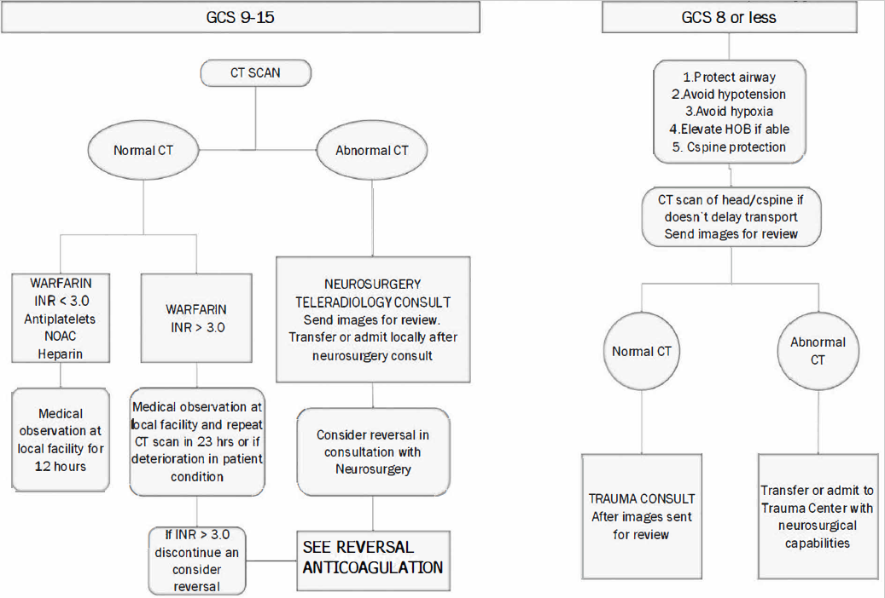
ANTICOAGULATION OR ANTIPLATELET THERAPY (Including ground level falls, excluding patients on aspirin)
GCS 14 or 15 who are on anti-coagulants or anti-platelet therapy. a non-contrast CT head should be obtained and consideration of C-spine CT if clinically indicated.
Warfarin - INR level <3. If the head CT imaging is normal , medical observation locally for a minimum of 12 hours.
After medical observation and GCS to 15 discharge with a competent observer and head injury patient education sheet.
The patient should be counseled that they are at increased risk of a delayed bleed and should be given warning signs requiring repeat medical evaluation.

Slide 32
ANTICOAGULATION OR ANTIPLATELET THERAPY (Including ground level falls, excluding patients on aspirin)
GCS 14-15
CT imaging normal, INR level is ≥ 3 medical observation locally with a repeat head CT in 23 hours or if clinical deterioration. Discontinuation of warfarin therapy and consideration of reversal as clinically appropriate.
If repeat CT imaging remains normal, patient may be discharged with a competent observer and head injury patient education sheet.
The patient should be counseled that they are at increased risk of a delayed bleed and should be given warning signs requiring repeat medical evaluation.

Slide 33
ANTICOAGULATION OR ANTIPLATELET THERAPY (Including ground level falls, excluding patients on aspirin)
CT imaging is abnormal Images via teleradiology for review by a neurosurgeon. Local admission or transfer based on neurosurgical recommendations. Consideration of reversal should be made in consultation with neurosurgery.
Patients with GCS ≤ 13, the previous guidelines may be followed. Check INR levels if the patient is on warfarin therapy. Consideration of reversal if the INR is ≥ 3 or if CT shows intracranial hemorrhage.

Slide 34
REVERSAL ANTICOAGULATION ON ACUTE BLUNT HEAD TRAUMA PATIENTS (Including ground level falls, excluding patients on aspirin)

Slide 35
ABNORMAL CT FINDINGS USUALLY NOT REQUIRING CONSULTATION OR TRANSFER
**ABNORMAL CT FINDINGS NOT REQUIRING CONSULTATION OR TRANSFER
Non depressed skull fracture open or closed
Solitary cerebral contusion < 10mm
Multiple cerebral contusions < 5mm
Subarachnoid hemorrhage < 5mm
Isolated pneumocephalus
Subdural hematoma< 5 mm
DOESN’T APPLY TO PATIENTS ON ANTICOAGULATION

Slide 36
Emergency Craniotomy
Decision should only be made in consultation with a neurosurgeon.
Decompressive craniotomy or burr holes should be a consideration only if:
-There is CT imaging consistent with an epidural or subdural hematoma.
-The patient is rapidly deteriorating.
-A facility with a neurosurgeon is more than two hours away.
Most importantly, there needs to be a surgeon capable of doing the procedure along with the necessary equipment.

Slide 37
Non Salvageable Head Injuries
Patients should be medically optimized with:
protection of the airway, avoidance of hypoxia, avoidance of hypotension, elevating the head of bed to greater than thirty degrees if possible, and cervical spine immobilization.

Slide 38
Non Salvageable Head Injuries
Patients should undergo CT scan imaging and prompt neurosurgical teleradiology consult.
In some circumstances, it is reasonable not to transport these patients to a facility with neurosurgical capabilities.
This decision should be made with the input of a neurosurgical consultation.
It is appropriate to transport patients with brain death or impending brain death that are potential organ donors.

Slide 39
Conclusions
An approach to the evaluation of head injured patients in Alaska, including facilities that do not have a neurosurgeon or CT imaging available.
It is an attempt to combine a reading of current literature with the realities of medical practice and resource availability in our state.
It is not meant to replace clinical judgment.
There are limits to the applicability of these guidelines, including small children and infants and patients under the influence of drugs or alcohol.

Slide 40
Conclusions
Our state is unique in the factors that may play into obtaining CT scans or neurosurgical consults, especially the frequent need for aeromedical transport and delays in care.
Our hope is that this will offer some guidance to clinicians faced with caring for the head injured patient in this very challenging environment.
In addition, it will help us utilize our transport and subspecialty resources in a safe, responsible, and efficient manner.

