Slide 1
Summary of HIV Infection in Alaska, 1982–2019
Prepared by the State of Alaska Department of Health and Social Services, Division of Public Health, HIV/STD Program, Section of Epidemiology. For questions about this presentation please visit http://www.epi.hss.state.ak.us/hivstd/default.stm or call the Alaska Section of Epidemiology at
(907) 269-8000.
State of Alaska, Section of Epidemiology – May 2020

Slide 2
Highlights, Cumulative HIV Cases,
1982-2019 (N=1,959)
1,254 (64%) ever had a diagnosis of AIDS
683 (35%) are known to have died
1,580 (81%) were male
1,182 (60%) were men who have sex with men (MSM) including 160 MSM/IDU; 365 (19%) were heterosexual (Hetero) and 216 (11%) were IDU
1,006 (51%) were White; 384 (20%) were Alaska Native/American Indian; 273 (14%) were Black
1,262 (64%) had an initial diagnosis in Alaska; 866 (67%) of those were living in Anchorage/Mat-Su at the time of diagnosis
State of Alaska, Section of Epidemiology – May 2020

Slide 3
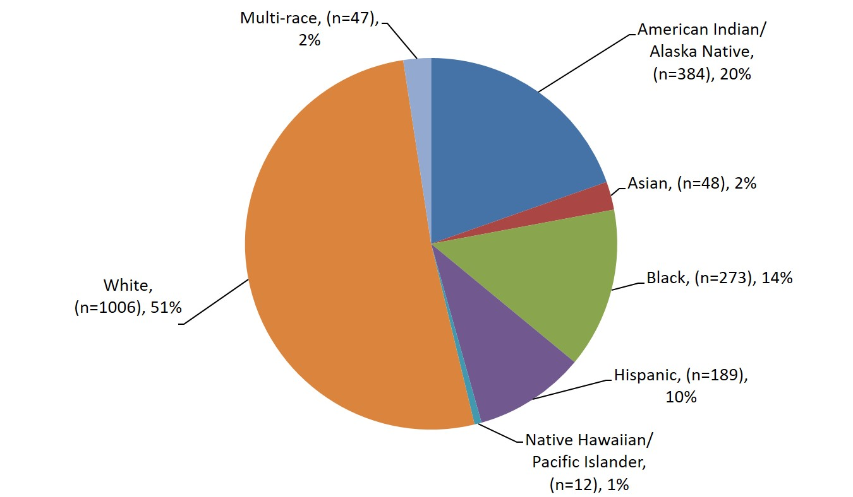
Reported Cases of HIV by Race/Ethnicity,
1982–2019 (N=1,959)
State of Alaska, Section of Epidemiology – May 2020

Slide 4
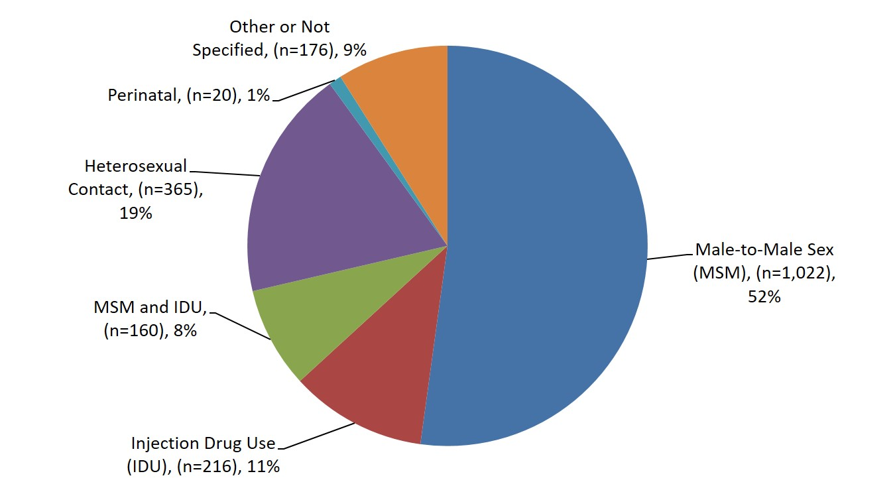
Reported Cases of HIV by Transmission, Category 1982–2019 (N=1,959)
State of Alaska, Section of Epidemiology – May 2020

Slide 5
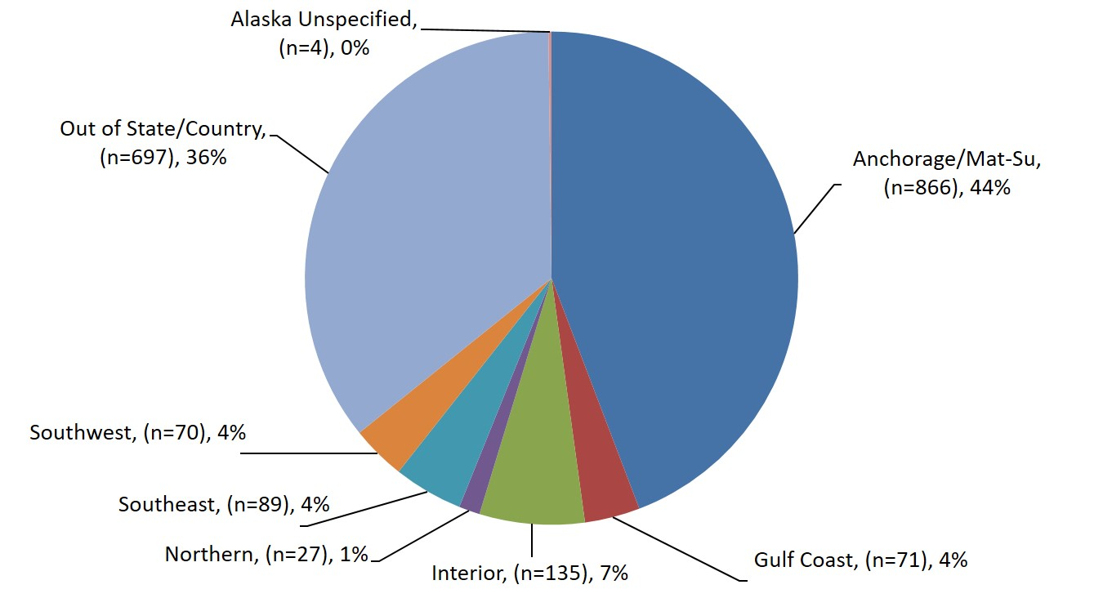
Reported Cases of HIV by Residence at Diagnosis, 1982–2019 (N=1,959)
State of Alaska, Section of Epidemiology – May 2020

Slide 6
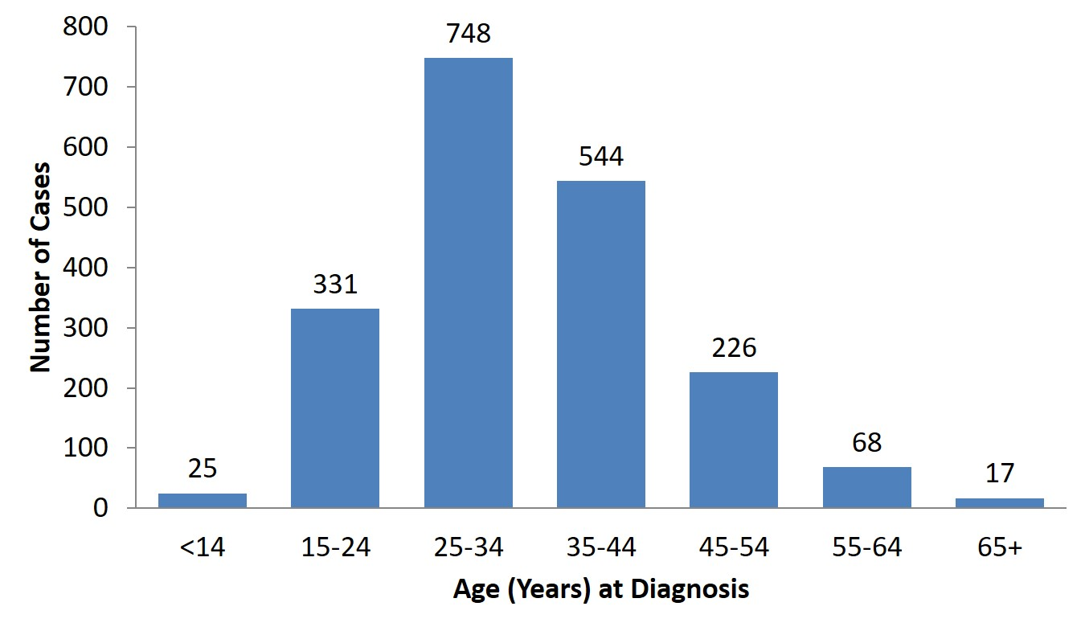
Reported Cases of HIV by Age at Diagnosis,
1982–2019 (N=1,959)
State of Alaska, Section of Epidemiology – May 2020

Slide 7
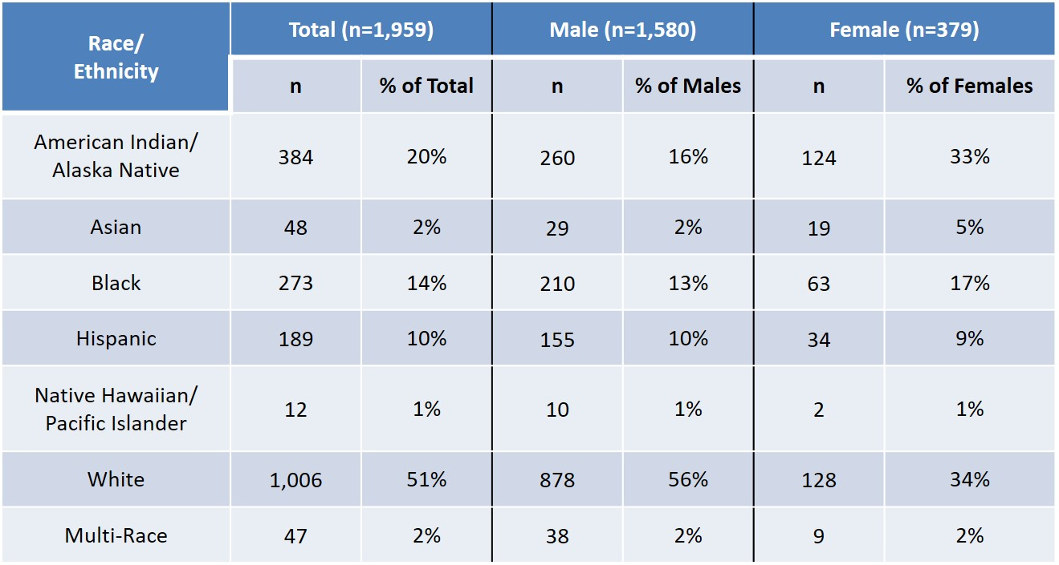
Reported Cases of HIV by Race/Ethnicity and Gender at Birth, 1982–2019 (N=1,959)
State of Alaska, Section of Epidemiology – May 2020

Slide 8
Highlights, 2019 Newly Diagnosed HIV
Cases (n=27)
Of the 69 cases reported to the Alaska Section of Epidemiology in 2019, 27 were newly diagnosed in Alaska. Of those 27:
4 (15%) were also diagnosed with AIDS at the time of initial diagnosis
One is known to have died
20 (74%) were male
14 (52%) were Men Who Have Sex with Men (MSM); 6 (22%) were heterosexual; 3 (11%) were Injection Drug Users (IDU); 1 (4%) were MSM/IDU
12 (44%) were White; 6 (22%) were Alaska Native/American Indian; 5 (19%) were Black; 4 (15%) were Hispanic
19 (70%) were 34 years old or younger at the time of diagnosis
13 (48%) were living in Anchorage/Mat-Su at the time of diagnosis; 6 (22%) were living in the Interior
State of Alaska, Section of Epidemiology – May 2020

Slide 9
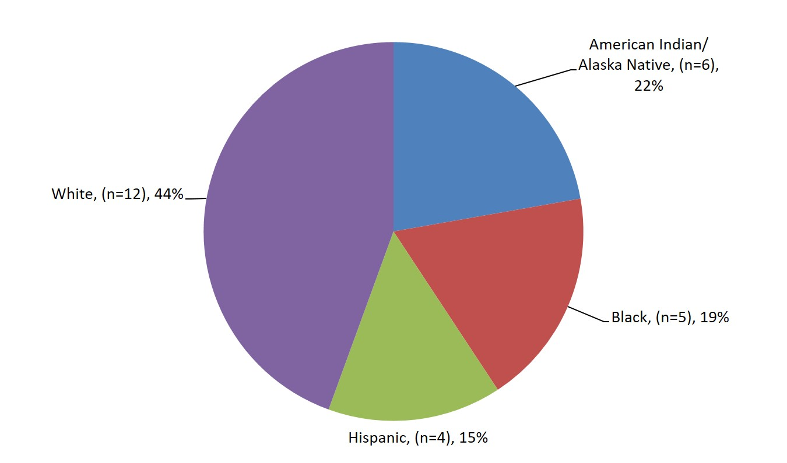
2019 Reported Cases of HIV First Diagnosed in Alaska by Race/Ethnicity (n=27)
State of Alaska, Section of Epidemiology – May 2020

Slide 10
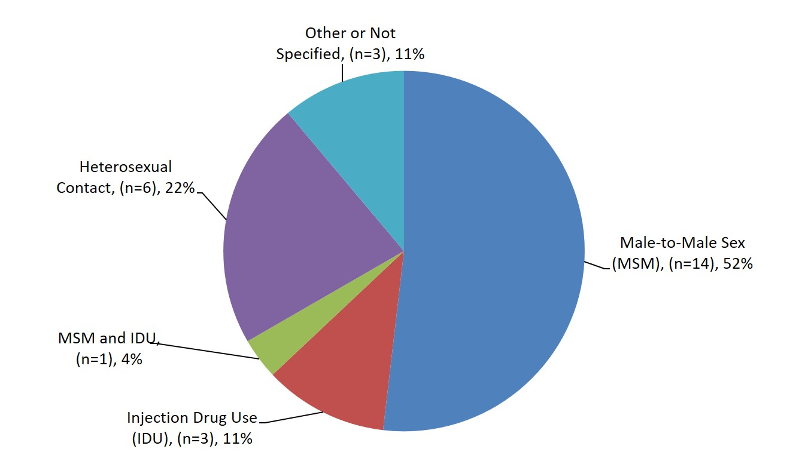
2019 Reported Cases of HIV First Diagnosed in Alaska by Transmission Category (n=27)
State of Alaska, Section of Epidemiology – May 2020

Slide 11
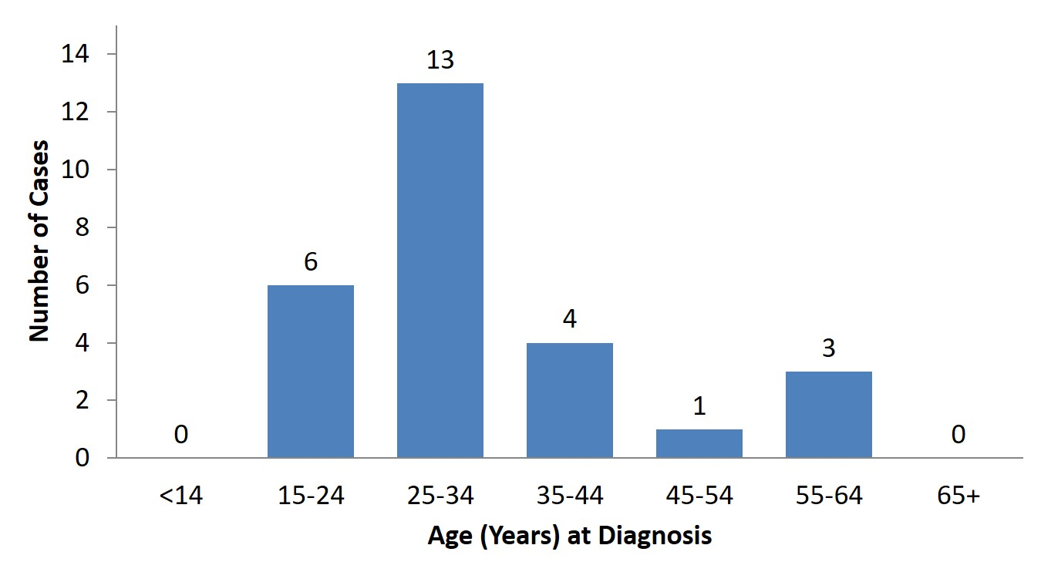
2019 Cases of HIV First Diagnosed in Alaska by Age at Diagnosis (n=27)
State of Alaska, Section of Epidemiology – May 2020

Slide 12
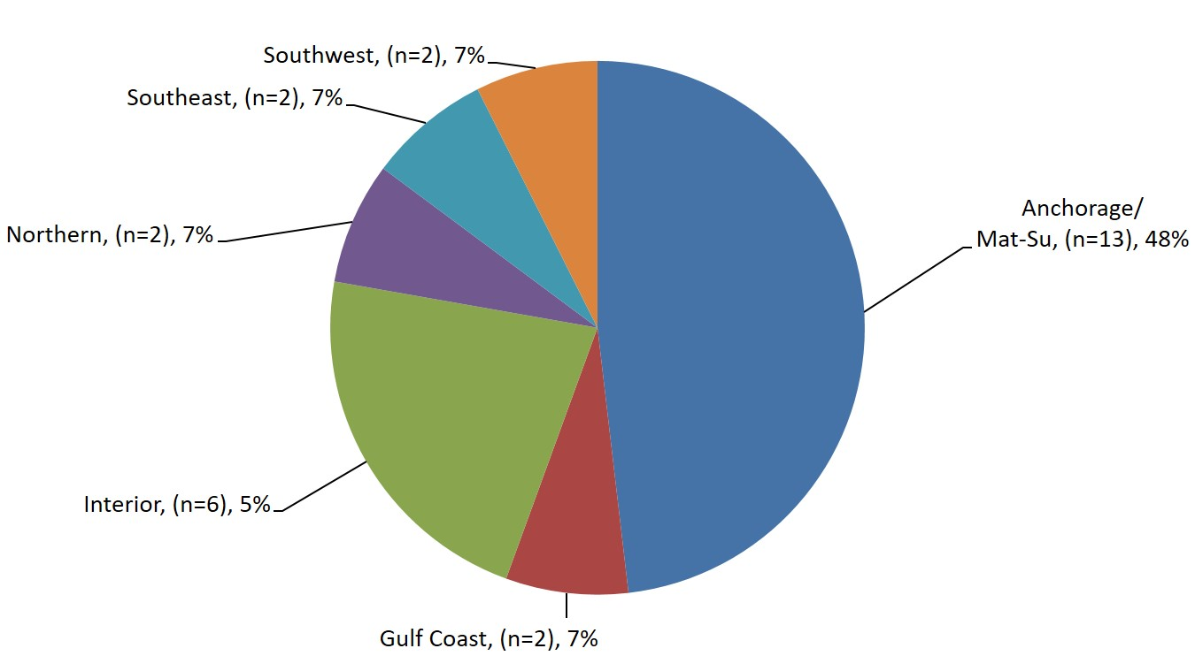
2019 Reported Cases of HIV First Diagnosed in Alaska by Residence at Diagnosis (n=27)
State of Alaska, Section of Epidemiology – May 2020

Slide 13

2019 Reported Cases of HIV by Race/Ethnicity and Gender at Birth (n=27)
State of Alaska, Section of Epidemiology – May 2020

Slide 14
Highlights, Persons Living with HIV in Alaska
As of December 31, 2019 (n=703)
360 (51%) ever had a diagnosis of AIDS
527 (75%) were male
395 (56%) were Men Who Have Sex with Men (MSM) including 42 MSM/Injection Drug Users (IDU); 188 (27%) were heterosexual
276 (39%) were White; 201 (29%) were Alaska Native/American Indian; 98 (14%) were Black
459 (65%) had an initial diagnosis in Alaska; 302 (66%) of those were living in Anchorage/Mat-Su at the time of diagnosis
90% of those thought to be living with HIV in Alaska during 2019 were engaged in medical care, and of those 92% were virally suppressed
State of Alaska, Section of Epidemiology – May 2020

Slide 15
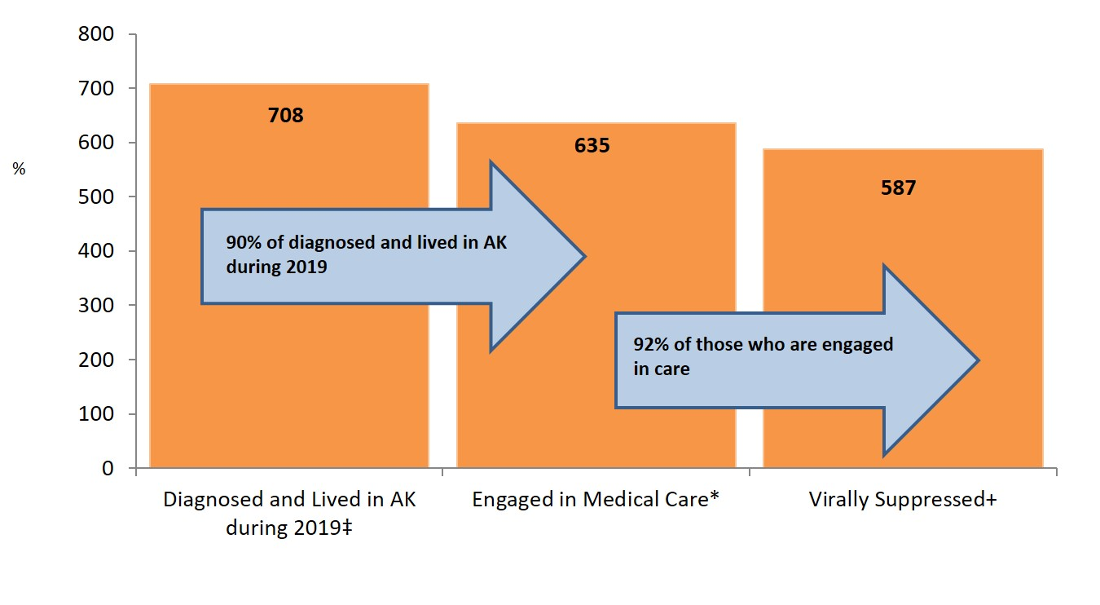
HIV Care Continuum, Alaska ― 2019 (n=708)
‡ Includes all cases who lived in Alaska (AK) during 2019; cases with unknown residence and no activity in the surveillance system for ten or more years were excluded (n=16).
* Received at least one CD4/Viral Load between Jan. 1 and Dec. 31, 2019.
+ Viral Load ≤200 copies/mL.
State of Alaska, Section of Epidemiology – May 2020

Slide 16
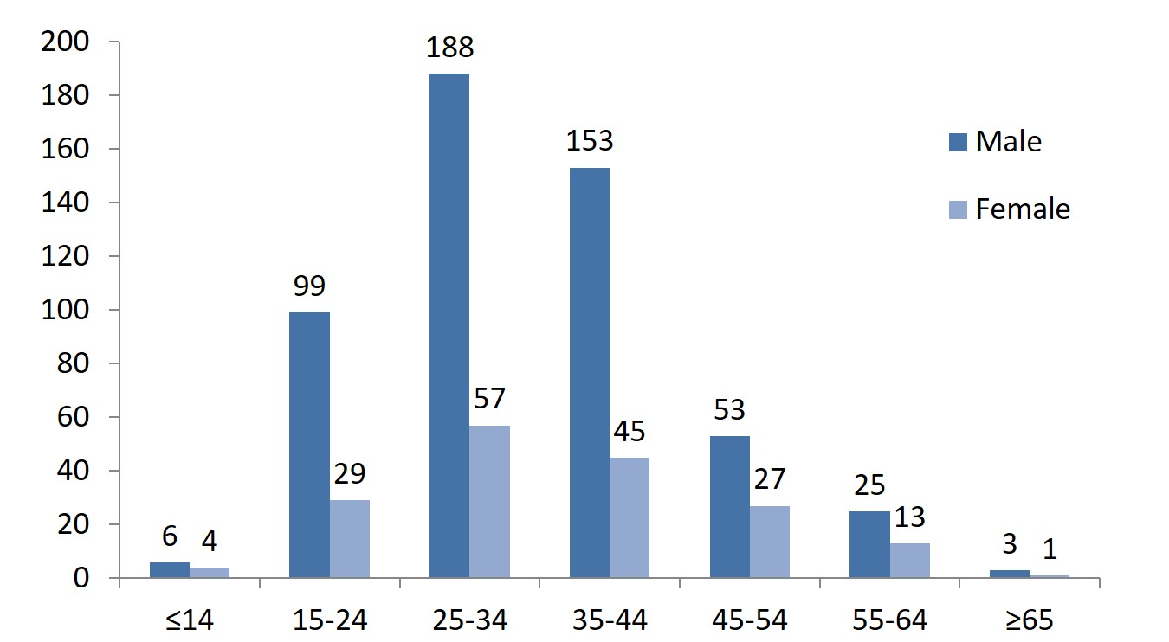
Persons Living with HIV in Alaska by Age of Diagnosis and Gender at Birth–As of December 31, 2019 (n=703)
State of Alaska, Section of Epidemiology – May 2020

Slide 17
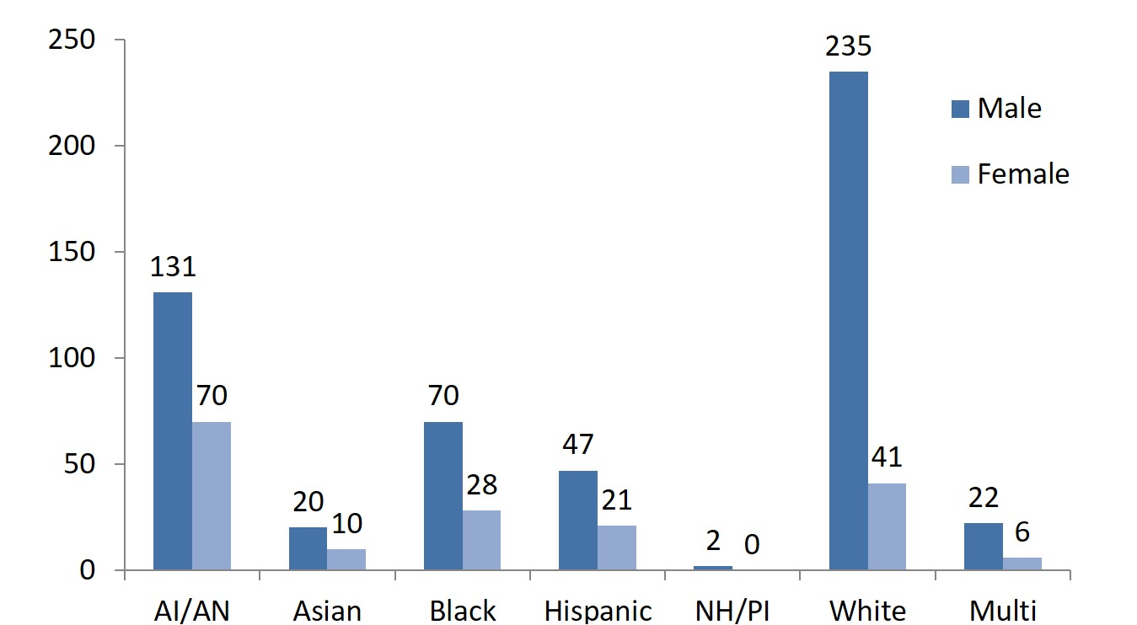
Persons Living with HIV in Alaska by Race/Ethnicity and Gender at Birth–As of December 31, 2019 (n=703)
State of Alaska, Section of Epidemiology – May 2020

Slide 18
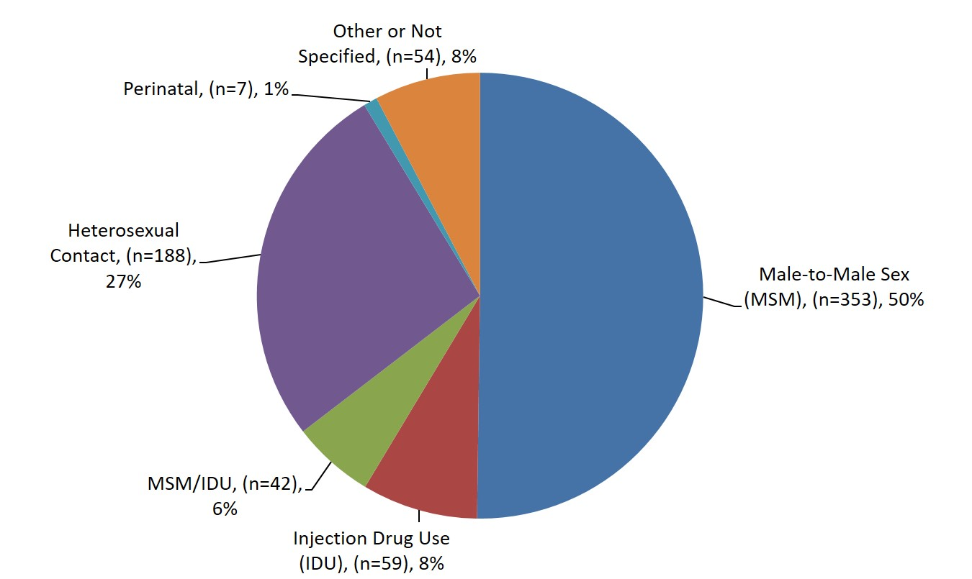
Persons Living with HIV in Alaska by Transmission Category–As of December 31, 2019 (n=703)
State of Alaska, Section of Epidemiology – May 2020

Slide 19
Version last updated May 7, 2020
Visit the HIV Data and Statistics Page at http://dhss.alaska.gov/dph/Epi/hivstd/Pages/hivdata.aspx for the most up-to-date version.

