Slide 1
State of Alaska
Section of Epidemiology
HIV Epidemiologic Profile -- 1982-2011
Published: March 27, 2013
Notes:
Alaska is a low incidence state and many subgroups have a small number of events each year. Both small numerators and denominators can make interpretation of results difficult. To help control for these random variations which occur from year to year, most data are shown in either 5-year or 10-year aggregates. Even using aggregate data, many of the subgroups discussed in this document, particularly females, youth aged 14 years and younger, and most races, contain fewer than 20 events. Therefore, many changes in percentages and rates presented in this document should be interpreted with caution.

Slide 2
Important Note:
From January 1, 1982 through December 31, 2011, 1,458 cases of HIV were reported to the Alaska Section of Epidemiology, 1,130 of which were initially diagnosed in Alaska and 504 of which were in individuals who are known to have subsequently died. For the purposes of this presentation, the following data, taken from the 2013-2016 Alaska HIV Plan, are based on the cases initially diagnosed in Alaska (n=1,130).
State of Alaska, Section of Epidemiology – April 2013

Slide 3
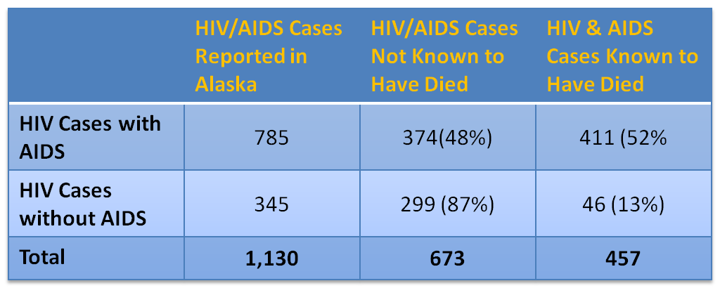
Cumulative Newly Diagnosed Alaska HIV/AIDS Cases Reported to the Alaska Section of Epidemiology, 1982-2011, (N=1,130)
State of Alaska, Section of Epidemiology – April 2013
Notes:
From 1982 through 2011, a total number of 1,130 cases of HIV and AIDS were reported to the Alaska Section of Epidemiology. Of those cases, an estimated 673 HIV/AIDS cases are not known to have died. HIV cases with AIDS and HIV cases without AIDS have been reported separately to better illustrate disease status at diagnosis. It should be noted that not all reported deaths have necessarily been caused by HIV infection; persons living with HIV/AIDS may die due to other causes

Slide 4
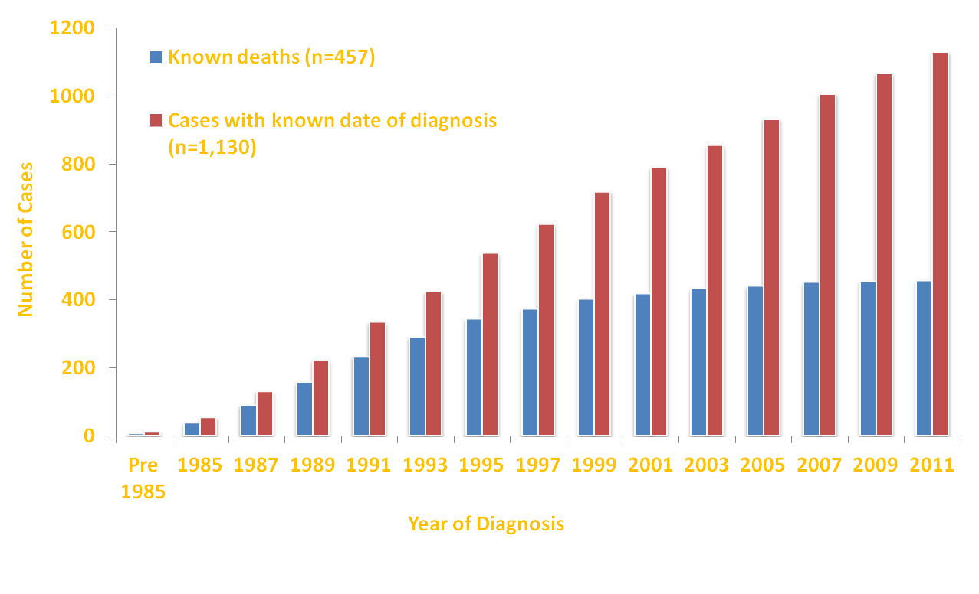
Cumulative HIV Cases and Known Deaths by Year of First Known HIV Diagnosis – Alaska Diagnoses, 1982-2011 (N=1,130)
State of Alaska, Section of Epidemiology – April 2013
Notes:
Of the original 1,130 cumulative cases of HIV and AIDS, 457 are known to have died To better illustrate case mortality, a death in a person with HIV is shown in the year the case was first diagnosed. On average, 34 HIV/AIDS cases were newly diagnosed between 2002 and 2011, a decline from 45 new cases per year between 1992 and 2001. In addition, advances in medical technology and medications used in the treatment of HIV/AIDS have progressed, resulting in better treatment outcomes for HIV-positive individuals. This decline in deaths among HIV-positive individuals, combined with the ongoing occurrence of new infections, has resulted in a steady increase in the number of persons living with HIV in Alaska. The need for medical care, supportive services, and ongoing prevention will continue to grow as persons with HIV live longer, healthier lives
Of the original 1,130 cumulative cases of HIV and AIDS, 457 are known to have died To better illustrate case mortality, a death in a person with HIV is shown in the year the case was first diagnosed. On average, 34 HIV/AIDS cases were newly diagnosed between 2002 and 2011, a decline from 45 new cases per year between 1992 and 2001. In addition, advances in medical technology and medications used in the treatment of HIV/AIDS have progressed, resulting in better treatment outcomes for HIV-positive individuals. This decline in deaths among HIV-positive individuals, combined with the ongoing occurrence of new infections, has resulted in a steady increase in the number of persons living with HIV in Alaska. The need for medical care, supportive services, and ongoing prevention will continue to grow as persons with HIV live longer, healthier lives

Slide 5
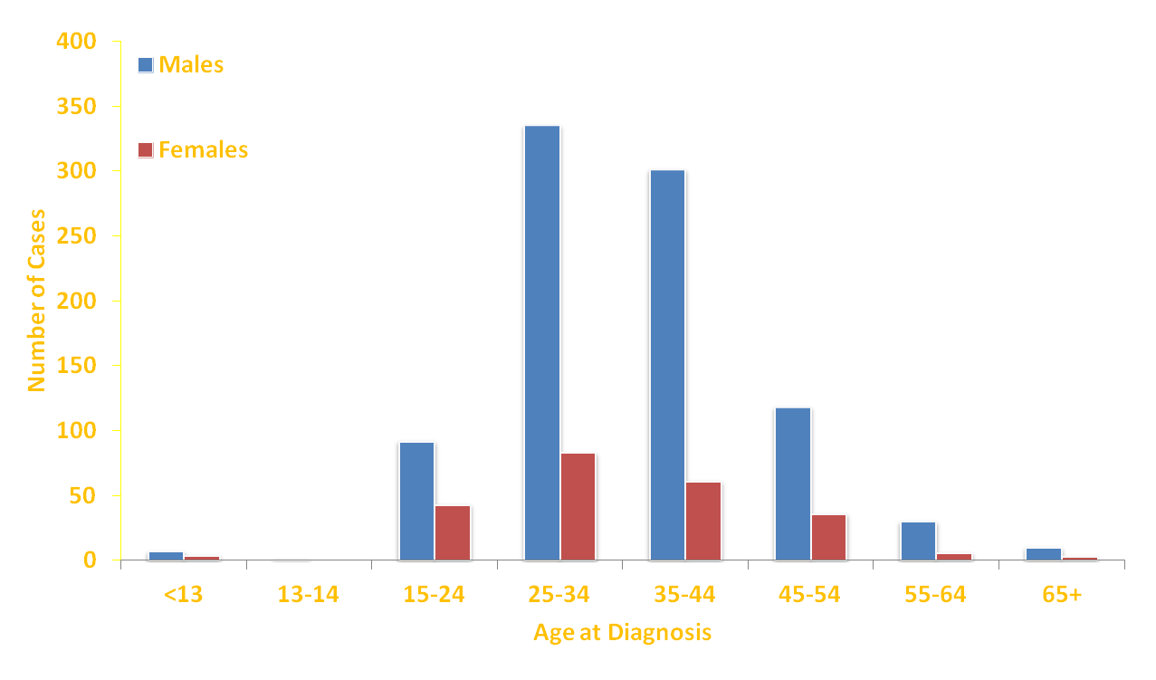
Cumulative HIV Cases (with and without AIDS) by Age at First Known HIV Diagnosis – Alaska Diagnoses, 1982-2011 (N=1,130)
State of Alaska, Section of Epidemiology – April 2013
Notes:
Of the total cumulative HIV/AIDS cases reported to the State of Alaska Section of Epidemiology, the greatest number were in persons aged 25-44 years at initial diagnosis (n=780; 69%). This varies from national trends where in 2009 young persons aged 13-29 accounted for 39% of all new HIV infections in the U.S. Relatively few cases are reported among young persons in Alaska: 12 (1%) cases were aged 0-14 and 135 (12%) were aged 14-24 at the time of initial HIV diagnosis

Slide 6
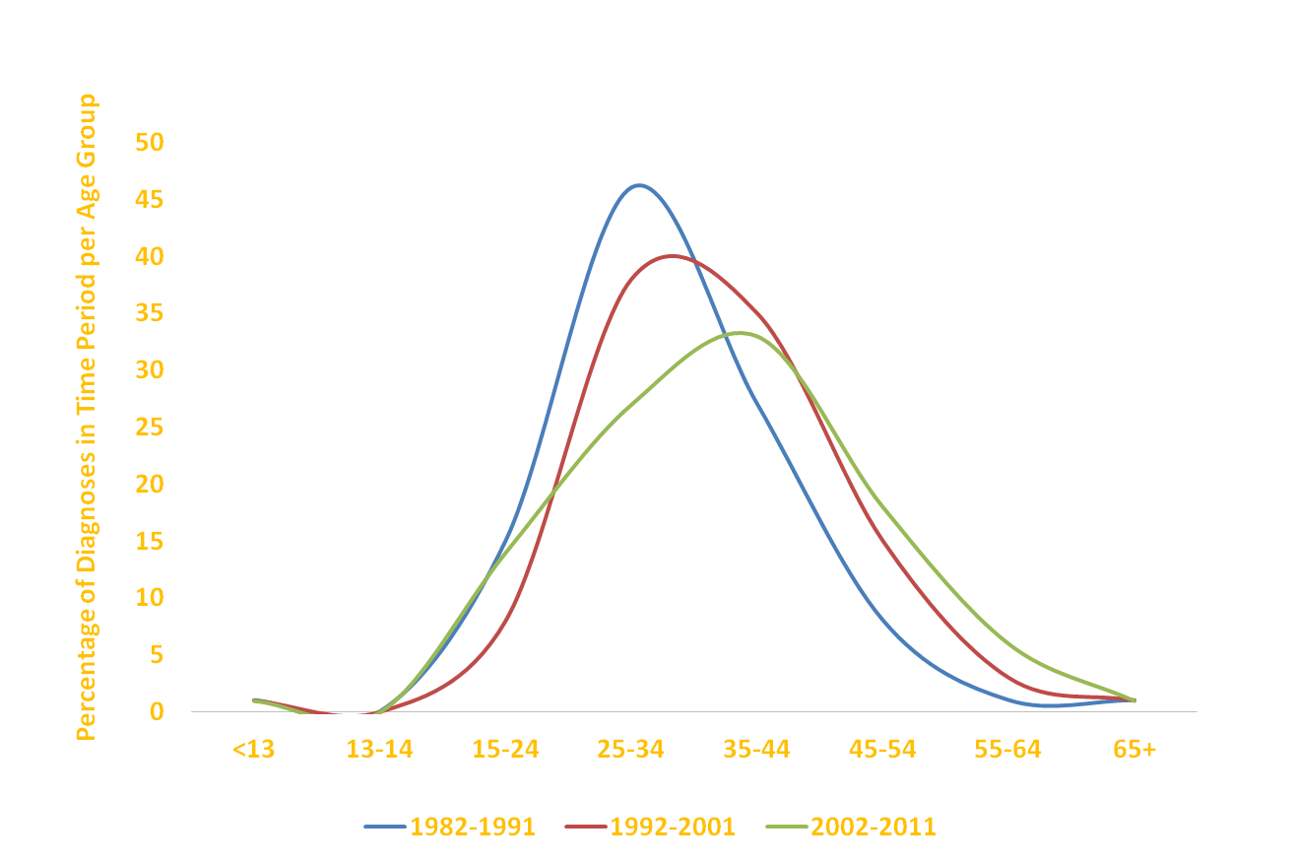
Percentage of HIV/AIDS Diagnoses by Age Group, Both Genders – Alaska Diagnoses, 1982-2011 (N=1,130)
State of Alaska, Section of Epidemiology – April 2013
Notes:
In Alaska, age at initial HIV diagnosis has been gradually increasing since data collection began. From 1982-1991 the majority of newly diagnosed cases in the state were in individuals ages 25-34 years. By 2002-2011 the average age of diagnosis had increased to 35-44. This shift in demographic trends may be attributed to the gradual aging of Alaska’s population, as well as the positive effect improved medical treatment and medications have on life expectancy of people living with HIV/AIDS.

Slide 7
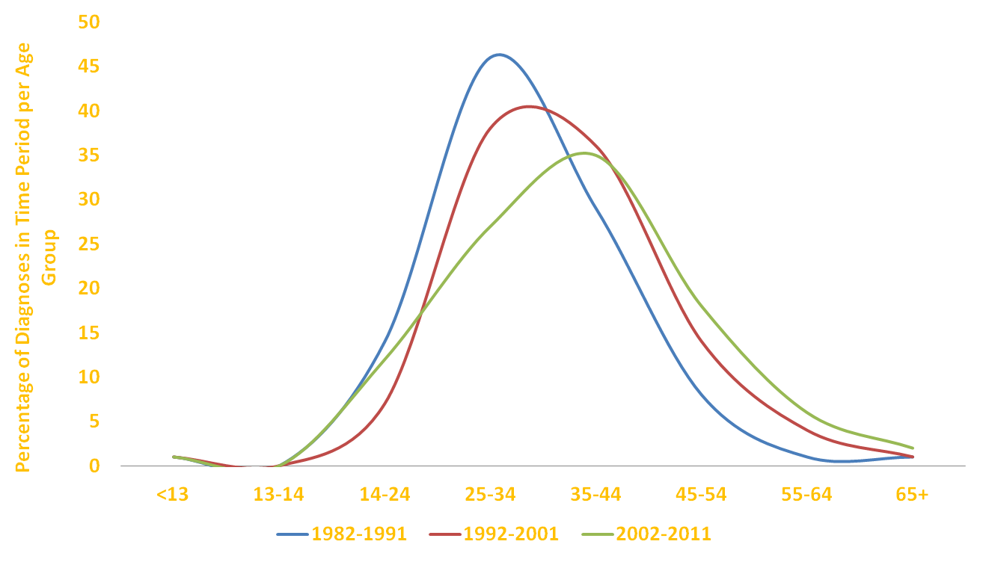
Percentage of HIV/AIDS Diagnoses by Age Group, Males – Alaska Diagnoses, 1982- 2011, (N=894)
State of Alaska, Section of Epidemiology – April 2013
Notes:
Trends in HIV diagnosis in males have remained relatively steady over time and are similar to the trends for both genders combined, in that the average age of new diagnoses has gradually moved upward from the 25-34 age group to the 35-44 age group.

Slide 8
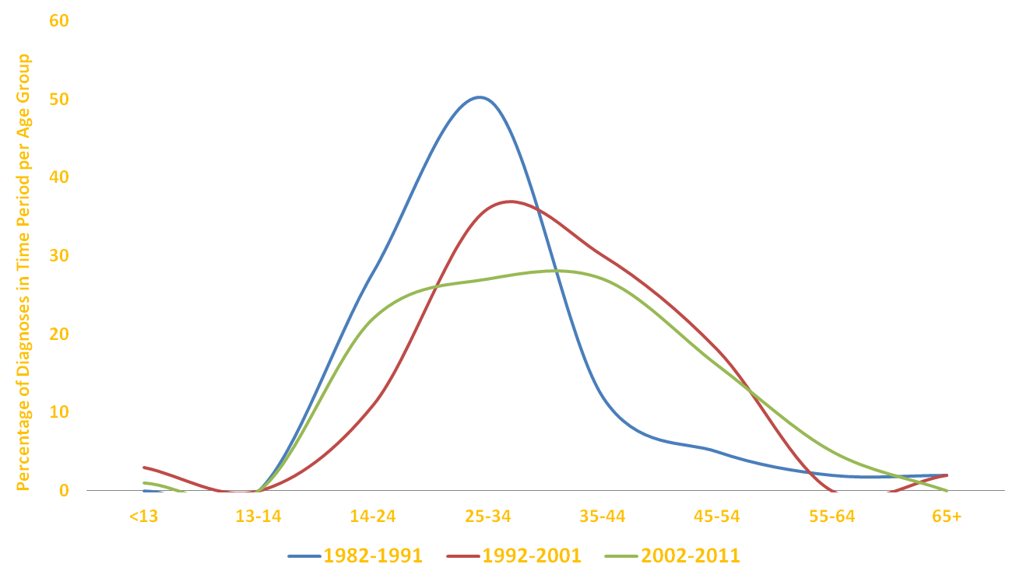
Percentage of HIV/AIDS Diagnosis by Age Group, Females – Alaska Diagnoses, 1982-2011, (N=236)
State of Alaska, Section of Epidemiology – April, 2013
Notes:
While in 1982-1991 and 1992-2001 trends in HIV diagnosis in females were similar to their male counterparts, in 2002-2011 the trend shifted to be fairly evenly distributed in the 14-24, 25-34, and 35-44 age groups. This change may be attributed to random variation and the small number of cases diagnosed.

Slide 9
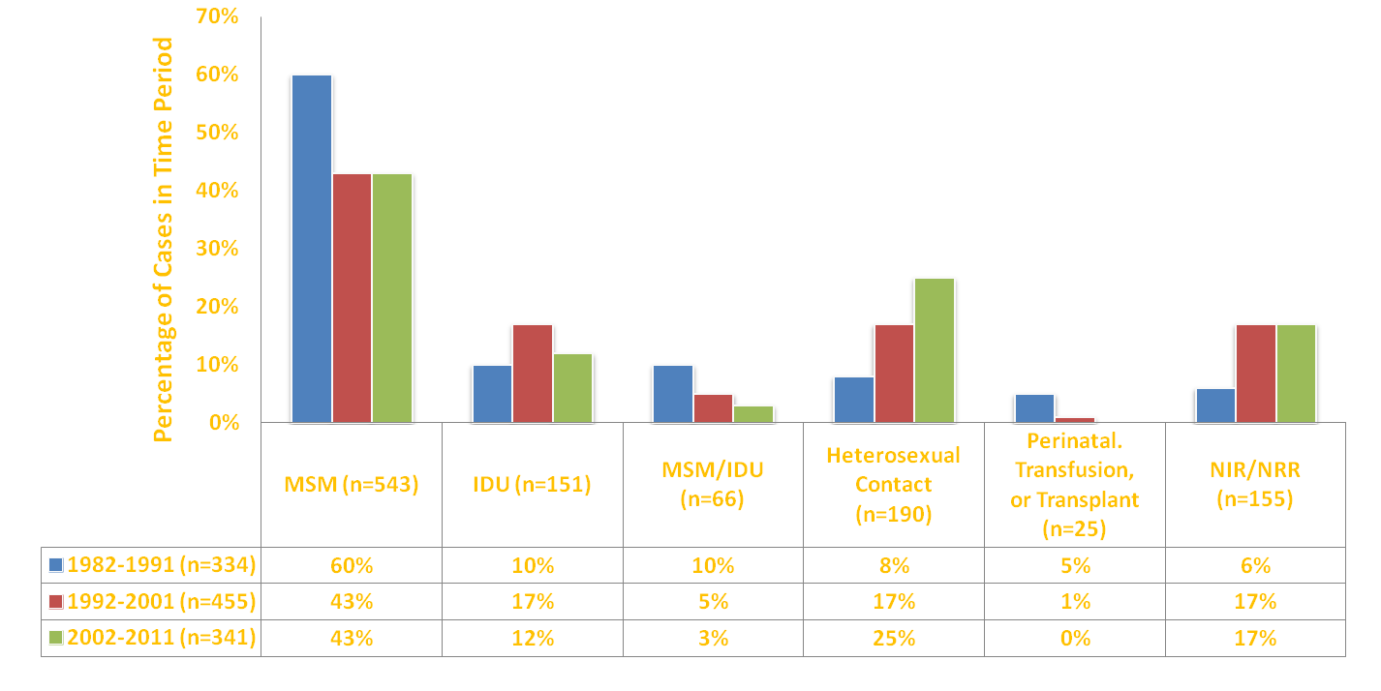
HIV/AIDS Diagnoses by Category of Exposure, Both Sexes – Alaska Diagnoses, 1982-2011 (N=1,130)
State of Alaska, Section of Epidemiology April 2013
Notes:
From 1982-1991 60% (n=202) of new HIV diagnosis reported MSM as an exposure category. From 1992-2001 that number dropped to 43% (n=195) of new diagnoses, and that decrease stayed steady through the 2002-2011 time period, when 43% (n=341) of new diagnoses reported MSM. Conversely, the number and proportion of new diagnoses for heterosexual contact increased from 8% (n=28) of new diagnoses in the time period 1982-1991, to 17% (n=77) of new diagnoses in 1992-2001, to 25% (n=85) of new diagnoses in 2002-2011.
Numbers and proportions of new diagnoses in the other transmission categories have either decreased or remained stable since 1982-1991.

Slide 10
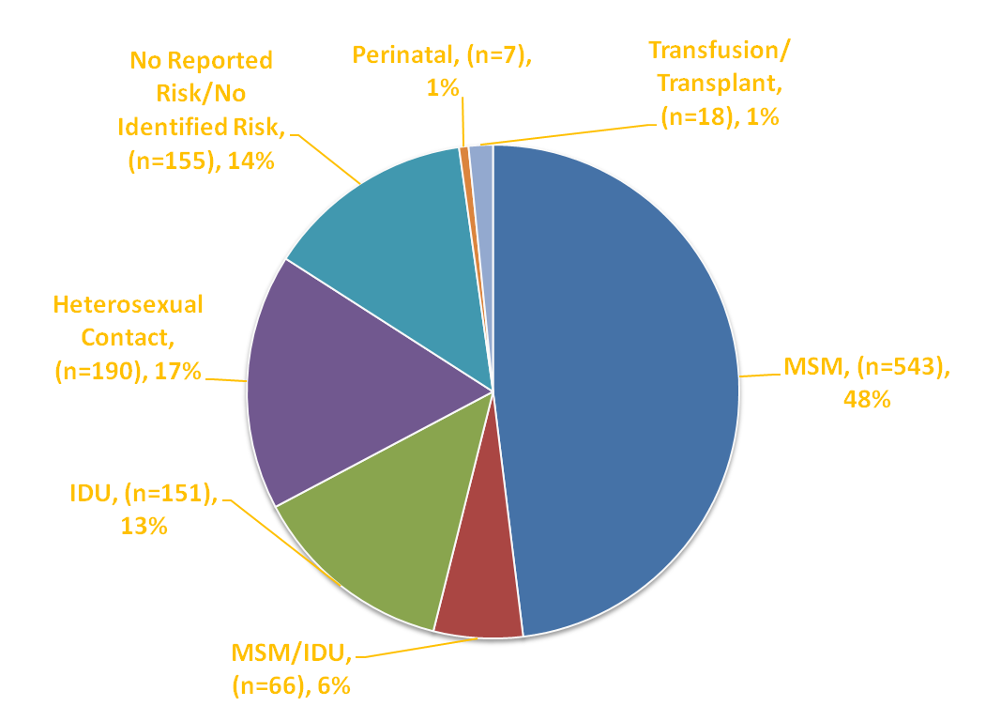
Cumulative HIV/AIDS Diagnosis, 1982-2011, by Category of Exposure, Both Sexes – Alaska Diagnoses (N=1,130)
State of Alaska, Section of Epidemiology – April 2013
Notes:
Male-to-male (MSM) sexual contact is the most commonly reported transmission category of the 1,130 cases of HIV/AIDS initially diagnosed in Alaska and reported to the Alaska Division of Public Health Section of Epidemiology since Alaska’s first HIV case was diagnosed in 1982. MSM comprised 48% (n=543) of all cases diagnosed since 1982; injection drug use, 13% (n=151); MSM/IDU, 6% (n=66); heterosexual contact, 17% (n=190); and perinatal transmission, transfusion and transplant, 2% (n=25).

Slide 11
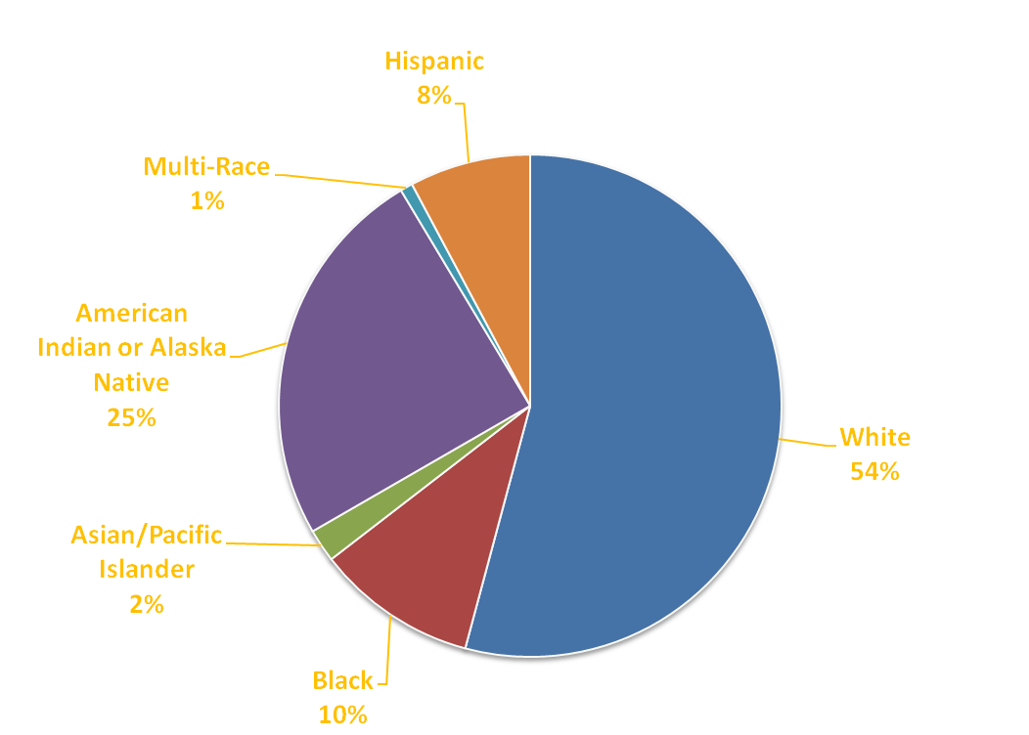
Cumulative HIV Cases (with and without AIDS) by Race and Ethnicity – Alaska Diagnoses, 1982-2011 (N=1,130)
State of Alaska, Section of Epidemiology – April 2013
Notes:
HIV affects individuals of all racial and ethnic groups in Alaska. Although individuals are not at risk of HIV infection due to their race/ethnicity, race and ethnicity can be indicators of economic and social factors that may influence risk of exposure to HIV. Of the 1,130 cases initially diagnosed in Alaska reported through December 31, 2011, 611 (54%) were in Whites, 279 (25%) in American Indians/Alaska Natives (AN/AI), 117 (10%) in Blacks, 24 (2%) in Asian/Pacific Islanders (A/PI), 11 (1%) in those reporting more than one race (multi-race), and 88 (8%) in Hispanics.

Slide 12
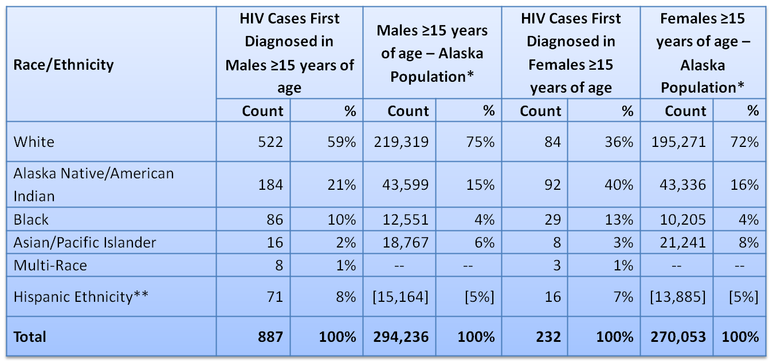
Cumulative HIV Cases (with and without AIDS) Diagnosed 1982-2011, by Race/Ethnicity, Both Sexes Aged 15 Years and Older at First Diagnosis vs. Alaska Population Aged 15 Years and Older – Alaska Diagnosed (N=1,119)
*Population data are from the Alaska Department of Labor and Workforce Development’s Alaska State Race Bridged Smooth Series estimates for July 2011.
**Males and females of Hispanic/Latino ethnicity are included within the four race categories in the Alaska population data, as well as shown as a separate group.
State of Alaska, Section of Epidemiology – April 2013
Notes:
Both genders for AI/AN, Black and Hispanic populations are over-represented in the HIV positive population in Alaska. American Indian/Alaska Native males make up 15% of the general male population in Alaska, compared to 21% of the diagnosed HIV cases In men; females, 16% of the general female population in Alaska and 40% of diagnosed HIV cases in women. Black males make up 4% of the general male population in Alaska, compared to 10% of the diagnosed HIV cases in men; females, 4% of the general female population in Alaska and 13% of diagnosed HIV cases in women. Hispanic males make up 5% of the general male population in Alaska, compared to 8% of the diagnosed HIV cases in men; females, 5% of the general female population in Alaska and 7% of diagnosed HIV cases in women. Conversely White men and women are under-represented in the HIV positive population – 75% of total Alaska population compared to 59% of the HIV positive population in men and 72% of total Alaska population compared to 36% of the HIV positive population in women. Asian/Pacific Islander men and women are also under-represented in the HIV positive population – 6% of total Alaska population compared to 2% of the HIV positive population in men and 8% of total Alaska population compared to 3% of the HIV positive population in women.

Slide 13
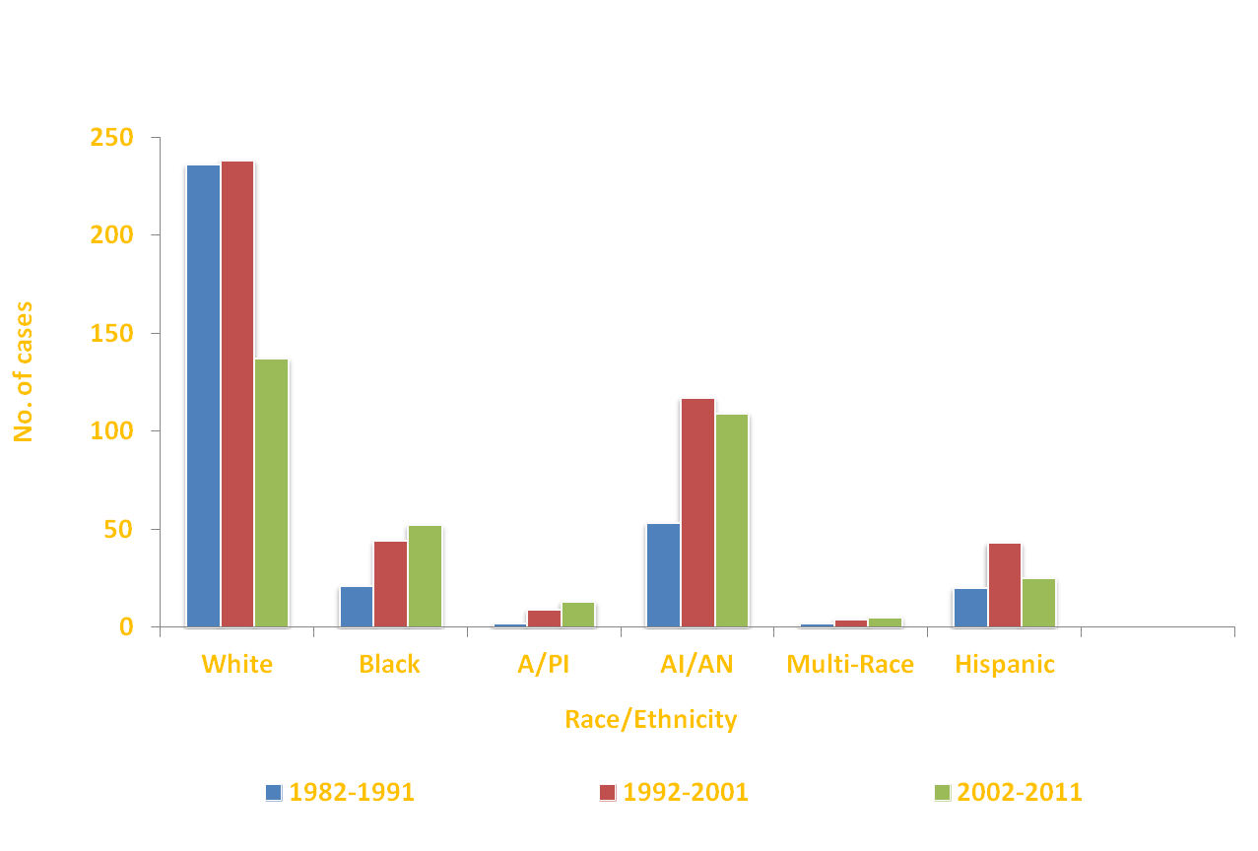
HIV/AIDS Diagnoses by Race and Ethnicity, Both Sexes – Alaska Diagnoses, 1982-2011, (N=1,130)
State of Alaska, Section of Epidemiology – April 2013
Notes:
Irrespective of gender, from 1982 through 2001 there was an increase in the number of new HIV diagnoses across all races and ethnicities; from 334 new cases in the time period 1982-1991 to 455 new cases in the time period 1992-2001. However, the greatest increases between those time periods were seen in Black and Alaska Native/American Indian populations. From 2002 the epidemic began to stabilize, and there was a sharp downward trend in the number of newly diagnosed cases of HIV in Whites; from 238 cases in 1992-2001 down to 197 in 2002-2011. However, a similar decrease was not observed in Black, A/PI, AI/AN, and Multi-Race populations although incidence remained relatively stable, with the number of new cases of HIV diagnosis in each ten year period too small to draw any statistically significant conclusions about changes in trends.

Slide 14
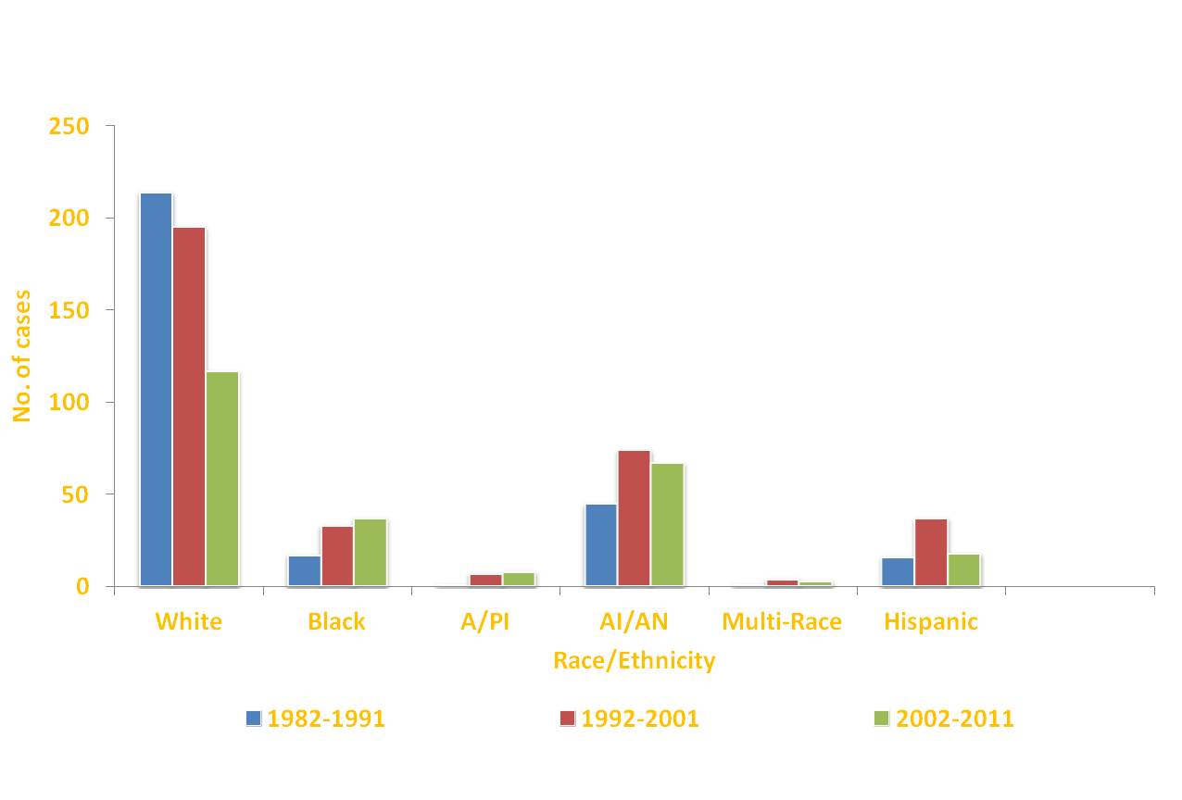
HIV/AIDS Diagnoses by Race and Ethnicity, Males – Alaska Diagnoses, 1982-2011, (N=894)
State of Alaska, Section of Epidemiology – April 2013
Notes:
In 1982-1991 the largest population group impacted by HIV/AIDS was White males. Of the 294 new male cases of HIV in the time period 1982-1991, 73% (n=214) were White. In the time period 1992-2001 the racial makeup of the HIV epidemic in Alaska began to change. While there was a sharp decrease in the number of White males diagnosed with HIV in the time period 1992-2001, the numbers of Black, Asian/Pacific Islander, American Indian/Alaska Native and ethnic Hispanics newly diagnosed with HIV during that time period all increased. By 2002-2011, there had been a 45% decrease in the number of White males newly diagnosed with HIV; from 214 in the time period 1982-1991 to 117 in the time period 2002-2011. Corresponding decreases were not observed in other racial and ethnic groups, which either saw slight increases or remained steady in the number of new HIV diagnoses.

Slide 15
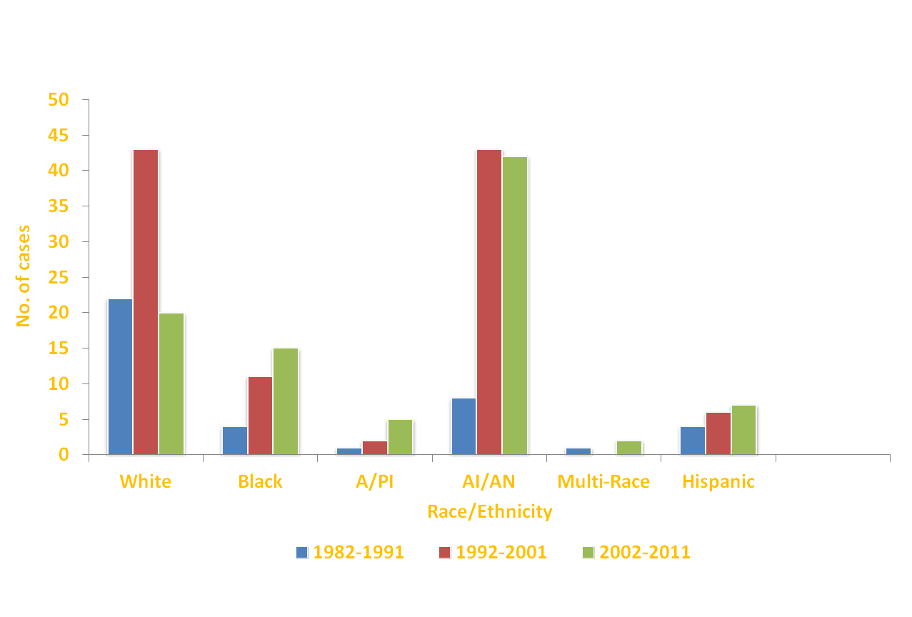
HIV/AIDS Diagnoses by Race and Ethnicity, Females – Alaska Diagnoses, 1982-2011, (N=236)
State of Alaska, Section of Epidemiology – April 2013
Notes:
Changes in trends by race and ethnicity in the HIV positive female population of Alaska vary significantly from their male counterparts. In 1982-1991 females made up a small proportion of the total number of new HIV cases, approximately 12% (n=40). Of those, over half (55%) were White and 20% were American Indian/Alaska Native. In 1992-2001 the racial makeup of HIV-positive females in Alaska changed dramatically. Not only did the number and percentage of females newly diagnosed with HIV sharply increase, up to 23% (n=105) of all new cases in the time period, but the number of American Indian/Alaska Native females increased to 41% (n=43), on par with White females. This trend continued through the 2002-2011 time period, when American Indian/Alaska Native women made up nearly half of new HIV cases in females—46% (n=42). In the past decade, it appears that while there has been a decrease in newly diagnosed cases in White women, there has not been a commensurate decrease in women of color. Reasons for this disparity are not clear.
It is important to note that even though the percentage of females newly diagnosed increased sharply, the average number of new cases per year decreased from 11 in the time period 1992-2001 to 9 in the time period 2002-2011.

Slide 16
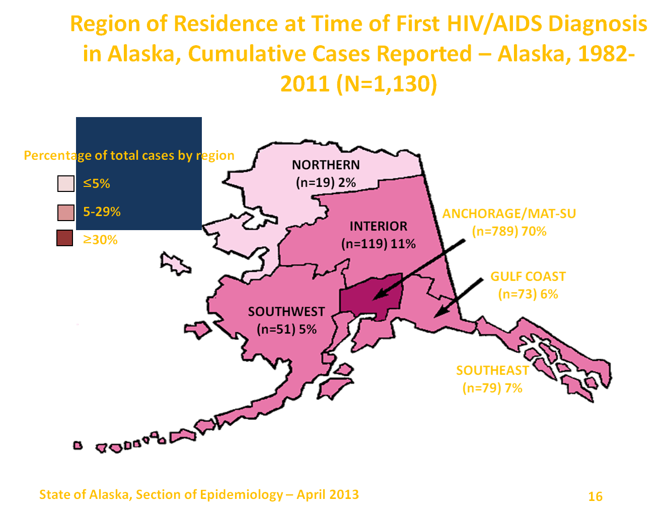
Notes:
HIV cases have been reported from all regions of Alaska. At the time of their first HIV diagnoses in Alaska, 789 cases (70%) reported a residence of Anchorage/Mat-Su, the most populous region of the state (54% of the state population was estimated to reside in the Anchorage/Mat-Su region in 2011). It is important to note that an individual’s residence at the time of first diagnosis with HIV is not necessarily the area where infection initially occurred or the area where the infected individual resides or seeks care, if still living. For example, an individual residing in a rural village may have been infected during a visit to Anchorage, and may seek care at a provider located in a hub city. People with HIV infection may not be diagnosed for years after initial infection. Additionally, Alaskans tend to be highly mobile. Therefore, the following data must be interpreted with caution.

Slide 17
Summary of HIV 1982-2012
These data include all reported cases, including those diagnosed out of state.
Source: State of Alaska Department of Health and Social Services, Division of Public Health, HIV/STD Program, Section of Epidemiology
State of Alaska, Section of Epidemiology – April 2013

Slide 18
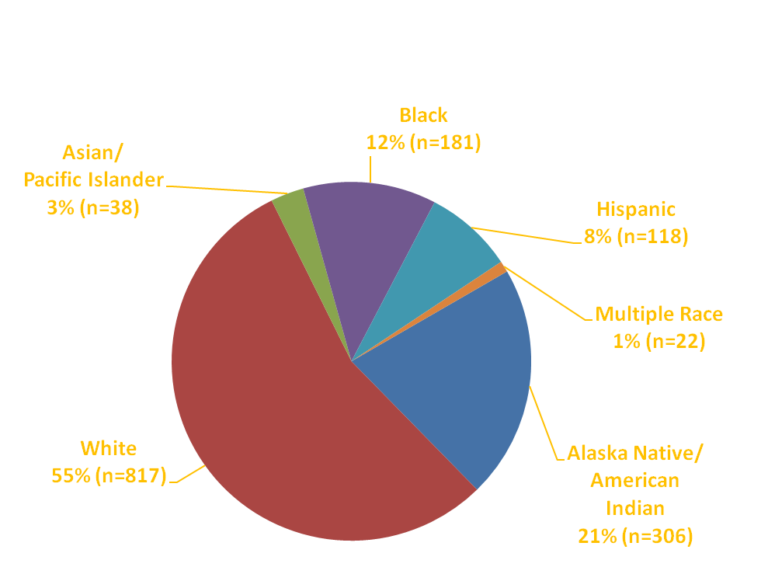
Percentage of HIV Cases by Race/Ethnicity, 1982-2012 (N=1,482)
State of Alaska, Section of Epidemiology – April 2013

Slide 19
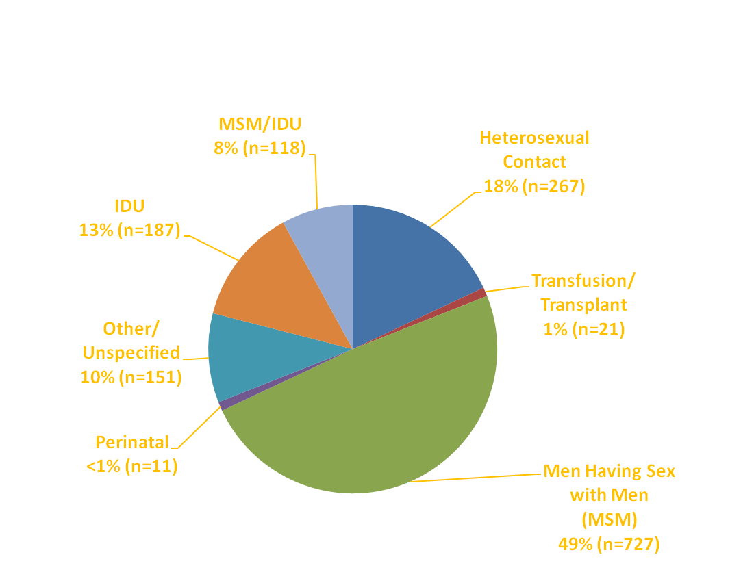
Percentage of HIV Cases by
Exposure Category, 1982–2012 (N=1,482)
State of Alaska, Section of Epidemiology – April 2013

Slide 20
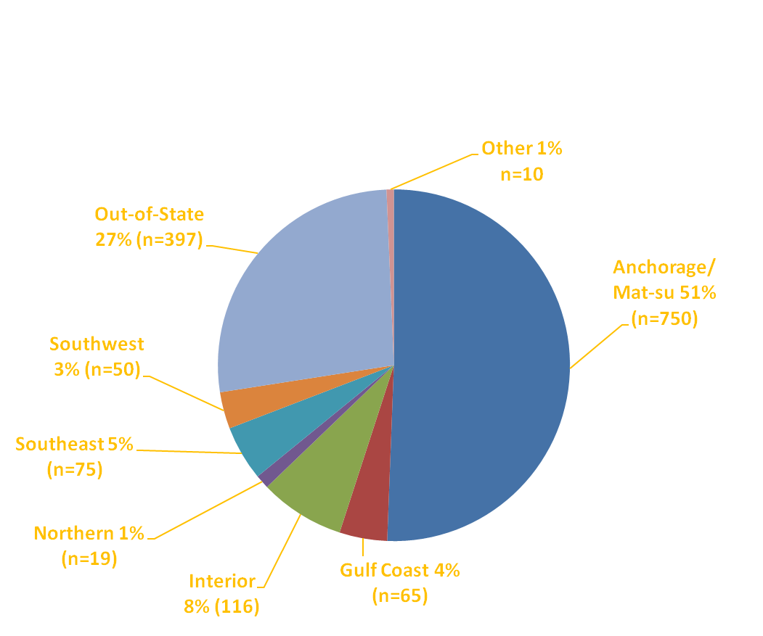
Percentage of HIV Cases by
Region of Diagnosis, 1982–2012 (N=1,482)
State of Alaska, Section of Epidemiology – April 2013

Slide 21
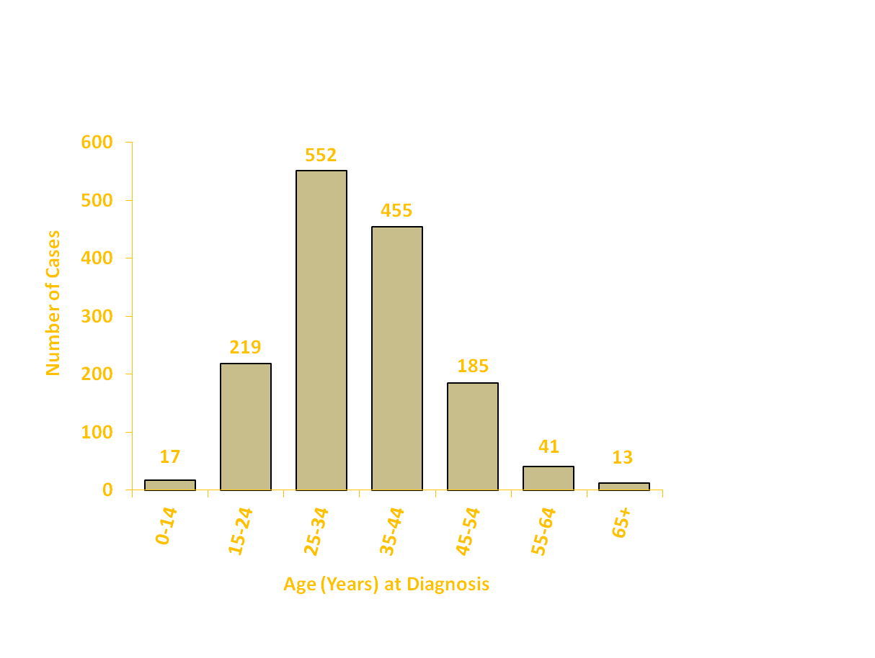
Number of HIV Cases by
Age at Diagnosis, 1982–2012 (N=1,482)
State of Alaska, Section of Epidemiology – April 2013

Slide 22
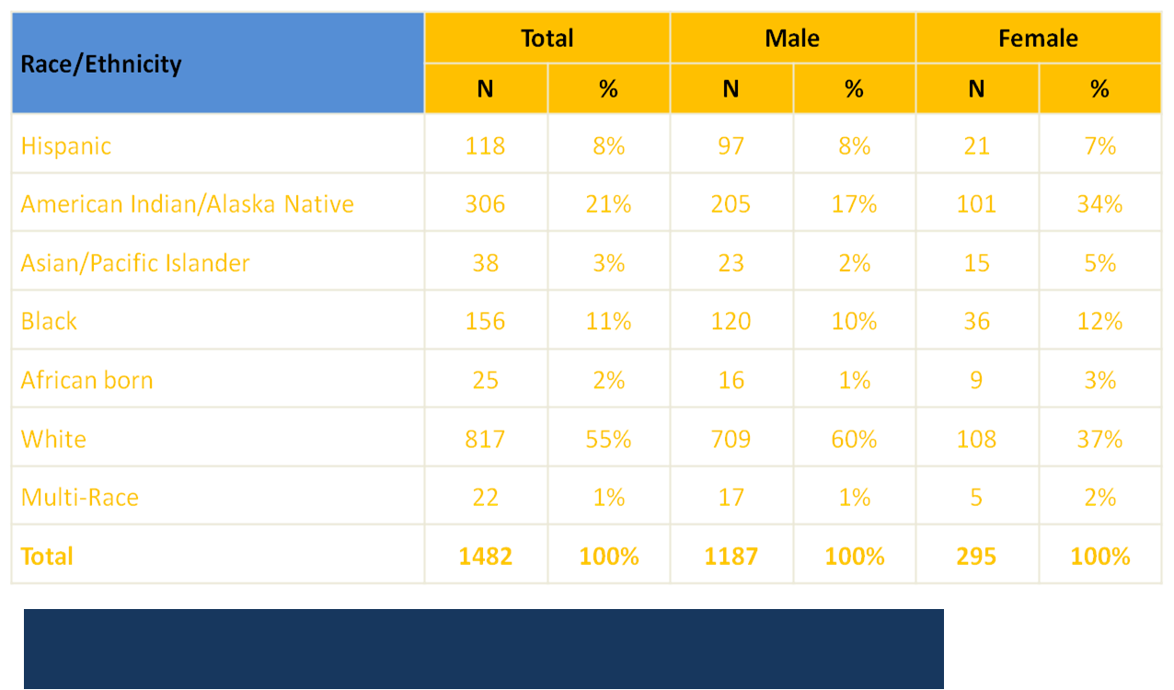
HIV Cases by Race/Ethnicity and Gender, 1982-2012, N=1,482
State of Alaska, Section of Epidemiology – April 2013

