Slide 1
--Important update for 2014--
Increased Syphilis and HIV among Men Who Have Sex with Men
Alaska is experiencing a spike in the number of reported cases of both infectious syphilis and HIV among men who have sex with men (MSM)
As of August 31, 2014 there have been 28 newly diagnosed cases of HIV reported
16 (57%) of the cases were in MSM
Only 24 cases of new HIV reported in Alaska all of 2013
As of August 31, 2014 there have been 35 cases of infectious syphilis reported
26 (75%) of these cases were in MSM
This follows a 63% increase in cases from 2012 (n=19) to 2013 (n=31)
Similar increases in syphilis incidence are being seen elsewhere in the U.S. (http://www.cdc.gov/mmwr/preview/mmwrhtml/mm6318a4.htm?s_cid=mm6318a4_w )

Slide 2
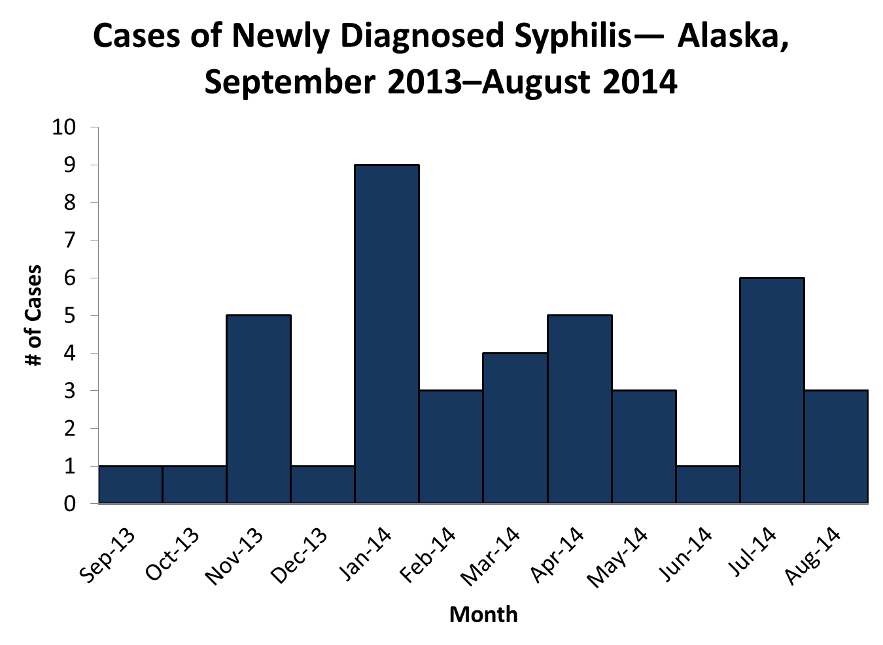

Slide 3
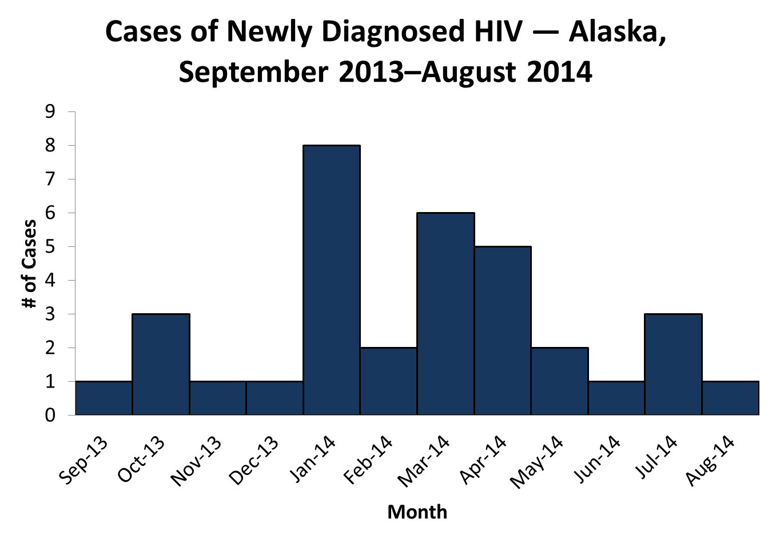

Slide 4
Increased Syphilis and HIV among Men Who Have Sex with Men, 2014
Factors associated with the current increase in syphilis and HIV among MSM include:
Finding sexual partners online
Craigslist and Adam4Adam
Using mobile apps to find sexual partners
Grindr, Scruff, and Hornet
Having a co-infection with other STDs
E.g., chlamydia and gonorrhea
Having unprotected sex with multiple, anonymous sexual partners

Slide 5
Signs and Symptoms of Infectious Syphilis and Acute HIV
Disease | Signs and Symptoms | Recommended Testing
Primary Syphilis | A small, usually painless, ulcerated lesion in or around the genitals, mouth, or anal region A typical primary chancre will last three weeks and resolve on its own after which begins a latent period of four weeks | RPR (Serological Nontreponemal) AND FTA or TP-PA (Treponemal antigen testing)
Secondary Syphilis | Palmer/plantar rash Body rashes, typically of the torso and extremities Condylomata lata (flat, raised papules) Mucous patches Lymphadenopathy Alopecia
Acute HIV Infection | Fever Lymphadenopathy Skin rash Myalgia/arthralgia Headache Diarrhea Oral ulcers Leucopenia Thrombocytopenia Transaminase elevation | HIV RNA test

Slide 6
Recommendations for Health Care Providers
Be alert to symptoms of primary and secondary syphilis and acute HIV infection, particularly in MSM
Assess for risky behaviors, symptoms, and STD testing history
When performing routine STD screening
Include testing for chlamydia and gonorrhea from multiple anatomical sites, as appropriate (i.e., urine, rectal, and oral)
Test for both syphilis and HIV

Slide 7
Recommendations for Health Care Providers
Test MSM for HIV and syphilis at least annually
More frequently if at high risk (i.e., unsafe sexual activity with multiple and/or anonymous partners)
Screen sexually active HIV patients for syphilis, chlamydia, and gonorrhea in all anatomical sites at least twice per year
Individuals with a confirmed diagnosis of primary, secondary, or early latent syphilis or known exposure to syphilis within the previous 90 days should be treated with Bicillin L-A (benzathine penicillin G), 2.4 million units in a single intramuscular dose

Slide 8
Recommendations for Health Care Providers
Report all newly diagnosed cases of syphilis and HIV immediately to the Section of Epidemiology
Telephone (561-4234 or 800-478-1700), or
Fax to 907-561-4239
The confidential STD/HIV report form can be found at: http://www.epi.hss.state.ak.us/pubs/conditions/frmSTD.pdf

Slide 9
Recommendations for At-risk MSM
Use condoms with all sexual encounters
Seek immediate testing for HIV and syphilis
Testing sites for HIV and STDs can be found at http://www.hivtest.org/
Seek immediate medical attention if you
Have symptoms of infectious syphilis or acute HIV
Are notified by Alaska Division of Public Health, clinical staff, or a sexual partner about a disease exposure
Participate in the timely notification of sexual and injection partners if infected with HIV, syphilis, or other STD

