Slide 1
Summary of HIV Infection in Alaska, 1982–2015
Prepared by the State of Alaska Department of Health and Social Services, Division of Public Health, HIV/STD Program, Section of Epidemiology. For questions about this presentation please visit http://www.epi.hss.state.ak.us/hivstd/default.stm or call the Alaska Section of Epidemiology at
(907) 269-8000.
State of Alaska, Section of Epidemiology – March 2016

Slide 2
Highlights, Cumulative HIV Cases 1982-2015, n=1,680
1,128 (67%) ever had a diagnosis of AIDS
586 (35%) are known to have died
1,353 (81%) were male
840 (50%) were Men Who Have Sex with Men (MSM); 318 (19%) were Heterosexual (Hetero)
901 (54%) were White; 336 (20%) were Alaska Native/American Indian; 220 (13%) were Black
1,156 (69%) had an initial diagnosis in Alaska; 807 (70%) of those were living in Anchorage/Mat-Su at the time of diagnosis

Slide 3
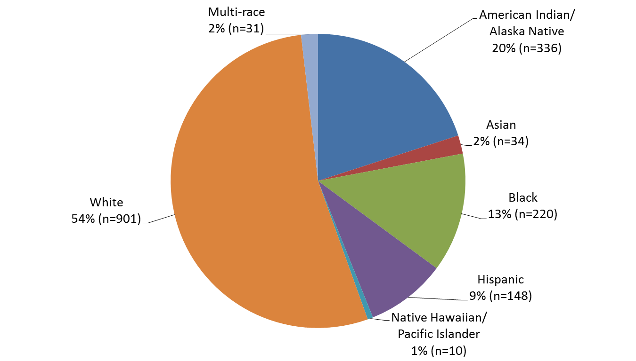
Reported Cases of HIV by Race/Ethnicity, 1982–2015 (N=1,680)
State of Alaska, Section of Epidemiology – March 2016

Slide 4
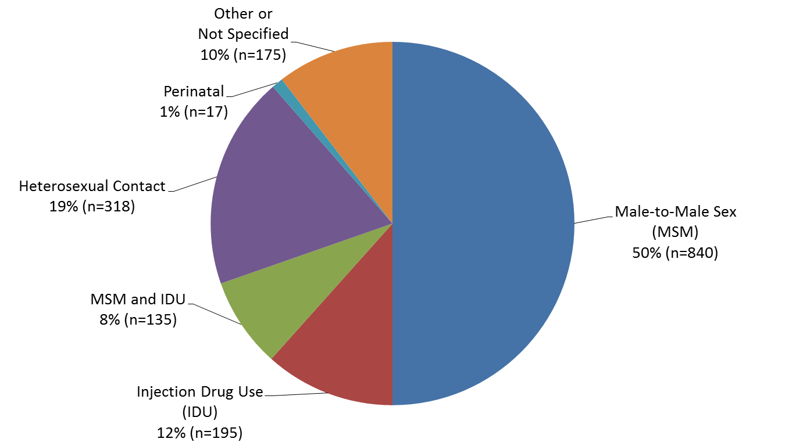
Reported Cases of HIV by Transmission Category 1982–2015 (n=1,680)
State of Alaska, Section of Epidemiology – March 2016

Slide 5
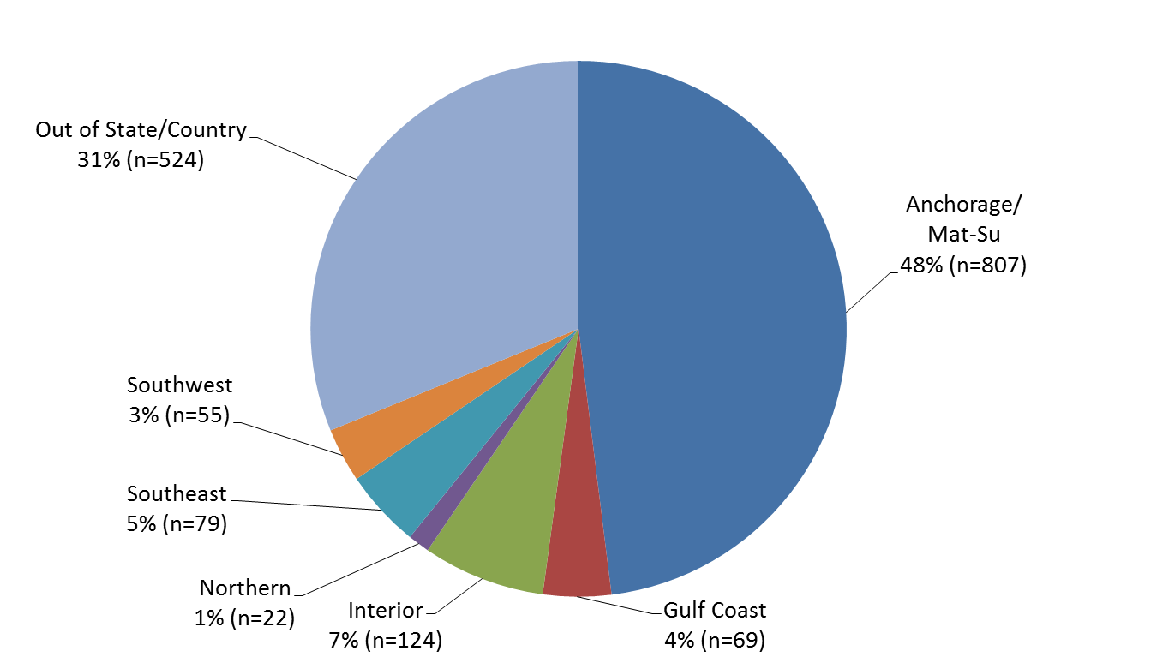
Reported Cases of HIV by Residence at Diagnosis 1982–2015 (n=1,680)
State of Alaska, Section of Epidemiology – March 2016

Slide 6
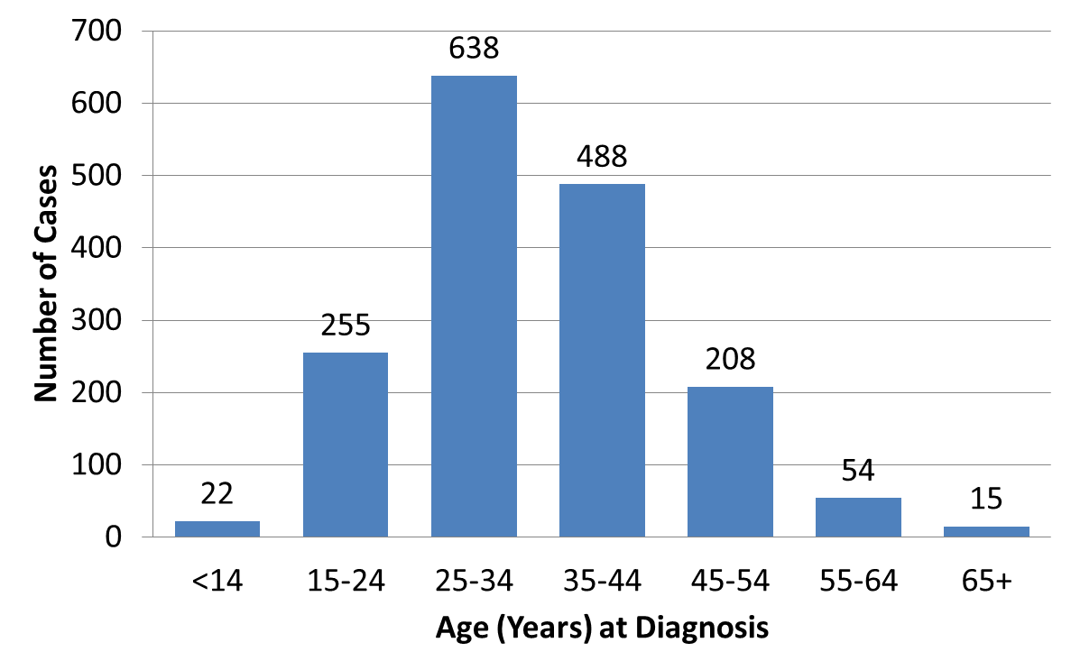
Reported Cases of HIV by Age at Diagnosis 1982–2015 (n=1,680)
State of Alaska, Section of Epidemiology – March 2016

Slide 7
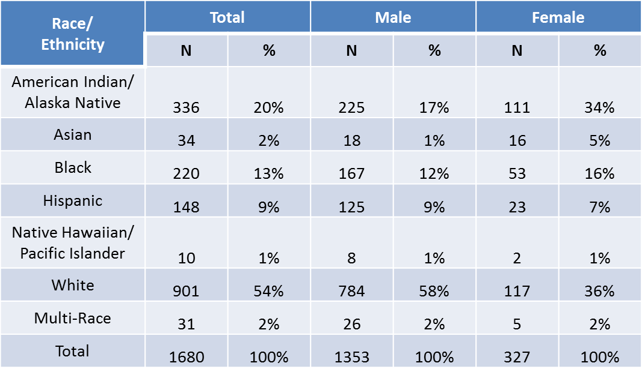
Reported Cases of HIV by Race/Ethnicity and Gender, 1982–2015 (N=1,680)
State of Alaska, Section of Epidemiology – March 2016

Slide 8
Highlights, Newly Diagnosed HIV Cases 2015, n=22
6 (27%) were also diagnosed with AIDS
None are known to have died
17 (77%) were male
10 (45%) were Men Who Have Sex with Men (MSM); 9 (41%) were Heterosexual
7 (32%) were White; 9 (41%) were Alaska Native/American Indian; 4 (18%) were Black
12 (55%) were living in Anchorage/Mat-Su at the time of diagnosis

Slide 9
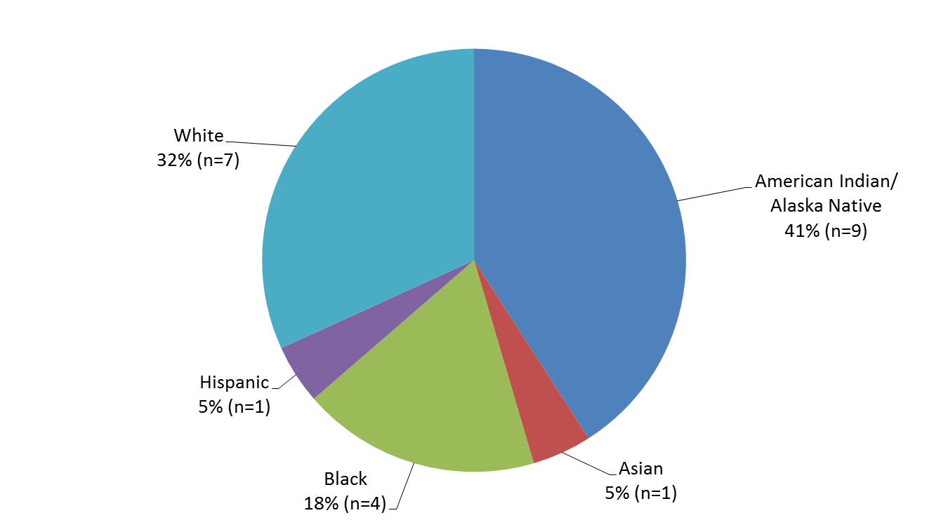
2015 Reported Cases of HIV First Diagnosed in Alaska by Race/Ethnicity (n=22)
State of Alaska, Section of Epidemiology – March 2016

Slide 10
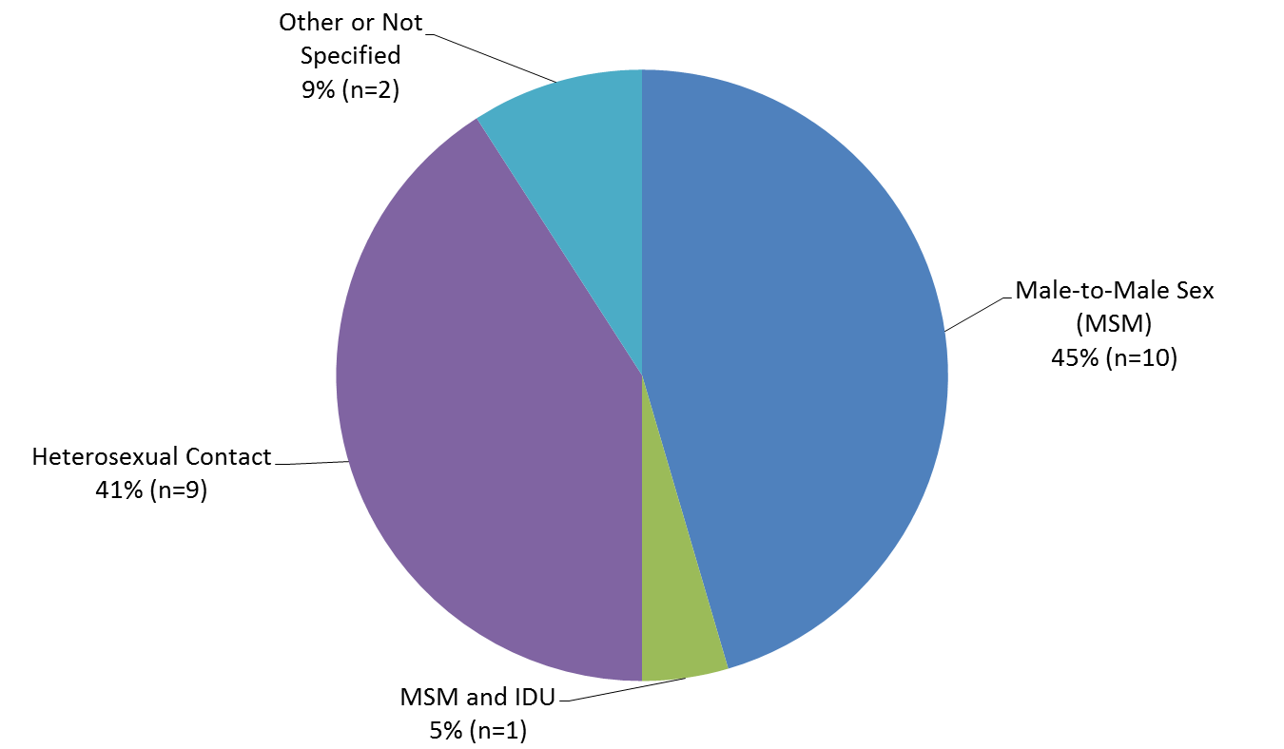
2015 Reported Cases of HIV First Diagnosed in Alaska by Transmission Category (n=22)
State of Alaska, Section of Epidemiology – March 2016

Slide 11
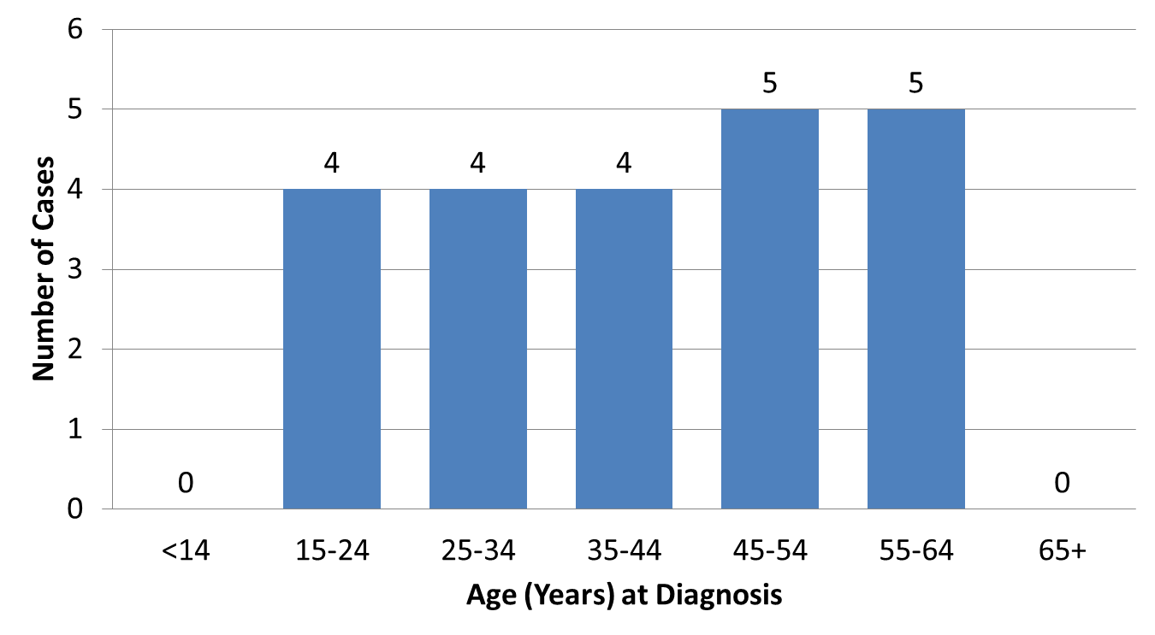
2015 Cases of HIV First Diagnosed in Alaska by Age at Diagnosis (n=22)
State of Alaska, Section of Epidemiology – March 2016

Slide 12
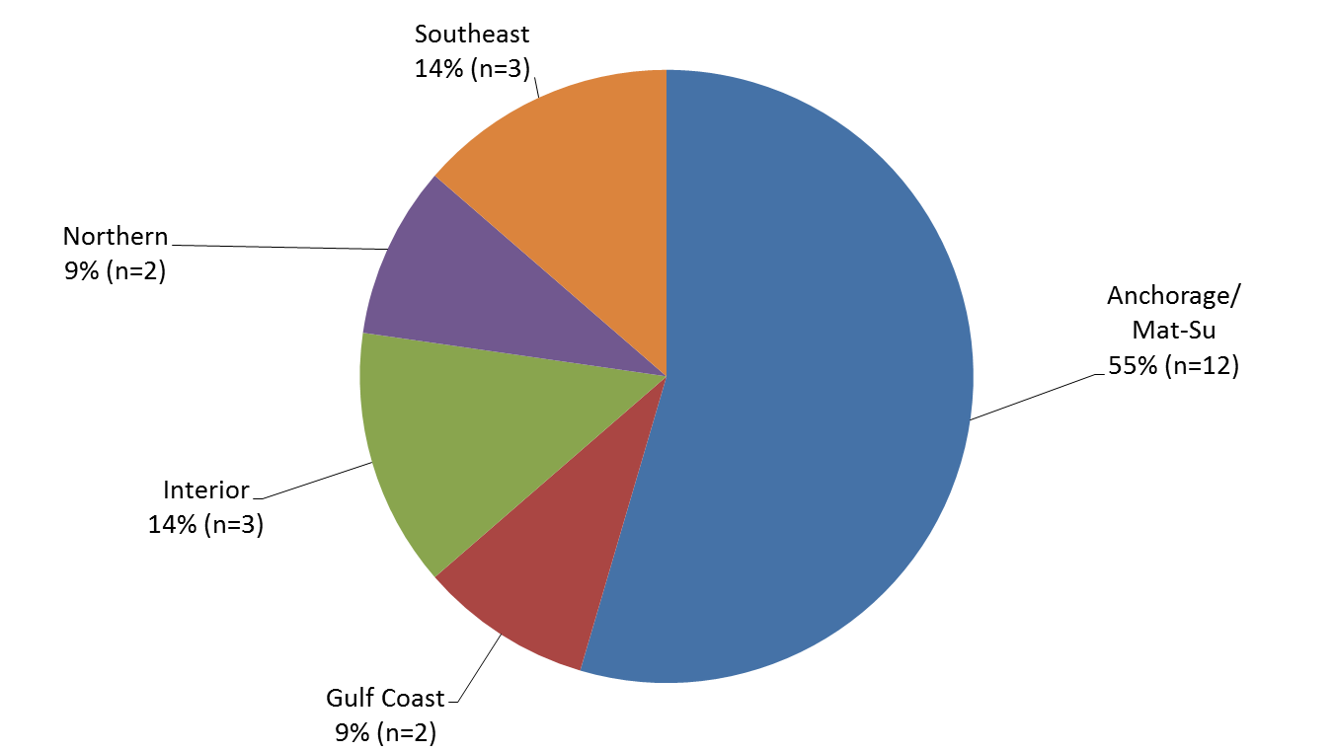
2015 Reported Cases of HIV First Diagnosed in Alaska by Residence at Diagnosis (n=22)
State of Alaska, Section of Epidemiology – March 2016

Slide 13
Highlights, Persons Living with HIV in Alaska As of December 2015, n=671
374 (56%) were also diagnosed with AIDS
506 (75%) were male
305 (45%) were Men Who Have Sex with Men (MSM); 178 (27%) were Heterosexual
301 (45%) were White; 168 (25%) were Alaska Native/American Indian; 92 (14%) were Black
448 (67%) had an initial diagnosis in Alaska; 306 (68%) of those were living in Anchorage/Mat-Su at the time of diagnosis
587 (87%) received at least one CD4 or viral load, and of those 517 (88%) are virally suppressed

Slide 14
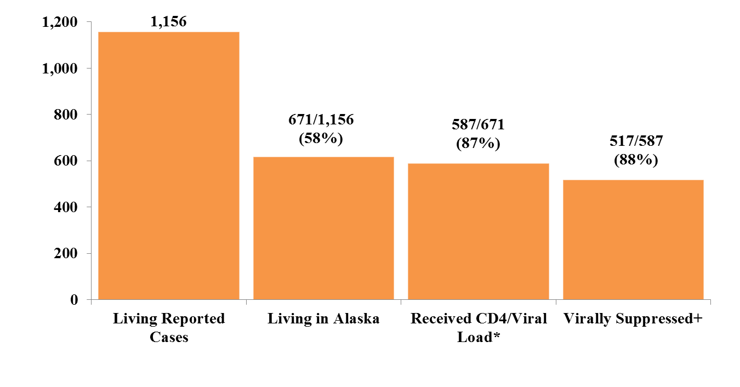
HIV Care Continuum, Alaska ― As of December 31, 2015
* In preceding 12 months, between Jan. 1, 2015 and Dec. 31, 2015
+ Viral Load ≤200 copies/mL

