Slide 1
Summary of HIV Infection in Alaska, 1982–2016
Prepared by the State of Alaska Department of Health and Social Services, Division of Public Health, HIV/STD Program, Section of Epidemiology. For questions about this presentation please visit http://www.epi.hss.state.ak.us/hivstd/default.stm or call the Alaska Section of Epidemiology at
(907) 269-8000.
State of Alaska, Section of Epidemiology – April 2017

Slide 2
Highlights, Cumulative HIV Cases 1982-2016 (N=1,757)
1,153 (66%) ever had a diagnosis of AIDS
623 (35%) are known to have died
1,410 (80%) were male
889 (51%) were Men Who Have Sex with Men (MSM); 335 (19%) were Heterosexual (Hetero)
926 (53%) were White; 354 (20%) were Alaska Native/American Indian; 235 (13%) were Black
1,197 (68%) had an initial diagnosis in Alaska; 821 (69%) of those were living in Anchorage/Mat-Su at the time of diagnosis
State of Alaska, Section of Epidemiology – April 2017

Slide 3
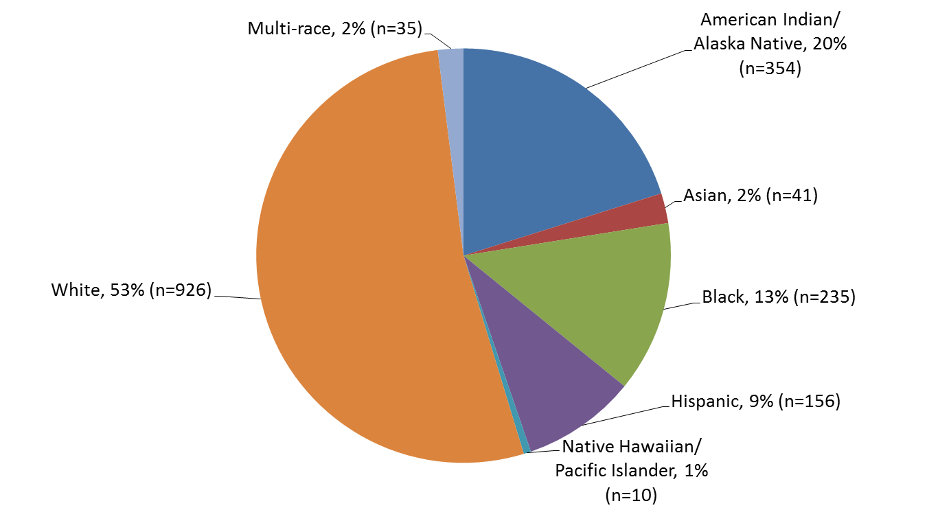
Reported Cases of HIV by Race/Ethnicity, 1982–2016 (N=1,757)
State of Alaska, Section of Epidemiology – April 2017

Slide 4
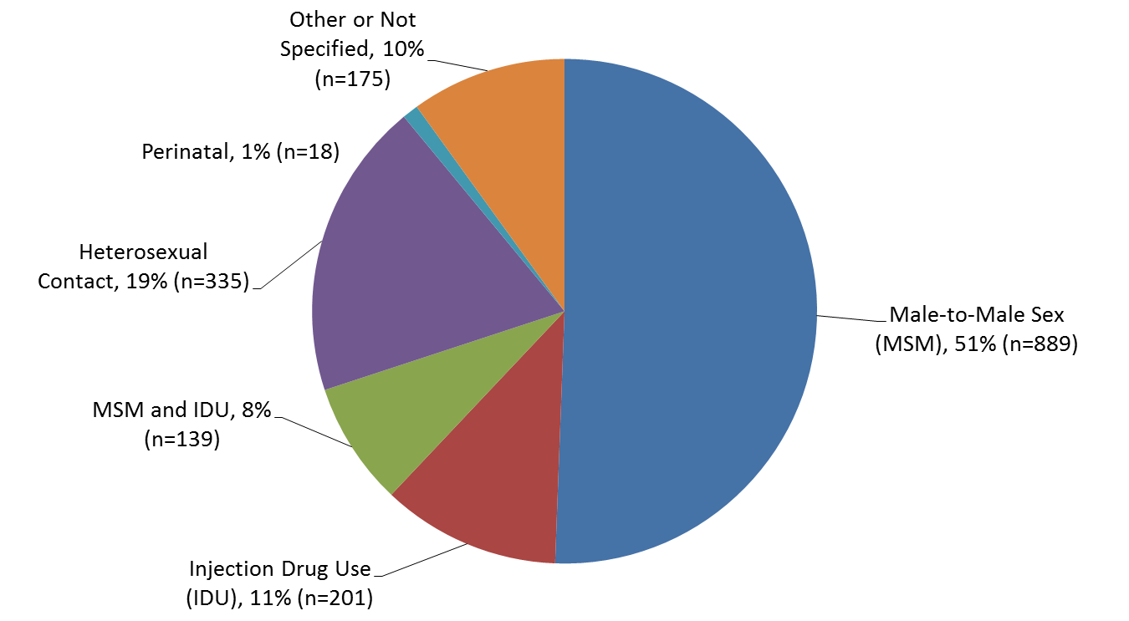
Reported Cases of HIV by Transmission Category 1982–2016 (N=1,757)
State of Alaska, Section of Epidemiology – April 2017

Slide 5
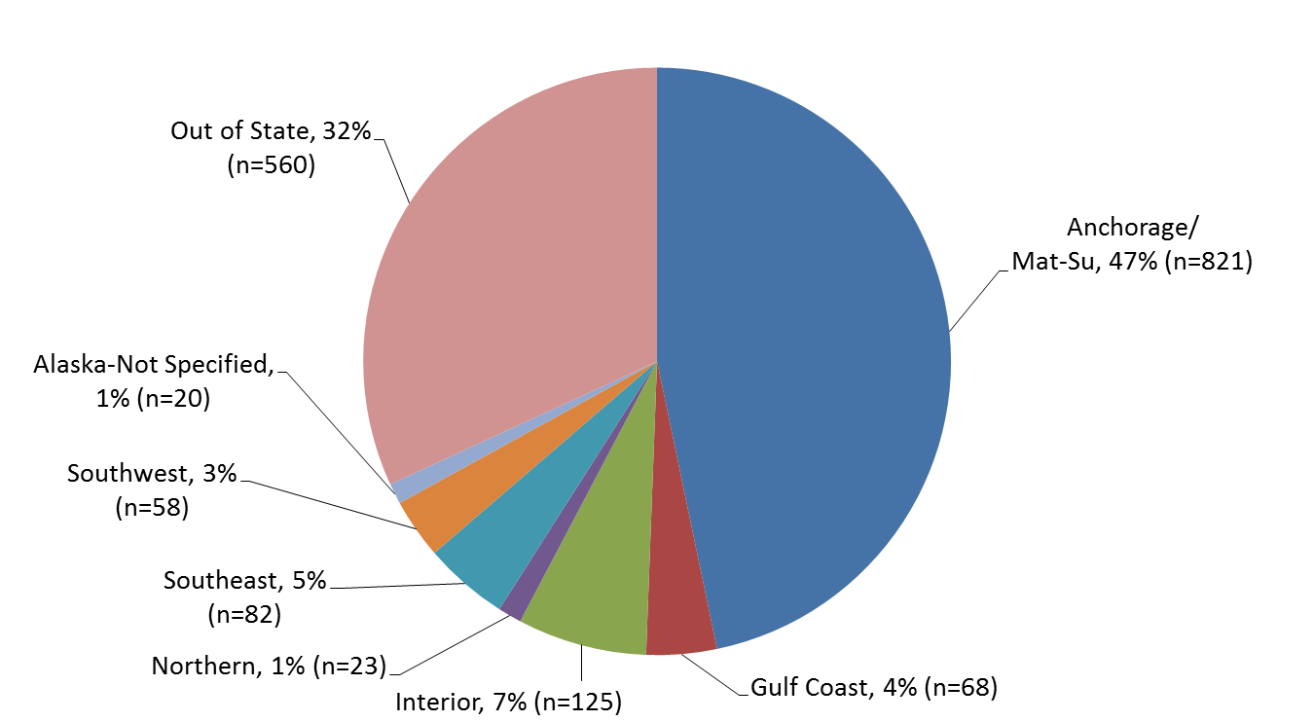
Reported Cases of HIV by Residence at Diagnosis 1982–2016 (N=1,757)
State of Alaska, Section of Epidemiology – April 2017

Slide 6
Reported Cases of HIV by Age at Diagnosis 1982–2016 (N=1,757)
State of Alaska, Section of Epidemiology – April 2017

Slide 7
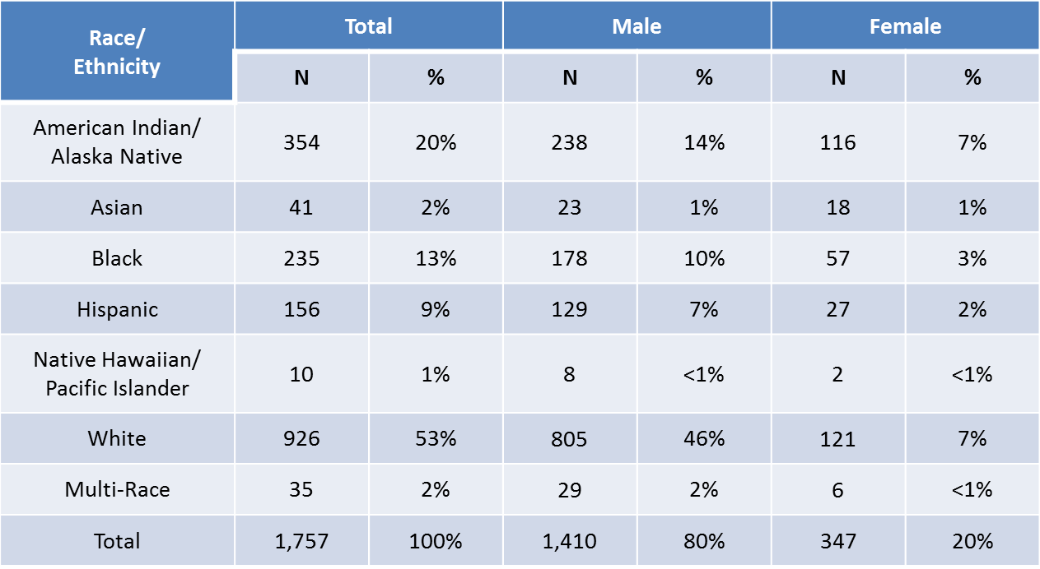
Reported Cases of HIV by Race/Ethnicity and Gender, 1982–2016 (N=1,757)
State of Alaska, Section of Epidemiology – April 2017

Slide 8
Highlights, Newly Diagnosed HIV Cases 2016 (n=38)
Of the 76 cases reported to the Alaska Section of Epidemiology in 2016, 38 were newly diagnosed in Alaska. Of those 38:
6 (16%) were also diagnosed with AIDS
None are known to have died
30 (79%) were male
25 (66%) were Men Who Have Sex with Men (MSM); 9 (24%) were Heterosexual
9 (24%) were White; 17 (45%) were Alaska Native/American Indian; 5 (13%) were Black
22 (58%) were 34 years old or younger at the time of diagnosis
22 (58%) were living in Anchorage/Mat-Su at the time of diagnosis
State of Alaska, Section of Epidemiology – April 2017

Slide 9
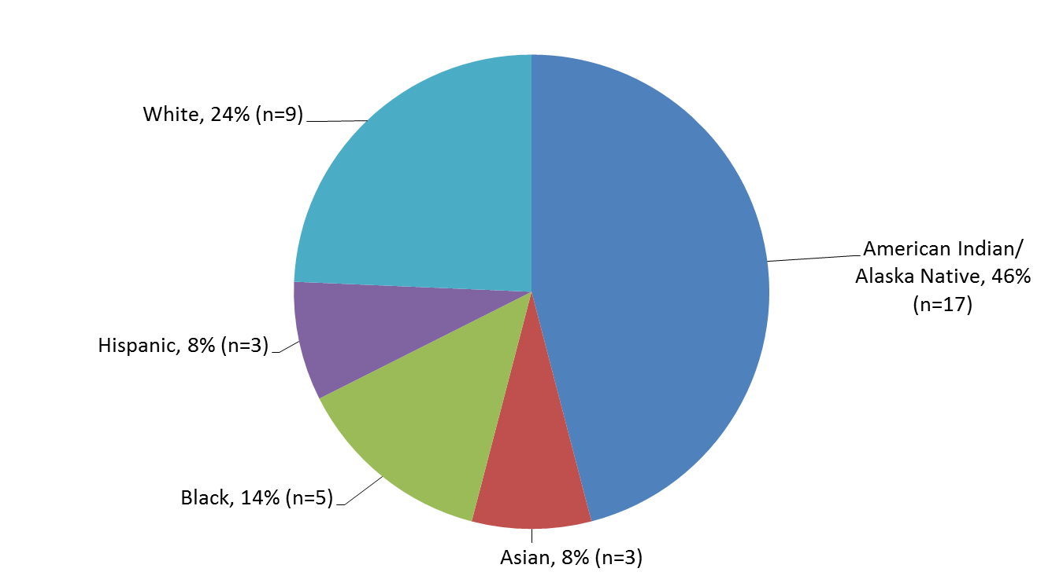
2016 Reported Cases of HIV First Diagnosed in Alaska by Race/Ethnicity (n=38)
State of Alaska, Section of Epidemiology – April 2017

Slide 10
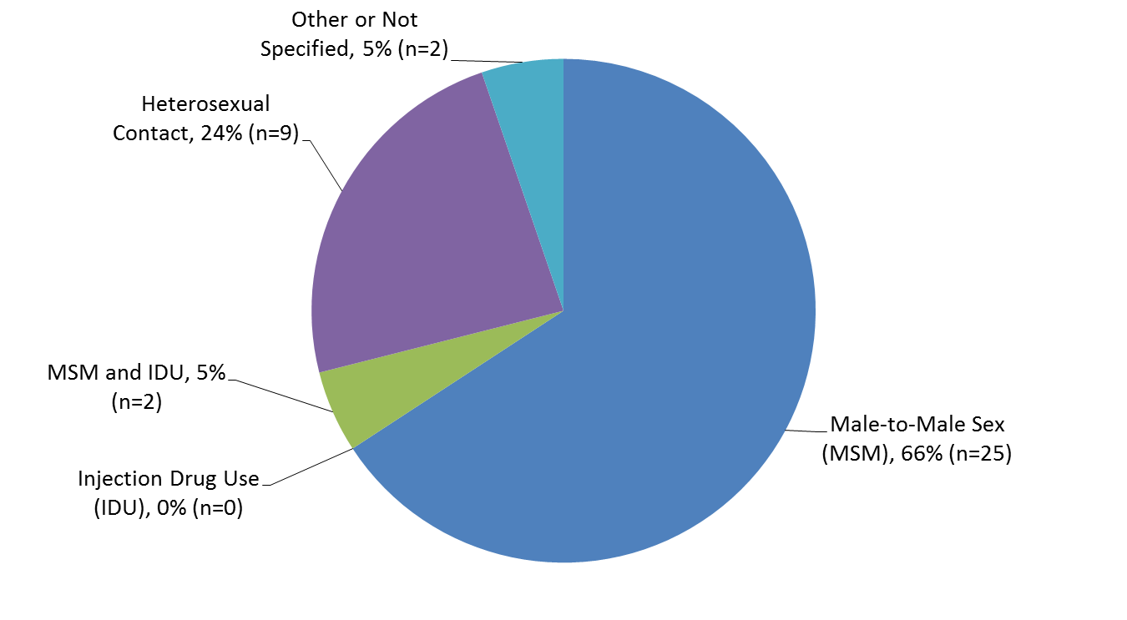
2016 Reported Cases of HIV First Diagnosed in Alaska by Transmission Category (n=38)
State of Alaska, Section of Epidemiology – April 2017

Slide 11
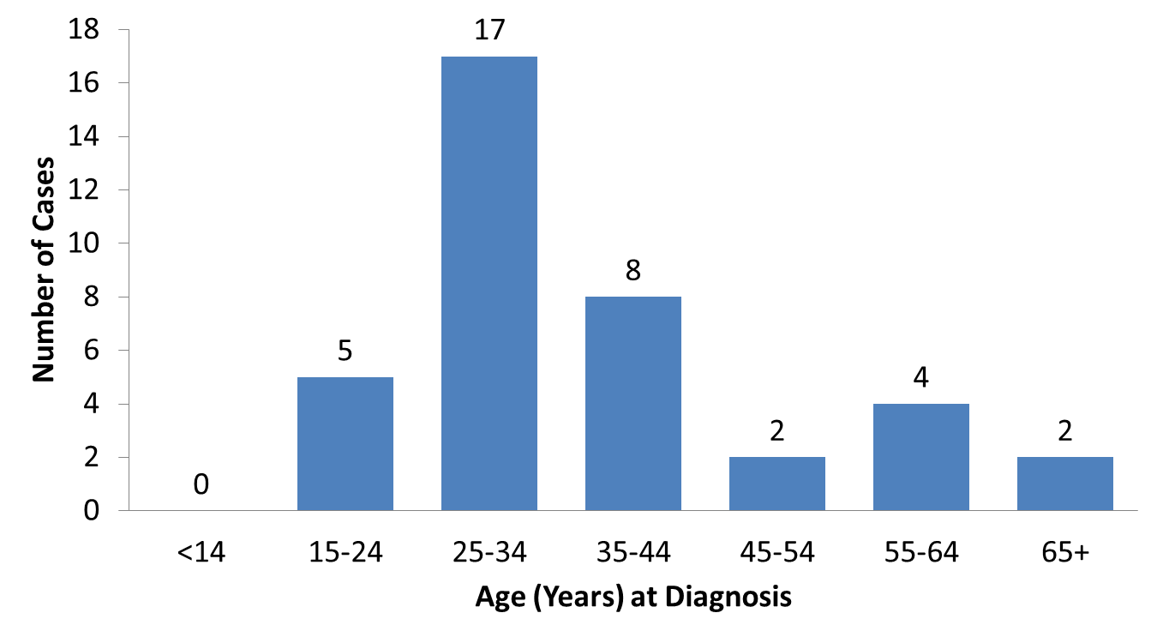
2016 Cases of HIV First Diagnosed in Alaska by Age at Diagnosis (n=38)
State of Alaska, Section of Epidemiology – April 2017

Slide 12
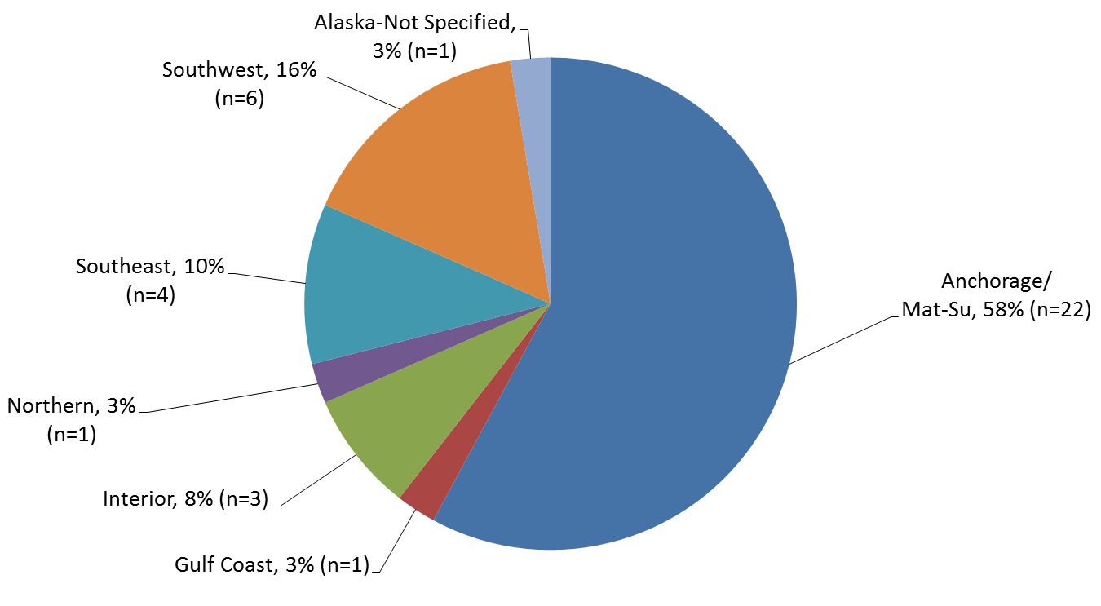
2016 Reported Cases of HIV First Diagnosed in Alaska by Residence at Diagnosis (n=38)
State of Alaska, Section of Epidemiology – April 2017

Slide 13
Highlights, Persons Living with HIV in Alaska As of December 31, 2016, n=692
380 (55%) ever had a diagnosis of AIDS
520 (75%) were male
326 (47%) were Men Who Have Sex with Men (MSM); 181 (26%) were Heterosexual
292 (42%) were White; 181 (26%) were Alaska Native/American Indian; 101 (15%) were Black
463 (67%) had an initial diagnosis in Alaska; 310 (67%) of those were living in Anchorage/Mat-Su at the time of diagnosis
92% of those thought to be living with HIV in Alaska during 2016 were engaged in medical care, and of those 87% were virally suppressed
State of Alaska, Section of Epidemiology – April 2017

Slide 14
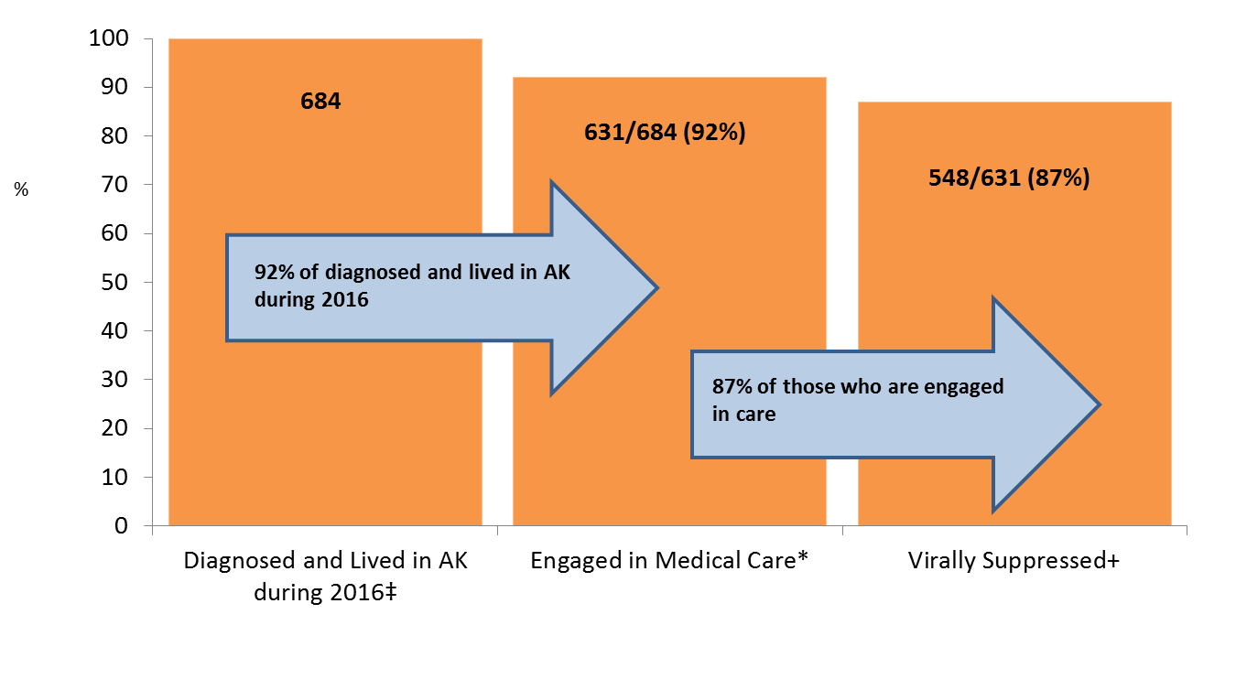
HIV Care Continuum, Alaska ― 2016 (n=684)
‡ Includes all cases who lived in Alaska (AK) during 2016 (n=704). Cases with unknown residence and no activity in the surveillance system for ten or more years were excluded (n=20).
* Received at least one CD4/Viral Load between Jan. 1 and Dec. 31, 2016.
+ Viral Load ≤200 copies/mL.
State of Alaska, Section of Epidemiology – April 2017

Slide 15
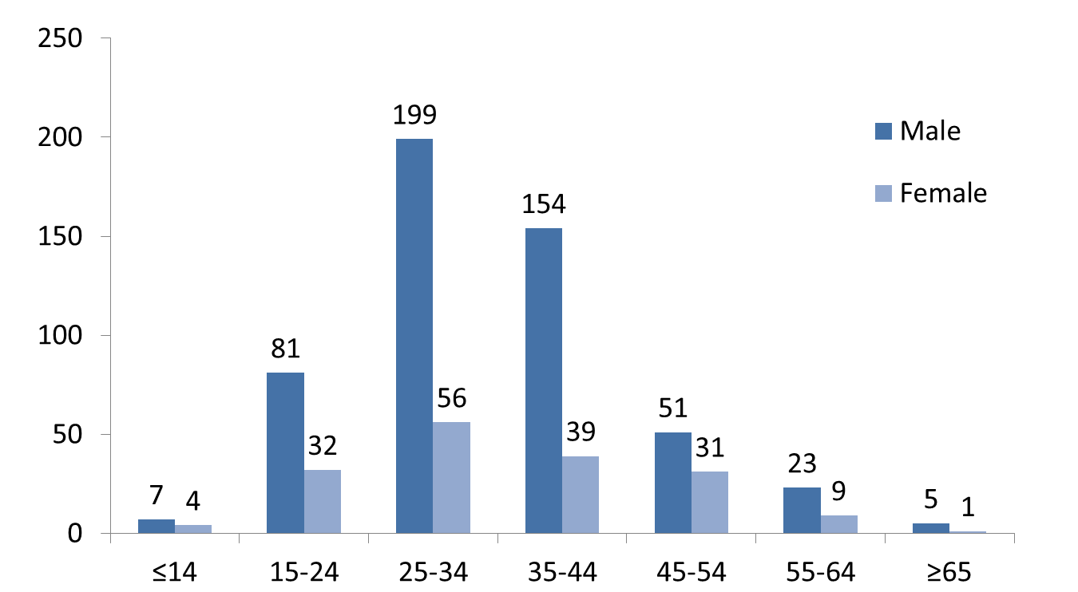
Persons Living with HIV in Alaska by Age of Diagnosis and Gender–As of December 31, 2016 (n=692)
State of Alaska, Section of Epidemiology – April 2017

Slide 16
Persons Living with HIV in Alaska by Race/Ethnicity and Gender–As of December 31, 2016 (n=692)
State of Alaska, Section of Epidemiology – April 2017

Slide 17
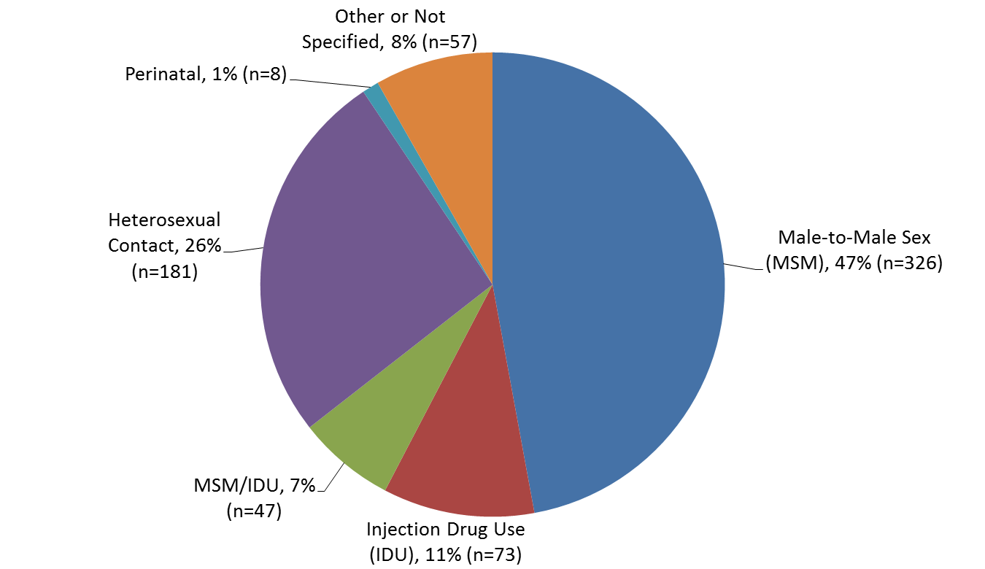
Persons Living with HIV in Alaska by Transmission Category–As of December 31, 2016 (n=692)
State of Alaska, Section of Epidemiology – April 2017

Slide 18
Version last updated April 5, 2017
Visit the HIV Data and Statistics Page at http://dhss.alaska.gov/dph/Epi/hivstd/Pages/hivdata.aspx for the most up-to-date version.

