Slide 1
Summary of HIV Infection in Alaska, 1982–2018
Prepared by the State of Alaska Department of Health and Social Services, Division of Public Health, HIV/STD Program, Section of Epidemiology. For questions about this presentation please visit http://www.epi.hss.state.ak.us/hivstd/default.stm or call the Alaska Section of Epidemiology at
(907) 269-8000.
State of Alaska, Section of Epidemiology – March 2019

Slide 2
Highlights, Cumulative HIV Cases 1982-2018 (N=1,890)
1,228 (65%) ever had a diagnosis of AIDS
658 (35%) are known to have died
1,523 (81%) were male
1,132 (60%) were men who have sex with men (MSM) including 154 MSM/IDU; 354 (19%) were heterosexual (Hetero) and 209 (11%) were IDU
971 (51%) were White; 377 (20%) were Alaska Native/American Indian; 259 (14%) were Black
1,239 (66%) had an initial diagnosis in Alaska; 867 (70%) of those were living in Anchorage/Mat-Su at the time of diagnosis
State of Alaska, Section of Epidemiology – March 2019

Slide 3
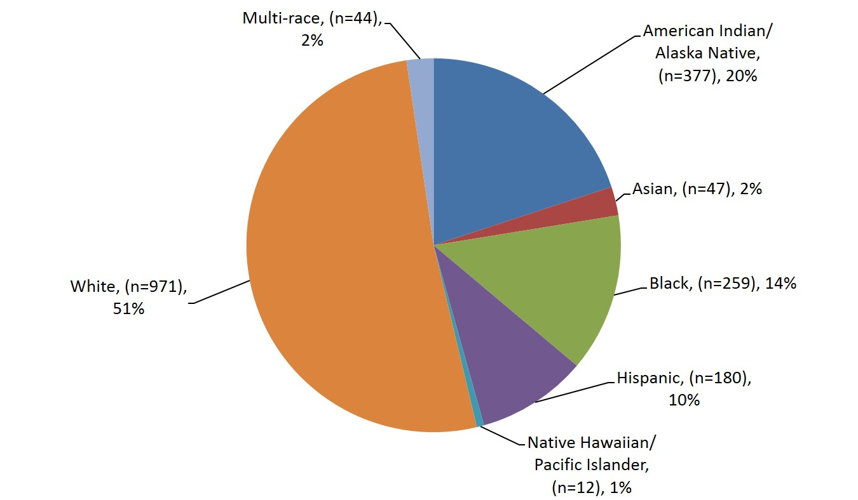
Reported Cases of HIV by Race/Ethnicity, 1982–2018 (N=1,890)
State of Alaska, Section of Epidemiology – March 2019

Slide 4
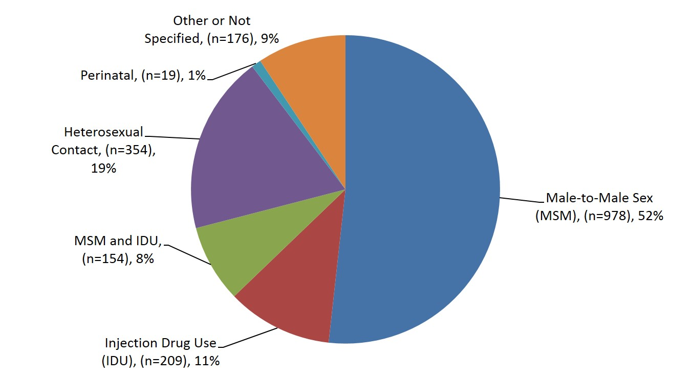
Reported Cases of HIV by Transmission Category 1982–2018 (N=1,890)
State of Alaska, Section of Epidemiology – March 2019

Slide 5
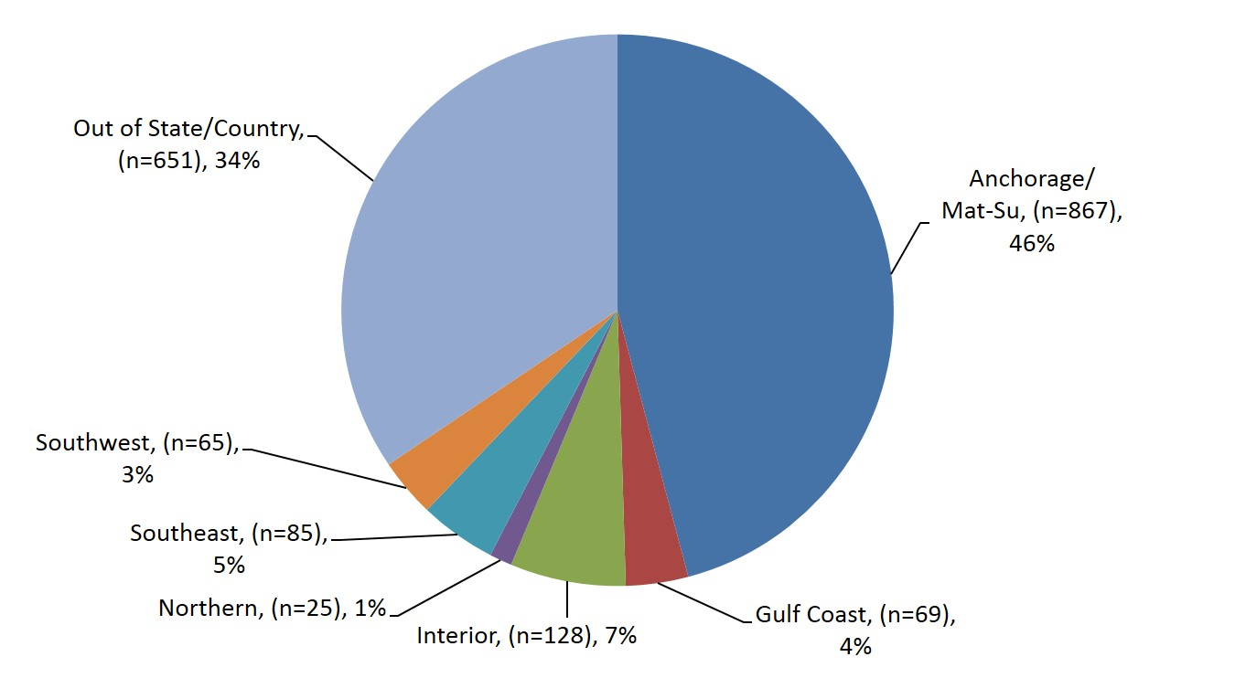
Reported Cases of HIV by Residence at Diagnosis 1982–2018 (N=1,890)
State of Alaska, Section of Epidemiology – March 2019

Slide 6
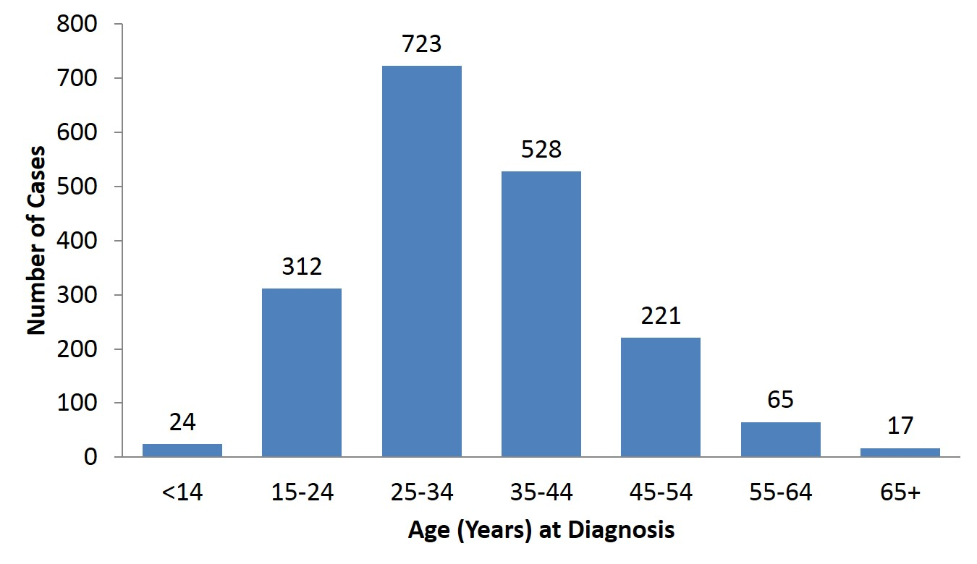
Reported Cases of HIV by Age at Diagnosis 1982–2018 (N=1,890)
State of Alaska, Section of Epidemiology – March 2019

Slide 7
Reported Cases of HIV by Race/Ethnicity and Gender at Birth, 1982–2018 (N=1,890)
Race/ Ethnicity | Total (n=1,890) |  | Male (n=1,523) |  | Female (n=367)
 | n | % of Total | n | % of Males | n | % of Females
American Indian/ Alaska Native | 377 | 20% | 256 | 17% | 121 | 33%
Asian | 47 | 2% | 28 | 2% | 19 | 5%
Black | 259 | 14% | 199 | 13% | 60 | 16%
Hispanic | 180 | 10% | 149 | 10% | 31 | 8%
Native Hawaiian/ Pacific Islander | 12 | 1% | 10 | 1% | 2 | 1%
White | 971 | 51% | 844 | 55% | 127 | 35%
Multi-Race | 44 | 2% | 37 | 2% | 7 | 2%
State of Alaska, Section of Epidemiology – March 2019

Slide 8
Highlights, Newly Diagnosed HIV Cases 2018 (n=22)
Of the 58 cases reported to the Alaska Section of Epidemiology in 2018, 22 were newly diagnosed in Alaska. Of those 22:
3 (14%) were also diagnosed with AIDS at the time of initial diagnosis
None are known to have died
19 (86%) were male at birth, one of whom is transgender male to female
12 (50%) were Men Who Have Sex with Men (MSM); 5 (23%) were MSM/IDU; 2 (9%) were IDU; 2 (9%) were heterosexual
8 (36%) were Alaska Native/American Indian; 7 (32%) were White; 4 (14%) were multi-race
14 (64%) were 34 years old or younger at the time of diagnosis
16 (73%) were living in Anchorage/Mat-Su at the time of diagnosis
State of Alaska, Section of Epidemiology – March 2019

Slide 9
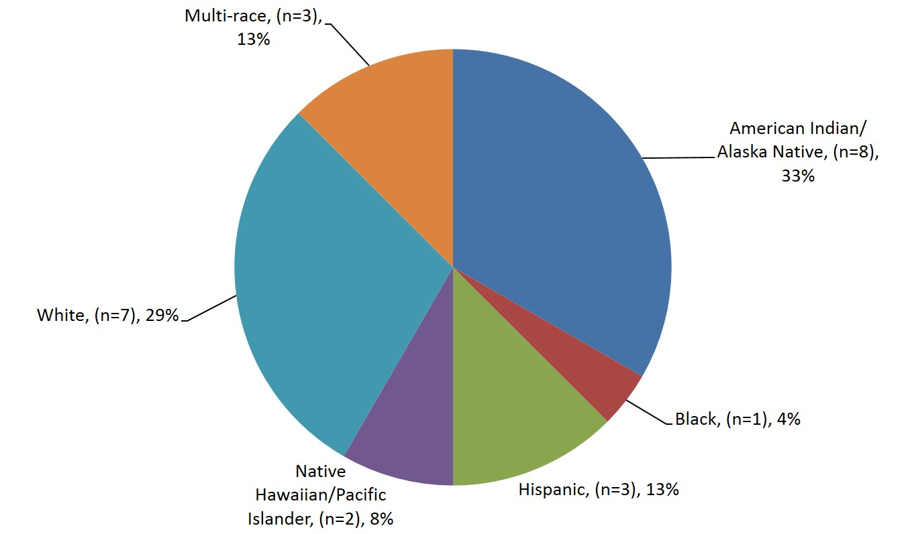
2018 Reported Cases of HIV First Diagnosed in Alaska by Race/Ethnicity (n=22)
State of Alaska, Section of Epidemiology – March 2019

Slide 10
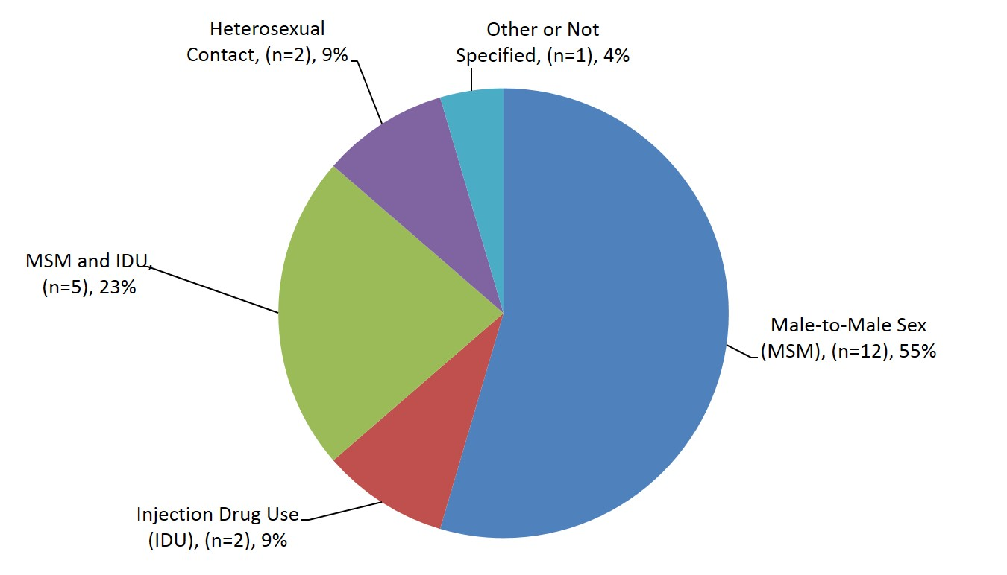
2018 Reported Cases of HIV First Diagnosed in Alaska by Transmission Category (n=22)
State of Alaska, Section of Epidemiology – March 2019

Slide 11
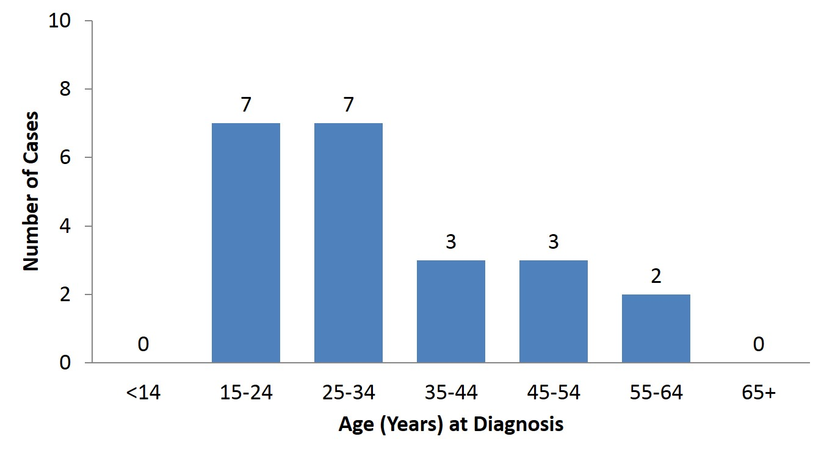
2018 Cases of HIV First Diagnosed in Alaska by Age at Diagnosis (n=22)
State of Alaska, Section of Epidemiology – March 2019

Slide 12
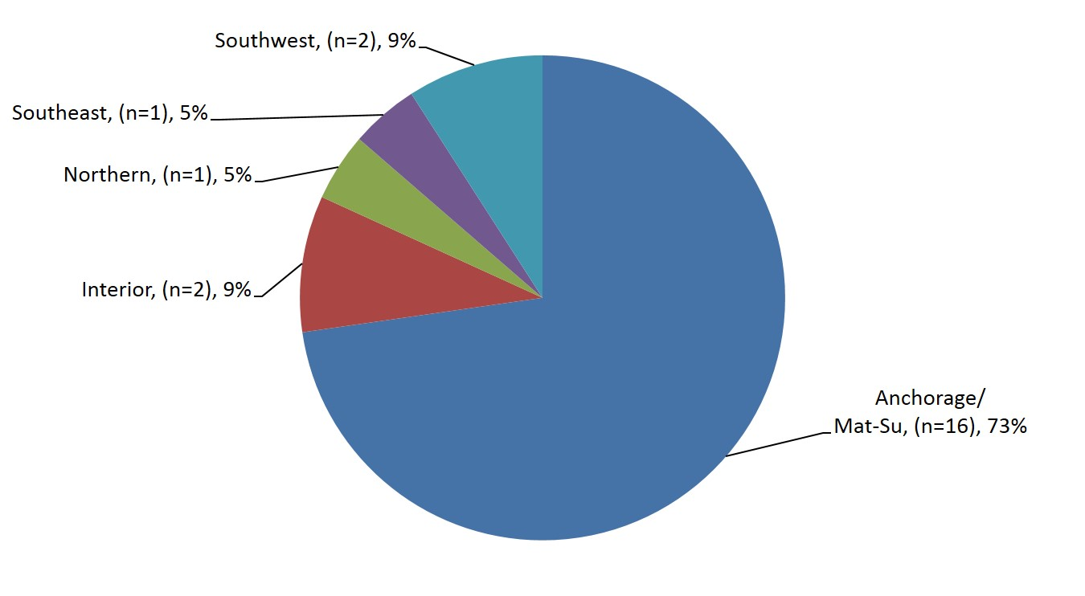
2018 Reported Cases of HIV First Diagnosed in Alaska by Residence at Diagnosis (n=22)
State of Alaska, Section of Epidemiology – March 2019

Slide 13
Reported Cases of HIV by Race/Ethnicity and Gender at Birth, 2018 (n=22)
Race/ Ethnicity | Total (n=22) |  | Male (n=19) |  | Female (n=3)
 | n | % of Total | n | % of Males | n | % of Females
American Indian/ Alaska Native | 8 | 36% | 7 | 37% | 1 | 33%
Asian | 0 | 0% | 0 | 0% | 0 | 0%
Black | 1 | 5% | 1 | 5% | 0 | 0%
Hispanic | 1 | 5% | 0 | 0% | 1 | 33%
Native Hawaiian/ Pacific Islander | 2 | 9% | 2 | 11% | 0 | 0%
White | 7 | 32% | 6 | 32% | 1 | 33%
Multi-Race | 3 | 14% | 3 | 16% | 0 | 0%
State of Alaska, Section of Epidemiology – March 2019

Slide 14
Highlights, Persons Living with HIV in Alaska As of December 31, 2018 (n=699)
374 (54%) ever had a diagnosis of AIDS
524 (75%) were male at birth
386 (55%) were Men Who Have Sex with Men (MSM) including 49 MSM/IDU; 187 (26%) were heterosexual
271 (39%) were White; 199 (29%) were Alaska Native/American Indian; 98 (14%) were Black
465 (66%) had an initial diagnosis in Alaska; 311 (67%) of those were living in Anchorage/Mat-Su at the time of diagnosis
94% of those thought to be living with HIV in Alaska during 2018 were engaged in medical care, and of those 89% were virally suppressed
State of Alaska, Section of Epidemiology – March 2019

Slide 15
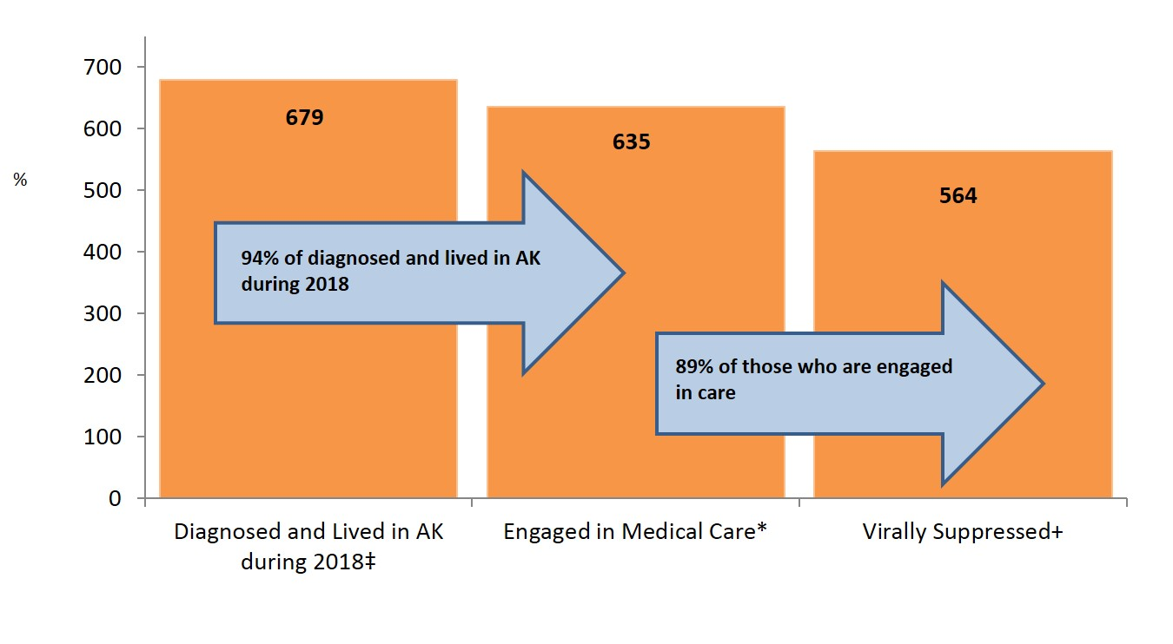
HIV Care Continuum, Alaska ― 2018 (n=679)
‡ Includes all cases who lived in Alaska (AK) during 2018; cases with unknown residence and no activity in the surveillance system for ten or more years were excluded (n=20).
* Received at least one CD4/Viral Load between Jan. 1 and Dec. 31, 2018.
+ Viral Load ≤200 copies/mL.
State of Alaska, Section of Epidemiology – March 2019

Slide 16
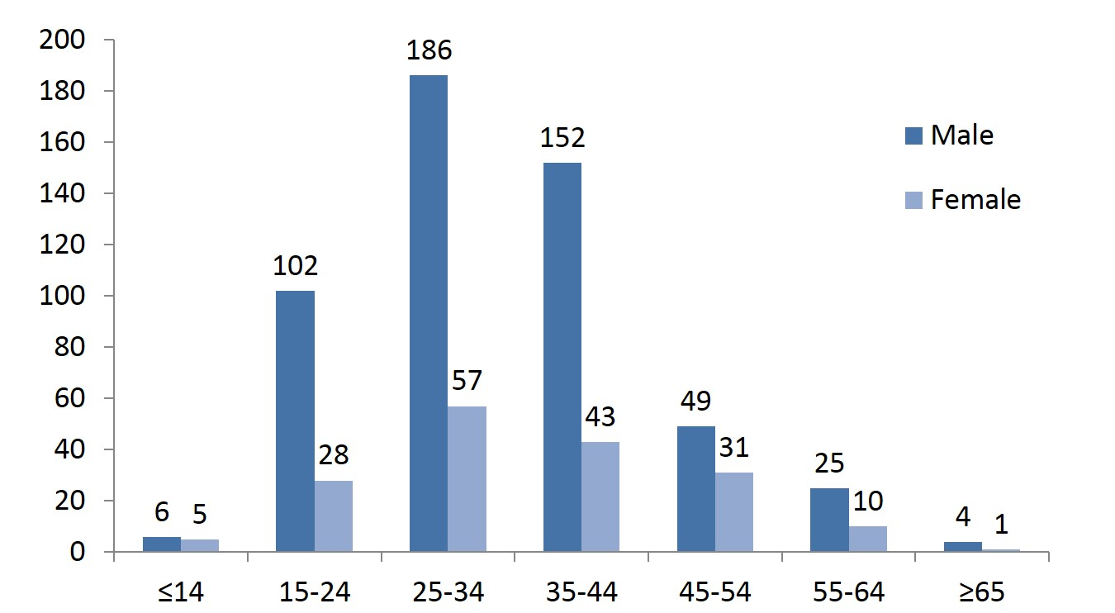
Persons Living with HIV in Alaska by Age of Diagnosis and Gender at Birth–As of December 31, 2018 (n=699)
State of Alaska, Section of Epidemiology – March 2019

Slide 17
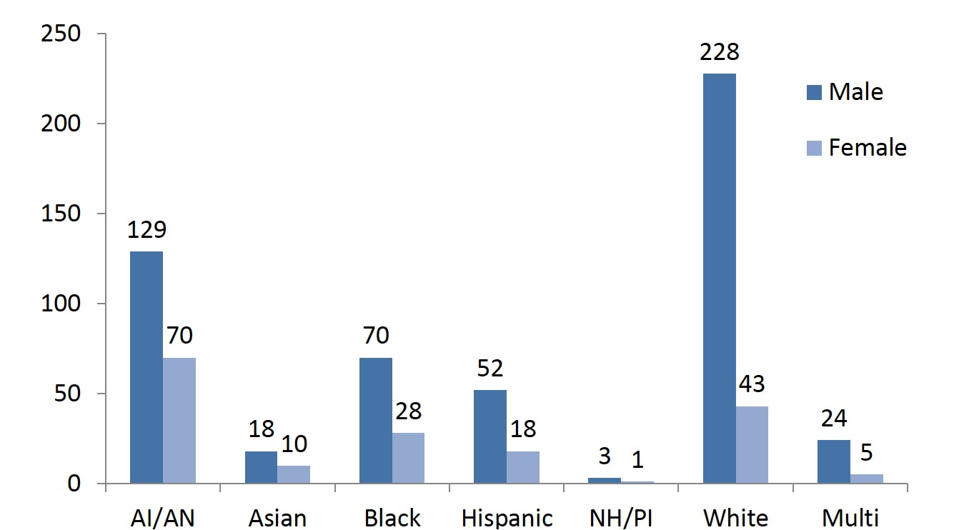
Persons Living with HIV in Alaska by Race/Ethnicity and Gender at Birth–As of December 31, 2018 (n=699)
State of Alaska, Section of Epidemiology – March 2019

Slide 18
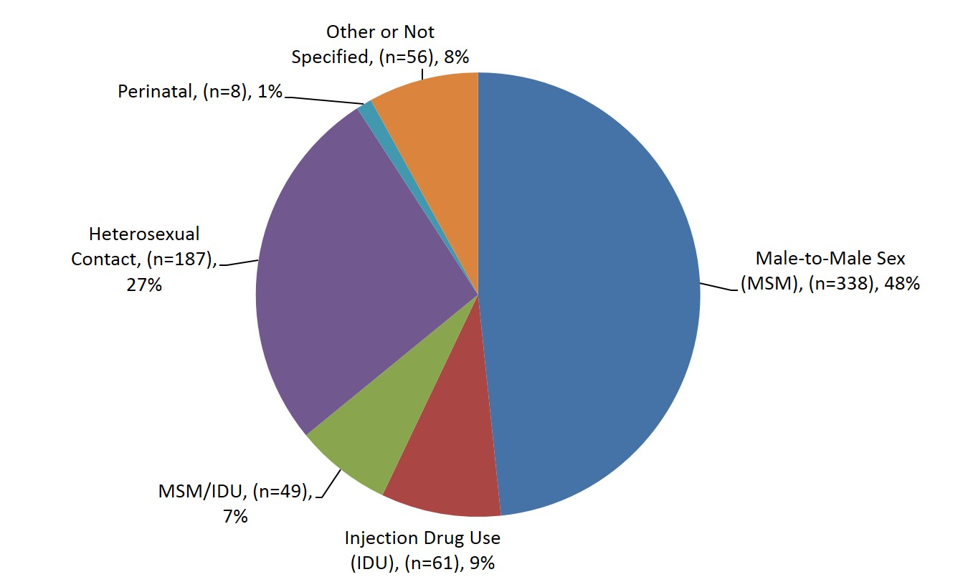
Persons Living with HIV in Alaska by Transmission Category–As of December 31, 2018 (n=699)
State of Alaska, Section of Epidemiology – March 2019

Slide 19
Version last updated April 1, 2019
Visit the HIV Data and Statistics Page at http://dhss.alaska.gov/dph/Epi/hivstd/Pages/hivdata.aspx for the most up-to-date version.

