Slide 1
Summary of HIV Infection in Alaska, 1982–2013
Updated on May 12, 2014
Source: State of Alaska Department of Health and Social Services, Division of Public Health, HIV/STD Program, Section of Epidemiology
State of Alaska, Section of Epidemiology – April 2014

Slide 2
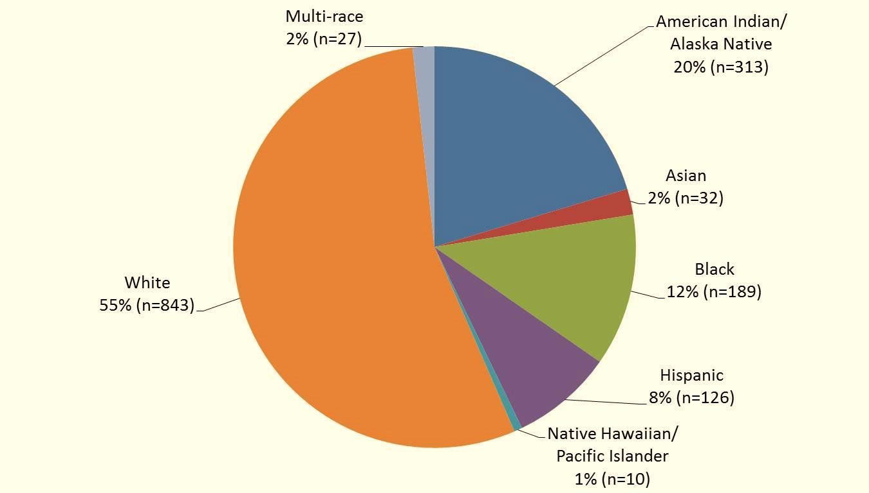
Reported Cases of HIV by Race/Ethnicity,
1982–2013 (N=1,540)
State of Alaska, Section of Epidemiology – April 2014

Slide 3
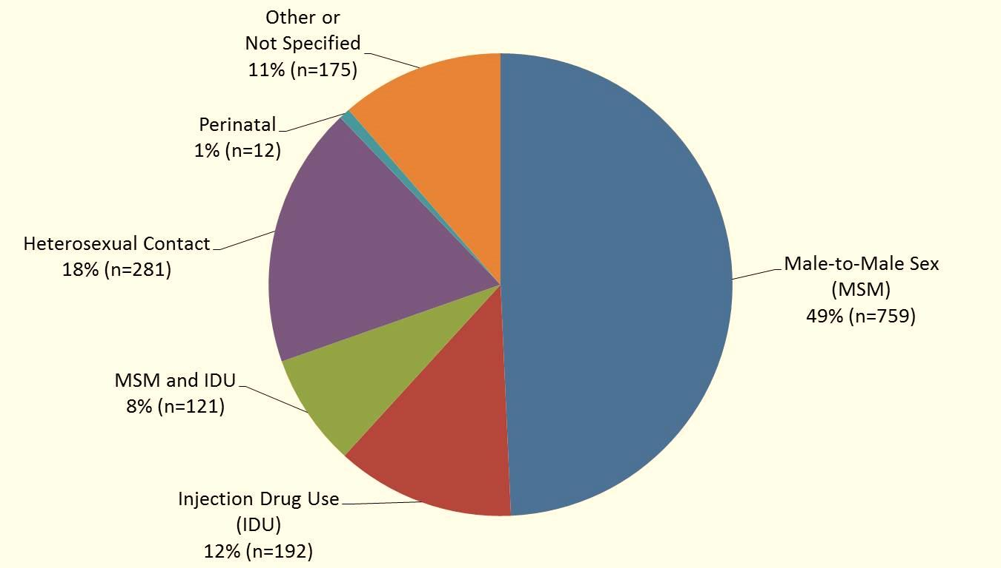
Reported Cases of HIV by Transmission Category
1982–2013 (n=1,540)
State of Alaska, Section of Epidemiology – April 2014

Slide 4
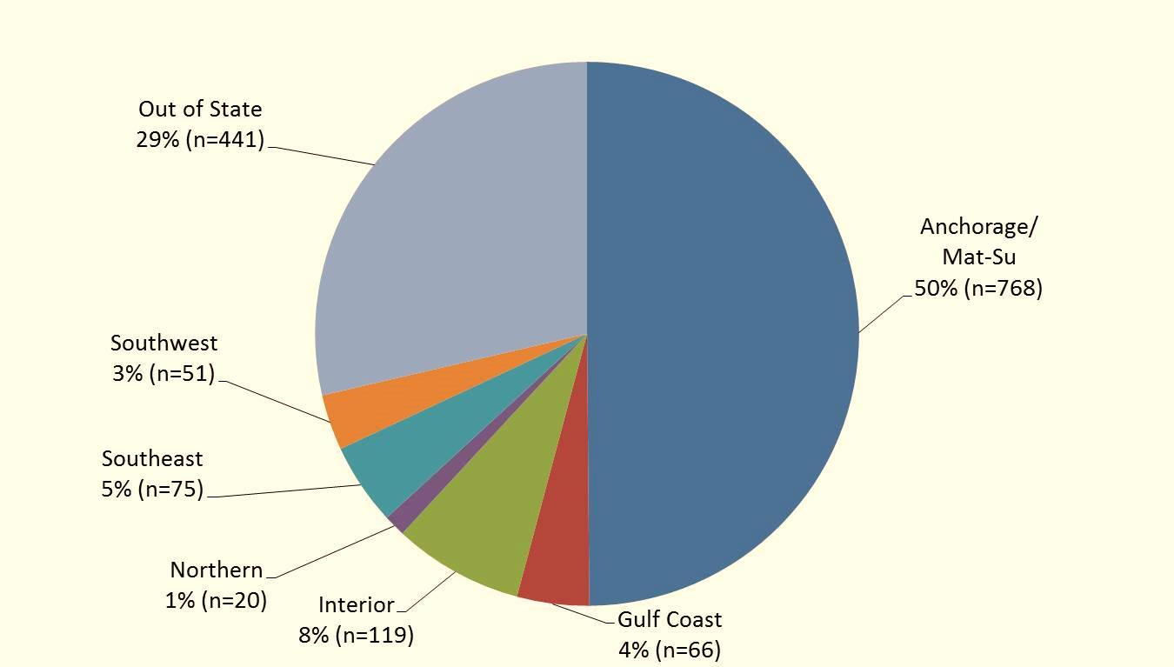
Reported Cases of HIV by Residence at Diagnosis
1982–2013 (n=1,540)
State of Alaska, Section of Epidemiology – April 2014

Slide 5
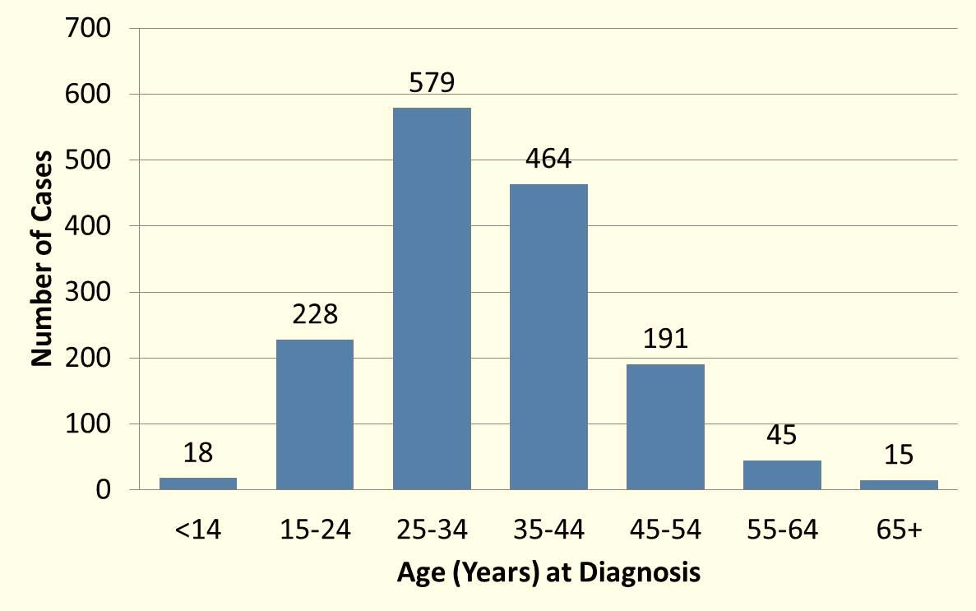
Reported Cases of HIV by Age at Diagnosis
1982–2013 (n=1,540)
State of Alaska, Section of Epidemiology – April 2014

Slide 6
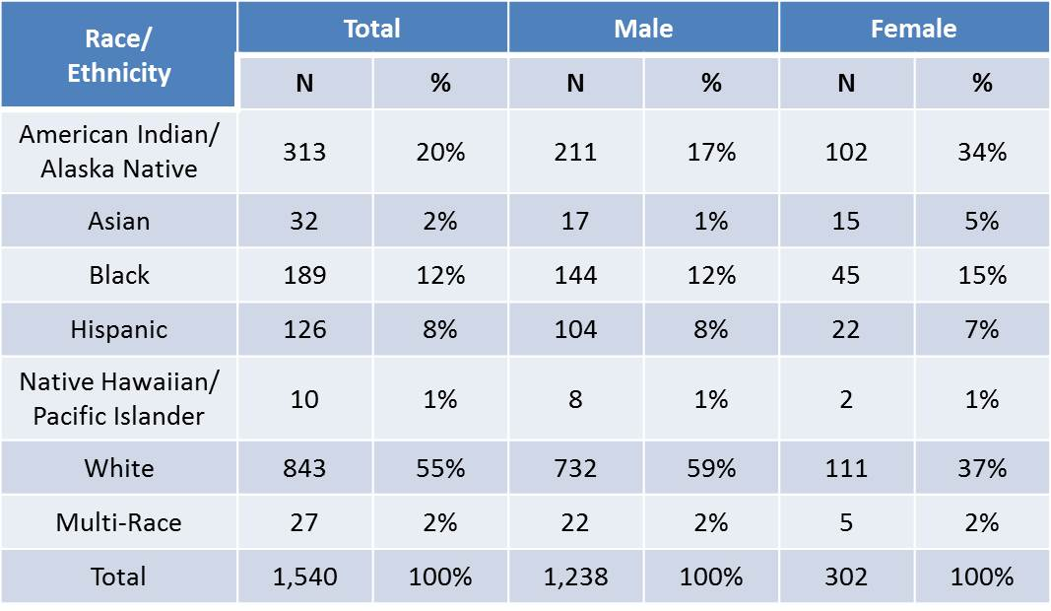
Reported Cases of HIV by Race/Ethnicity and Gender,
1982–2013 (N=1,540)
State of Alaska, Section of Epidemiology – April 2014

Slide 7
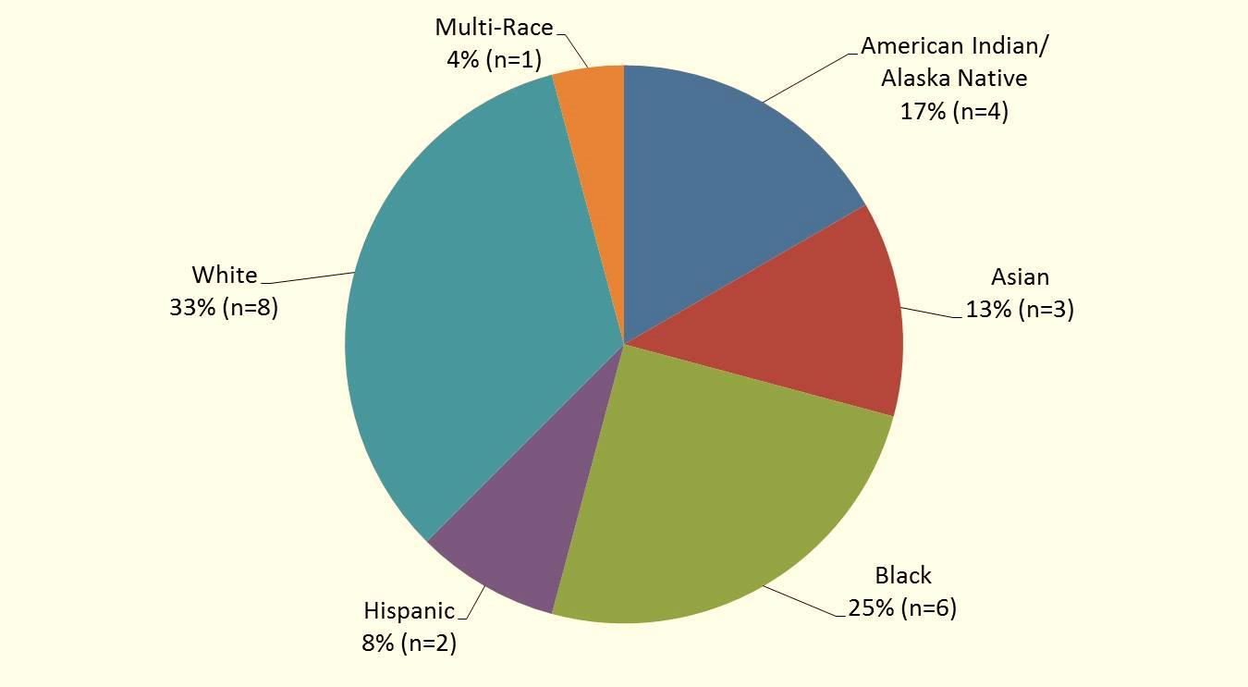
2013 Reported Cases of HIV First Diagnosed in Alaska by Race/Ethnicity (n=24)
State of Alaska, Section of Epidemiology – April 2014

Slide 8
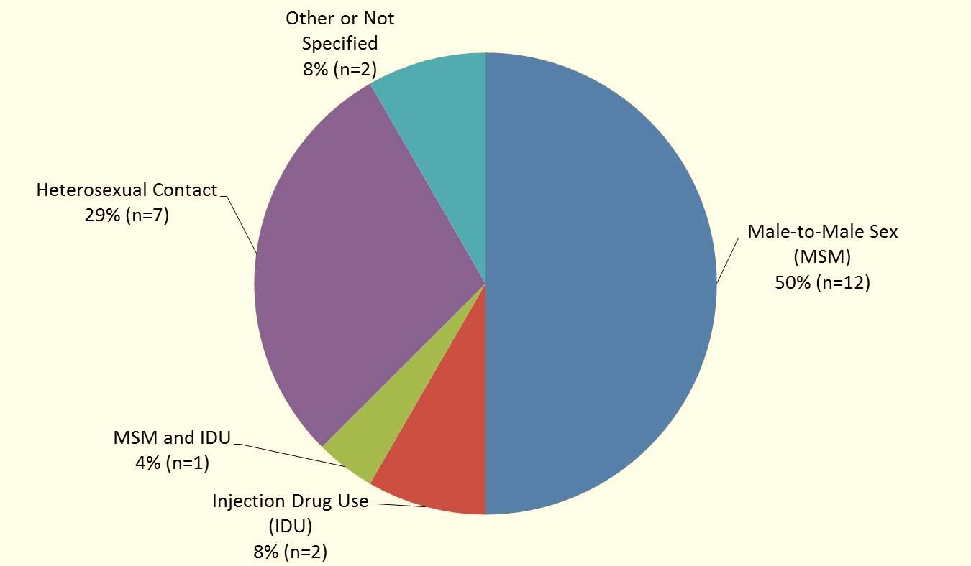
2013 Reported Cases of HIV First Diagnosed in Alaska by Transmission Category (n=24)
State of Alaska, Section of Epidemiology – April 2014

Slide 9
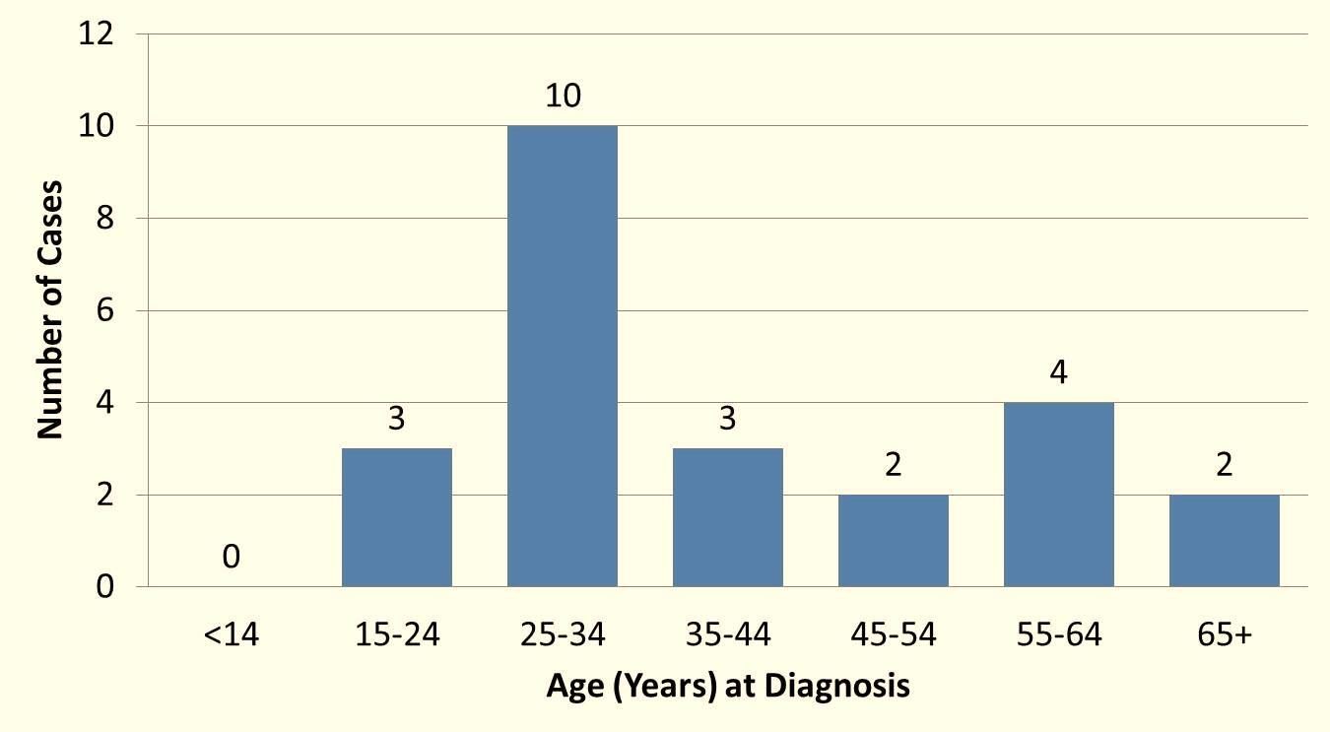
2013 Cases of HIV First Diagnosed in Alaska by Age at Diagnosis (n=24)
State of Alaska, Section of Epidemiology – April 2014

Slide 10
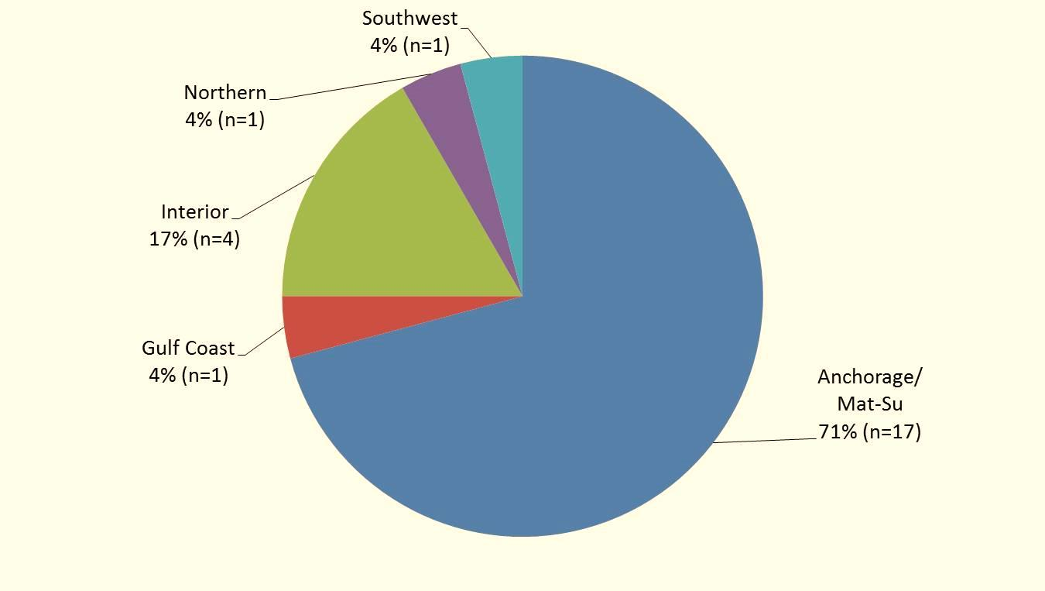
2013 Reported Cases of HIV First Diagnosed in Alaska by Residence at Diagnosis (n=24)
State of Alaska, Section of Epidemiology – April 2014

