Slide 1
Summary of HIV Infection in Alaska, 1982-2014
Prepared by the State of Alaska Department of Health and Social Services, Division of Public Health, HIV/STD Program, Section of Epidemiology. For questions about this presentation please visit http://www.epi.hss.state.ak.us/hivstd/default.stm or call the Alaska Section of Epidemiology at
(907) 269-8000.
State of Alaska, Section of Epidemiology – April 2015

Slide 2
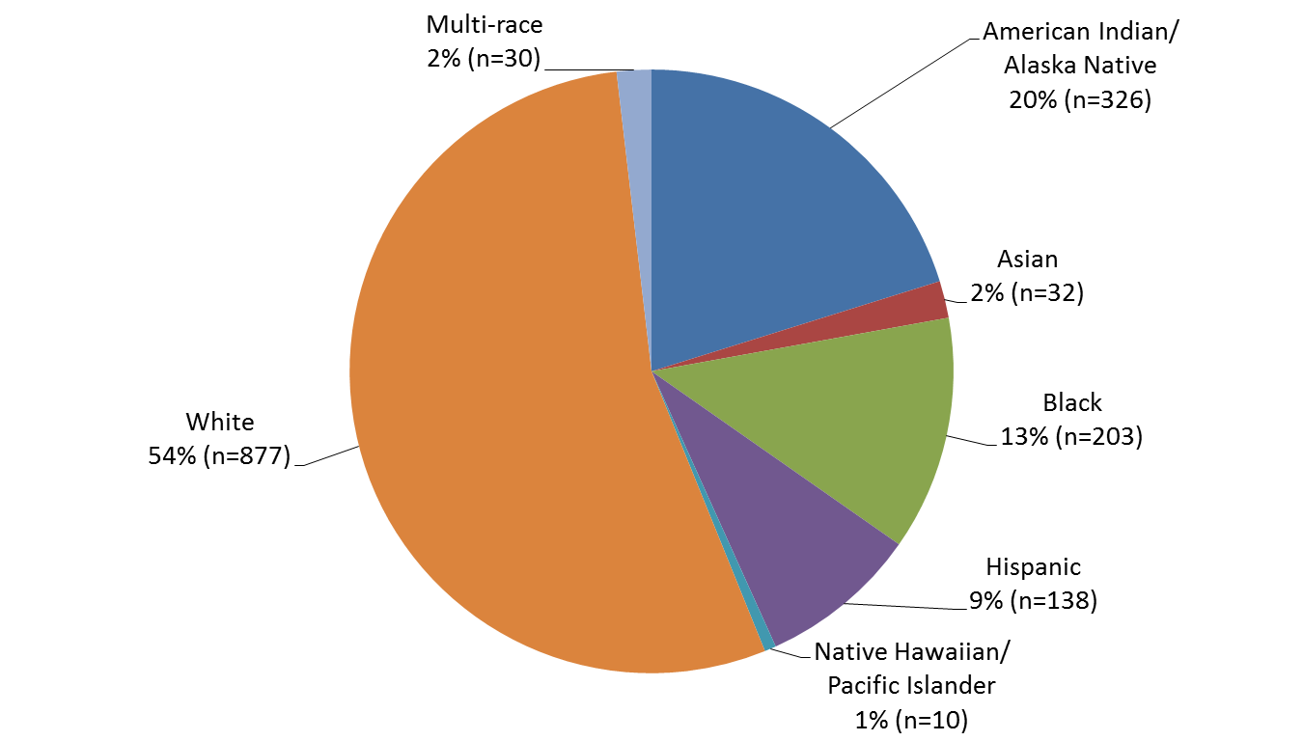
Reported Cases of HIV by Race/Ethnicity, 1982-2014 (N=1,616)
State of Alaska, Section of Epidemiology – April 2015

Slide 3
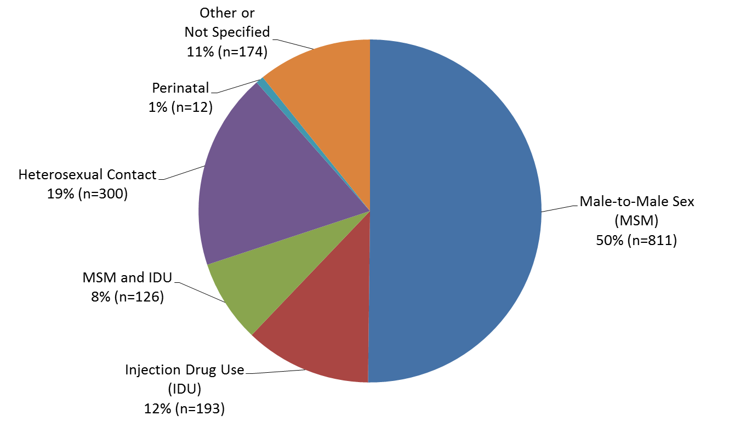
Reported Cases of HIV by Transmission Category 1982-2014 (n=1,616)
State of Alaska, Section of Epidemiology – April 2015

Slide 4
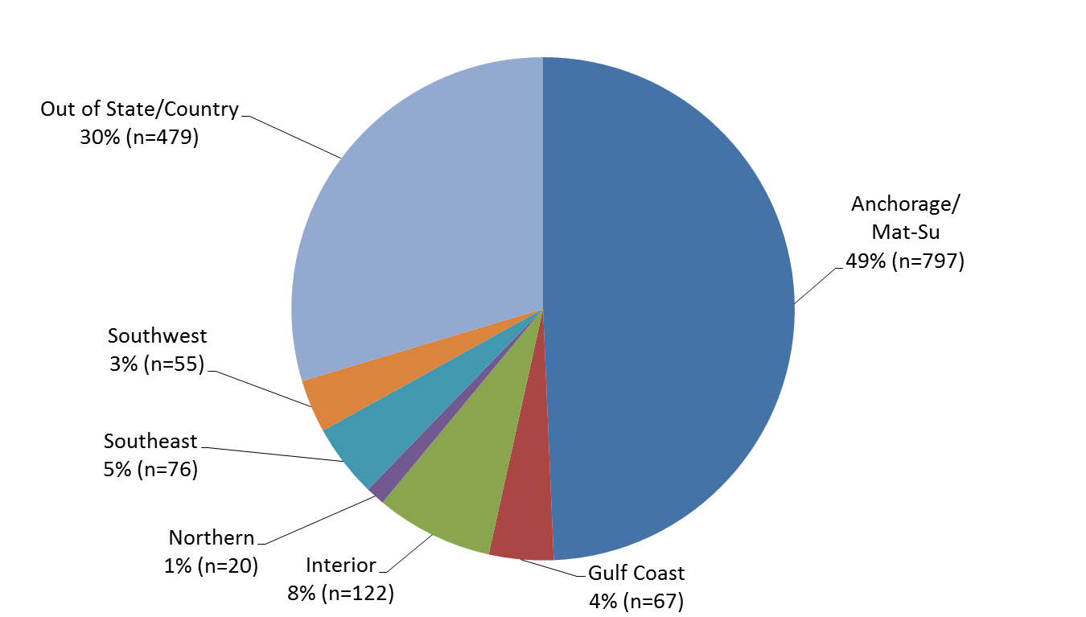
Reported Cases of HIV by Residence at Diagnosis 1982-2014 (n=1,616)
State of Alaska, Section of Epidemiology – April 2015

Slide 5
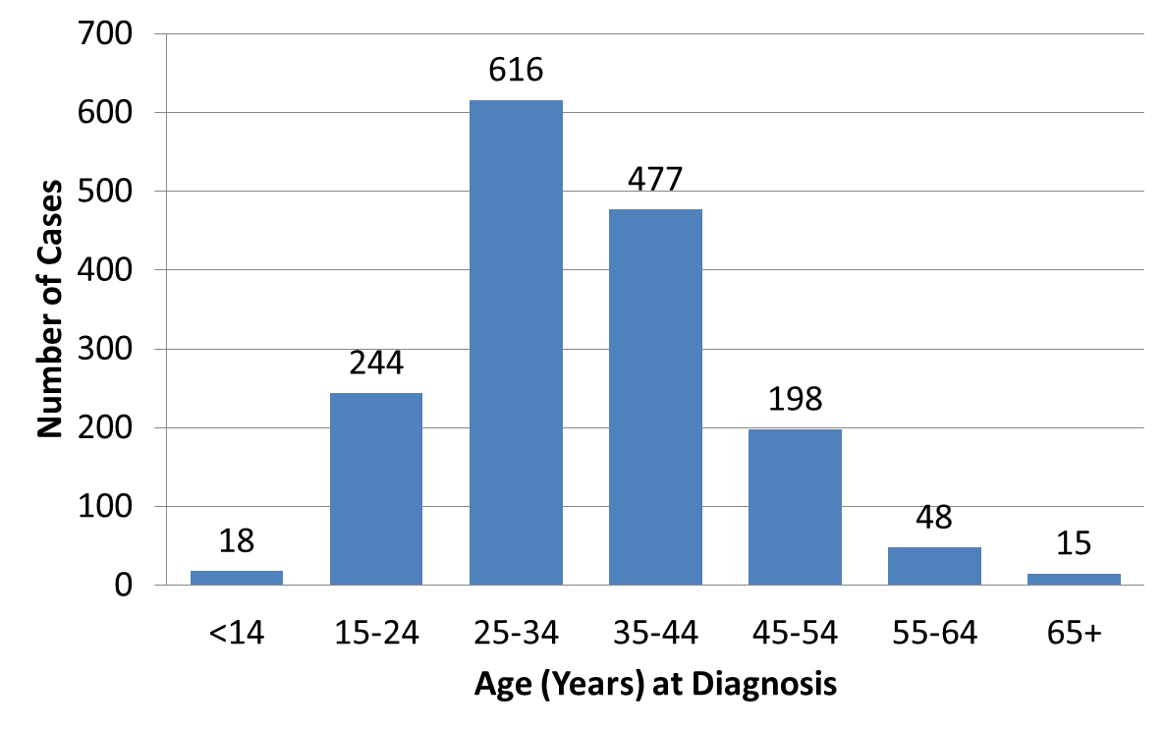
Reported Cases of HIV by Age at Diagnosis 1982-2014 (n=1,616)
State of Alaska, Section of Epidemiology – April 2015

Slide 6
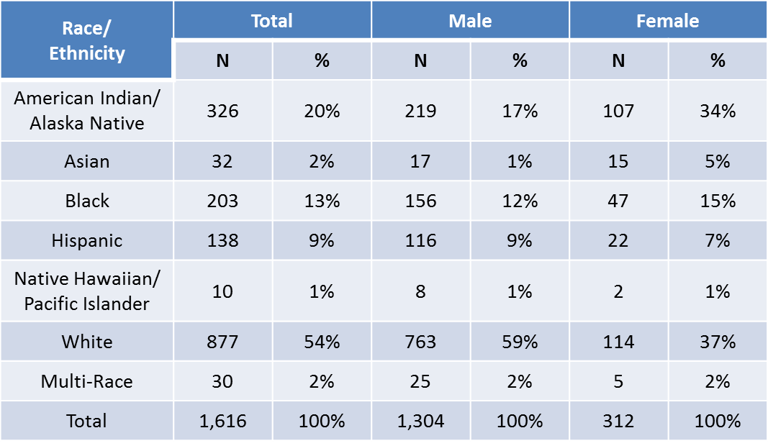
Reported Cases of HIV by Race/Ethnicity and Gender, 1982-2014 (N=1,616)
State of Alaska, Section of Epidemiology – April 2015

Slide 7
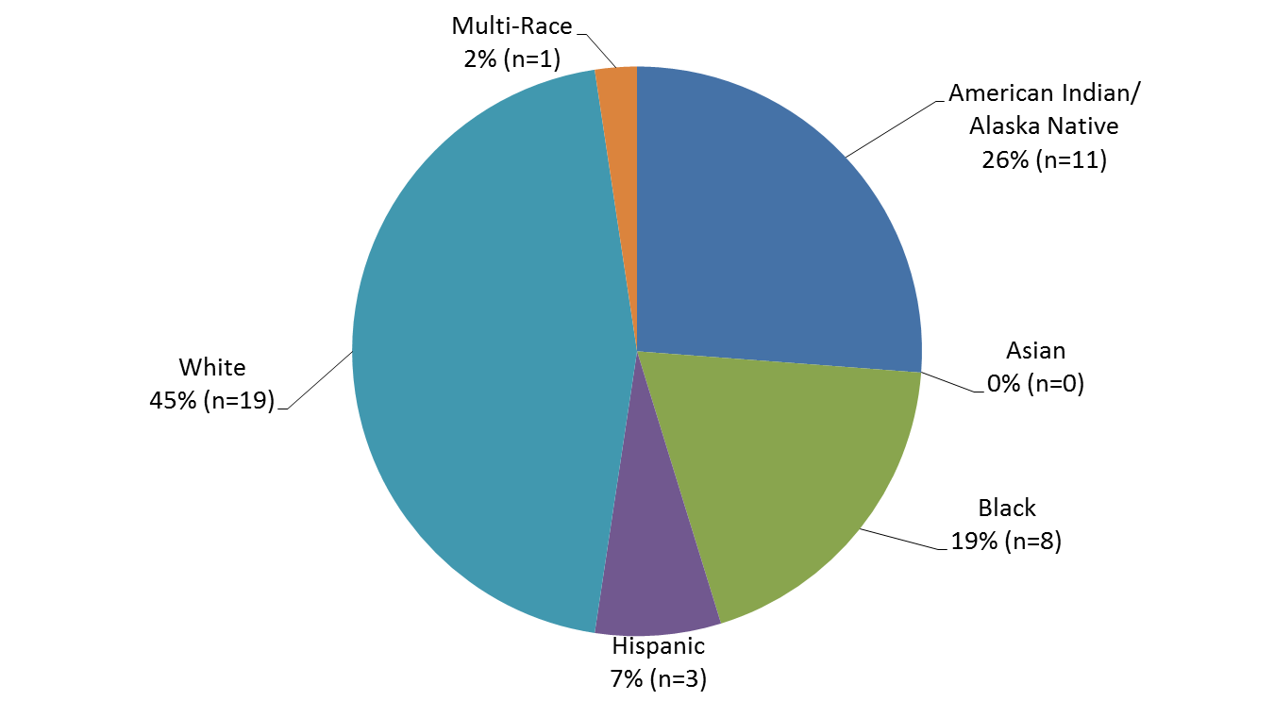
2014 Reported Cases of HIV First Diagnosed in Alaska by Race/Ethnicity (n=42)
State of Alaska, Section of Epidemiology – April 2015

Slide 8
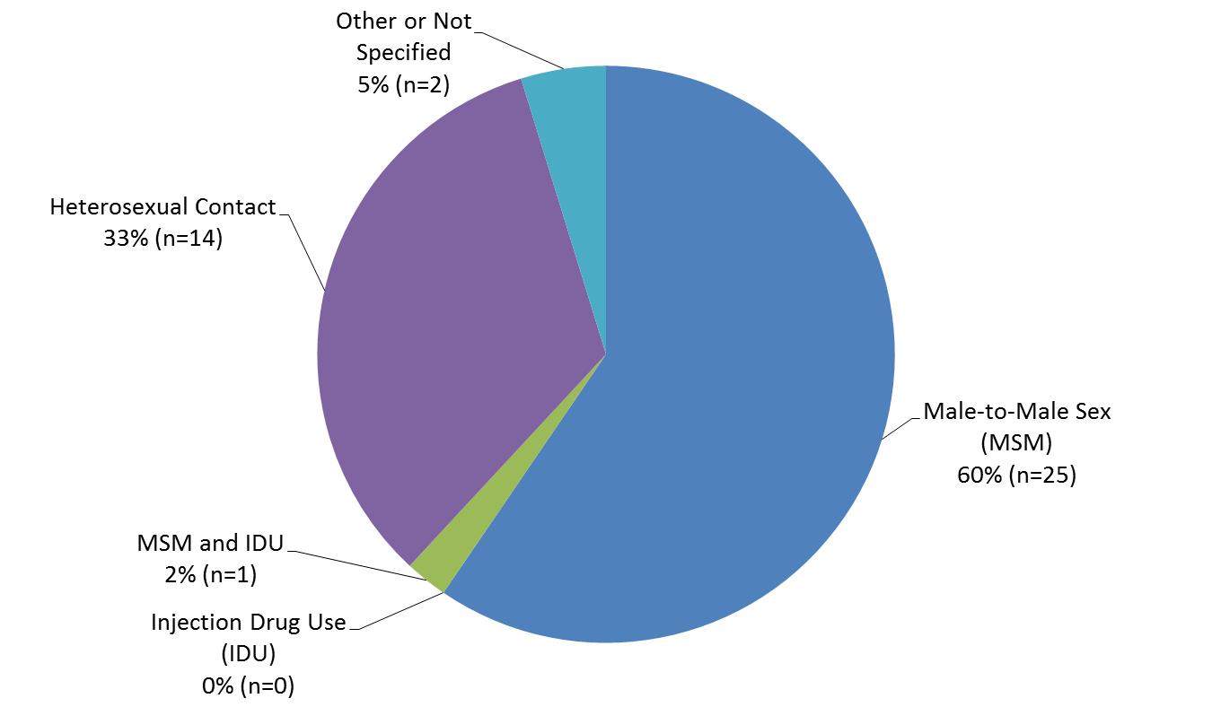
2014 Reported Cases of HIV First Diagnosed in Alaska by Transmission Category (n=42)
State of Alaska, Section of Epidemiology – April 2015

Slide 9
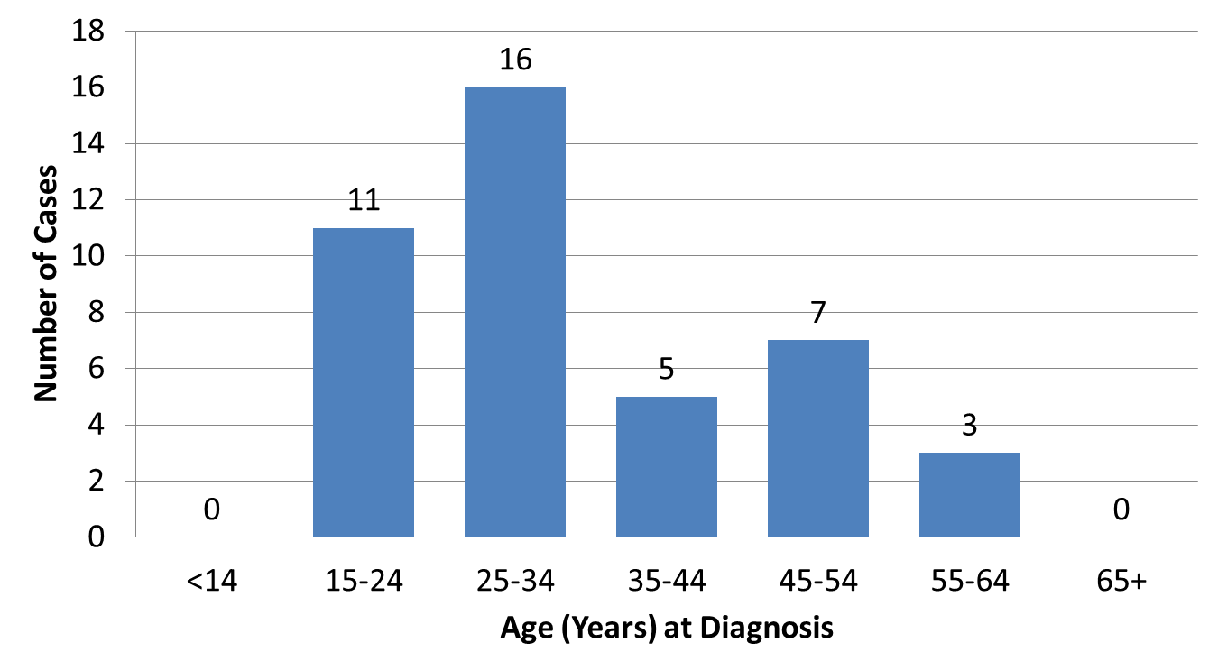
2014 Cases of HIV First Diagnosed in Alaska by Age at Diagnosis (n=42)
State of Alaska, Section of Epidemiology – April 2015

Slide 10
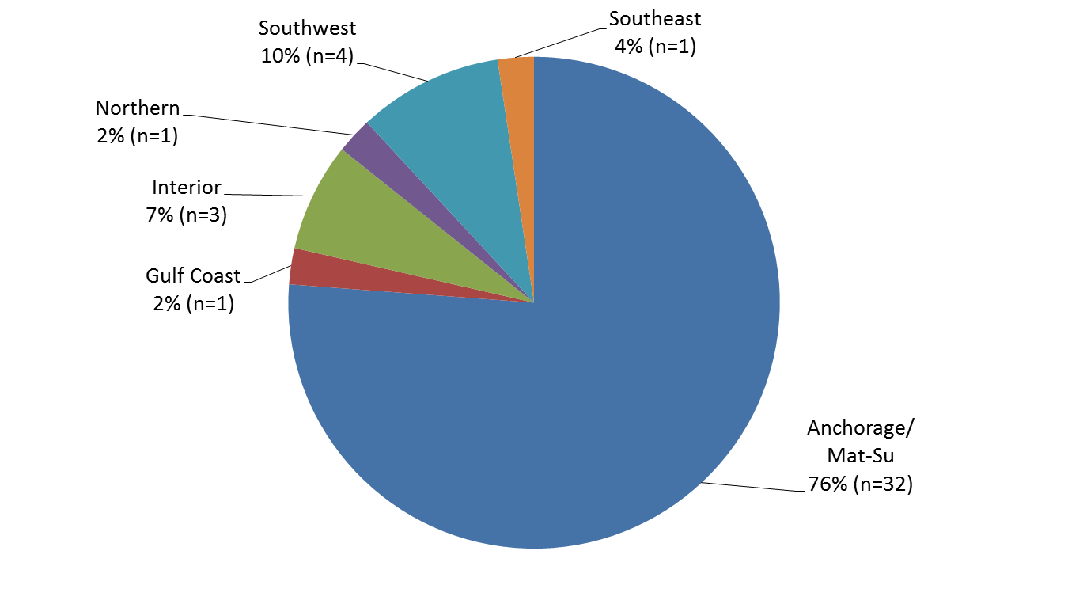
2014 Reported Cases of HIV First Diagnosed in Alaska by Residence at Diagnosis (n=42)
State of Alaska, Section of Epidemiology – April 2015

