Slide 1
Welcome to IP Boot Camp!

Slide 2
Thanks for your support!

Slide 3
Introduction-what do you want to know?
The agenda is flexible, this is your time to learn, network and participate with colleagues.
Use the sticky notes to write down any questions that you may have and we will post them to the community board.
We want to answer your questions as the day goes along!

Slide 4
Nursing Contact Hours (NCH)
The Alaska Division of Public Health is an approved with distinction as a provider of continuing nursing education by Montana Nurses Association, an accredited approver by the American Nurse’s Credentialing Center’s Commission on Accreditation.
There is no identified conflict of interest by any planner or presenter involved in this learning activity.
In order to receive nursing contact hours:
Register (sign in) and attend 80% of each day.
Participate and complete an evaluation form at the end of day.
Contact Kim Spink at 907-269-8085 or kimberly.spink@alaska.gov for any concerns for NCH

Slide 5
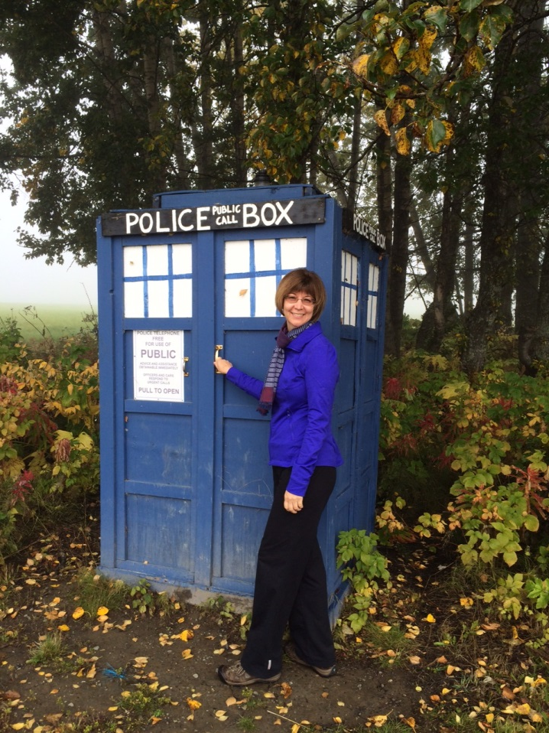
Regulatory overview
Kim Spink, RN, BSN, CIC
State of Alaska, Department of Health and Social Services
Section of Epidemiology
HAI Program/Nurse Consultant II
Phone 907-269-8085
Kimberly.spink@alaska.gov

Slide 6
Objectives
1. Know where to find your facilities licensure requirements.
2. Review AK reportable conditions and describe what diseases need to be reported.

Slide 7
Historical perspective of regulations… St Thomas Hospital, London, UK 1821
Rules for Taking-In of Patients (St Thomas Hospital 1821)
On Thursday Present Petitions to
Takers-In, namely Hospital Surgeons, Physician, and Governor.
2. Present evidence of Ability to pay for Burial Shroud, and Burial Expenses.
Explain When and How the Distemper Commenced.
Describe Nature and Regularity of Symptoms.
5. Show that Disorder is not Incurable.
6. Pay 2s 6p if Cleane, 5s if Foule.
7. Foule Patients straying from Veneral Disease Wards will be expelled.
By Order of the Governors
Notes:
7 rules, primarily for patients, must be able to pay for your burial shroud and burial expenses. Also, show the disorder is not incurable!

Slide 8
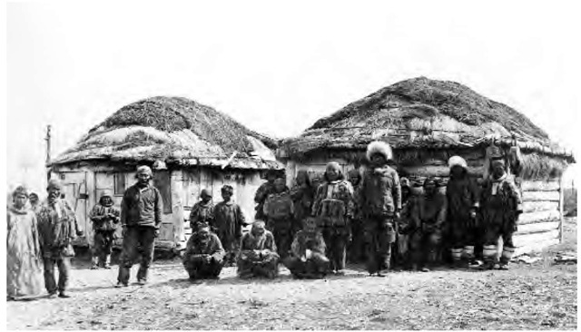
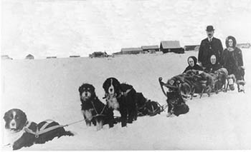
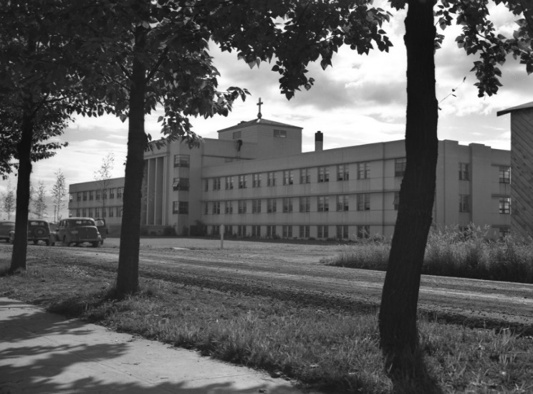
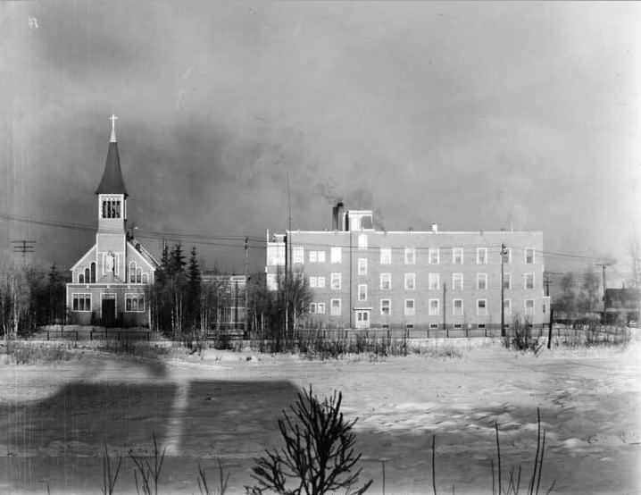
Providence Hospital, Anchorage, AK 1939
Yup’ik settlement in Togiak, AK 1909
St. Joseph’s Hospital, Fairbanks, AK 1930

Slide 9
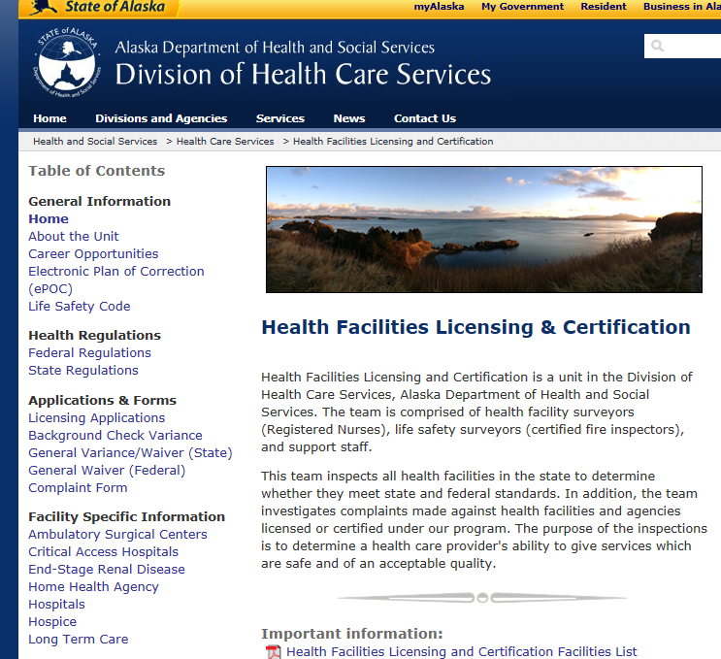
Where can I find regulations?
http://dhss.alaska.gov/dhcs/pages/hflc/default.aspx

Slide 10
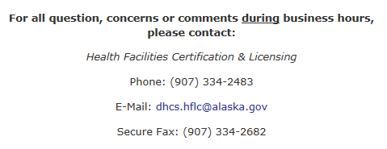
How your facility is classified!
Who can I contact if I don’t know how my facility is classified?
Notes:
Not all types of health care clinics or independently owned facilities are required to be licensed, if you are not sure, contact AK Health Facilities Licensure and they can help you.

Slide 11
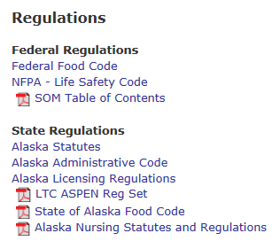
Example: Long Term Care
Step 1
Step 3
Step 2
Step 4

Slide 12
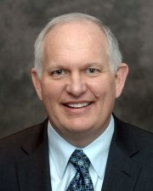
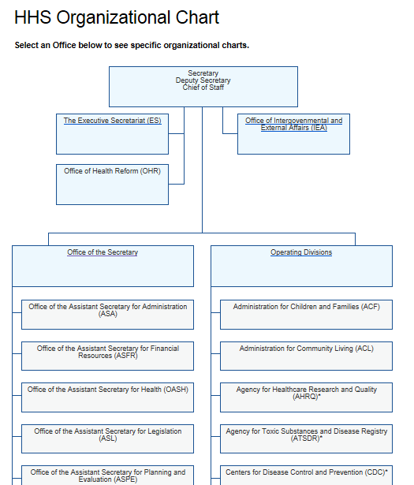
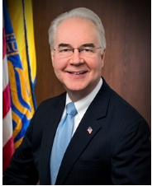
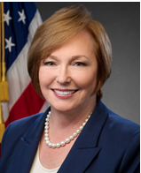
Federal regulations
HHS-Health and Human Services
http://www.hhs.gov/about/agencies/orgchart/index.html
A few familiar agencies under HHS include:
CMS- Centers for Medicare and Medicaid Services
CDC-Centers for Disease Control and Prevention
FDA-Food and Drug Administration
Was Thomas E. Price, M.D.
Now? Don Wright, MD, MPH
HHS Secretary
Brenda Fitzgerald, M.D.
CDC Director
Notes:
Tom Price has resigned-controversy over use of private jet/reimbursed federal government more than $50,000. President intends to designate Don Wright (Deputy Assist. to HHS secretary and director).
HHS has 11 operating divisions, including eight agencies in the U.S. Public Health Service and three human services agencies. These divisions administer a wide variety of health and human services and conduct life-saving research for the nation, protecting and serving all Americans.
The Office of the Secretary (OS), HHS’s chief policy officer and general manager, administers and oversees the organization, its programs, and its activities. The Deputy Secretary and a number of Assistant Secretaries and Offices support OS.

Slide 13
Skilled Nursing Facility Inspection Report(s) http://dhss.alaska.gov/dhcs/Pages/hflc/fac_LTC.aspx

Slide 14
Federal regulations
The Affordable Care Act (ACA) was passed by Congress and then signed into law by the President on March 23, 2010. On June 28, 2012 the Supreme Court rendered a final decision to uphold the health care law.
A provision under the ACA includes improving quality and lowering costs of healthcare:
Notes:
Remember the term VBD or Value Based Purchasing because this is where your facilities payment is linked to the reduction or prevention of Health Care-Associated infections (HAIs) by facility type.

Slide 15
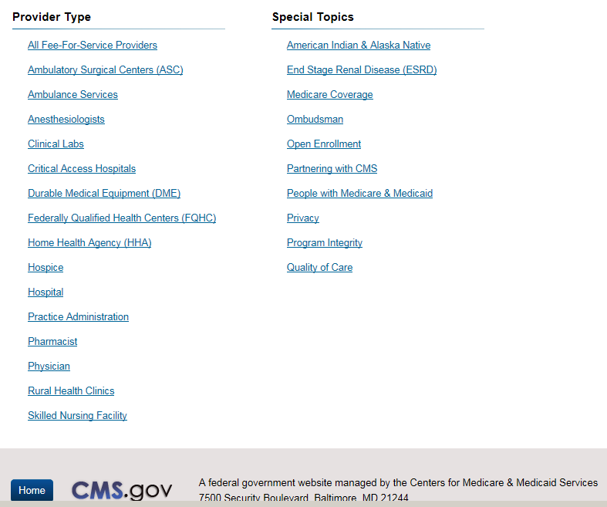
CMS-Centers for Medicare and Medicaid Services
https://www.cms.gov/Regulations-and-Guidance/Regulations-and-Guidance.html

Slide 16
CMS NHSN Requirements for Reporting HAIs
https://www.cdc.gov/nhsn/cms/index.html

Slide 17
Alaska Conditions Reportable to Public Health http://dhss.alaska.gov/dph/Epi/Pages/default.aspx
Condition | Timeframe | Acceptable report methods
Public Health Emergencies | Immediate | Phone*
Infectious diseases Sexually transmitted diseases or HIV All other infectious diseases | Within 5 days | Phone*, Fax, Mail
Firearm injuries | Within 5 days | Phone*, Fax
Occupational disease and injury | Within 5 days | Phone, Fax
Blood lead levels (link p14) >5 ug/dl in persons < 18 years old >10 ug/dl in persons >18 years old | Within 1 week | Phone*, Fax, Mail
Toxic or hazardous exposures | Within 1 day | Phone*, Fax
Healthcare associated infections required to be reported to federal authorities | Follow NHSN practice | NHSN

Slide 18
What is a Public Health Emergency?
Notes:
Don’t forget if you are experiencing an usual number of cluster of infections for your patient/staff population, give us a call! We can help.
Can you think of an example when you had an outbreak or increased number of infections? (Ex. Influenza LTC, Norovirus, Serratia Marcesans)

Slide 19
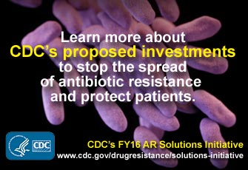
AK Reporting of significant organisms
Antibiotic-resistant organisms of national
significance:
Vancomycin-Resistant Staphylococcus aureus (VRSA) and
Carbapenemase-Resistant Enterobacteriaceae (CRE)
Antibiotic-resistant germs cause more than 2 million illnesses and at least 23,000 deaths each year in the US.
Up to 70% fewer patients will get CRE over 5 years if facilities coordinate to protect patients.
Preventing infections and improving antibiotic prescribing could save 37,000 lives from drug-resistant infections over 5 years.
Notes:
CRE-tests resistant to any carbapenem including doripenem, ertapenem, imipenem, or meropenem.
CRE enterobactiaceae are part of a large family of gram negative bacteria that live in the GI tract. Enterobacteriaceae can cause a range of clinical infections in the community or as healthcare-associated infections, such as urinary tract, blood stream, surgical site, and intra-abdominal infections, and pneumonia. CRE are divided into 2 major categories: carbapenemase-producing (CP-CRE) or non-carbapenemase producing. Carbapenemases are enzymes the bacteria produce that inactivate carbapenems directly. NICE: Notify public health, Intervene in all cases with infection control (HH, contact precautions, private room and optimal cleaning), Communicate CRE infection or colonization to receiving facility and Educate patients/staff and visitors about CRE.

Slide 20
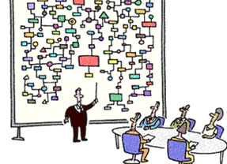
It’s complicated!

Slide 21
Voluntary accreditations
Accreditation has been a voluntary process through which the organization is able to measure the quality of its services and performance against nationally or internationally recognized standards.
Examples:
The Joint Commission (TJC)
Health Facilities Accreditation Program (HFAP)
Det Norske Veritas Healthcare, Inc. (DNV)
Accreditation Association for Ambulatory Health Care (AAAHC)
American Accreditation Association for Ambulatory Surgery Facilities (AAAASF)
Commission for the Accreditation of Birth Centers (CABC)
Notes:
Costs can range from $1,780 to $36,845 , facilities can be assessed 1-3 year time frame.

Slide 22
Other professional organizations with the goal to improve patient care!
AABC-American Association of Birthing Centers
ASHNHA-Alaska State Hospital and Nursing Home Association
APIC-Association for Professionals in Infection Control and Epidemiology
A2SC-Alaska Antimicrobial Stewardship Collaborative
MPQH-Mountain Pacific Quality Health Foundation
National groups (LTC and others)
NABC-National Association of Birth Centers
NASL-National Association for the Support of Long Term Care

Slide 23
Regulatory Overview
Shelley White

Slide 24
Infection prevention and control program
Shelley White, RN
Cert/Licensing

Slide 25
Background/benefit to resident
F 441 frequently cited
HAI increase the mortality and morbidity of the LTC residents
1.6 -3.8 million HAI in LTC annually
150,000 hospitalizations annually
388,00 deaths annually
40-75 % of Abx prescribed are potentially inappropriate

Slide 26
Regulatory Groups
Infection Control
F880: Infection Prevention and Control
Facility Assessment
F881: Abx Stewardship Program
F882: Infection Preventionist 11/28/19
F883: Influenza and Pneumococcal Immunizations (334)

Slide 27
Expanded guidance
Hand Hygiene
Transmission Based Precautions
Respiratory etiquette
Medical Devices
Linens
Pneumococcal Vaccines
Surveillance
Reporting
Occupational policies

Slide 28
Hand Hygiene
C-difficile Infection and Norovirus Infection outbreaks
Contact precautions
**strict adherence to glove use
HH with soap and water
Colonization or single case of CDI or norovirus
Contact precautions
**strict adherence to glove use
AHBS
**Surveyors will review Process and Outcome Surveillance & observe adherence to best practice standards
https://www.shea-online.org/images/patients/CDI-hand-hygiene-Update.pdf

Slide 29
Transmission based precautions
Contact precautions
Least restrictive as possible
Used for the least amount of time
Individualized, based on the likelihood of transmission
Pathogen
Resident risk factors
Psychological impact
Other considerations
**Surveyor will observe the practice, review policy and medical record, surveillance, & training

Slide 30
Transmission Based Precautions
Donning and doffing PPE
Upon entry and before exit
Discard PPE in room
Hand hygiene after glove removal in the room
Droplet precautions
Mask, face shield or goggles upon entry to room
Visitors during influenza season
Surveillance of practice
**Surveyor will observe practice, review policy and medical record, surveillance, & training

Slide 31
Update policies
Hand hygiene best practices
How and when to use transmission based precautions
Donning and doffing of PPE
PPE Selection
Room assignments
When and how to limit movement
Time frame and process for reassessment of isolation

Slide 32
Medical devices
Blood glucose and INR meters
Cleaned per manufacturers recommendation
EPA disinfectant, no alcohol
Individual meters
Single use or auto-disabling finger stick devices

Slide 33
Linen
Standard precautions
Sorting and Rinsing of linen at point of use is prohibited
Transport
Held away from clothing, minimize agitation
Manufacturer’s instructions for use
Washing machines and dryers
Detergents
Linens
Chlorine bleach rinse not required for low temp wash

Slide 34
Pneumonia and influnza
F883 = F334
Policies to be updated based on best practice
CDC changes: PCV13 in addition to PPSV23
**Surveyors will review documentation
vaccine dates, education, refusal, risk and benefits, and contradiction from MD

Slide 35
Surveillance
Must establish a system for surveillance based on national standards of practice.
Must establish routing, ongoing, and systematic collection, analysis interpretations, and dissemination of data that:
Identifies infections
Infection risks
Communicable diseases outbreaks to state/local public health
Monitors staff performance when needed
Document follow-up activity in response to findings

Slide 36
Surveillance system CON’T
Must identify how reports will be provided to staff and/or prescribing practitioners.
Process for communicating information upon transfer
Include both process and outcome surveillance
**Surveyor triggers may lead to review of additional regulatory requirements

Slide 37
Infection Control Plan
A system for preventing, identifying, reporting, investigating, and controlling infections and communicable diseases that:
Covers all residents, staff, volunteers, visitors, and other individuals providing services under a contractual arrangement;
Is based on the individual facility assessment;
Follows accepted national standards;
Written standards, policies and procedures
A system for recording incidents identified under the IPCP and corrective actions taken by the facility; and
An antibiotic stewardship program (ASP) (F881).
Annual review

Slide 38
Facility assessment
Must include
Resident population
# of residents and resident capacity;
Care required by the resident population based on disease, physical & cognitive disabilities, acuity, behaviors;
Staff competencies necessary to provide the level of care and services;
Physical environment, equipment, services needed
Ethnic, cultural, religious factors
Facility resources
Building, vehicles, medical and non-medical equipment
Training/competency requirements of non-nursing staff
A facility-based and community-based risk assessment

Slide 39
Elements of non-compliance
Develop a policy and procedure addressing the new guidelines
Maintain or follow the new guidelines in your policy and procedure for immunizations against influenza and pneumococcal disease
Vaccinate a resident or document why it was not given
Allow the resident or representative to refuse the vaccine

Slide 40
Key elements of non-compliance
Failed to establish and maintain IPCP program
ICPC plan was not reviewed annually and updated as needed
Best practice standards not incorporated into policy
No documented surveillance or action plans
Implement an Abx stewardship program

Slide 41
Updates
Tablets
Survey process
Pathways
Tags
Expanded Regulatory language
Expanded interpretative guidance

Slide 42
Riley and riggins

Slide 43
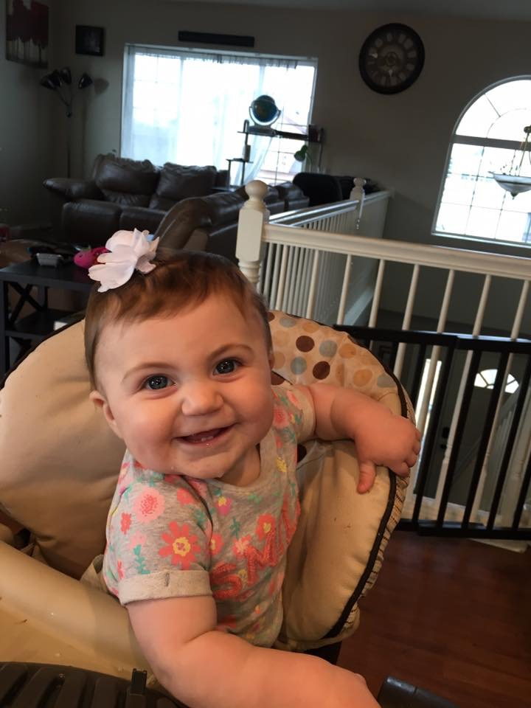
Maylee kay

Slide 45
What is a risk assessment?
“Living document that forms the foundation of a comprehensive IPC program”
Identifies risks
Population: (residents/patients) health and safety
Geography & weather: earthquake, fire, flood
Employees: communicable infectious diseases
Environment: physical space, ventilation systems, cleanliness
Infections: endemic, seasonal or outbreak related
Procedures: medical devices, injections, dialysis
Emergency management: loss of utilities or water
CMS Intent: For the facility to evaluate their resident population and identify resources needed to provide necessary person-centered care and services required by residents
Refer to tools/procedures/plans already in place to prevent infection, such as staff training
Marcia Patrick, MSN, CIC
Notes:
Page 64-2 in APIC Text
Purpose: to determine what resources are necessary to care for residents competently during day-to-day operations and emergencies
A risk assessment will help in prioritization of actions and goal-setting for your facility

Slide 46
What’s the point?
Identify and prioritize your risks (infections)
Plan to prevent and control factors affecting transmission
Helps you keep track of all the balls
Minimize transmitting
infections, keep it safe
for residents/staff and visitors!

Slide 47
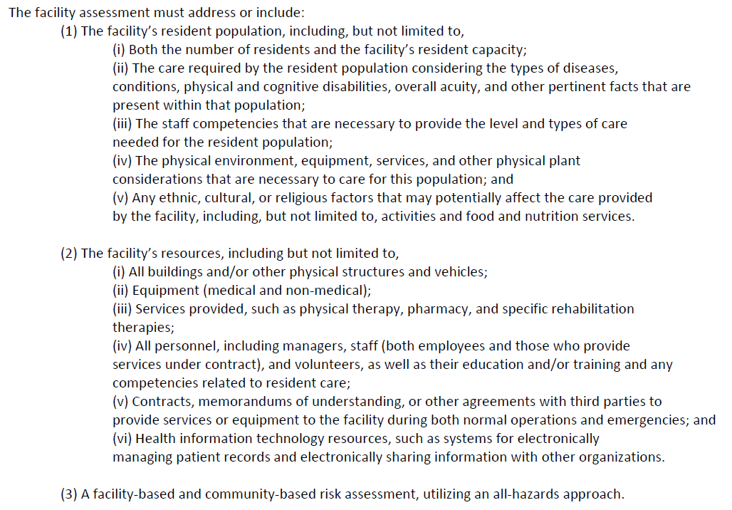
Notes:
The CMS regulation on requirements for your facility Assessment. The purpose of the assessment is to determine what resources are necessary to care for residents during both day-to-day operations and emergencies. Use an assessment tool to make decisions about your staff needs, as well as your capacity to provide resident services.

Slide 48
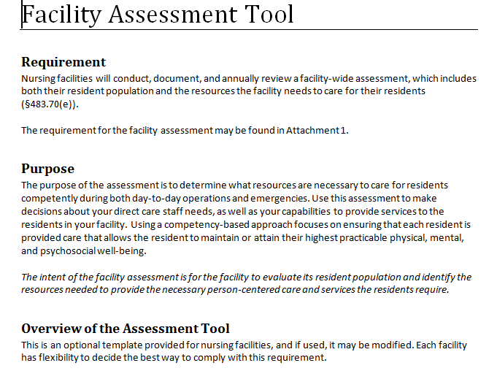
What information do you need?
http://qioprogram.org/facility-assessment-tool
When using the CMS Template the Risk Assessment is organized into 3 parts:
Resident profile
Services and care offered
Facility Resources needed
***Caveats: Use of this tool is not mandated by CMS, nor does its completion ensure regulatory compliance.
You can use or adapt this tool to comply with regulations and fit your needs!
Notes:
Draft tool shared during a pilot test (July 2017)
-National partner and stakeholder organizations –representing nursing homes, administrators, directors of nursing, medical directors, consumers, and surveyors
-Nursing homes, 17 homes representing 7 states, mix of rural/urban, large/medium/small, for profit/nonprofit, ownership
-Comments and feedback used to revise the tool
Pilot Test Comments and Feedback
Agreement that it was helpful in providing direction for the assessment
Nearly all agreed the tool was aligned with the regulations and interpretive guidance, included clear descriptions of what was being asked, provided helpful examples, and could be used to determine what resources are necessary to care for residents
Agreement that lists and examples in the tool were helpful, to help teams think more in-depth and not over look key areas
“Makes us analyze what our resources are and lack of resources to meet the
needs and requests of our clientele.”
“It triggers a pause for leadership to comprehensively look at the facility’s operations
and compare that to its stated goals (if any), identified challenges, etc.”

Slide 49
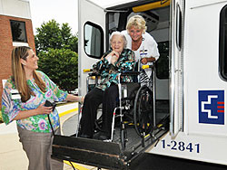
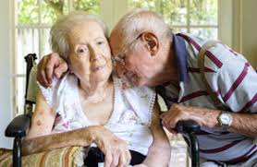
Part 1: Resident Profile
Numbers (Population: licensed beds, census)
Diseases/conditions
Physical or cognitive disabilities
Acuity of care
Decision to care for residents outside what you normally care for….
Notes:
Risk assessment should describe who your patients are, in general, and then note any risks related to this. For example, older folks are at higher risk for respiratory illness: that’s a risk. If you have specialized care areas, like a dementia floor or Alzheimer unit, there will be specific risks for those groups. And if you don’t take patients with certain conditions, i.e. ventilators, then you’ll record that patients who need those services will be transferred.

Slide 50
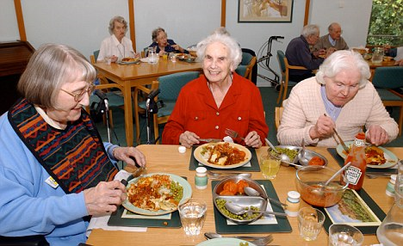
Part 2: Services and Care
Based on resident needs
General categories: may include ADL’s or fall prevention
Nutrition: tube feedings
Special care: may include dialysis or cancer treatment
Identification and containment of infections
Notes:
In looking at the residents you accept (or they may develop), list the common conditions, diseases, physical or cognitive disabilities or combination thereof that require care and management. Common diagnoses: psychiatric/mood disorders (hallucinations, impaired cognition), heart disease, vision/hearing loss, mobility issues (arthritis, falls/fractures), respiratory (COPD, chronic lung disease), infectious diseases (ulcers, TB, C Diff, UTI). Determine those resident services and care that will need to be included in your day-to-day work and what would be different in an emergency…..would certain residents need to be transferred or services/care deferred? Do you have sufficient staff with the appropriate skills and training to provide service and care? Example; peritoneal dialysis or IV chemotherapy/pain medications. Enough feeding assistants, nurse aides, dietician, physical/occupational therapist?

Slide 51
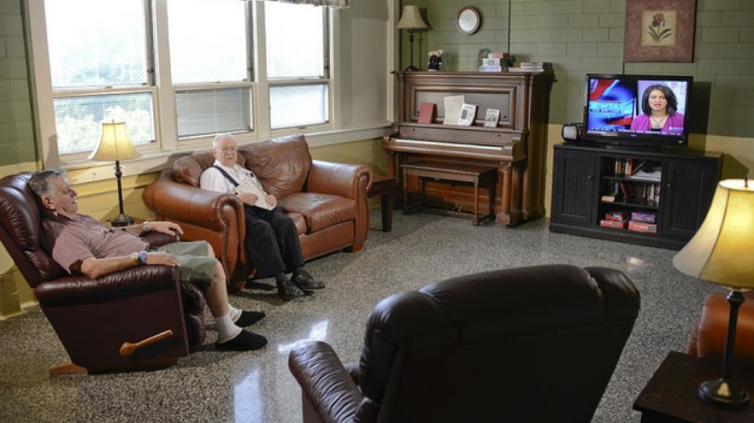
Part 3: Facility Resources
Identify what is needed to provide competent care
Staff and staffing plan
Staff education and training
Physical environment/building
Technology based resources and systems
Can refer to your current emergency plans and risk assessment!
Notes:
Utilize existing information about your general approach to staffing. Think about resident acuity levels and how much assistance they may need for ADL’s or other care. Build upon what you know about your residents profile, higher acuity levels impact staffing plans. For example, residents with cognitive or mobility issues will require more assistance with staff (nursing assistant, PT, behavioral or mental health provider).
Infection control-hand hygiene, isolation based precautions, use of PPE and environmental cleaning policies/procedures or practices! Required: IPC training for staff and written policies and procedures.
Managing resident medical information and ability to share pertinent information with other facilities (admission, transfer or discharge).

Slide 52
Refer to other risk assessments
Notes:
Example of a Hazard and Vulnerability Assessment Tool of Naturally Occurring Events used by AK Facilities for Emergency Preparedness. We have used a similarly constructed tool for Infection Prevention and Control. See what is available in your facility!

Slide 53
Group Work
1. Your turn to practice! (15 minutes)
Individually-fill in the Fishbone Diagram with specific information that applies to your residents and facility.
2. Next….write on a sticky notes one factoid you have identified for your residents or facility and add it to the larger Fishbone Diagram in the room.
3. This exercise will help you identify elements for your own Risk Assessment and share ideas with others!
***Note: There are a variety of risk assessment tools, choose one that works for you and make it your own!
Go!
Notes:
Brainstorming tool, we will not be able to complete a RA in this class. The fishbone diagram is a way to start thinking about your community and the residents you care for and what type of information you will need to conduct a RA for your facility. Start out by taking a some time to add to your (individual ) fishbone diagram then jot down some examples on a sticky note and place it on the large fishbone diagram in the room. The ideas you share may be helpful to others!

Slide 54
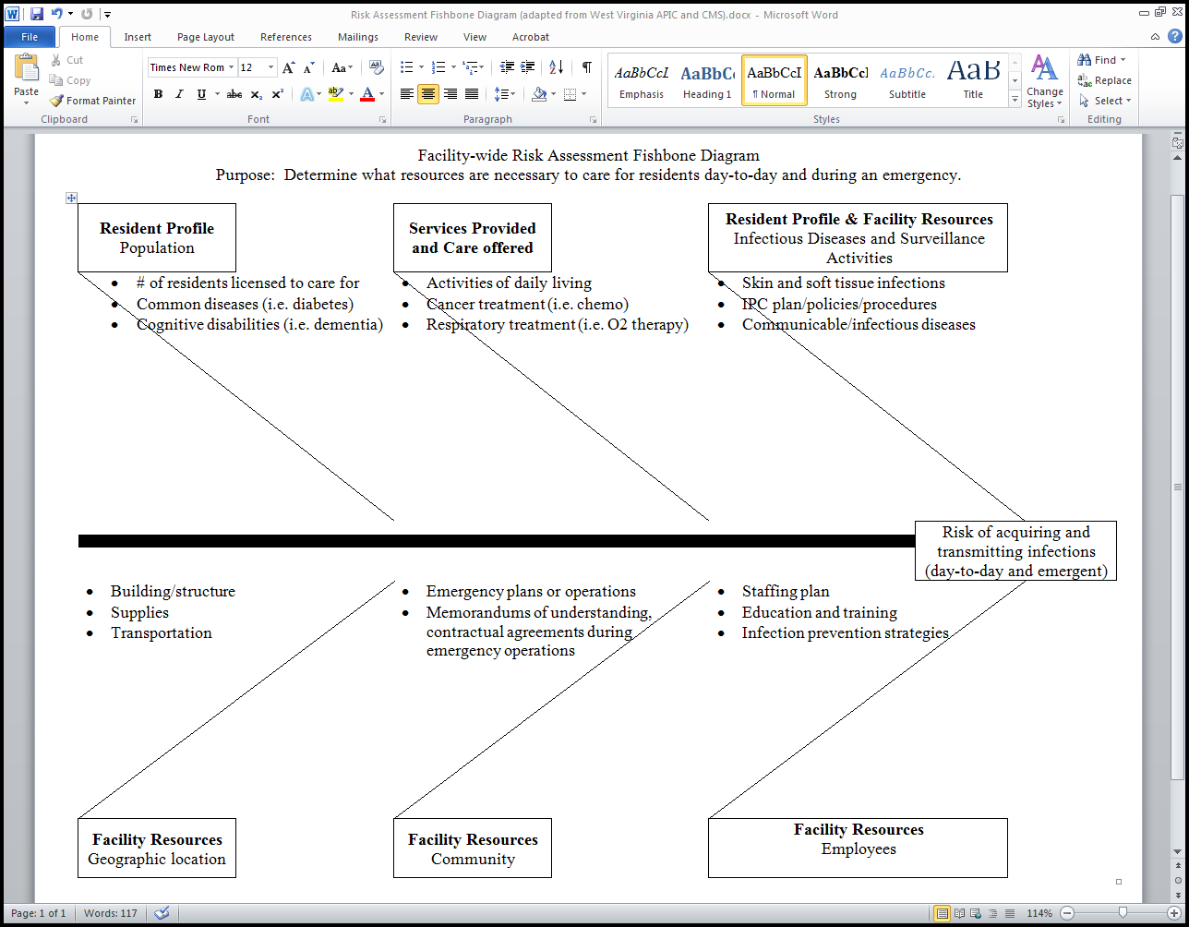

Slide 55
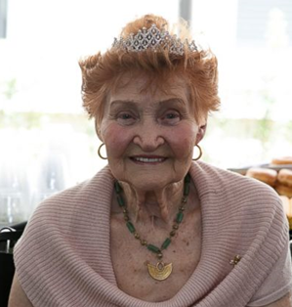
Recap of the Resident Profile
Numbers: licensed beds, average daily census, # persons admitted/discharged
Common diseases/conditions, physical and cognitive disabilities (to help identify types of resources needed to meet the needs of residents living with these conditions or combinations of conditions)
Decisions regarding caring for residents with conditions that you not commonly see
Ethnic, culture, religious or other factors that may affect the care provided
Notes:
Acuity –to identify potential implications regarding the intensity of care and services needed
Three examples provided:
Major Resource Utilization Groups (RUG)-IV categories
Special treatment and conditions
Assistance with activities of daily living
Other-resident belongings, activities

Slide 56
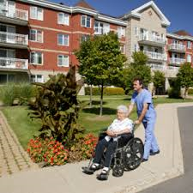
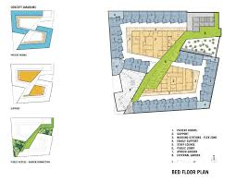
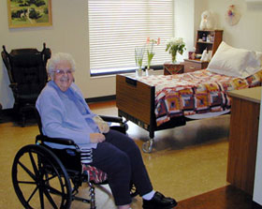
More Info about the facility
All buildings and facility layout
Equipment (medical and non-medical)
Personnel, including managers, staff and volunteers
Water, utilities, heating/cooling, food supply
Waste management
Notes:
Additional information about your facility to keep in mind! Refer to existing emergency risk assessments and update annually or if major changes.
You’ll need some of the supplies stuff for emergency preparedness planning, but it’s also important for infection prevention. Things like legionella risk are related to your water supply, and you may have risks related to food supply depending on where your food comes from. You may be able to get your emergency preparedness person to share this information with you.

Slide 57
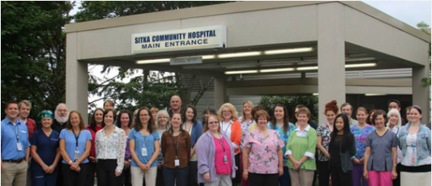
More about your community
Resources available, such as local hospitals and a public health center
Contracts you have for certain services or staff
Community health patterns: some areas have more TB, lower vaccination rates, etc.
Location factors: supply chain concerns, weather, transportation

Slide 58
Don’t forget about your staff!
How many are there, roles and type of service they provide, specialty services (i.e. physical therapy, pharmacist, behavioral health counselor)
Employee health policies: cultural awareness, immunization screening/requirements, sick or ill
Staff competencies and trainings

Slide 59
Risk Assessment Basics
Review and updated annually, or when there are major changes
Include required content (as per regulations)
Determine resources necessary to care for residents
on a day-to-day basis and during an emergency
Several tools/formats exist; but can also DIY
Get input from other departments

Slide 60
Guidelines for conducting RA
At a minimum involve: administrator, representative from the governing body, medical director and director of nursing.
May include input from corporation but must be conducted at facility level.
Determine your timeline for completion.
Review and update annually or when there is a significant change requiring modification.
RA is a living document….changes can be made!
Appendix PP: provides surveyor guidance thru SOM (State Operations Manual)
Notes:
Appendix PP surveyor guidance thru SOM: if systemic care concerns are identified in the planning, review the RA to determine if these concerns and did staff update their plan to address the issue. Example; if a facility recently started accepting bariatric residents, and concerns are identified related to providing bariatric services, did the facility staff update it’s assessment before accepting these residents by having enough staff and equipment to provide care that is safe and effective for all residents (new and existing)?

Slide 61
What do you do with your RA
Based on identified risks, develop an infection prevention plan to minimize the risks of transmitting infections
Determine high-risk, high volume, and problem prone areas to prioritize
Plan ahead, assemble your team and set your timeline!

Slide 62
Questions?
Hey, I got one!
I’m thinking ….

Slide 63
LUNCH!!

Slide 64
Surveillance
Anna Frick, MPH, CIC

Slide 65
What is surveillance?
“a comprehensive method of measuring outcomes and related processes of care, analyzing the data, and providing information to members of the healthcare team to assist in improving those outcomes.” –APIC
Essential to infection prevention
Notes:
Without surveillance, you won’t know if you are doing a good or bad job! You won’t know if there is a problem!

Slide 66
A quote
“I think what’s important to note is that we’re not necessarily talking about very sophisticated epidemiology using complex statistical methods to determine associations – sometimes this is literally as simple as making a line list of the patients who were involved, what infections they had, what people took care of them or where they were in the hospital,” he says. “In many instances it’s those very simple epidemiologic tools that are the most important and the most helpful in terms of getting to the bottom of an outbreak.”
-Dr. Arjun Srinivasan, quoted in Infection Control Today
Notes:
http://www.infectioncontroltoday.com/articles/2005/01/surveillance.aspx

Slide 67
Why do we do surveillance?
Because we have to
To identify problems early and intervene
Isolate and use precautions EARLY to prevent spread
To monitor for less-obvious problems
So we can work towards having NO HAIs!

Slide 68
Elements of a surveillance plan
What infections/events are you looking for?
How will you find/identify events?
What data elements will you collect?
How will you collect the data?
How will the data be analyzed?
What will you do with the results?
Notes:
A plan answers these questions

Slide 69
Choosing what to monitor
Regulatory requirements
Things that are identified as risks for your facility
Formal risk assessment
Type of facility
“It seems like we’ve seen a lot of X lately”
Known issues
High volume procedures
Notes:
In an LTC setting, it may be possible for you to simply keep a list of ALL infections. If possible, you should do this because it will be an awesome source of data and will make it much easier for you to spot patterns. If this isn’t possible, you’ll need to prioritize: and you may still need to prioritize how much followup you do for different infection types.
In thinking about the fact that you’re in a nursing home, that tells us quickly about some things that we know are problems for this type of setting like respiratory infections
Known issues- by this I mean things you’ve had a problem with before. Maybe you’ve been cited for something, maybe you have a local burden of MRSA, etc.
Probably, you have a lot of residents with catheters, so CAUTI may make sense for you to monitor

Slide 70
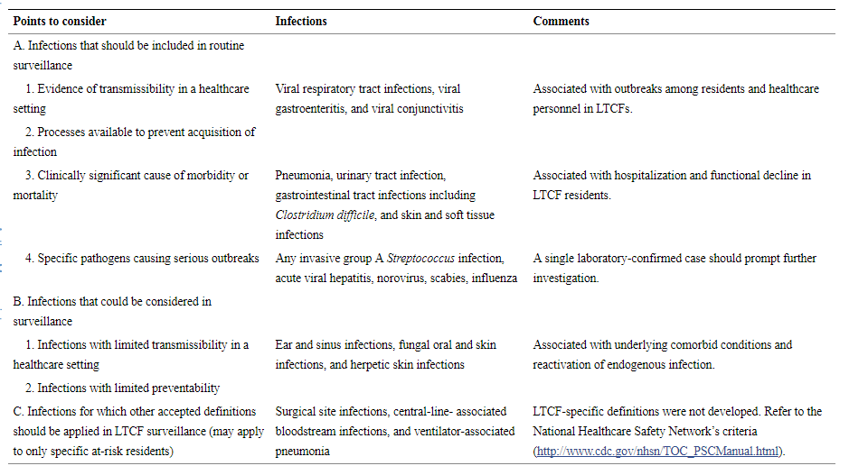
Notes:
Really great chart from the paper where Nimali Stone and others published the updated McGreer Criteria
:Infect Control Hosp Epidemiol. Author manuscript; available in PMC 2013 Oct 1.Published in final edited form as:
Infect Control Hosp Epidemiol. 2012 Oct; 33(10): 965–977.
doi: 10.1086/667743

Slide 71
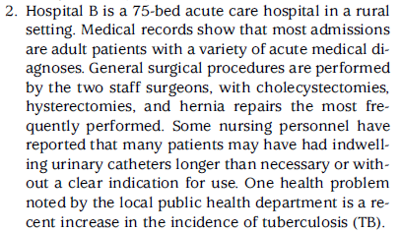
Example
Notes:
From the APIC Surveillance Practice guidelines in the resource folder
Used data about the community and data about the hospital; also qualitative information.

Slide 72
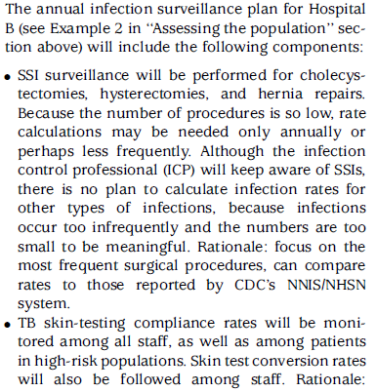
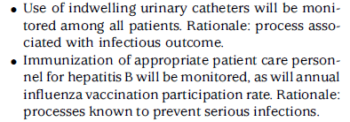
Example
Doesn’t discuss regulatory requirements, but that would fit into the prioritization system here

Slide 73
Case definitions
A set of uniform criteria used to define a disease
Include attributes of risk (who can be a case?)
Include attributes of symptoms
Include attributes of diagnosis (lab confirmed?)
Should be written, so can be consistent
Notes:
We’ve conceptually defined what we’re going to monitor, now we need to be specific about EXACTLY what a case is
More specifically, within what you’re going to monitor, what will count as a case.
I.e.- will only lab-confirmed influenza count, or would ILI?

Slide 74
Where to find ‘official’ case definitions
Nice to use sometimes because it makes it easier to compare with other facilities
McGeer Criteria designed for LTC: https://www.ncbi.nlm.nih.gov/pmc/articles/PMC3538836/
https://wwwn.cdc.gov/nndss/case-definitions.html is where CDC keeps its reportable disease definitions
CDC’s HAI definitions are at http://www.cdc.gov/nhsn/enrolled-facilities/index.html
Notes:
The McGeer Criteria are really meant for the LTC setting and I highly recommend them. One important thing about these definitions though is that you need a change from baseline status for some, which means you need a documented baseline.
CDC’s NHSN definitions have some definitions applicable to long-term care, have sections for ASCs, and have LOTS of support.
http://www.health.state.mn.us/divs/idepc/dtopics/antibioticresistance/asp/ltc/apxj.pdf Really great notes from Minnesota on applying CDC and McGeer
You may also have definitions for some conditions, like maybe falls or adverse drug events, from corporate structures or prevention collaboratives you participate in.

Slide 75
Clinical vs. surveillance definitions
Clinical definitions are for patient treatment
Up to the clinician
Surveillance definitions are for data purposes
Must be applied consistently
Not for treatment
Not relevant for clinical actions
Notes:
People get upset with the NHSN definitions sometimes, because the clinician doesn’t feel an infection should “count”. Remember, they are 2 totally different things!
This potential conflict is another reason why having written definitions that are very explicit can be helpful.

Slide 76
How to find cases?
Passive surveillance: wait for someone to tell you
Lab notifications of positive blood cultures
Staff report a resident with influenza
Less work for you; may miss cases
Active surveillance: go look for cases
Check every new resident’s record for infectious disease
Go visit patients and ask about symptoms
Review medical records, look at boards
More work for you; makes sure you find cases
Notes:
Later today Helen will talk a bit more about how to set these systems up with your IT, lab, and other partners.
You can do surveillance concurrently, meaning in real time, which lets you intervene, go talk to people and collect lots of data; but also not all the information you need might be available
You can also do retrospective surveillance, which is a good idea when you recognize a problem after it’s been ongoing; or when you don’t have a need to identify cases right away. Retrospective surveillance is nice because all the info is (hopefully) in the medical record for you to quickly assess, but it can delay you identifying problems, and it limits the information you can collect.
Can also do a mixture of approaches, depending on the condition you’re looking at. Maybe you do concurrent, passive surveillance for CAUTIs, where you ask staff to report all UTIs and all catheterized patients daily, and then every 6 months you use medical records review (active, retrospective surveillance) to look for anything you missed.
It’s a super good idea to at least ask your lab if they can send you a daily list of positive cultures/results. It’s low hanging fruit to make sure that an IP review of all incoming residents is in place- bring them in on the right precautions. Using facility transfer forms can be super helpful here.

Slide 77
Important data elements to consider
Demographics
Risk factor details
Underlying medical conditions
Procedure/current visit details
When patient was where
Information about infection
Onset
Symptoms
Pathogen
Other info needed to prove case meets case definition
Notes:
After you know what you’re looking for, you need a data collection tool so that you collect the same information for everyone, and collect it in one place. People usually use some kind of form or spreadsheet for this.
When I say demographics, I mean usually you want to have patient age, gender, and where they are/were at the time they got sick
Risk factors will vary with what you’re doing surveillance on
You don’t necessarily need to collect a ton of information for routine surveillance, but you definitely want to get some basics and anything that doesn’t get recorded in the medical record very well- things like visitors, mild symptoms, . After you do it for a bit, you’ll have a good system.

Slide 78
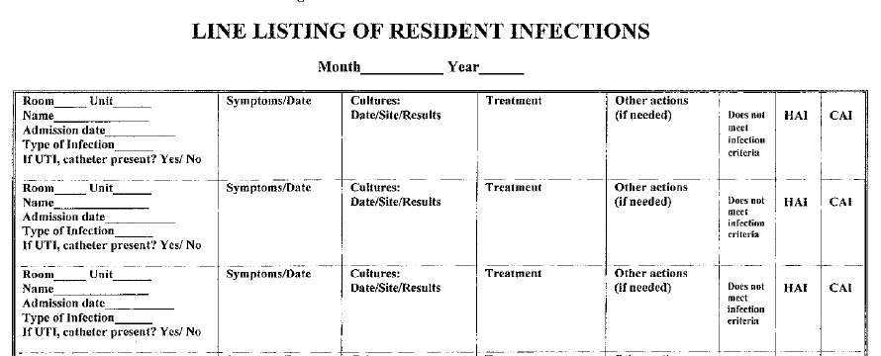
Basic data collection line list
Example from Gail Bennet, RN
Notes:
Simple line list; would work best for normal monitoring (if you had an outbreak or were trying to figure out where infections were coming from, you’d want more information)
Tells you who and what; and at you could at least eyeball for patterns here.

Slide 79
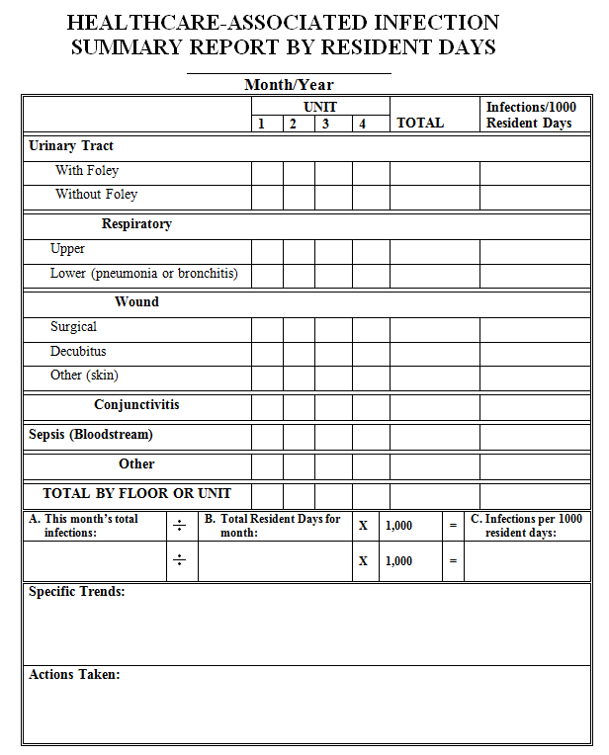
Example from Gail Bennet, RN
Notes:
Summary and analysis sheet where you could aggregate your line list

Slide 80
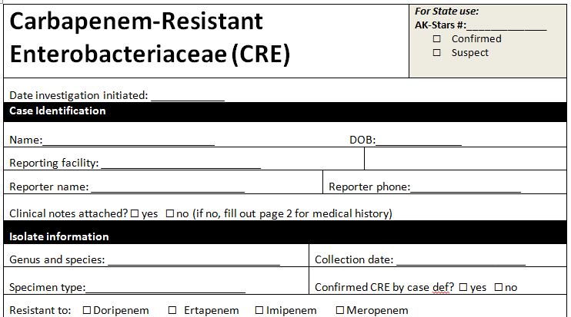
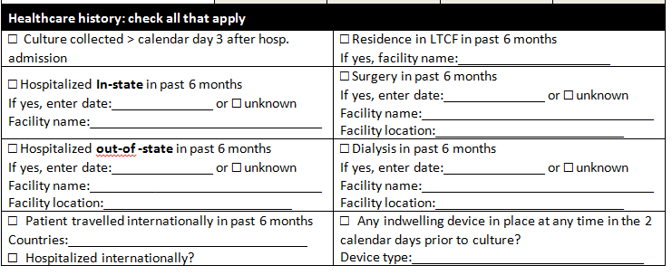
In-depth data collection form
Notes:
If you were having an outbreak, you might want to collect a lot more information, which is what public health does.

Slide 81
Denominator data
Notes:
This is a very simple form that collects all your denominator data in one place, and which you could easily train nurses to complete for you. We’ll talk about why you want denominator data more in a minute, but it’s also likely that at some point you’ll be roped into a quality improvement project to decrease catheter use, for example, and the easier it is to track the better.

Slide 82
Key: consistency
Collect the same minimum information on all patients
Log it in the same way
Have clear criteria defining cases
Collect denominator data at the same time each day
TRAIN YOUR DATA COLLECTORS!
Notes:
Even not-amazing data collected consistently is good for trends. As long as you’re consistent and not straight-up making up numbers, if more people are getting sick you’ll see it

Slide 83
Practice
You’ve noticed your facility has a lot of catheterized patients, and you’re worried about CAUTIs.
What kind of surveillance will you do (how will you find your cases?)
What data will you need?
How will you collect data?
On cases?
For denominator data?
Notes:
You can ignore NHSN rules if you want for this exercise ☺

Slide 84
Analysis
Doesn’t have to be complicated or scary!
Notes:
You need to have several cases, or a fair amount of time without having seen a case, before analysis becomes a thing you can really do

Slide 85
Ways to see a problem
Time series → clustering
Number of infections
Unusual events
Pathogens with a ‘trademark’
“Weird” bugs or infections
“Outbreak” or excess of infections
Trends
Notes:
Sooo first, time series

Slide 86
Which facility has a bigger problem?
Facility A had 5 catheter-associated UTIs last month
Facility B had 8 catheter-associated UTIs last year
Which one are you more worried about?

Slide 87
Time Series
Shows events over time
Can use number, rate, proportion, etc.
Infections, compliance, number of residents, etc.
Simple to make and visually interpret

Slide 88
Time series + clusters
Clusters in time should be investigated
Notes:
You could also see a gradual increase or decrease this way
You might do this by day, but probably you’d want to do use weeks, months, or even quarters as your unit of time if the number of infections is low. I’m pretty much always using at least weeks, and I have a whole state of data. For HAI stuff, I pretty much only look at reported data at the month level or higher, so I’m sure you guys need to roll up to quarters for many things.

Slide 89
How to make in Excel
Put dates in one column
If you want to do things by week, it sometimes is easier to use the week ending/starting date
Put number of cases in the second
Select both columns → insert → “Column chart”
Notes:
I usually prefer to use a line chart for rates or other calculated values, because I associate bar charts with count data.

Slide 90
Which facility has a bigger problem?
Facility A had 5 surgical site infections … and performed 50 surgeries
Facility B had 8 surgical site infections … and performed 20 surgeries

Slide 91
Denominator data + rates
Infection rate = # new infections/ at-risk person time
For surgeries, it’s normal to do a proportion (infections/surgeries)
At-risk person-time: Total amount of time (days) each individual is potentially able to get the disease, summed up
Rates tell you the “speed”
Proportions tell you how common
Overlap
Notes:
At-risk person time sounds scary but it isn’t! When are you at risk for getting a catheter-associated UTI? Only when you have a catheter -> catheter days make up our time. For other stuff, like maybe if you were interested in falls, it might just be the number of patient-days.
Can totally make time series of these as well

Slide 92
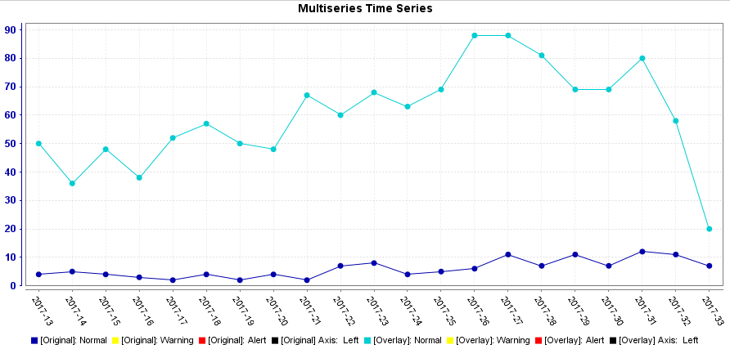
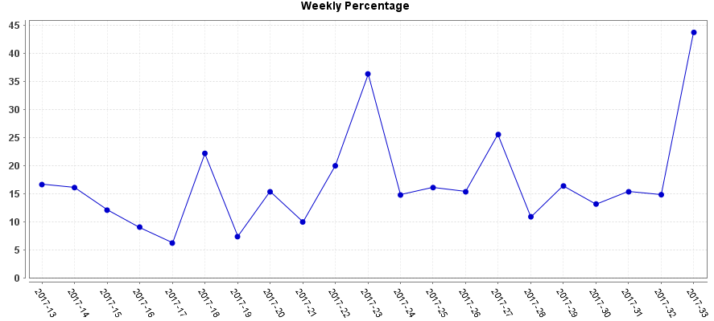
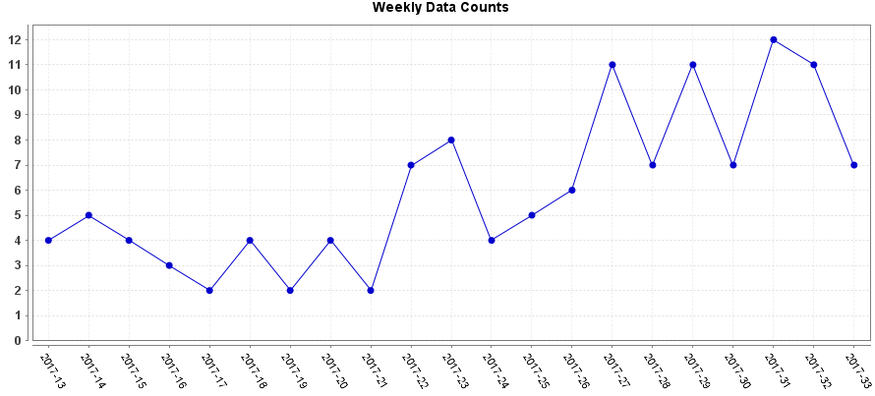
Why rates?
Changes in volume should affect your case counts: rates balance that out
Allows comparisons with other facilities
Notes:
This is a graph of emergency department visits for a certain condition at a small hospital in Alaska. Does this look like there’s a problem?
Here’s a second graph. The dark blue line is the data from before, and the light blue is the total number of ED visits. Over the summer, lots more people were coming into this hospital, so their number of cases of basically everything went up from baseline.
Now, here’s the percent of visits with that same condition: you can see that while it bounces around a lot, there isn’t an upward trend over time. That’s why it’s important to look at percents and rates.

Slide 93
How to calculate a rate
Count number of infections
Count number of at-risk days
Divide infections/days, and multiply by a scaling factor
i.e. common to do CAUTIs per 1,000 catheter days

Slide 94
Ways to see a problem
Time series → clustering
Number of infections
Unusual events
Pathogens with a ‘trademark’
“Weird” bugs or infections
Example: a case of a very drug-resistant organism
Notes:
An example of a pathogen with a trademark might be Legionella: we all know legionella comes from the water somewhere, and if a patient in your facility has it you’ll definitely want to dig deeper on that. Obviously, it may turn out that they got it elsewhere, but you’ll want to investigate with the help of public health to make sure.
Weird bugs is kind of a loose one- relies on your judgement or maybe on some policies. If you had a very drug resistant organism, you’d want to work proactively to make sure no one else gets it!

Slide 95
Opportunistic infections
Endogenous
Exogenous
Coagulase-negative Staphylococci
Enterococcus spp.
Streptococcus bovis
Clostridium septicum
Candida and Torulopsis glabrata
Malassezia furfur
Coccidioides immitis
Histoplasma capsulatum
Mycobacterium TB
Pneumocystis jiroveci
Toxoplasma gondii
Herpes simplex
Herpes zoster
Clostridium difficile
Legionella pneumophila
Rhodococcus equi
Aspergillus spp.
Zygomycetes
Rapid-growing mycobacteria
Cryptosporidium
Viruses other than the herpes group
Aerobic Gram-negatives
Staphylococcus aureus
Notes:
Adapted from APIC textbook table 23-3; this is not a comprehensive list and only what’s common, not rules. Also geared towards immunocompromised patients, but I think conceptually it’s helpful to remember where a pathogen LIKELY came from
The first listed endogenous organisms are ones that are commonly part of the microbiota; CNS are all over your skin normally, enterococcus and strep bovis are gut bugs, etc.
The ones below the line are infections you catch elsewhere, but which have the ability to do long latency periods and then reactivate when the host is struggling.
The exogenous organisms are mostly environment bugs; Crypto and legionella are water bugs; Aspergillus is everywhere but it’s strongly associated with construction work around the hospital; Rhodococcus is a soil bug. C diff is spread by the hospital environment. Viruses are coming from other people somehow as well. We could also add in the common foodborne bugs here- if someone gets a Salmonella infection, that almost certainly came from a food contamination problem.

Slide 96
Ways to see a problem
Time series → clustering
Number of infections
Unusual events
Pathogens with a ‘trademark’
“Weird” bugs or infections
“Outbreak” or excess of infections

Slide 97
How do I know there’s an outbreak?
Need to know the baseline
Baseline= “normal” number of cases for a given time period and population
Requires you to have historical data
6 months+ is preferable
For seasonal infections, need a year
How many more cases? Does it seem like a lot? Are there any patterns?
Notes:
Obviously work with what you have.
I don’t have time to explain the math in this short talk ☹ of how you would officially compare rates, but use your best judgement and go with the ‘Vibe’. It’s ok to say “hmm, this seems kinda high, I’m going to look into it a little” and just take a quick look at cases to see if anything strikes you as weird. It’s also OK to call Epi and ask for advice.
Patterns means shared attributes, like infections all caused by the same organism, infections in patients who all live on one particular hallway, or who all have a particular care factor, such as wound care.
Also, for some things, “normal” is no cases (you should normally have no patients with botulism) so if you have only 1 or 2, that’s an outbreak. You probably normally have a few residents with UTIs, so one more isn’t an outbreak, but if you come in after a weekend and there are 10 residents with UTIs, that might be an outbreak.

Slide 98
Ways to see a problem
Time series → clustering
Number of infections
Unusual events
Pathogens with a ‘trademark’
“Weird” bugs or infections
“Outbreak” or excess of infections
Trends
Notes:
Sooo first, time series

Slide 99
Trends
Notes:
Easy enough to fit a line in excel; is the slope 0? It’ll also give you a value for how fast things are changing.
This can be helpful for infection types that you usually have some of, and want to make sure aren’t increasing. It’s also a great way to see if any interventions you’re doing are making a difference.

Slide 100
Trends

Slide 101
Good Stats Resources
http://stattrek.com/
Has tutorials
Has some tools to help you decide what math to do with the data you have
Onlinestatbook.com
http://www.biostathandbook.com/testchoice.html
Can also take free stats classes online from universities for a more formal training
Notes:
If you have absolutely no stats background, going through some tutorials is worth it to help you pick up on vocabulary. That makes it a lot easier to know what to Google later.

Slide 102
How often should you analyze?
Monthly is common
Calculate rates and add to time series
Update epi curve
At least quarterly for timely response
People need regular feedback in order to improve
If there is a problem, you want to solve it!
Makes the data burden easier
Notes:
Right before meetings is also common ☺

Slide 103
Ways to monitor progress
Look for downward trends!
Benchmarks
Can compare to national benchmark, or to your facility’s history
Some have percentile distributions
Statistically compare your rate or SIR to the benchmark

Slide 104
Results communication
Should be part of the plan
Infection control committee should see data
Share with management
Post somewhere so staff can see?
Some places “compete” for lowest HAI rates

Slide 105
What to do if you see a problem
Call Epidemiology- we can chat! 269-8000
Management: show them your data
Look at the literature for ideas on what the problem might be and how to solve it
Notes:
You don’t get in trouble for calling us, and we can help you make a plan for what to do.

Slide 106
Thank you for your time!
This material was developed by Mountain-Pacific Quality Health, the Medicare Quality Innovation Network-Quality Improvement Organization (QIN-QIO) for Montana, Wyoming, Alaska, Hawaii and the U.S. Pacific Territories of Guam and American Samoa and the Commonwealth of the Northern Mariana Islands, under contract with the Centers for Medicare & Medicaid Services (CMS), an agency of the U.S. Department of Health and Human Services. The contents presented do not necessarily reflect CMS policy. 11SOW-MPQHF-AK-C2-17-48

Slide 107
QAPI “In A can” basic overview for infection prevention
Leiza Johnson, BSN, RN
NH Quality Improvement Specialist
Mountain-Pacific Quality Health

Slide 108
What is qapi in a can?
Quality Assurance and Performance Improvement (QAPI) training in small, individual-sized servings.
There is a whole “pantry” of soup cans that you can use for training.
Each can will cover a different topic related to nursing home quality improvement.
Objective is to promote quality tools and techniques by making training short, easy and fun.

Slide 109
Basic overview: What we’re serving today
Understand definition of “QAPI”
What is/is not QAPI
Examples of QAPI – especially as it relates to infection prevention
Why is QAPI important?
Notes:
QIN-QIO is Quality Innovation Network – Quality Improvement Organization
CMS created QIOs essentially to help make sure their money is spent wisely.
Role of QIN-QIO:
CMS contracts with QINs across the US. Various contracts all with ‘triple aim’ of improving patient experience, reducing cost, decreasing HACs/improving clinical outcomes
MPQH has task leads (in Alaska!) working on:
Antimicrobial stewardship/CDI – across settings
Diabetes self management
Reducing readmissions
Safe medication practices (ADEs, cardiac, diabetic)
Role in reducing HACs – part of the contract is related to nursing home QI. Goals set by CMS are:
50% of collaborative will achieve composite of <6
Antipsychotic RIR
Etc.
ANHT collaborative – 100% commitment by all AK nursing homes. Etc etc
Partners to support ANHTs: licensing & certification, ASHNHA, Alz Resource of AK, GWEP, ANTHC, Mental Health Trust, etc.
Oh and I like to say we have a big state, little mascot… ☺
* Leiza – began in QA in 1990’s – worked in Nome – came to Anch began to ‘specialize in JCAHO’ – went to school to get RN – worked in adolescent psych – full circle back to quality

Slide 110
Definition of qapi Breaking it down...
Quality Assurance (QA)
Performance Improvement (PI)
Process of meeting standards set by regulators/others
Required monitoring to ensure certain thresholds are met
Examining processes to prevent/decrease problems
Proactive approach for identifying problems and testing solutions
 | Quality Assurance | Performance Improvement
Motivation | Meeting standards | Continuously improving processes to meet/exceed standards
Means | Inspection | Prevention
Attitude | Required, reactive | Chosen, proactive
Focus | Outliers, individuals, “bad apples” | Processes or systems
Responsibility | Few | All

Slide 111
QA + PI = QAPI
Identify and correct quality deficiencies
Systematic, comprehensive, data-driven, proactive approach
All-encompassing to improve quality of life, care and services
Involves members at all levels of organization to:
Identify opportunities for improvement
Prioritize and address issues brought forward
Implement improvements
Monitor the effectiveness of interventions

Slide 112
QA + PI = QAPI
Another way of looking at QAPI:
QA is collecting and using data, monitoring and ensuring compliance.
PI is using the information from QA to make improvements. PI is the process of identifying root causes and fixing problems.
QAPI together = a robust, active quality program. ☺

Slide 113
Let’s be Clear: What QAPI Is and Isn’t
QAPI is…
QAPI isn’t…
Organization-wide
The quality department’s job
Ongoing
Something done a couple times per year or just before a survey
To be shared and celebrated with everyone (residents, staff, families, providers)
Just for leadership or those who work in a nursing home
A way to improve resident care and outcomes and your work; a way to problem-solve
A way to just del with organizational problems or find work-arounds
Creative and fun
Just collecting and reporting a bunch of data

Slide 114
Quality assurance (as it relates to infection prevention)
What data do you have… do you collect… do you report…?
Examples:
Pneumonia vaccination rates for residents and staff
CAUTI rates
CDI rates
Flu vaccination rates for staff, residents
Infection rates (URI, wound, etc.)

Slide 115
Performance improvement (as it relates to infection prevention)
What can you look at (drill down) regarding your QA data?
Are there areas where your organization is performing below state/national average?
Are you trending upward (negatively) in any areas?
Do you see any sudden spikes in the data?

Slide 116
Let’s use an example
QA: Data shows you have below average* vaccination rates for staff for the flu vaccine. (*statewide benchmark data)
PI: You “drill down” the data more
Rates vary widely by shift
Night shift has much higher non-vaccination rates
Establish a team to look at process issues (include someone from night shift!)
No flu vaccines offered during night shift
Staff needed to come during day shift or get vaccine on their own time

Slide 117
QA + pi = QAPI
QA
PI
QAPI
Data indicated problem with flu vaccination rates for staff
Determined shift variances and process issues around the vaccine
Made process changes (offer vaccines across all shifts) and follow-up data reveals greater number of staff receiving flu vaccine.

Slide 118
A quick caveat
In the example, I did not include real numbers or data.
This is a vital part of the process!
Include % along with numerator/denominators when possible.
“Without data you are just another person with an opinion.” – Mark Twain

Slide 119
Purely made up numbers/example
Flu vaccination rates for staff are at 50%(40/80 employees) compared to statewide benchmark of 96%.
‘Drill down’ the data - of the 40 unvaccinated employees: 30 were RNs, 5 were housekeeping staff, 4 were dietary staff and one was a maintenance worker.
Continue to ‘drill down’ - of the 30 RNs who did not get the vaccine, 29 worked on the pm (night) shift. In addition, 4 of the 5 housekeepers and 2 of the dietary staff who did not get vaccine worked the pm shift.
You would report your intervention(s) here.
Following the intervention (flu shots offered during pm shift) rates improved to 90% (72/80 employees had vaccine documented).
You can continue to ‘drill down’ and do more PI…

Slide 120
Examples
Quality Assurance:
Collecting data on infections (CAUTI, CDI, UTI, respiratory)
Trending flu and pneumo vaccination rates for residents and staff
Performance Improvement:
Team reviewed process for environmental cleaning following isolation precautions
Vaccination clinic and incentives for residents and staff who received flu and pneumo vaccine
QA+PI:
Trended data reveals higher than average rates for CDI
Analysis reveals opportunities for improvement:
Environmental cleaning following resident with CDI
Precautions for residents who are infectious
Identification of “high-risk” residents for CDI

Slide 121
Can you think of examples in your department of QA and/or PI activities?
Food for thought…
Quality Assurance
Performance Improvement

Slide 122
Why is qapi important?
THE TAKE-HOME POINT:
QAPI is how your nursing home can be the best it can be.
It is how you solve problems, improve resident care and have better outcomes.
As an infection preventionist, QAPI provides the framework to make a difference
To keep staff healthy,
To provide a safe place for residents to live and heal
To prevent health-associated infections in long term care.

Slide 123
Why is qapi important?
Also…
It is expected
Families expect you to provide the best care to residents.
Payors (like Medicare) will not pay for outcomes of poor care (example is a healthcare-acquired infection like a new pressure injury)
Surveyors will ask
Everyone should know about QAPI (basic understanding)
Staff should be able to talk about improvement projects in your nursing home

Slide 124
Questions? Final Thoughts?
Leiza Johnson, BSN, RN
Mountain-Pacific Quality Health
ejohnson@mpqhf.org

Slide 125
Thank you for your time!
This material was developed by Mountain-Pacific Quality Health, the Medicare Quality Innovation Network-Quality Improvement Organization (QIN-QIO) for Montana, Wyoming, Alaska, Hawaii and the U.S. Pacific Territories of Guam and American Samoa and the Commonwealth of the Northern Mariana Islands, under contract with the Centers for Medicare & Medicaid Services (CMS), an agency of the U.S. Department of Health and Human Services. The contents presented do not necessarily reflect CMS policy. 11SOW-MPQHF-AK-C2-17-51

Slide 126
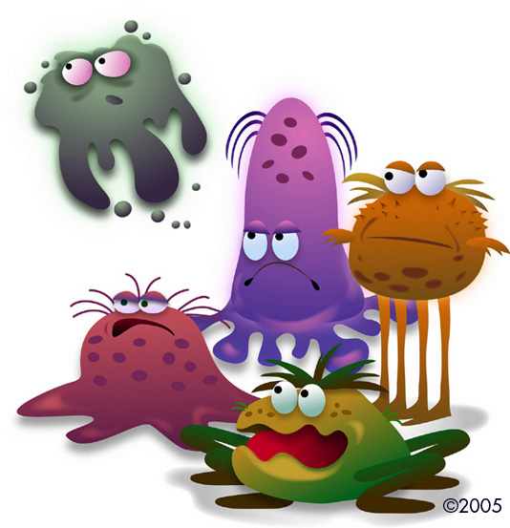
A Day in the Life………..
….of an Infection Preventionist
Helen Lazeration RN, BSN
Foundation Health Fairbanks Memorial Hospital

Slide 127
Establishing Daily Routines
My priorities for the Day:
Prepare for SAFETY HUDDLE each Morning:
(House wide multi-disciplinary group that reports on
each area they are representing)
I report on:
Number of Foley Catheters in-house
Number of Central Lines in-house
Number of in-house Isolations and what the isolation is for i.e. MDRO’s, Flu, TB etc.
Any trending communicable disease issues
being admitted or may be active in the community that may impact admissions to the hospital/Long Term Care
Any unusual occurrences that have happened in the
previous 24 hours such as Bed Bugs, Lice, Exposures
communicable diseases to staff/patients

Slide 128
Review of new admits that may have infections or communicable diseases that may need isolation.
Review current isolations:
are patient’s not on isolation that should be?
are patient’s on the correct isolation?
are the negative air rooms negative
can isolation be discontinued? (MOST POPULAR “?” From
nurses and doctors)
Review of Surgery Schedule for the day to look for any patient’s that may be going back to surgery for things such as:
Joint “Revisions”
Hardware removal’s
Incision and Drainage
etc.
(all are clues that a patient may have a problem with
infections from a previous surgery)

Slide 129
Review Infection Prevention “WORKLIST” in our EMR (CERNER):
The “WORKLIST” contains information on patient’s that helps us with
daily surveillance.
( It functions as an electronic culture and readmission list for any patient that may have had surgery within the last 30-90 days that has had cultures or a return trip to the hospital for x-rays, admission for repeat surgery etc.
The “WORKLIST” provides us a list of patients that may be seen inpatient or outpatient that may have had surgery and may need review for SSI’s or HAI’s:
It includes patient’s: Seen in our local Clinics
In our Long Term Care Facility
In our Home Care Services (Hospice and Home Care)
Physician Offices that use our lab/imaging/
Outpatient Procedural Area
Emergency Room

Slide 130
It includes a list of inpatients that may have had cultures done that clue us in to possible:
CAUTI’s
CLABSI’s
HAI Pneumonia’s
Ventilator Associated Conditions
Ventilator Associated Pneumonias
Inpatient/Outpatient Surgical Site Infections(SSI’s)
It provides us a list of all inpatient’s on Isolation.
TAKEWAY: If you don’t have access to an EMR worklist for cultures and readmissions
- work with your lab/IT dept. to see if they can generate a daily paper list of cultures for your review
focus on your surgeons on the list that have
ordered cultures
patients who have cultures done on day 3 or later
in their stay
Review your admission’s/patient roster for any patient’s that are re-admitted or having x-rays etc. done that may need follow-up for SSI’s

Slide 131
Rounding on your inpatient units (Acute Care and Long Term Care):
Things to do and look for when rounding:
Proper Isolation Signs and PPE availability
Answering questions for staff about Infection Prevention Issues
this is your opportunity for staff education on many
topics such as:
cleaning and disinfection
education about diseases such as meningitis
TB, MDRO’s etc.
hand hygiene
Visit patient’s that have infection control concerns/questions
While making rounds I do Audits for compliance on:
Hand Hygiene
CAUTI Bundles
Central Line Bundles
Ventilator Bundles
Pre-Klenz
Isolation

Slide 132
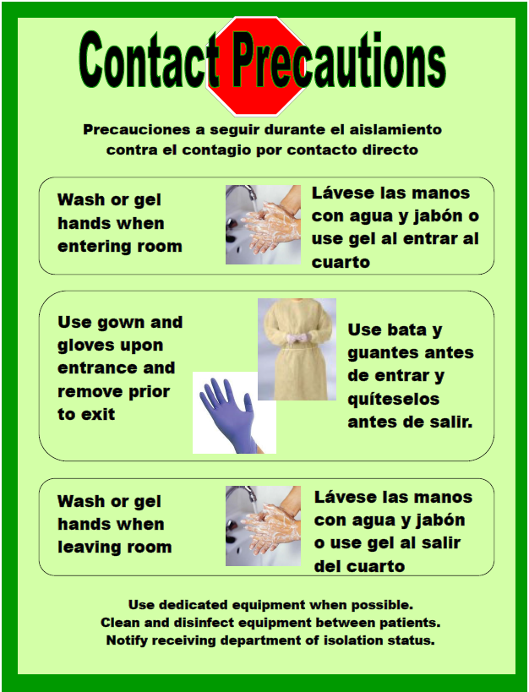
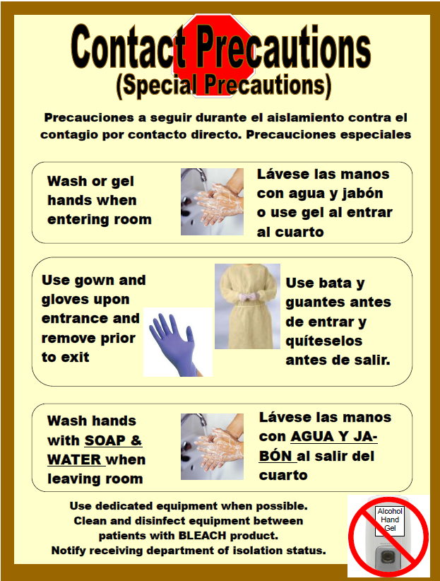
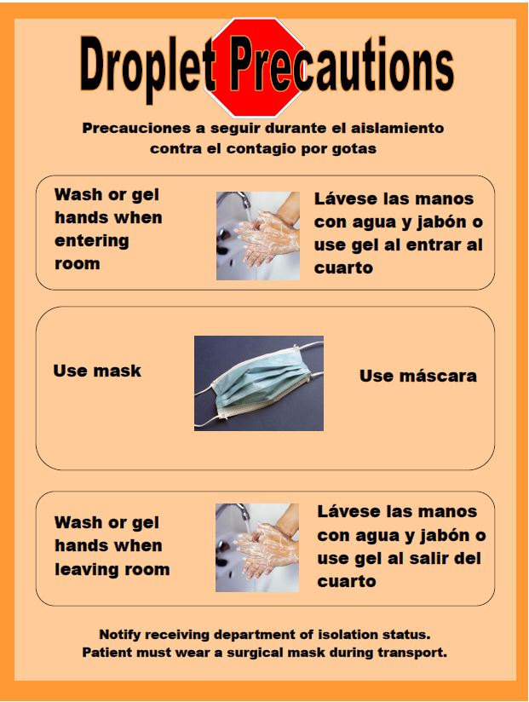
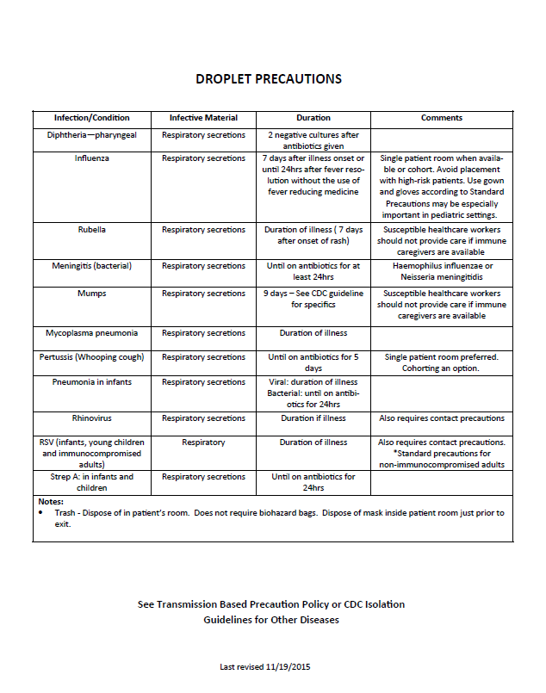
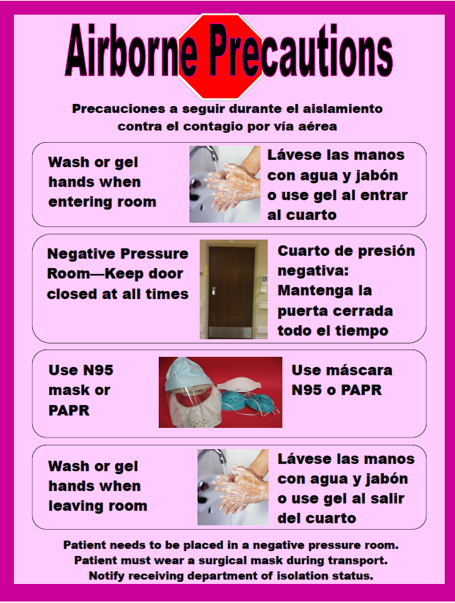
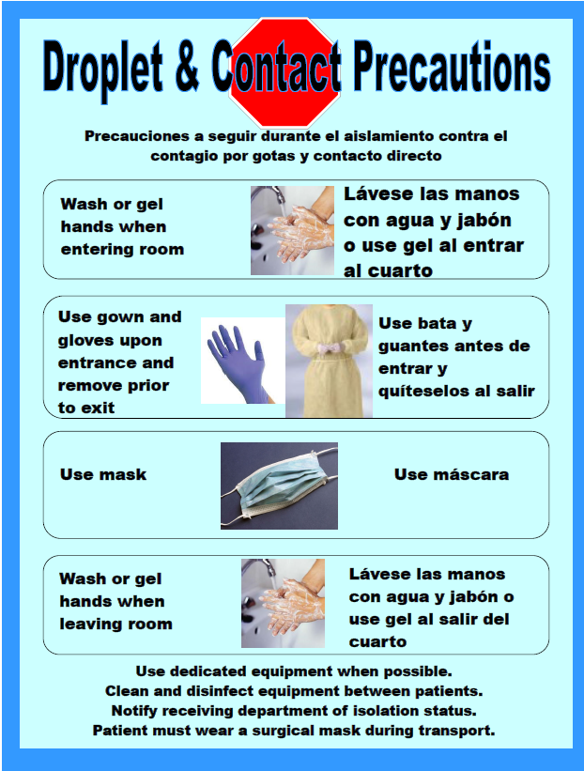
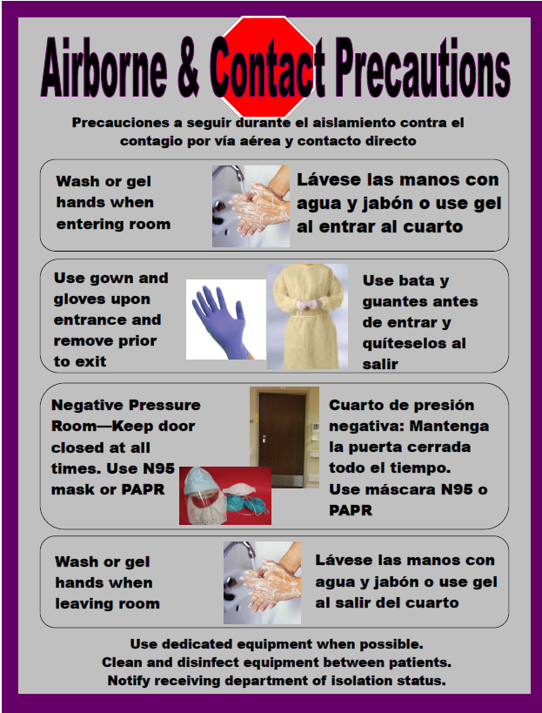
Acute Care
Info on the back of our signs
Isolation Signage

Slide 133
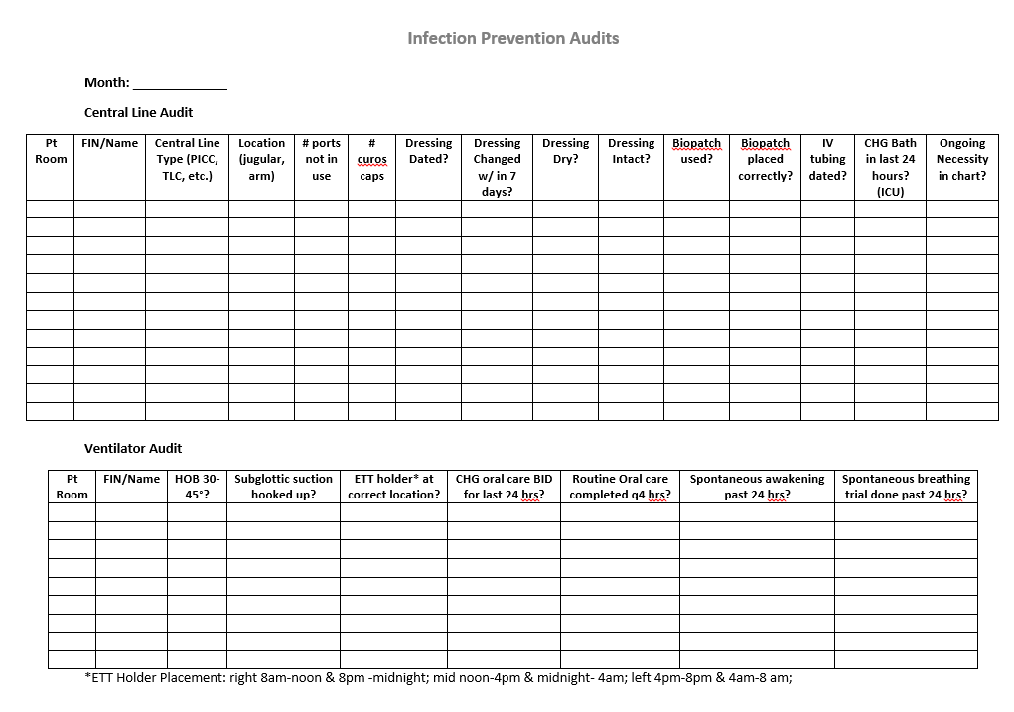
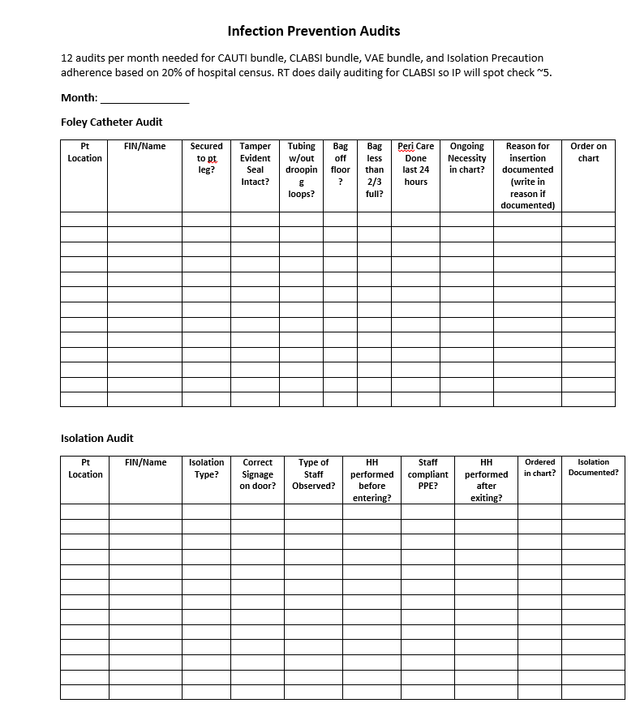
Samples of our Audit Tools
Based on “Bundle Compliance”

Slide 134
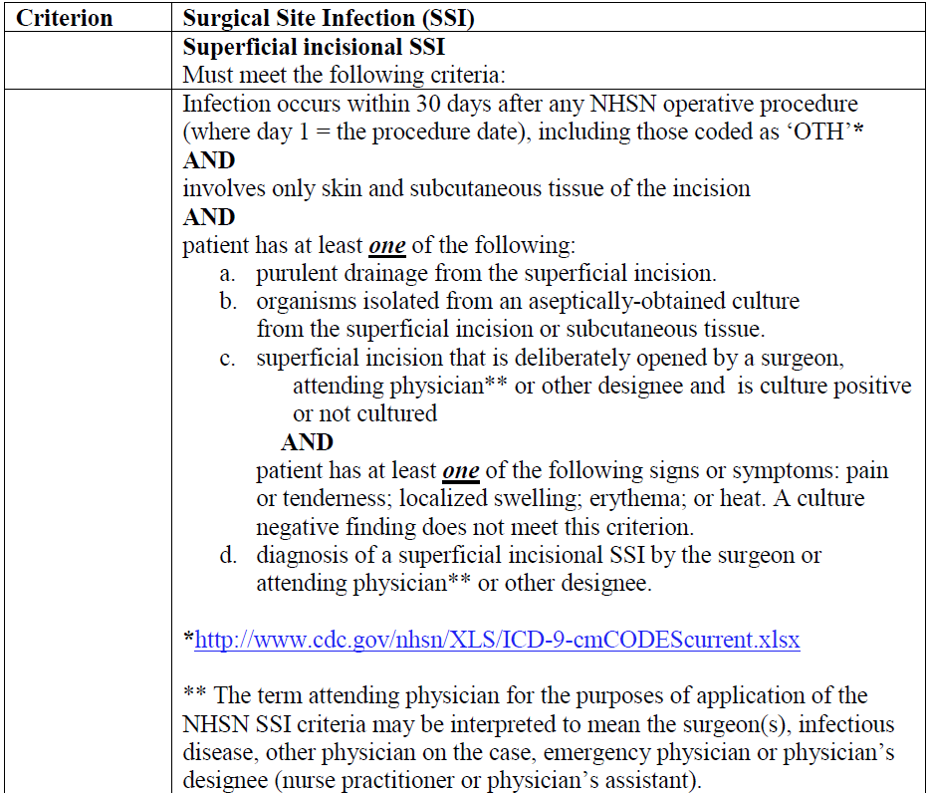
Daily Reporting/Write ups:
(After rounds)
Make out any reports that need to go to State Epi
Write up any SSI’s and other HAI”s
I use the NHSN criteria pages to write down how the patient meets criteria
We also do a second review on most cases
Don’t be afraid to use the NHSN resources to help you determine HAI’s:
VAE calculator
HAI Calculator
NHSN@CDC.gov for questions about difficult cases that you
may not be able to determine if they meet criteria or no

Slide 135
ATP TESTING
We do random ATP testing throughout the house in the following areas:
Operating Room
Patient Rooms
Wound Care and Infusion Clinics
Cardiac Cath Labs
ICRA’s (Infection Control Risk Assessments)
Become good friends with your Plant Operations and Engineering
Staff and construction crews
Weekly rounds on all active construction and remodeling projects to
monitor for compliance with: - Construction barriers/walk-off mats
- Air handling set-ups are appropriate
- Transporting of construction equipment/debris is done correctly - SIGNING OFF on the Infection Control Risk Assessments (ICRA’s)
- Reviewing the pre-construction Infection Control Risk Assessments (PICRA’s)

Slide 136
WEEKLY ACTIVITIES:
RED TEAM ROUNDS: (Ready Every Day) Multi-disciplinary team that rounds on all clinical areas of the hospital twice a year and non-clinical areas once a year looking for items/issues that are out of compliance with regulatory requirements and for areas that may need education on a subject related to your area of expertise.
Members of the RED TEAM:
Infection Prevention
EVS
Engineering/Plant Operations
Human Resources
Performance Improvement
Security
Biomedical (Clinical Equipment Services)
Supply Chain Management
ICRA Rounding: Round weekly with the Facilities Operations Coordinator on all construction and renovation activities to make sure that the barriers for construction and renovation are appropriate and that the contractors/construction crews are adhering to expected Infection Control guidelines.

Slide 137
Monthly Activities:
Auditing: OR cases
High Level Disinfection
Sterilization Processes in
SPD (review IUSS logs)
Review any temperature and humidity fallouts monthly and prn as they occur

Slide 138
Annual Activities:
Review of Policies ( State of Alaska requires an annual review)
Review of your facilities:
Bloodborne Pathogen Plan
Respiratory Protection Plan
Waterborne Pathogen Plan
Annual Infection Control Risk Assessments(HVA’s) for Acute Care/Home Care Services/Clinics and LTC
Write Evaluations of the years activities

Slide 139
…………Squeezing in those Committee Meetings and Endless Projects……..!!!!!

Slide 140
Important Committees……………
EOC (Environment of Care) – multi-disciplinary group that
oversees many interrelated issues: ICRA, Environmental
Service and Laundry issues, Supply Chain Management
Waterborne Pathogen Management
Emergency Management Committee: Involves designing and
writing emergency management plans including the
Infection Prevention Component for the Influx of Infectious
Patient Plan
Infection Control Committee: Our committee is a House wide
multi-disciplinary committee – no longer considered just a
medical staff committee (meets quarterly)
Quality/Safety Committee
Events Oversight Committee: Reviews trends in unusual occurrences
Infection Control Committee: ours meets quarterly

Slide 141
Samples of the projects we are working on:
Review of employee Mandatory Flu Vaccinations Process (annual)
Review of Inpatient Flu Vaccination Requirements/Documentation(annual)
Personal Protective Equipment: Isolation Gown Upgrade to meet AAMI
Guidelines
Pre-op Bathing Protocol
Review of Nurse Driven CAUTI Prevention/Foley Removal Protocol/Documentation
Review of ATP testing: Areas we perform ATP and Surfaces we are testing
Implementation of Testing of all scopes for contamination utilizing the
RESI-TEST Technology
Education for Home Care Services on Disease Transmission and Sentinel Events related to Infection Control
Pre-Klenz Competency
……..just to name a few!!!!!
Many of the projects we are working on are a result of our risk assessments/HVA done at the beginning of the year.

Slide 142
Are you overwhelmed Yet?
……..there is still more to do!

Slide 143
WHAT CAN DERAIL YOUR SMOOTHLY RUNNNG DAY……………..!!!!!!

Slide 144
Most common for us is:
Patient or staff exposures to a communicable disease!!!!!
Most common exposures:
TUBERCULOSIS
MENINGITIS
………and the dreaded
BED BUGS and LICE!

Slide 145
Remember:
Staff tend to underestimate their risk of exposure
ESPECIALLY nurses and physician’s at least 50% of the
time!
When looking at those who were potentially exposed don’t forget to include:
X-ray
Lab
EVS and
Ambulance/transport personnel if appropriate

Slide 146
Typical Findings in Bacterial vs. Viral Meningitis
 | Bacterial | Viral
Cell Count | 1,000 – 5,000* (range: 1,000-100,000) | 100-1,000
Cell Type | Neutrophils/polys predominate (>80%) | Mostly Mononuclear/lymph's
Pressure | >180 | Normal
Protein | >45 (usually 100-500) | Normal/slightly elevated
Glucose | <40 (or <40% of blood glucose) | Normal/slightly decreased
Gram Stain | H.Flu & S. pneumoniae identified more readily than N. meningitides | Negative
* Cell count may be normal in premature neonates and infants <1 month
White Blood Cell Differentials: White Blood Cells can be divided into the following groups:
Neutrophils, Monocytes, Eosinophils and Basophils. Neutrophils may also be called “Polys” or “Segs.”
Neutrophils can be designated as mature or “bands.” “Bands” are immature neutrophils , which
normally are only in the bone marrow but are released into the bloodstream with significant
Infection, especially sepsis. The term “left shift” indicates the presence of “bands” on a peripheral
blood smear.
Bacterial Meningitis Trifecta: CSF with elevated protein
decreased glucose
elevated WBC’s
……….. and the patient is started on Rocephin: DROPLET ISOLATION until you know your culture
is negative or for at least 24 hours after
antibiotics started
CSF table by Dr. Ken Gersham (May 2000)

Slide 147
TUBERCULOSIS
Patient with history of TB or Positive PPD history – review
diagnosis on admission
– if respiratory diagnosis review CXR’s, CT scans
review admission history for TB S/S
Patient with recent exposure
Patient who comes in with following s/s:
Cough > 2 weeks
Coughing up blood
Fevers
Night sweats
Weight Loss
CXR: Right Upper Lobe Opacities and/or cavitation
Isolate until you know sputum is negative

Slide 148
EXPOSURES TAKE A LOT OF TIME TO WORK THROUGH TO DETERMINE
Who was exposed
How it happened
How to prevent
Infection Prevention puts together the list of exposed and forwards it to
Occupational Health follow up

Slide 150
LONG TERM CARE VS ACUTE CARE
Priorities same or similar:
Prevent the spread of infection/exposure of other
residents and staff to communicable disease
CMS and State Regulations redirect your
Focus for some requirements

Slide 151
The
Challenges of Long Term Care
for
Infection Prevention

Slide 152
Infection Prevention Admission Priorities at Foundation Health (Denali Center) Long Term Care
Transfer Form completion
Infection Control Assessment
Does your patient need isolation
What is the residents’ risk for infection
Vaccine Assessment

Slide 153
What “plagues” our Long Term Care Residents:
Residents in Long Term Care are some of our most vulnerable citizens to infection/disease
Influenza and gastrointestinal illness can spread easily and quickly
visitors can bring in Influenza
Pneumonia, UTI’s are the most common followed by skin breakdown
On admission:
Assess risk of infection
Assess vaccine status:
Review reason for admission
Review vaccine records: VACTRAK, Clinic records, hospital records, talk with patient/family
Determine eligibility for: PPSV 23, Prevnar 13 and Zoster and
Flu Vaccines(during flu season)
Twice a year review of Vaccine eligibility
We Have Standing Orders/Screening forms

Slide 154
Useful Admission Forms

Slide 156
Occupational Health, Employees and Long Term Care
Employees are encouraged to not come to work sick
Residents are extremely susceptible to the average cold,
gastrointestinal bug that a sick employee can bring in
We have a form that is filled out by the RCC’s (Resident Care Coordinators) when an employee calls in sick
It automatically goes to Occ Health and Infection Control
for review
Majority of the time the employee must be cleared for return to work if it involves a communicable illness
CMS is very focused on employee illness in Long Term Care and how it is tracked and reviewed

Slide 157
Employee call out for review

Slide 158
Isolation in Long Term Care vs. Acute Care
 | Long Term Care | Acute Care
Colonization | Usually don’t isolate | Usually isolate
History of MDRO’s | Depends on if infection is current Transmission based policy/CDC isolation guidelines determine who we isolate with active infections | Depends on if infection is current
If active wound infection what activities can patient participate in | With clean gowns and good hand hygiene and any wounds contained resident can be out of room and go to dining area, PT/OT | Restricted to room except for tests – rare exception can be out of room for PT on the unit – then puts on clean gown/does hand hygiene and not allowed to touch surfaces in hallways and drainage is contained
Airborne isolation | Currently we are not set up to accommodate at LTC facility so would be admitted to Acute Care
Co-horting patients | Try to provide private rooms, if not able- assess roommates risk of infection, if two patients have same MDRO etc. put together | Rare to co-hort, usually private room

Slide 160
Isolation Standing Orders Form is very helpful and is initiated primarily by
Infection Prevention on admission if necessary and as the need arises

Slide 161
Vaccine Screening Forms

Slide 162
Other important issues in Long Term Care:
Maintaining that “homelike” environment:
assess each patient’s needs and preferences balance with medical needs
Our Long Term Care adheres to the “Eden Philosophy”
Maintaining isolation easier in LTC because the recommended criteria
for determining the degree of isolation is more “patient friendly”
a. Animals in long tem care
Our Long Term Care Facility has a Pet Committee
meets quarterly and prn
meets with family/patient to set up care plan
care plan covers:
Who takes care of the Pet Needs
i.e. litter boxes
buying food
taking pets outside
Care plan is reviewed every six months and prn

Slide 163
Pet Policy in Long Term Care
Allow dogs, cats, birds, fish only
All animals that are facility/patient pets that live in the facility must be cleared by a veterinarian which includes scheduled vaccines, deworming, temperament screens
Visiting animals that come to the facility routinely with groups such as “Companions Inc.” must also be screened by a Veterinarian- in our facility they are treated as “volunteers”
One time visiting by allowed pets happens without screening
Staff cannot provide the care for the animals such as bathing, toileting, cleaning of cages, tanks, litter boxes unless it is done at the end of their shift and they are not going to provide any more care for the day to residents

Slide 164
…………..THE END
…….NOT!!!!!!
In Infection Prevention there is always MORE TO DO!
Questions?

Slide 165
IP Practices with Rebecca Hamel

