Slide 1

Welcome! Questions and Answers
Notes:
15 minutes

Slide 2
Nursing Contact Hours (NCH)
The Alaska Division of Public Health is an approved provider of continuing nursing education by Montana Nurses Association, an accredited approver by the American Nurse’s Credentialing Center’s Commission on Accreditation.
There is no identified conflict of interest by any planner or presenter involved in this learning activity.
In order to receive nursing contact hours:
  Register (sign in) and attend 80% of each day.
  Complete a two question evaluation form at the end of day.
  Contact Kim Spink at 907-269-8085 or kimberly.spink@alaska.gov for any concerns for NCH

Slide 3
Understanding the Basics of Clinical Microbiology.
Ryan W. Stevens, Pharm.D., BCPS
Infectious diseases clinical pharmacy specialist
Providence Alaska Medical Center

Slide 4
Disclosures:
None

Slide 5
Objectives:
Describe the utility of laboratory testing/chemistries in the workup of infection.
Describe general microbiologic culture and susceptibility methods and their associated time courses.
Describe some forms of rapid diagnostic testing (RDTs)

Slide 6
Learning Assessment:
T/F – Elevations in inflammatory biomarkers including (ESR, CRP, PCT, and WBC) indicate the presence of an infectious condition.
Which of the following is a catalase positive, coagulase positive, latex positive GPC?
  Staphylococcus aureus
  Streptotoccus pyogenes
  Staphylococcus epidermidis
  Streptococcus pneumoniae
Which susceptibility testing method provides a formal MIC? (circle all that apply)
  Broth microdilution (BMD)
  Epsilometer test (E-test)
  Kirby-Bauer disk diffusion

Slide 7
Non-specific Lab Tests:^{1,2}
There is NO single definitive test for identification of infection!
  i.e. All have limitations
  Always should be paired with clinical presentation.
Examples:
  White Blood Cell (WBC) Count:
    Elevate in response to infection
    Also elevate in response to: Drugs (i.e. steroids), stress, inflammation, etc.
    Bands = immature neutrophils
      “Left Shift”: >9% bands
  Lactate:
    Demonstrates shift to anaerobic metabolism / illustrates tissue hypoperfusion
    Elevates in response to shock, tissue ischemia, severe liver disease, and some medication (metformin)
Notes:
Understand that this is really more laboratory than it is microbiology, but it is necessary…we will get there.

Slide 8
Non-specific Lab Tests:¹⁻³
CRP and ESR:
  C-reactive protein (CRP) and erythrocyte sedimentation rate (ESR:
    Non-specific acute phase reactant (i.e. non-specific inflammatory marker)
    Elevate vaguely in response to inflammation
    Generally CRP reacts faster than ESR
    Better for trending chronic infections vs. determining if infection present.
  Erythrocyte sedimentation rate (ESR)
    Non-specific inflammatory marker
    Generally reacts slower than CRP
Procalcitonin:
  116 amino acid precursor of calcitonin
  More sensitive than CRP at detecting bacterial infection
  Detectable in 2-4 hours / Peak = 8-24 hours / Half-life = 24 hours
  Rises not impaired by neutropenia or immunosuppression
  Most useful in community-acquired lower respiratory tract and sepsis

Slide 9
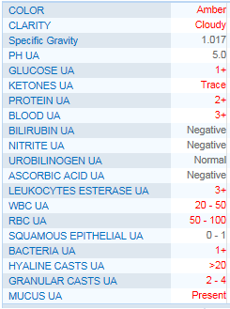
Non-specific Lab Tests:^{4,5}
Urinalysis:
  Color and Clarity: Non-specific
  Nitrites:
    Reductase: Nitrates → Nitrities
    Weakly sensitive/highly specific for the PRESENCE of bacteria.
  Leukocyte Esterase:
    Produced by neutrophils
    Indicates pyuria
  WBC: Grades the pyuria
  Bacteria: May signal contamination, ASB, or infection
  Squamous Epithelial Cells: May help determine quality of specimen.

Slide 10
Asymptomatic Bacteriuria (ASB):⁵
No mater what Bear Grylls tells you…
…urine is not a sterile body fluid.
A “dirty” UA or “pyuria” in the absence of symptoms is NOT an indication for antimicrobial therapy.
  Caveats:
    Pregnancy
    ASB during procedures which will compromise of urinary mucosa.

Slide 11
Cultures…the basics:^{1,6-9}
Only culture something…if you plan to use the culture to guide therapy.
  May NOT always be necessary (i.e. uncomplicated CAP or perforated appendicitis)
Always culture PRIOR TO administration of antibiotics if possible.
  Sepsis is the obvious exception
    7.6% increase in mortality for every hour antimicrobial therapy is delayed.
Take care to avoid contamination with patient’s usual flora.
Interpret cultures with a critical eye:
  What source/type of culture was obtained?
  What was the culture method?
  What did the gram-stain/grouping show?
  What grew?
  Does what grew match the clinical suspicions?
  What did susceptibilities show?

Slide 12
Culture Source/Type:¹
Source:
  Blood
  Wound, bone, tissue, abscess
  CSF
  Respiratory
  Stool
  Urine
  Body fluid (pleural, ascites, etc.)
Type:
  Aerobic
  Anaerobic
  Fungal
  Acid fast bacilli

Slide 13
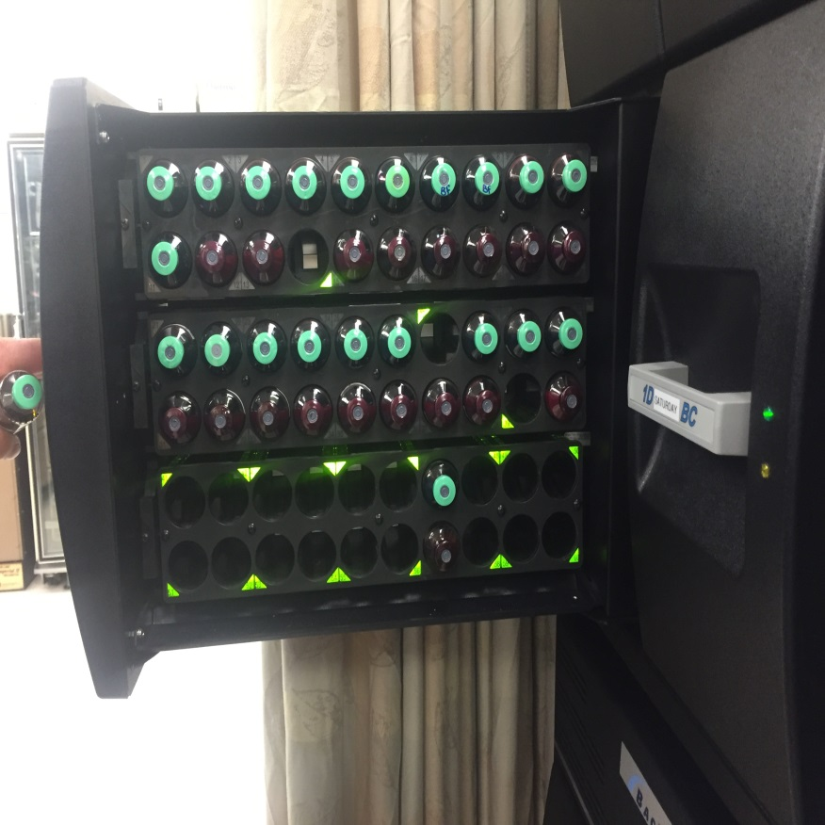
Culture Source/Type:¹
Some variance in microbiology processing:
  BACTEC alert device
    Blood
    Gram-stain negative Body Fluids
  Required additional processing:
    Tissue
    Bone
  Straight to plate
    Wound
    Respiratory
    Urine
    Gram-stain positive
    CSF

Slide 14
Culture Source/Type:^{1,8-11}
Anticipate pathogen based on location of infection.
  Skin and Soft Tissue Source:
    Skin flora (Staphylococcus/Streptococcus)
  Respiratory Source: S. pneumoniae, M. catarrhalis, L. pneumophila, M. Pneumoniae, C. pneumoniae, H. influenzae.
    Hospital-acquired: MDRO gram-negative rods (including P. aeruginosa) and S. aureus
  GI Source: E. coli, Klebsiella spp., B. fragilis, S. anginosus, Enterococcus spp.

Slide 15
Culture Method:¹⁰⁻¹⁴
How was it collected?
Is it a good specimen?
Could it be contaminated?
General features:
  Look for presence of WBC
  Look for absence of squamous epithelial cells
Respiratory:
  Sputum (expectorated) vs. sputum (suction)
  Endotracheal aspirate vs. Bronchoalveolar lavage (BAL) vs. mini-BAL
Wounds:
  Purulent vs. Non-purulent
  Superficial swab vs. tissue/biopsy
  Chronic ulcer vs. acute wound
Blood:
  ? Contaminant
    How many bottles of how many draws?
    How long did it take to grow?

Slide 16
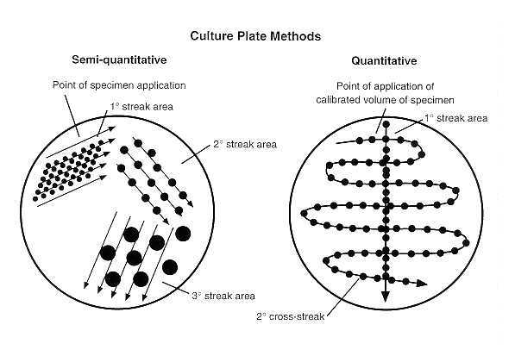
Culture Method:¹⁵
Semi-quantitative:
  Attempts to ESTIMATE the quantity of organisms in a given culture.
  Cultures plated in one quadrant on plate
  Growth in primary quadrant = 1+
  Extension characterized as 2+, 3+, and 4+
Quantitative:
  Provides more robust estimate of number of organisms in a given culture.
  Requires fluid specimen.
  One mL of specimen is plate in plated and depending on growth on streak estimate made.
  i.e. >100,000 cfu/mL
http://intranet.tdmu.edu.ua/data/cd/disk2/ch010.htm

Slide 17
Gram Stains:¹
Specimen applied to slide
Crystal violet stain applied followed by iodine.
Alcohol decolorizing solution applied
Counterstain with safranin
Gram-negative: Red/Pink
Gram-positive: Purple in appearance

Slide 18
Gram Stains:¹⁶
Grouping:
More relevant in gram positive cocci (GPC):
  Staphylococcus spp. → GPC pairs, tetrads, and clusters
  Streptococcus spp. / Enterococcus spp. :
    Generally: GPC in chains
      LONG chains → Beta-hemolytic strep or S. viridans
      Diplococci and chains → S. pneumonia
What about… GPC pairs?

Slide 19
Gram Stains/Grouping:¹

Slide 20
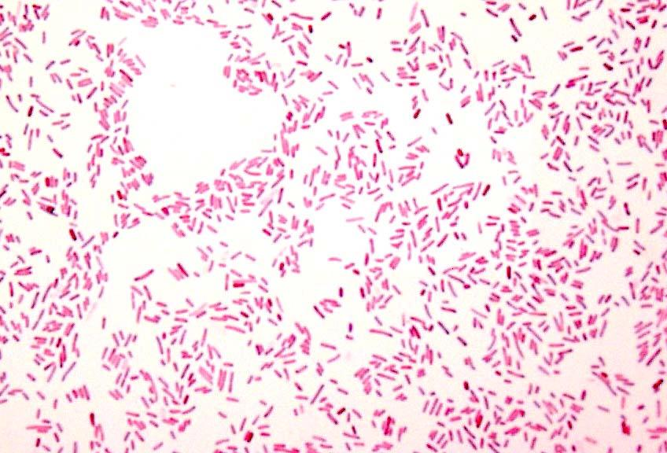
Gram Stains:¹⁶
Notes:
Staphylococcus
Streptococcus
Pneumococcus
Gram-variable rods – Clostridium (mention other GPR)
GN diplococcus – N. meningitidis/Moraxella
GNR – Enterobactereciae (E. coli)

Slide 21
Gram Stains x 2:
Specimen received
Initial gram stain (1-6 hours)
Plated and grown (24-48 hours)
Growth gram stain
Organism identification (0-24 hours)
Susceptibilities (18-24 hours)

Slide 22
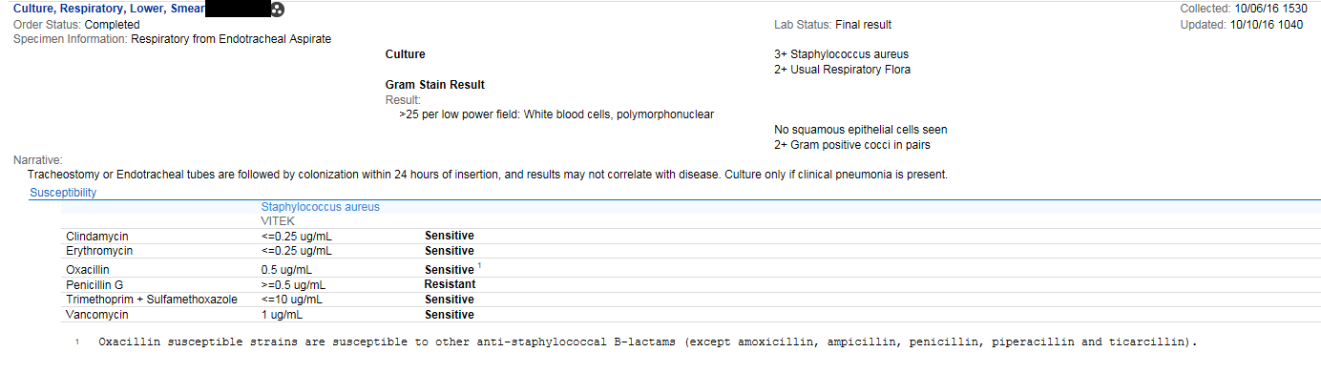
Gram Stains → Plate Growth:

Slide 23
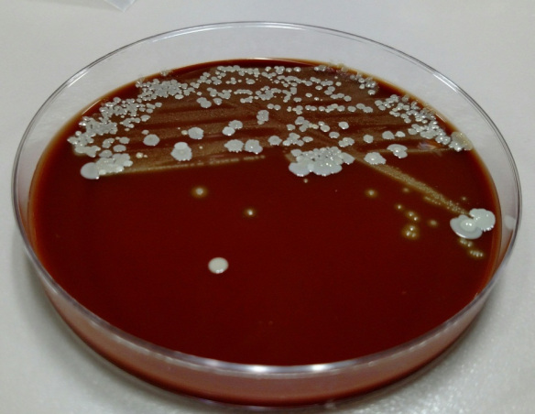
Plate Growth:
Identification…
…what is taking so long?
  Pure plates vs. mixed plates
    “re-isolating for more information”
  Poor vs. no plate growth plates
  Oddly behaving organisms

Slide 24
Plate Growth (GNR):¹

Slide 25
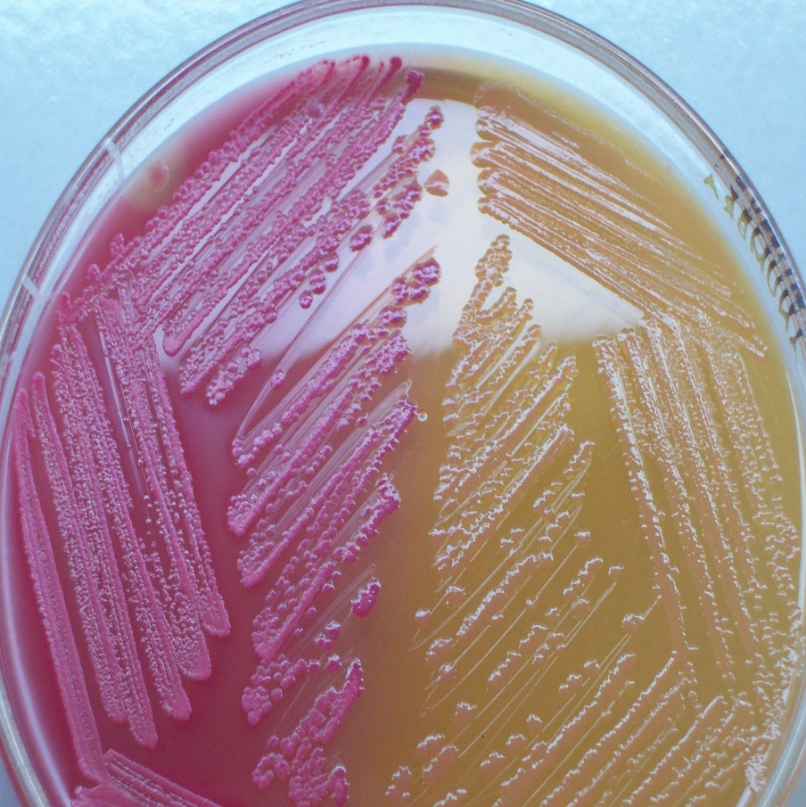
Plate Growth (GNR):¹⁷
Gram Negatives:
  Lactose fermentation:
    Helps to distinguish between GNRs prior to formal ID.
      Pseudomonas vs. other
    MacConkey agar:
      Inhibits gram-positive growth
      Lactose Fermenting:
        Lowers pH → red agar
      Non-lactose fermenting:
        Ammonia production raises pH → Clear/opaque agar
https://en.wikipedia.org/wiki/MacConkey_agar#/media/File:MacConkey_agar_with_LF_and_LF_colonies.jpg

Slide 26
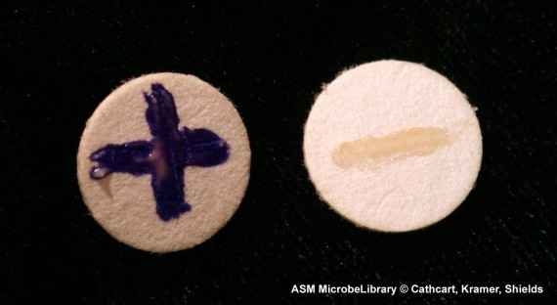
Plate Growth (GNR):¹⁷
Oxidase:
  Assesses for presence of cytochrome oxidase
  Not produced by Enterobacteriaceae
    Produced by pseudomonas
  Positive test = Purple stain
    i.e. agent is oxidized
  Negative test = Colorless
    i.e. agent remains reduced
http://www.medical-labs.net/oxidase-test-1291/

Slide 27
Plate Growth (GPC):¹

Slide 28
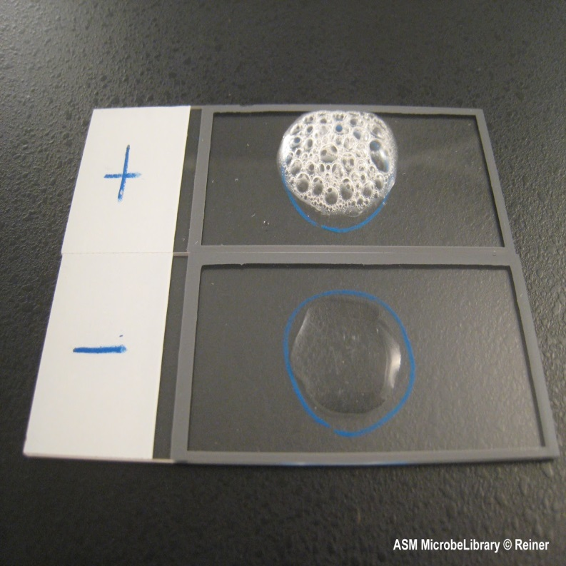
Plate Growth (GPC):¹⁷
Catalase:
  2H₂O₂ → O₂ + H₂O
    O₂ released as gas = bubbles
  Differentiates staphylococcus from streptococcus
    Staphylococcus = catalase positive
    Streptococcus = catalase negative
http://4.bp.blogspot.com/-pGWy_YzoaD4/UZXnPopWsUI/AAAAAAAAAH0/nrnpu-kKutg/s1600/slide+catalase+test+results.jpg

Slide 29
Plate Growth (GPC):¹⁷
Catalase positive:
  Latex agglutination:
    Antibody for S. aureus on latex beads
      Latex positive = S. aureus
      Latex negative = CoNS
  Coagulase:
    Converts fibrinogen to fibrin clot with help of plasma factors
    S. aureus = positive
    S. epidermidis and other CoNS = negative
Catalase negative:
  Hemolysis:
    Does it growth cause hemolysis of blood agar
      Alpha = green = partial hemolysis
        S. viridans
        S. pneumonia
        Maybe S. anginosus
      Beta = clear = full hemolysis
        “Typeable” streptococcus
          Group A, B, C, G
      Gamma = red = no hemolysis
        Enterococcus spp. (PYR)
        Maybe S. anginosus

Slide 30
Organism Identification:
Specimen received
Initial gram stain (1-6 hours)
Plated and grown (24-48 hours)
Growth gram stain
Organism identification (0-24 hours)
Susceptibilities (18-24 hours)

Slide 31
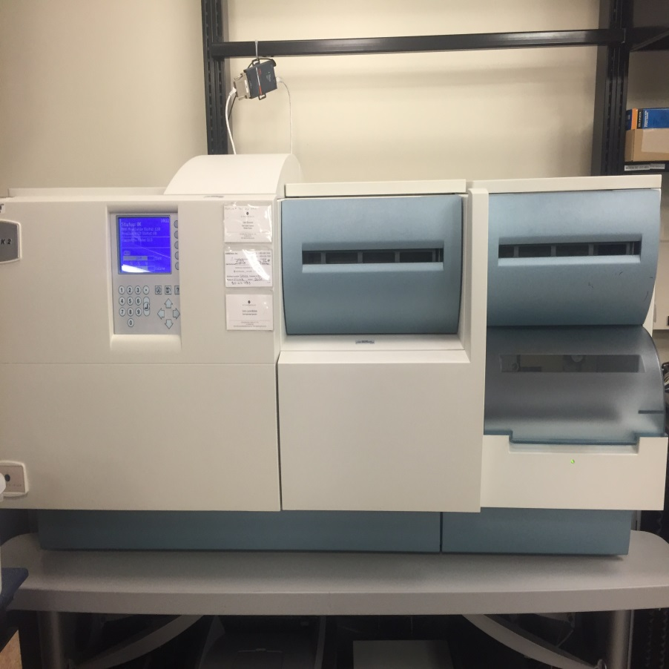
Organism Identification:
VITEK vs. Microscan vs. Phoenix
PAMC = VITEK2
  Performs both:
    Organism identification
    Susceptibilities
      Automated broth microdilution (BMD)
        We will come back to this!

Slide 32
Organism ID vs. Clinical Suspicion:
Culture Source
Method of Collection
Suspicion for Contamination
Gram stains
Growth
Organism ID
Presence of Usual flora?
Odd organism for culture source?
Growth that doesn’t match the initial gram stain?
Initial gram stain that doesn’t match the growth?

Slide 33
Susceptibilities:
Specimen received
Initial gram stain (1-6 hours)
Plated and grown (24-48 hours)
Growth gram stain
Organism identification (0-24 hours)
Susceptibilities (18-24 hours)

Slide 34
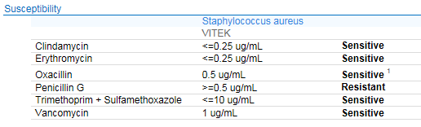
Susceptibilities:¹
Qualitative Results:
Driven by MIC
Actual determinant behind quantitative results
Multiple methods (BMD vs. KB vs. E-test)
Valuable…but sometimes hard to interpret.
Quantitative Results:
Susceptible
Intermediate
Resistant
User friendly…but perhaps oversimplified.

Slide 35
“Semi” -Qualitative Susceptibilities:¹
Disk diffusion test (i.e. Kirby Bauer)
  Grow bug → Drop Disk → Measure zone of inhibition
  Susceptibility of organism is determined by “zone of inhibition”
    Determined by CLSI standards
    Varies depending on organism
    Varies depending on drug
  Generally:
    Bigger zone of inhibition = more susceptible bug
    Can perform multiple tests (up to 12) on same plate
    Able to choose specific agents to test
  Pros: Reliable, flexible, cheap, and simple
  Cons: May be impacted by incubation temp or bacterial inoculum

Slide 36
Qualitative Susceptibilities:¹
Minimum Inhibitory Concentration:
  “The lowest antimicrobial concentration that prevents visible growth of an organism after ~24 hours of incubation in a specified growth medium”
  Susceptibility breakpoints determined by CLSI
  Traditionally
    Macrotube dilution method vs. Solid agar
    Labor intensive!
  Present day:
    Automated
      VITEK2 vs. Microscan (turbidity) vs. Phoenix
    Epsilometer Test (I.e. E-test)
  Tells us the level of susceptibility of an organism rather than just the interpretation of that level.
    E. coli: Piperacillin/tazobactam </= 4 vs. 32 mcg/mL
    MRSA: Vancomycin <0.5 vs. 2 mcg/mL

Slide 37

Qualitative Susceptibilities:¹
Automated Broth Microdilution (BMD):
  Inoculate card → Put in machine → Wait
  Tests organism to multiple concentrations of multiple drugs
    Drugs in card determined by manufacturer or card selected.
  Determines organism MIC to multiple agents in single test
    Run time = 18-24 hours
  Pros: Easy, reliable, provides formal MIC
  Cons: Requires machine ($$$) and lacks flexibility in agent selection.

Slide 38
Qualitative Susceptibilities:^{1,18}
Epsilometer test (i.e. E-test)
  Grow bug → Drop strip → look for ellipse/strip intersection.
  E-Strip:
    Single agent
    Increasing concentrations
  One strip per plate.
    Has been at times to be more accurate than automated broth microdilution
  Pros: Easy to perform, ? Easy to read, cheap
  Cons: One per plate, ? Easy to read

Slide 39
Susceptibilities:
Summary:
Do you have qualitative, quantitative, or both?
If qualitative, was it performed via BMD, E-test, or Kirby-Bauer?
If BMD or E-test, just how susceptible was the organism (i.e. what was the MIC)?
Select a therapy!
What is the narrowest spectrum agent that treats all presently identified organisms?

Slide 40
Rapid Diagnostic Testing:¹⁷
Sensitivity vs. Specificity
Varies depending on testing method and specific test
Sensitivity:
  If a person HAS the disease how often will the test be positive?
    I.e.
      10 influenza patients present and are swabbed for EIA
      Rapid flu swab (EIA) detects 5/10.
      Sensitivity = 50%
  Rate of true positive vs. false negative.
Specificity:
  If a person does NOT HAVE the disease how often will the test be negative.
    I.e.
      10 patients WITHOUT influenza present and are swabbed for EIA
      Rapid flu swab (EIA) detects 2/10
      Specificity = 80%
  Rate of true negative vs. false positive.

Slide 41
Rapid Diagnostic Testing (RDT):¹⁷
Antibody testing:
  Agglutination testing:
    Antibodies (polyclonal or monoclonal) attached to latex beads and specimen introduced.
      If lattice structure forms then antigen is present (antibody-antigen complexes)
    Typically tested from growth (not generally from direct specimen)
    Ex: S. aureus from plate growth
  Enzyme immunoassay (EIA)/Enzyme-linked immunosorbent assay (ELISA):
    Antibody coated wells/trays → Specimen (antigen) introduced → Well washed out → Second antibody introduced → well washed out → coloring agent added.
      Wells that change color = positive for antigen.
    Typically tested direct from specimen
    Ex: Influenza A and B, Ag EIA (i.e. rapid flu swab)

Slide 42
Rapid Diagnostic Testing (RDT):^{1,17}
Polymerase Chain Reaction (PCR / NAAT):
  Testing done directly from collection specimen
  Target amplification system
    Amplifies SMALL sections of DNA using DNA polymerase and short oligonucleotide primers for detection.
      If more than one primer used = improved sensitivity (multiplex PCR)
  Ex: Respiratory viral pathogen panel (BiofireTM)
      Blood Culture Identification Panel (BCID)
      GI Panel
      Meningitis/Encephalitis Panel
    C. diff, NAAT
16S rRNA:
  Looks for specific section of ribosomal RNA that helps to identify specific organisms in a specimen.
    Draws on LARGE bank of known sequencing vs. specific testing on specific platform
    Testing of direct specimen

Slide 43
Rapid Diagnostic Testing (RDT):¹⁷
Mass Spectrometry:
  Matrix-assisted laser desorption ionization time-of-flight (MALDI-TOF)
    Thin smear on metallic slide
    Hit with pulses of laser
    Desorbed and deionized particles then accelerated through electrostatic field and drifted through vacuum tube
    Contact mass spectrometers detector
    Different particles fly at different speeds which indicates the presence of components of specific organisms
    Typically run off of organism growth

Slide 44
Rapid Diagnostic Testing (RDT):¹⁹
Accelerate Diagnostics – PhenoTM
  Gel electro-filtration (GEF)
    Sample loaded into gel well that contains pores smaller than bacterial cells
    Electric current applied which removes cellular debris to isolate/concentrate bacterial cells
  Electro-kinetic concentration (EKC)
    Cells are drawn to surface where analysis will take place by exposure to mild electric charge.
  FISH (Fluorescence in-site hybridization)
    Cells exposed to probes with fluorescent tags looking for specific nucleic acid sequences.
  Fast phenotypic susceptibility testing
    Cell exposed to single concentration of agent and time lapse imaging correlates growth patterns to MICs.

Slide 45
Learning Assessment:
T/F – Elevations in inflammatory biomarkers including (ESR, CRP, PCT, and WBC) indicate the presence of an infectious condition.
Which of the following is a catalase positive, coagulase positive, latex positive GPC?
  Staphylococcus aureus
  Streptotoccus pyogenes
  Staphylococcus epidermidis
  Streptococcus pneumoniae
Which susceptibility testing method provides a formal MIC? (circle all that apply)
  Broth microdilution (BMD)
  Epsilometer test (E-test)
  Kirby-Bauer disk diffusion

Slide 46
References:
Rybak M, Aeschlimann JR. Laboratory tests to direct antimicrobial pharmacotherapy. In: Dipiro JT et al. Pharmacotherapy: A Pathophysiologic Approach 7th ed. New York, NY: McGraw Hill Medical; 2008: 1715-1730.
Pagana KD, Pagana TJ. Mosby’s Diagnostic and Laboratory Reference. 9th ed. Williamsport, PA: Mosby Elsevier; 2009.
Simon L, et al. Serum procalcitonin and CRP levels as biomarkers of bacterial infection: a systematic review and meta-analysis. CID 2004;39:206-217.
Simerville JA, Maxted WC, Pahira JJ. Urinalysis: a comprehensive review. Am Fam Physician. 2005;7(6):1153-1162.
Nicolle LE, Bradley S, Colgan R, et al. Infectious Diseases Society of American guidelines for the diagnosis and treatment of asymptomatic bacteriuria in adults. CID 2005;40:643-54.
Kumar A, Roberts D, Wood KE, et al. Duration of hypotension before initiation of effective antimicrobial therapy is the critical determinant of survival in human septic shock. Crit Care Med 2006;34(6): 1589-96.
Septimus E. Clinician guide for interpreting cultures. Centers for Disease Control and Prevention Web site. http://www.cdc.gov/getsmart/healthcare/implementation/clinicianguide.html. Published April 7, 2015. Updated April 7, 2015. Accessed October 5, 2016.
Mandell LA, Wunderink RG, Anzueto A, et al. Infectious Diseases Society of American/American Thoracic Society Consensus Guidelines on the management of community-acquired pneumonia in adults. CID 2007;44:S27-72.
Solomkin JS, Mazuski JE, Bradley JS, et al. Diagnosis and management of complicated intra-abdominal infection in adults and children: guidelines by the Surgical Infection Society and the Infectious Diseases Society of America. CID 2010;50:133-64.
Kalil AC, Metersky ML, Klompas M, et al. Management of adults with hospital-acquired and ventilator-associated pneumonia: 2016 clinical practice guideline by the Infectious Diseases Society of America and the American Thoracic Society. CID 2016. doi: 10.1093/cid/ciw353.

Slide 47
References:
Stevens, DL, Bisno AL, Chambers HF, et al. Practice guidelines for the diagnosis and management of skin and soft tissue infections: 2014 update by the Infectious Diseases Society of America. CID 2014. doi: 10.1093/cid/ciu296.
Lipsky BA, Berendt AR, Cornia PB, et al. 2012 Infectious Diseases Society of America Clinical Practice Guideline for the diagnosis and management of diabetic foot infections. CID:54(12):e132-e173.
Bowler PG, Deurden BI, Armstrong DG. Wound microbiology and associated approaches to wound management. Clin Microbiol Rev 2001;14(2):244-269.
Hall KK, Lyman JA. Updated review of blood culture contamination. J Clin Microbiol 2006;19(4):788-802.
Kallstrom G. Are quantitative bacterial wound cultures useful? J Clin Microbiol 2014;52(8):2753-2756.
Barenfanger J, Drake CA. Interpretation of gram stains for the nonmicrobiologist. Lab Med 2001;7(32): 368-375.
Brooks GF, et al. Medical Microbiology 26th ed. New York, NY: McGraw Hill Medical; 2013
Rybak M, Vidaillac C, Sader HS. Evaluation of vancomycin susceptibility testing for methicillin-resistant staphylococcus aureus: comparison of Etest and three automated testing methods. J Clin Microbiol 2013;51(7): 2077-81.
Accelerate Pheno System. Accelerate diagnostics. Available at: http://acceleratediagnostics.com/products/accelerate-pheno-system/#features. Accessed December 30th, 2016.

Slide 48
Environmental Cleaning and Disinfection
Bonnie Barnard, MPH, CIC, FAPIC
Interim Infection Preventionist

Slide 49
Objectives
Describe the process for cleaning patient rooms daily and upon discharge
Explain the importance of dwell/contact time in relation to the use of disinfectants
List at least five high touch items in the patient’s environment that require special attention to cleaning

Slide 50
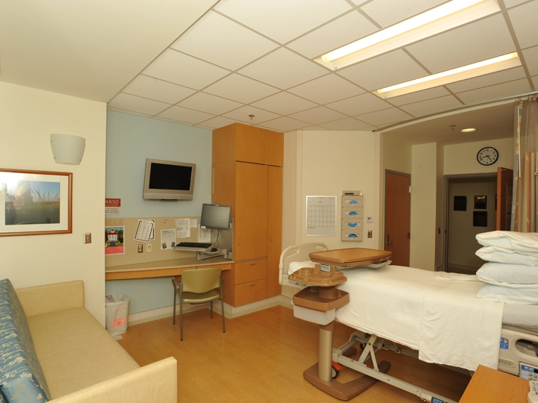

Slide 51
Pathogens Survive on Surfaces
BMC Infectious Disease 2006

Slide 52
Environment as Source of HAIs
20% of HAIs may be related to the environment
  --William Rutala, PhD
Environmental cleaning in healthcare is only done correctly 50% of the time

Slide 53
Definitions
Cleaning
  Removal of all soil from objects/surfaces
Decontamination
  Removal of pathogenic microorganisms from objects to ensure they are safe to handle
Disinfection (Low, Intermediate, High)
  Elimination of many or all pathogenic organisms with the exception of spores
Sterilization
  Complete elimination of all microbial life, including spores

Slide 54
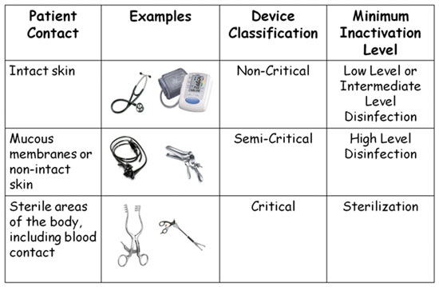
Spaulding Classification

Slide 55
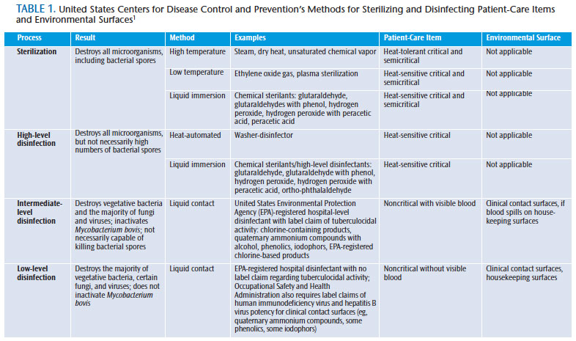

Slide 56
Processing “Noncritical”
Patient Care Objects
Classification: Noncritical objects will not come in contact with mucous membranes or skin that is not intact.
Object: Can be expected to be contaminated with some microorganisms.
Germicidal action: Kill vegetative bacteria, fungi and lipid viruses.
Examples: Bedpans; crutches; bed rails; EKG leads; bedside tables; walls, floors and furniture.
Method: Low-level disinfection

Slide 57
Regulations and Guidelines
CDC Guideline for Environmental Infection Control (2003)
Environmental Protection Agency (EPA)
  Pesticides
    Includes disinfectants and sterilants used on inanimate objects and environmental surfaces

Slide 58
Environmental Survival of Key Pathogens on Hospital Surfaces
Pathogen | Survival Time
S. aureus (including MRSA) | 7 days to >12 months
Enterococcus spp. (including VRE) | 5 days to >46 months
Acinetobacter spp. | 3 days to 11 months
Clostridium difficile (spores) | >5 months
Norovirus (and feline calicivirus) | 8 hours to >2 weeks
Pseudomonas aeruginosa | 6 hours to 16 months
Klebsiella spp. | 2 hours to >30 months
Adapted from Hota B, et al. Clin Infect Dis 2004;39:1182-9 and
Kramer A, et al. BMC Infectious Diseases 2006;6:130

Slide 59
Resistance of Microorganisms to Disinfectants
Most Resistant
Prions
Bacterial spores (C. difficile)
Mycobacteria
Small, non-enveloped viruses (noro, polio, EV-D68)
Fungal spores
Gram-negative bacilli (Acinetobacter)
Vegetative fungi and algae
Large, non-enveloped viruses
Gram-positive bacteria (MRSA, VRE)
Enveloped viruses (Ebola, MERS-CoV)
Most Susceptible

Slide 60
Understanding Chemicals
Cleaner
Cleaner/Disinfectant
Disinfectant
  EPA Registered
Special Products
  Stainless Steel
  Degreasers

Slide 61
Low-Level Disinfection
Exposure time > 1 min
  Germicide Use Concentration
  Ethyl or isopropyl alcohol 70-90%
  Chlorine 100ppm (1:500 dilution)
  Phenolic UD
  Quaternary ammonium UD
  Improved hydrogen peroxide 0.5%, 1.4%
  UD=Manufacturer’s recommended use dilution

Slide 62
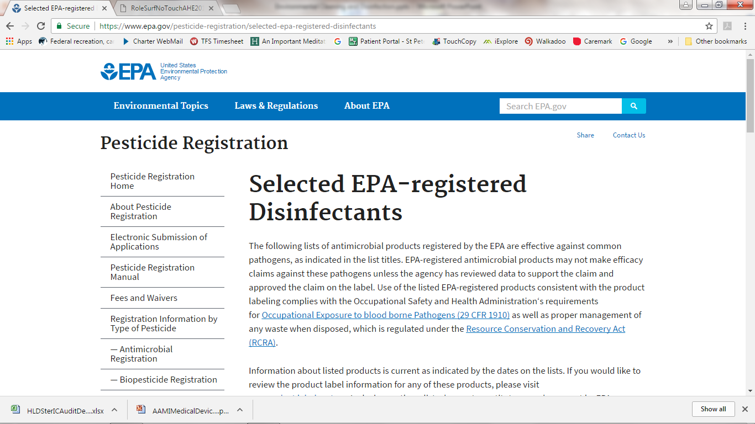

Slide 63
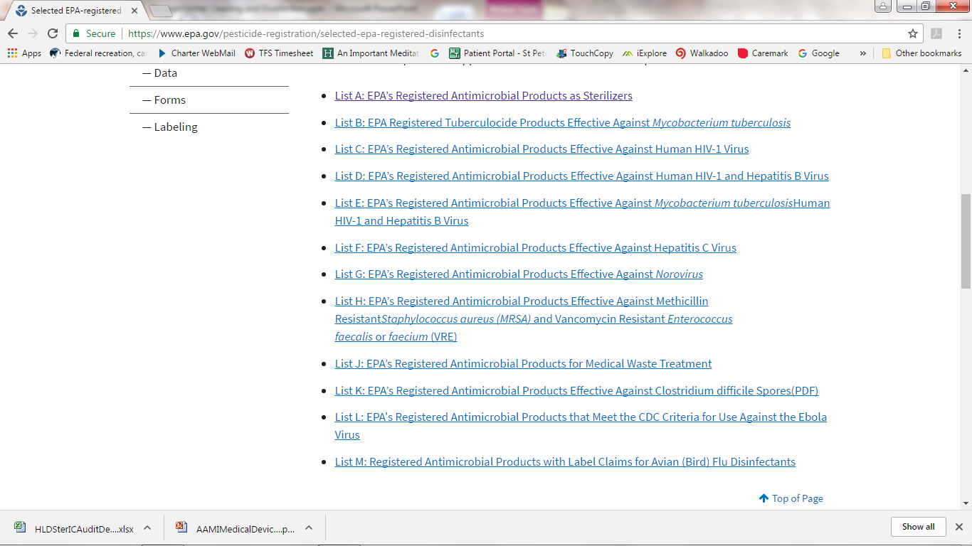

Slide 64
Ideal Disinfectant
Broad spectrum
Fast acting
Remains wet
Not affected by environmental factors
Nontoxic
Surface compatibility
Persistence
Easy to use
Acceptable odor
Economical
Solubility
Stability
Cleaner
Nonflammable
Rutala WA, Weber DJ. Infect Control Hosp Epidemiol 2014;35:855-865
Notes:
Disinfectants used in hospitals should be EPA registered
Hospital disinfectant must show activity against Salmonella, Pseudomonas and S. aureus
Labels are very specific about their kill claims (1-10 min contact time)
Does the product kill the most prevalent healthcare pathogens including those that
Cause most HAIs?
Cause most outbreaks?
Are of concern in your facility?

Slide 65
Surface Disinfectants
Oxidant Based
  Bleach
  Peracetic acid
  Hydrogen peroxide
Quaternary Ammonium Based
  High, low and no alcohol

Slide 66
Sodium Hypochlorite
Rutala, Weber. Am J Infect Control 2013;41:S36-S41
Advantages
Disadvantages
Bactericidal, tuberculocidal, fungicidal, virucidal
Sporicidal
Fast acting
Inexpensive (in dilutable form)
Not flammable
Unaffected by water hardness
Reduces biofilms on surfaces
Relatively stable (e.g., 50% reduction in chlorine concentration in 30 days)
Used as the disinfectant in water treatment
EPA registered
Reaction hazard with acids and ammonias
Leaves salt residue
Corrosive to metals (some ready-to-use products may be formulated with corrosion inhibitors)
Unstable active (some ready-to-use products may be formulated with stabilizers to achieve longer shelf life)
Affected by organic matter
Discolors/stains fabrics
Potential hazard is production of trihalomethane
Odor (some ready-to-use products may be formulated with odor inhibitors). Irritating at high concentrations.

Slide 67
Improved Hydrogen Peroxide
Rutala, Weber. Am J Infect Control 2013;41:S36-S41
Advantages
Disadvantages
Bactericidal, tuberculocidal, fungicidal, virucidal
Fast efficacy
Easy compliance with wet-contact times
Safe for workers (lowest EPA toxicity category, IV)
Benign for the environment
Surface compatible
Non-staining
EPA registered
Not flammable
More expensive than most other disinfecting actives
Not sporicidal at low concentrations

Slide 68
Quaternary ammonium compounds
Rutala, Weber. Am J Infect Control 2013;41:S36-S41
Advantages
Disadvantages
Not sporicidal
In general, not tuberculocidal and virucidal against non-enveloped viruses
High water hardness and cotton/gauze can make less microbicidal
A few reports documented asthma as result of exposure to benzalkonium chloride
Affected by organic matter
Multiple outbreaks ascribed to contaminated benzalkonium chloride
Bactericidal, fungicidal, virucidal against enveloped viruses (e.g., HIV)
Good cleaning agents
EPA registered
Surface compatible
Persistent antimicrobial activity when undisturbed
Inexpensive (in dilutable form)
Not flammable

Slide 69
Alcohol
Rutala, Weber. Am J Infect Control 2013;41:S36-S41
Advantages
Disadvantages
Bactericidal, tuberculocidal, fungicidal, virucidal
Fast acting
Non-corrosive
Non-staining
Used to disinfect small surfaces such as rubber stoppers on medication vials
No toxic residue
Not sporicidal
Affected by organic matter
Slow acting against non-enveloped viruses (e.g., norovirus)
No detergent or cleaning properties
Not EPA registered
Damage some instruments (e.g., harden rubber, deteriorate glue)
Flammable (large amounts require special storage)
Evaporates rapidly making contact time compliance difficult
Not recommended for use on large surfaces
Outbreaks ascribed to contaminated alcohol

Slide 70
Phenolics
Rutala, Weber. Am J Infect Control 2013;41:S36-S41
Advantages
Disadvantages
Bactericidal, tuberculocidal, fungicidal, virucidal
Inexpensive (in dilutable form)
Non-staining
Not flammable
EPA registered
Not sporicidal
Absorbed by porous materials and irritate tissue
Depigmentation of skin caused by certain phenolics
Hyperbilirubinemia in infants when phenolic not prepared as recommended

Slide 71
Proper Use of Disinfectants
Contact, dwell or ‘wet’ time
  3-10 minutes
  Reapplication
  Applicator
Considerations
  Cleaning ability
  Material compatibility
  Aesthetics (smell, residue)
Spectrum of activity
Safety

Slide 72
High Touch Areas/Items
Patient room
  Bedrail, side table, TV control, light switches
  Bathroom
Nursing station
  Counter tops
Electronic devices
  Keyboards
  Screens
  Cell Phones
Equipment
  IV poles, beds, gurneys, wheelchairs, bedside commodes

Slide 73
Shared Patient Care Equipment
Vital signs
Stethoscopes
Point of care testing (glucose, INR)
Therabands
Physical therapy (gait belts, lift slings)
Lift equipment
Wheelchairs
Transportation gurneys

Slide 74
Keys to Success
Standardize processes
Assign responsibilities
Training and skills validation
Monitor and provide feedback
Communicate

Slide 75
Standardize processes
  Room cleaning checklist
  Clear delineation of responsibilities
  Extensive education with competencies
  Room cleaning assessment

Slide 76
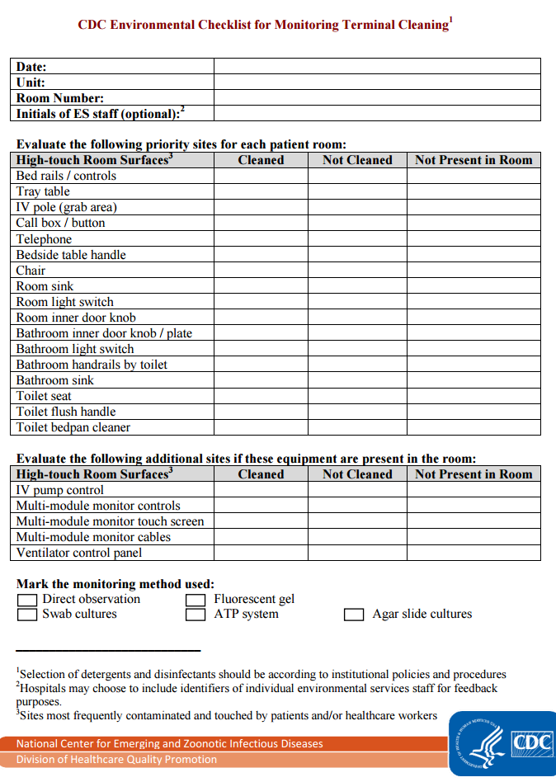
Terminal Cleaning Checklist https://www.cdc.gov/hai/pdfs/toolkits/environmental-cleaning-checklist-10-6-2010.pdf

Slide 77
Cleaning/Disinfection Responsibilities
Item | Frequency | Product | Responsible Party | Comment
Wheelchair | After every use | Sani-Wipe (purple top) | Transport Team
Gurney | After every use | Sani-Wipe (purple top) | Transport Team
IV Pump (in use) | Weekly | Sani-Wipe (purple top) | Nursing | Orange top if Cdiff patient
IV Pole | Weekly | Sani-Wipe (purple top) | Nursing | Orange top if Cdiff patient
Ventilator (in use) | Weekly | Sani-Wipe (purple top) | Respiratory Therapy | Orange top if Cdiff patient
Etcetera…..

Slide 78
Training and Skills Validation

Slide 79
Education for EVS Staff
Provide an overview of the importance of HAIs in a manner commensurate with their educational level using as many pictorial illustrations as is feasible.
Explain their role in improving patient safety through optimized hygienic practice.
Review specific terminal room cleaning practice expectations.
Discuss the manner in which their practice will be evaluated. A participatory demonstration of the monitoring method is very useful.
Source: CDC - https://www.cdc.gov/hai/toolkits/appendices-evaluating-environ-cleaning.html
Notes:
Many hospitals have provided a small (possibly ES staff-language specific) pictorial booklet to the environmental services personnel at the conclusion of the presentation which is often developed to be language skill appropriate.
EVS managers – As senior managers will be actively involved in the design and implementation of either Level I or Level II programs, educational interventions for them will need to be customized. While many of these individuals have an excellent understanding of the basic policies and procedures involved in terminal room cleaning, most will benefit from focused educational interventions related to our evolving understanding of the role of the environment in healthcare-associated pathogen (HAP) transmission. Evaluation of mid-level managers also needs to be customized. Most importantly, the impact of the program on mid-level ES managers needs to be monitored since additional formal and informal education is frequently needed for those individuals who are somewhat unsure of the importance of developing programmatic approaches to optimize terminal room cleaning.
Other groups – Given the overall importance of optimizing the thoroughness of hygienic practice in healthcare settings, hospital specific educational interventions graphically illustrating the impact of the program should be considered for both Level I and Level II programs. Such communications should be developed for a range of audiences within the hospital including the senior hospital administration, the medical staff, nursing personnel on the units, executive nursing and medical staff committees and the hospital’s board of managers or directors.

Slide 80
Education for EVS Staff (cont’d)
Provide them with information from the baseline evaluation emphasizing or possibly exclusively showing them results for those objects which have been most thoroughly cleaned.
Stress the non-punitive nature of the program.
Inform them that their good performance will be broadly recognized (i.e., beyond their department) and highlighted within their department for others to emulate.
Repeatedly reinforce the importance of their work, and how it directly relates to the hospital’s goals and mission and how it is appreciated by patients and plays a major role in a patient’s satisfaction with the hospital.

Slide 81
Monitoring

Slide 82
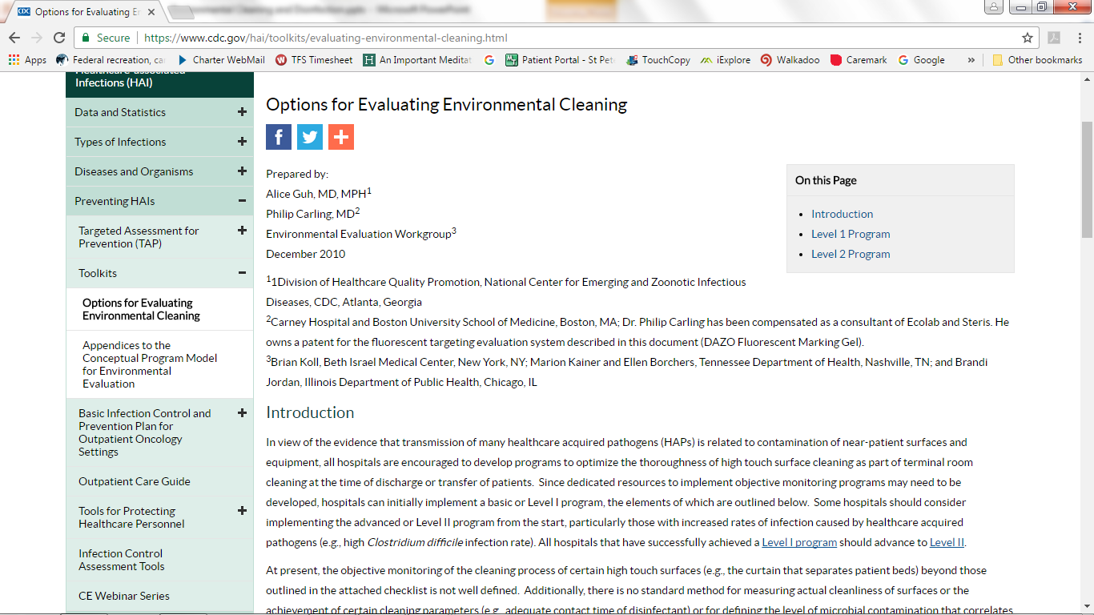

Slide 83
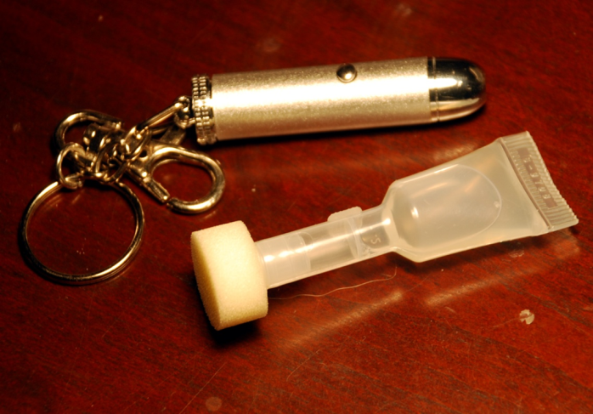
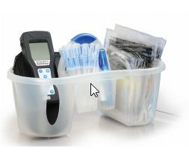
Monitoring Cleaning
Direct practice observation
Fluorescent marking
  Pre-cleaning placement
ATP
  Post-cleaning measurement
Notes:
Fluorescent Markers
Fluorescent gel, powder, and lotion have all been developed for the purpose of marking high touch objects prior to room cleaning.
While the powder and lotion have been used as part of educational interventions, their overt visibility (lotions and powder), ease with which they can be disturbed (powder), and difficulty with easy removal (lotion if allowed to air dry) may limit their use in a monitoring system and there is little or no published experience in their use for this purpose
Fluorescent gel dries transparent on surfaces, resists abrasion, and there are several studies demonstrating the accuracy of the system in objectively evaluating cleaning practice and quantifying the impact of educational interventions on such cleaning.
ATP Bioluminesence
The measurement of organic ATP on surfaces using a luciferase assay and luminometer has been used to evaluate cleanliness of food preparation surfaces for more than thirty years.
A specialized swab is used to sample a standardized surface area which is then analyzed using a portable handheld luminometer. The total amount of ATP, both microbial and non-microbial, is quantified and expressed as relative light units.
Very low readings are typically associated with low aerobic colony counts (ACCs).
Very high readings may represent either a viable bioburden, organic debris including dead bacteria or a combination of both.

Slide 84
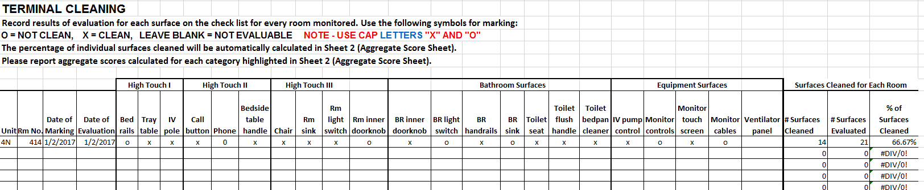
Cleaning Evaluation Monitoring Worksheet https://www.cdc.gov/hai/pdfs/toolkits/environmental-cleaning-eval-worksheet-10-6-2010.xls

Slide 85
Clean vs Dirty
Separate storage areas
Ventilation issues
Communication cues
Which one is clean?

Slide 86
Most Common Problems
Amount of time spent
Dwell/contact times
Number of wipes used
Over-dilution of disinfectant (mixing)
Confusion about responsibilities
Turnover in EVS staff
Infrequent monitoring of practices
Training and competency

Slide 87
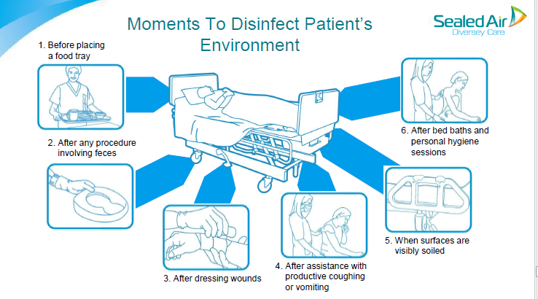
It’s not just EVS….
From “Collaborate to Eradicate” Webinar – Jim Gauthier

Slide 88
Special Situations
Operating/procedure rooms
  Between cases
  Periodic ‘deep’ clean
Discharge/terminal cleaning
Isolation rooms

Slide 89
What can you do if you are still seeing infections (e.g., C. difficile) and think you are doing a good job at cleaning?

Slide 90
No Touch Environmental Disinfection
Ultraviolet light
Fogging systems
Self disinfecting surfaces
ADJUNCTIVE ONLY!
NO ENVIRONMENTAL CULTURES FOR ROUTINE MONITORING
Notes:
No touch technologies do not eliminate the need for traditional cleaning and disinfection practices
Must be used properly according to the manufacturer’s instructions for use and after implementation of all other evidence-based practices
ADJUNCTIVE

Slide 91
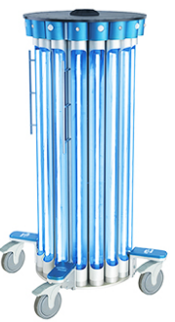
Ultraviolet Light
Continuous (UV-C)
Pulsed-xenon
Clostridium difficile

Slide 92
Fogging System
Hydrogen peroxide (H2O2)
  Aerosol
    3-7% H2O2
    +/- silver ions
  Vaporized
    “Dry” gas
    30% H2O2

Slide 93
“Self Disinfecting” Surfaces
Copper
Triclosan impregnated surfaces
Silver

Slide 94
Association for the Healthcare Environment
Practice Guidance for Environmental Cleaning
  www.ahe.org
Certificate of Mastery in Infection Prevention and Control for Environmental Services
  Certified Healthcare Environmental Services Technician
  Certified Healthcare Environmental Services Professional
  http://www.ahe.org/ahe/lead/CMIP/index.shtml

Slide 95
Resources
Association for the Healthcare Environment
  Cleaning tools
Environmental Protection Agency (EPA)
  Disinfectant information
Guideline for Disinfection and Sterilization in Healthcare Facilities - HICPAC
Environmental Cleaning Toolkit (CDC) https://www.cdc.gov/hai/prevent/prevention_tools.html
APIC
  Topic Specific – Environmental Services
    http://www.apic.org/Resources/Topic-specific-infection-prevention
  Webinars
  APIC Text
www.disinfectionandsterilization.org

Slide 96
Summary
Cleaning and disinfection of the health care environment is critical to preventing infections
Products that are used for cleaning must be used per the product’s IFU, which includes attention to contact time and compatibility with materials
Staff who are responsible for cleaning need to be trained with checklists and competencies to ensure standardization of practices

Slide 97

Questions
Bonnie Barnard, MPH, CIC
907.212.4829
bonnie.barnard@providence.org

Slide 98
Evaluation Workshop
Station 1: EVS rounding and assessments
Station 2: PPE teaching and audits
Station 3: Handwashing teaching and audits
Notes:
-Split group, have everyone go to stations. 20 min per station.
At the EVS station, we’ll look at a couple tools to do assess how well rooms are getting cleaned, and we will practice using GloGerm, blacklights, and checklists.
At the PPE station, we will demo correct PPE donning/doffing and demonstrate some ways you can teach this and audit use.
At the handwashing station, we will demo some teaching methods for this and also some ways you can audit hand hygiene.

Slide 99
Communicating between facilities
Interfacility transfers
  Precautions
  Known MDRO infection/colonization
Communicate about local issues

Slide 100
Communicating with residents + families
Resident and family participation in precautions is key
Key to balancing homelike environment/resident comfort and the safety of the group
Pro tips on how to talk to residents
  What to do with residents who don’t follow the rules

Slide 101
What’s an outbreak?
More cases than your baseline
More cases than you’d expect in the given population over the given time
Some disease-specific definitions:
  One confirmed case of influenza in an LTCF
  Anybody anywhere with smallpox
Notes:
This requires you to know how many cases you would normally have, which requires surveillance! ☺

Slide 102
Outbreak investigation
Make a line list
Confirm your cases
  Check each one with your case definition
Collect more data
  What are the symptoms?
  Who has been in contact with the patients?
  Where has the patient been (rooms, floors, special hospital areas)?
  Lab/microbiologic data
Look for patterns among cases
Take appropriate preventive action
Notifications in here; depends a little on how much you know
Notes:
If it’s pretty clear there’s something, you might give leadership a quick heads-up first and then go into the line list. If it’s a little more complicated, wait until you have a handle on exactly how many people are sick. The state will want to know how many sick people and how many total residents before we do much, so you should figure that out and then call us.

Slide 103
What’s a line list?
Patient Name | Date ill | Symptoms | Resident or staff? | Gender, age
Jim Halpert | 12/30/16 | Nausea, diarrhea | Resident | M, 83
Dwight Schrute | 12/31/16 | Vomiting | Resident | M, 85
Michael Scott | 1/2/16 | Abdominal pain, diarrhea, vomiting | Resident | M, 90
Pam Beesley | 1/4/16 | Nausea, vomiting, diarrhea | Staff | F, 82
Notes:
Just a list of your cases and when they got sick- the rest is optional, but it usually helps to have other stuff like where they are and if any lab work was done. This helps you stay organized- you know which people are sick and which are not, how many sick people there are, and you can quickly tell whether your outbreak is getting bigger or slowing down.
Also, it REALLY helps us help you if you can say that you have 50 residents and 10 are sick. We don’t need to know their names or anything, but those numbers let us understand the size of your problem.

Slide 104
Outbreak case definitions
Can be the same as normal for most conditions
In some cases, might make them looser:
  “any diarrhea or vomiting” during a noro outbreak could be a suspect case
Can use suspect/probable/confirmed lingo
  Confirmed cases have supporting lab results
  Probable cases meet the definition except no labs yet
  Suspect have some suggestive symptoms, but not all
Notes:
You can also make up special definitions, like if you got a recall notice for a product that not all residents use.
The suspect, probable, and confirmed cases can be helpful for organizing your response. People who are suspect cases might need you to check in on them to make sure they don’t develop into probable cases. I have been using probable and confirmed cases in an iGAS outbreak because it takes a long time to get the lab results back, so I can be more current this way.

Slide 105
Data collection
May not be necessary for simple outbreaks
For more complex ones, consider possible modes of transmission
  Close contact: caregivers, partners, close friends -> networks
  Fomites: shared activities
  Unsure/multiple: go broad with potential exposures
Notes:
Probably, you won’t need much more than a line list of who’s sick and when their symptoms start/resolve for something straightforward like flu.
If you have something trickier, like maybe you’ve had 4 residents with Pseudomonas skin infections in the past couple months and you think that’s weird, you’ll probably need more data to either figure out the source or rule out an outbreak. This is one of Kim and Anna’s favorite things and you should feel free to call us for help, advice, or brainstorming.

Slide 106
Stopping an outbreak
Interrupt transmission
  Must know how being spread
  Generally, promote hand hygiene and other basics
Use precautions and cohorting
  Staff and residents
  Disposable or cohorted instruments and equipment
Consider limiting group activities
Increase frequency of cleaning
Communicate with staff, residents, and visitors so they can help by adjusting their behavior
Notes:
These are some general recommendations; some pathogens have other specific stuff (like Legionella, for example)

Slide 107
Who to contact with an outbreak
Call Epidemiology- we can help!
  269-8000
Management: show them your data
Communicate with staff, residents, and visitors
  Don’t be scary
  Provide directions (wear a mask, wash hands, etc.)
Notes:
You don’t get in trouble for calling us, and we can help you make a plan for what to do. We can also potentially come to you and help, or do things from afar like work with the media, research things other people have done in your situation, and coordinate resources like CDC experts and potentially medication.

Slide 108
Influenza
Outbreaks of flu in long-term care facilities are COMMON → have a plan!
Standard and droplet precautions for ill residents
Give antivirals and chemoprophylaxis to residents
Website has resources: http://dhss.alaska.gov/dph/Epi/id/Pages/influenza/fluinfo.aspx
Notes:
Sooner or later, you WILL have a flu cluster/outbreak in your facility- we had several around the state last season.
Make a plan for what to do NOW, before it happens!
It is a real recommendation to give everyone preventative antivirals after one confirmed case, and everyone should be offered the flu vaccine.

Slide 109
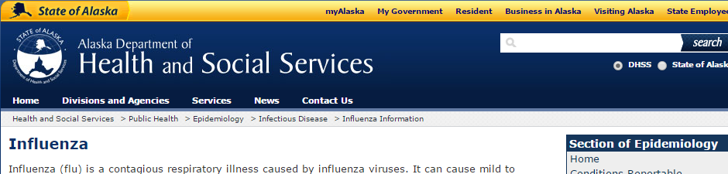
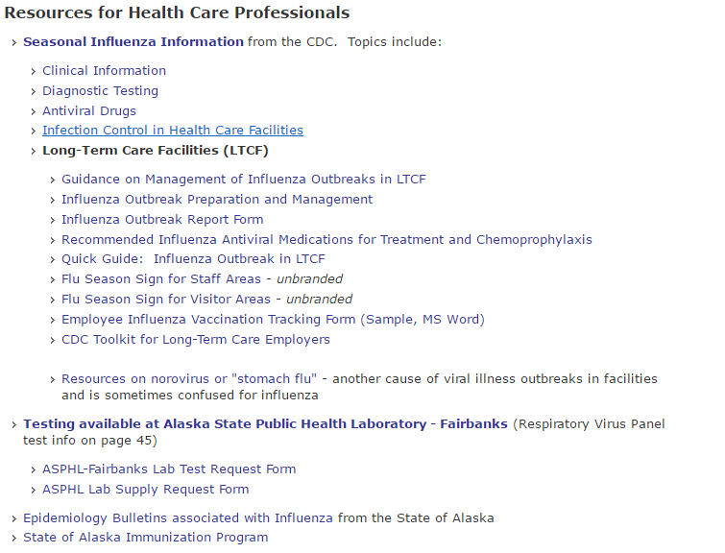
Notes:
Includes: fact sheet, planning stuff, line list template, antiviral and prophy recommendations, isolation precaution recommendations and signage, and employee vaccination materials.

Slide 110
Norovirus/ viral gastroenteritis
Contact precautions; consider cohorting and cancelling group activities
Encourage ill staff to stay home
Resources available- many more online: http://tn.gov/assets/entities/health/attachments/LTCF_guidelines.pdf
https://www.cdc.gov/hai/pdfs/norovirus/229110a-noroviruscontrolrecomm508a.pdf
Notes:
We’ve had a couple norovirus outbreaks in long-term care settings recently, and they are very unpleasant. Please let us know if this happens to you! We can help get testing done to figure out if it’s noro or something else. Also, our GI illness nurse will be pestering you for line list data (numbers of sick people) because we have to report it up to CDC.

Slide 111
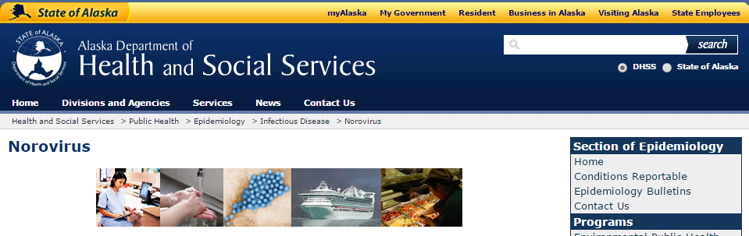
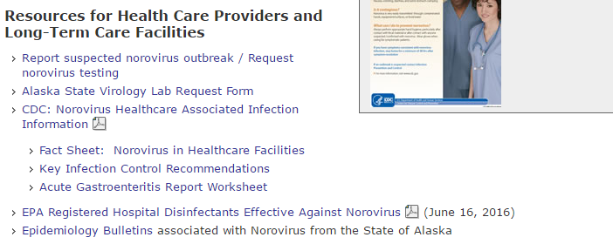

Slide 112
Outbreak Prevention and Prep
Vaccinate residents and staff!
  Influenza
  Chickenpox/ Shingles
Have records of vaccination/immunity status for everyone
Have standing orders for antivirals/antibiotics in case of an outbreak
Have a plan for when and how to cohort
Notes:
Additional info about standing orders for flu antivirals in the toolkit online!
It is REALLY helpful to have a way to quickly give every resident medication quickly. This is one thing that you will be much happier if you do ahead of time.
Having good records of vaccination/immunity status and TST results with dates is very, very helpful when assessing who is at risk after a possible exposure. This has been a big pain for people dealing with a varicella case.

Slide 113
APIC
Association for Professionals In Infection Control and Epidemiology
http://www.apic.org/About-APIC/About-APIC-Overview
What do they do?
Collect, analyze, and interpret health data in order to track infection trends, plan appropriate interventions, measure success, and report relevant data to public health agencies.
Establish scientifically based infection prevention practices and collaborate with the healthcare team to assure implementation.
Work to prevent healthcare-associated infections (HAIs) in healthcare facilities by isolating sources of infections and limiting their transmission.
Educate healthcare personnel and the public about infectious diseases and how to limit their spread.
Has groups for ACH, LTC, CAH, and ASC practitioners
State Chapter: Alaska Midnight Sun Chapter 065

Slide 114
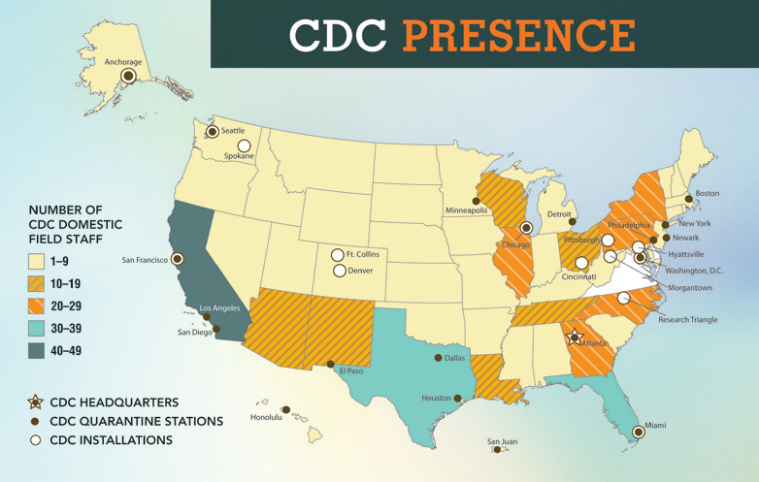
CDC
Centers for Disease Control and Prevention
Who are they?
Under HHS, founded in 1946, headquartered in Atlanta, GA.
What do they do?
CDC works 24/7 to keep America safe from health, safety, security threats, both foreign and domestic. Whether diseases start at home or abroad, chronic or acute, curable or preventable, human error or deliberate attack, CDC fights disease and supports communities
CDC presence
Notes:
Health and Human Services (HHS) has 11 operating divisions , includes CDC and CMS.
Please note there is a CDC field office located in Anchorage, AK (1-9 workers). Better known as Arctic Investigations Program or AIP.

Slide 115
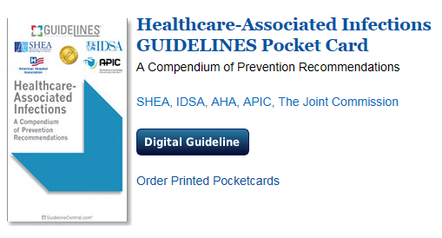
SHEA
The Society for Healthcare Epidemiology of America
http://www.shea-online.org/
Advances the science of healthcare epidemiology through research and education.
Translates knowledge into effective policy and practice.
Mentors, trains and promotes professional development in healthcare epidemiology.
Collaborates and shares expertise with other organizations.
Adheres to high ethical standards, promotes honesty and ethical principles in the practice of epidemiology.
Provide Guidelines and Expert Guidance Documents

Slide 116
Other important guideline producers
General Guidelines:
HICPAC (Healthcare Infection control Practices Advisory Committee) https://www.cdc.gov/infectioncontrol/guidelines/index.html
For construction/engineering:
ASHE (American Society for Healthcare Engineering) http://www.ashe.org/advocacy/orgs/fgi.shtml
For surgery-related stuff:
AORN (Association of periOperaative RNs) https://www.aorn.org/
AAMI (Assoc. for Advancement of Medical Instrumentation) http://www.aami.org/
Many state health departments have produced useful toolkits as well!

Slide 117
In-State Partners and resources
MPQHF Mountain-Pacific Quality Health Foundation
http://mpqhf.com/corporate/
ASHNHA: Alaska State Hospital and Nursing Home Association
http://www.ashnha.com/
AK, Health and Social Services, Section of Epidemiology
http://dhss.alaska.gov/dph/Epi/id/Pages/hai/default.aspx
AK Division of Health Care Services, Health Facilities Licensing and Certification
http://dhss.alaska.gov/dhcs/pages/hflc/default.aspx

Slide 118
Data collection
iAuditor
iScrub

Slide 119
iAuditor
Safety inspection product
Build a checklist, which you complete on a phone/tablet
  Can take and annotate pictures into the report
  Lots of smart design/complex checklist features
Analyze in program
Free and paid plans
Notes:
Free would probably be enough; more features (including exporting, multiple user management, etc) with paid

Slide 120
iScrub- for iOS
Hand Hygiene audit tool
Can edit to add your facility’s areas, employee types
Exports to Excel
Notes:
Also, if you ever have a helper, they can also use iScrub to do observations for you.

Slide 121
Options for Android
SpeedyAudit
  Really nice format for doing the audits
  Also does PPE
  Free
Paid options
Bio-Rite AR- a hand hygiene trainer

Slide 122
Free analysis programs
EpiInfo
  Doesn’t need to be installed
  Really, really easy descriptive stuff
  Can use data in a spreadsheet
  http://www.cdc.gov/epiinfo/index.html
GraphPad
  Quickly does statistics for you
  http://graphpad.com/quickcalcs/
Notes:
Probably, most of you have easy access to Excel and that works great; also remember about the awesomeness of pivot tables
GraphPad may be more than most of you will need, but if you ever wanted to do statistics it will run them for you if you give it some basic data. Sometimes it’s hard to get excel to do that stuff, and it’s quite hard to know exactly what Excel thinks it’s doing.

Slide 123
“Information” apps
Infection Control Pocketguide (iOS)
Infection Prevention (Android)
  Pathogen lookup- tells you the precautions
  Brings up a sign on how to do precautions
  PPE directions
Quick LabRef (Android)
Notes:
Just make sure it’s based on a reputable source and updated at least sometimes.

Slide 124
Other stuff
Youtube!
  Decent video on how to clean a bathroom: https://www.youtube.com/watch?v=yQrArIs74Ic
  There are others!
I like ExcelJet for Excel help (some formulas are real gamechangers)

