Slide 1


State of Alaska
Hearing Screening Guidelines for the Pre-school/School Population
Alaska Division Of public Health
School nursing/school health services program
April 2016
School Age & Adolescent Health Unit
Section of Women’s Children’s & Family Health
Notes:
In April 2016, the State of Alaska Hearing Screening Guidelines for the Pre-school/School Population were published and distributed. This PowerPoint presentation summarizes the main components of the guidelines and may be used for presentations or self-study.

Slide 2
Objectives
At the end of this presentation the participant will be able to :
  Explain the importance of hearing screening for the school-aged child.
  Discuss age appropriate screening techniques and procedures.
  Identify the steps of the screening process for pure tone audiometry.
  Discuss the pass/refer criteria and general steps in the referral and follow-up procedure.
Section of Women’s Children’s & Family Health

Slide 3
Why is it important to screen for hearing loss?
14.9% of U. S children have hearing loss in one or both ears.
Hearing loss impacts oral language development, academics, social-emotional well-being.
Early identification and treatment can prevent or reduce the consequences of many hearing problems.
Section of Women’s Children’s & Family Health
Notes:
Why is it important to screen for hearing loss?
Almost 15% of children in the U.S. have a hearing loss in one or both ears.
Hearing loss impacts language development, academics and social-emotional well-being. It is important to stress here that children with even a mild hearing deficit may be at a disadvantage educationally, emotionally, and socially.
Early identification and treatment can help ameliorate the negative outcomes of a hearing loss.

Slide 4
What is the Purpose of School Hearing Screening?
Identify students with potential hearing deficits at earliest stage possible in order to refer for diagnosis and treatment, if required.
To inform teachers of students with hearing problems and provide recommendations from hearing specialists regarding appropriate classroom environment and educational accommodations.
Section of Women’s Children’s & Family Health
Notes:
The purpose of a school hearing screening program is:
To screen a large number of children in a short amount of time in order to identify those children likely to have hearing problems from those not likely to have hearing problems.
To refer those children who do not pass the screening or who are suspect for hearing problems.
Though hearing loss may be a medical issue, the focus in the school setting is on how it impacts the child’s learning, so educational accommodations are an important part of the process.

Slide 5
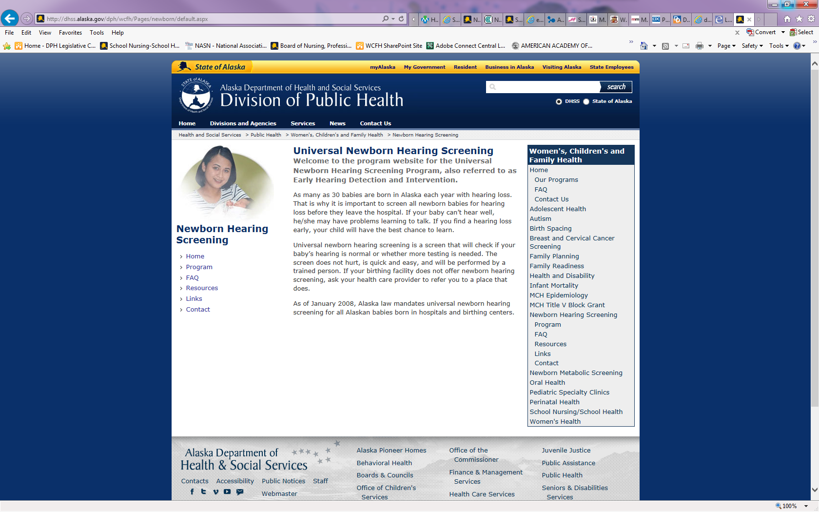
Early Hearing Detection and Intervention Program
http://dhss.alaska.gov/dph/wcfh/Pages/newborn/default.aspx
Section of Women’s Children’s & Family Health
Notes:
As of January 2008, Alaska law mandates universal newborn hearing screening for all Alaskan babies born in hospitals and birthing centers.
About 20-30 babies are identified annually as having a permanent hearing loss. The website for the newborn hearing screening program is available at the link above for further information.
So why then do we need to continue to screen in schools?
Some of these babies are lost to follow up.
Some congenital, genetic hearing loss does not become evident until later in childhood.
Some permanent hearing loss can be acquired (i.e., from infectious diseases, loud noises, etc.).
Some hearing loss is transient (i.e., ear infections).
In Alaska (and nationally), approximately 1 to 3 in 1,000 babies are born with hearing loss. By age 18, the incidence of permanent hearing loss is thought to increase to as high as 19 in 1,000 here in Alaska.

Slide 6
What does the state law say?
Hearing screening in schools is mandated by Alaska Statute Sec. 14.30.127.
A vision and hearing screening examination shall be given to each child attending school in the state. The examination shall be made when the child enters school or as soon thereafter as is practicable, and at regular intervals specified by regulation by the governing body of the district.
http://www.legis.state.ak.us/basis/folio.asp.
Section of Women’s Children’s & Family Health
Notes:
Another reason to perform hearing screening in schools is that it is mandated by Alaska law.
The law requires schools to screen children for hearing when they enter school and then at regular intervals determined by the school district.

Slide 7
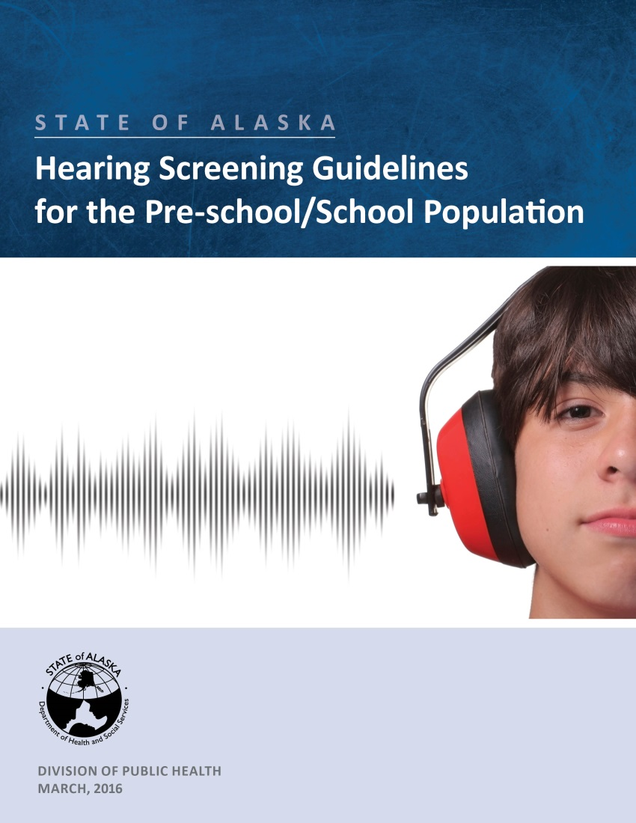
State of Alaska Hearing Screening Guidelines for the Pre-school/School Population
Section of Women’s Children’s & Family Health
Notes:
The law also states that the Department of Health & Social Services shall set standards for the performance of vision and hearing screening and provide training for screeners.
Finalized April 2016, the guidelines offer necessary information to assist schools in completing the hearing screening requirements of the law based on current evidence-based references and expert organizations.
Though school hearing screening is mandatory by state law, these guidelines are offered as best practice and each school district may adopt the standards, policies, and procedures that best meet the needs of their student population.

Slide 8





Who determines best practice for hearing screening?
Section of Women’s Children’s & Family Health
Notes:
These are the main resources used to develop the guidelines. The review of the literature is summarized in the Best Practice section beginning on page 4.
The American Academy of Audiology (AAA) had the most current national resource available as their Childhood Hearing Screening document was published in Sept 2011. This reference was used extensively in developing the Alaska guidelines.

Slide 9
Background Information
Review of knowledge
Section of Women’s Children’s & Family Health
Notes:
The next section of the PPT provides background knowledge that may be a helpful review.

Slide 10
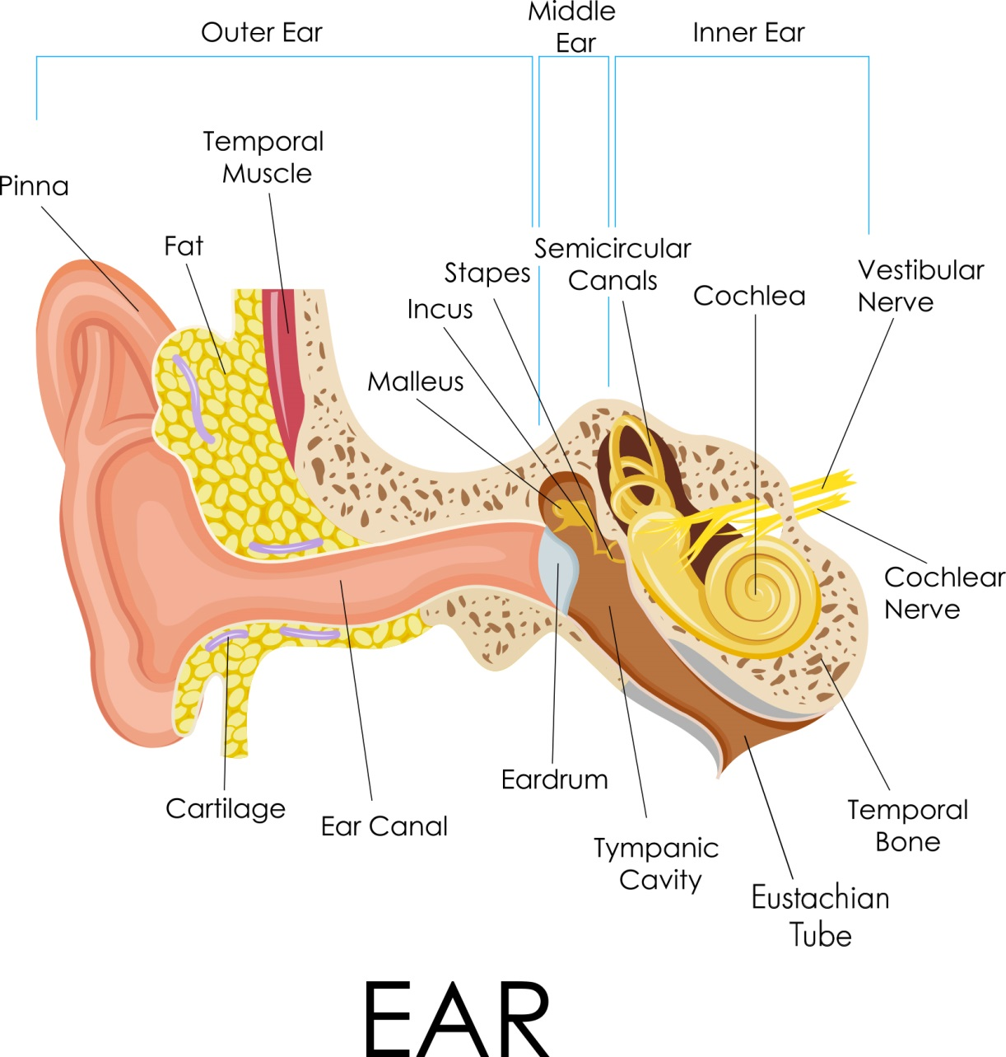
Ear Anatomy
Section of Women’s Children’s & Family Health
Notes:
This is a very brief review of ear anatomy and how we hear.
Ear is divided into three main areas: Outer, middle, and inner ear
Sound is captured by the pinna and travels through the ear canal, which make up the outer ear.
It then is transmitted through the middle ear as the eardrum vibrates and causes a lever action in the three middle ear bones: the malleus, incus and stapes, which are the smallest bones in the human body.
At that point, the energy reaches the cochlea in the inner ear where tiny nerve endings, known as hair cells, are stimulated. From there, the signal travels up the auditory nerve to the brain for interpretation.

Slide 11
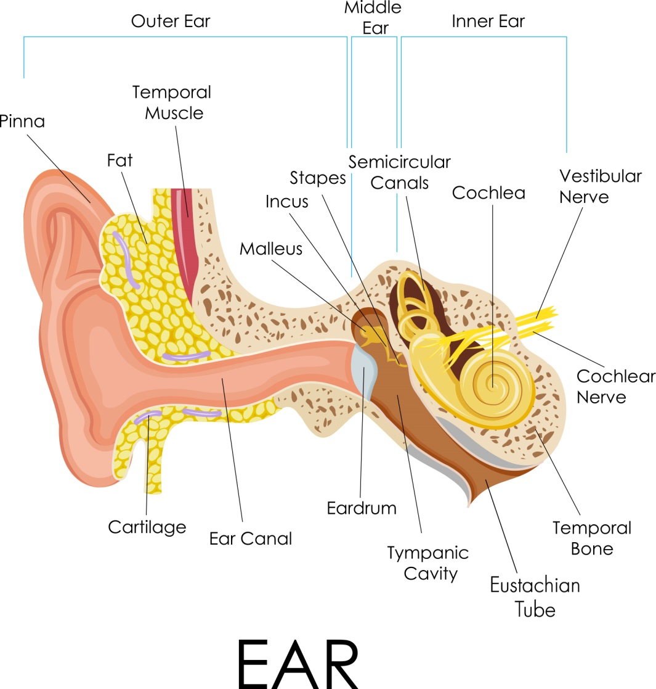
What are the types and causes of hearing loss?
Conductive
Sensorineural
Mixed
Central
Section of Women’s Children’s & Family Health
Notes:
These are the primary classifications used for describing hearing loss.
The type of hearing loss is described by the portion or portions of the ear involved.

Slide 12
What are the types and causes of hearing loss?
Conductive – sound not transmitted efficiently due to external or middle ear cause
perforation
middle ear fluid
cerumen
allergies
malformation
Eustachian tube dysfunction
tumors
foreign body
infections
Section of Women’s Children’s & Family Health
Notes:
A conductive hearing loss occurs when there is some problem in the outer or middle ear that prevents sound from traveling efficiently through these mechanisms. In other words, the sound is not CONDUCTED well through the outer or middle ear.
Many factors may contribute to a conductive hearing loss, some of which are shown here. The most common problem in children is Eustachian tube dysfunction which can result in middle ear fluid or infection.
Conductive losses are often temporary and remediated with medical management, although some conditions may be permanent.

Slide 13
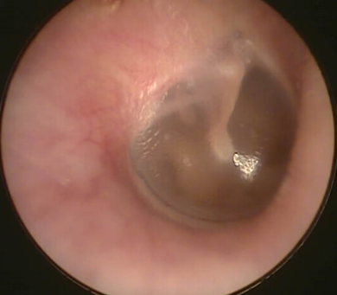
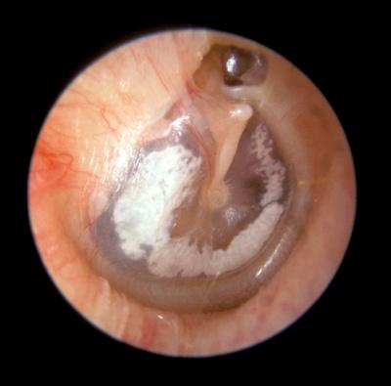
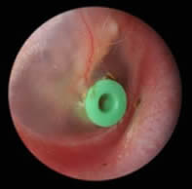
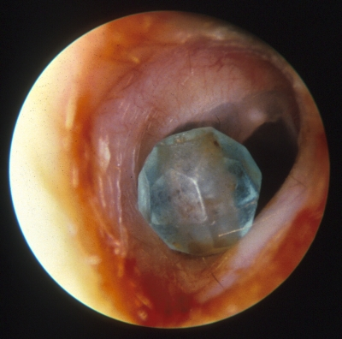
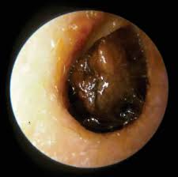

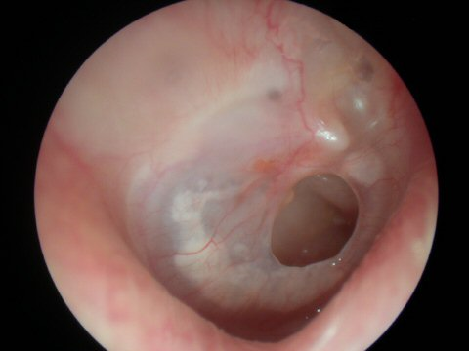
Normal vs. Abnormal
Normal
Scar tissue
PE Tube
Foreign body
Impacted cerumen
Perforation
Infection/bulging
Section of Women’s Children’s & Family Health
Notes:
This slide shows an image of a normal, healthy eardrum, as well as some conditions that may result in a conductive hearing loss such as:
Presence of foreign body
Impacted ear wax
Perforated eardrum
Bulging eardrum from middle ear infection
Also depicted here is an image showing Pressure Equalization (PE) tube placement in the eardrum, and an eardrum that has significant areas of scar tissue.
Scar tissue on the eardrum may occur as a result of previous eardrum perforation or PE tube placement.
These conditions would only be visible with otoscopic examination which is a second-tier screening tool that may be used in the hearing screening process for those who are trained in performing otoscopy.

Slide 14
What are the types and causes of hearing loss?
Sensorineural - results from pathology associated with the inner ear
  Congenital – genetic, prenatal, perinatal, postnatal infections
  Acquired – illness (e.g. meningitis), ototoxicity, loud noise, head trauma, aging
Section of Women’s Children’s & Family Health
Notes:
A sensorineural hearing loss results from pathology associated with the inner ear.
Causes may be congenital or acquired, but a sensorineural loss is generally permanent in nature.
Management MAY include hearing aid use or cochlear implantation, depending on the degree of loss.

Slide 15
What are the types and causes of hearing loss?
Mixed – elements of both sensorineural and conductive
  Sensorineural component is typically permanent
  Conductive component may or may not be medically managed
Central – result of damage/dysfunction in central auditory system
  Space occupying lesions
  Perceptual processing difficulties
Section of Women’s Children’s & Family Health
Notes:
A mixed hearing loss has both conductive and sensorineural components.
A central loss refers to hearing loss caused by pathology or dysfunction of the auditory nerve or at the level of the brain.
**It is important to remember that hearing screening cannot diagnose hearing loss, nor can it differentiate between the different types of hearing loss. Only an audiologist or healthcare provider can officially diagnose a hearing loss.

Slide 16
How is sound measured?
Frequency (pitch) = Hertz (Hz)
  Human range is 20 to 20,000 Hz
  Most important sounds are 500-4000 Hz
Intensity (loudness) = decibels (dB)
  Normal range in children -10 to 15 dB
  Normal conversation is 45-60 dB
Section of Women’s Children’s & Family Health
Notes:
How is sound measured?
Sound is described in terms of frequency and intensity.
FREQUENCY, or pitch, is measured in Hertz.
The human ear can hear frequencies as low as 20 Hz, to as high as 20,000 Hz
BUT
The most important sounds for understanding speech occur in the range of 500 to 4000 Hz.
INTENSITY refers to loudness and is measured in decibels.
For children, 15 dB and softer is the range of normal hearing.
Normal conversational loudness falls in the range of approximately 45-60 decibels while loud machines, alarms, and firearms may be as loud as 120 to 140 dB.

Slide 17
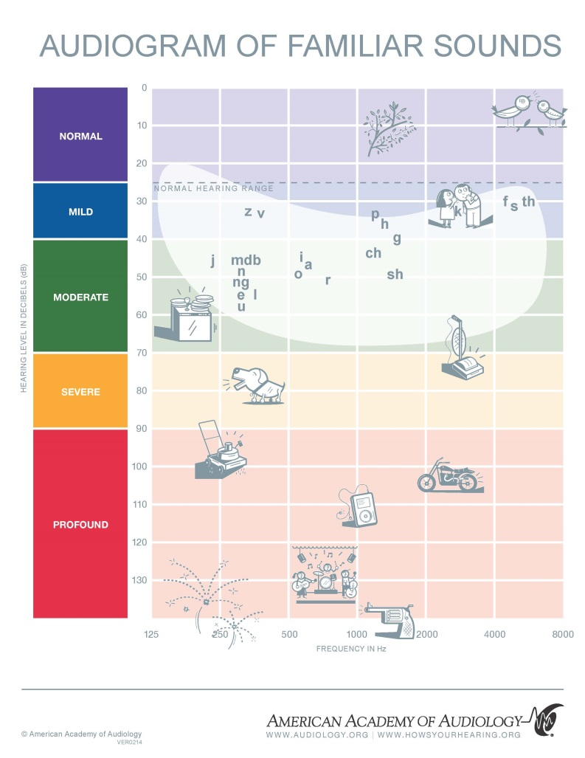
How is hearing loss defined?
Classified by the American Speech-Language-Hearing Association as follows:
  -0 to 15 dB - normal
  16 to 25 dB - slight
  26 to 40 dB - mild
  41 to 55 dB - moderate
  56 to 70 dB - moderately severe
  71 to 90 dB - severe
  91 + dB - profound
Section of Women’s Children’s & Family Health
Notes:
The image on this slide can be found in Appendix B, on page 50 in the screening guidelines.
This audiogram of familiar sounds is often used by audiologists as a counseling tool to demonstrate degree and possible effect of an individual’s hearing loss.
Severity of hearing loss ranges from slight to profound as indicated here.
For school-aged children, hearing loss is defined as hearing loss in one or both ears greater than 20 dB in the frequency region most important for speech recognition.
Because hearing is tested in 5 decibel increments, 15 dB is considered normal, while 20 dB is considered hearing loss.
On the image, the slight hearing loss range is not depicted but it is important to remember that even slight hearing loss may have a negative impact on a child’s development.

Slide 18

State of Alaska Hearing Screening Guidelines for the
Pre-school/School Population
Review of recommendations
Section of Women’s Children’s & Family Health
Notes:
The section on the recommendations in the guidelines is found starting on page 12. The recommendations are summarized in a table and flow charts for the screening process are provided.

Slide 19
State of Alaska Hearing Screening Recommendations
Who to screen:
  Grades:
    preschool
    kindergarten
    1st, 3rd, 5th, 7th, and 10th
    Screen 2nd grade if time and staffing allow.
  Regardless of grade, screen students upon:
    initial entry in the school district
    entrance into special education and with follow up evaluations
    grade repetition
    request of teacher, parent, or healthcare provider
    evidence of known risk factors
Section of Women’s Children’s & Family Health
Notes:
For who to screen, evidence from Bright Futures, AAA and ASHA were combined to come up with the grades recommended.
Screening younger children is imperative as the earlier the identification and treatment, the better the outcomes.
There is also strong evidence that exposure to recreational noise has resulted in increases in noise-induced, high frequency hearing loss in adolescents. Both AAA and ASHA recommend screening a middle and high school grade to identify these students.
Given the use of snowmachines, ATVs, firearms, and flying in small planes here in Alaska plus the use of earbuds to listen to loud music, it was important to recommend screening in the secondary grades.
Regardless of grade, screen students new-to-the-district, in special education, upon request and those with known hearing risk factors.

Slide 20
State of Alaska Hearing Screening Recommendations
Risk Factors:
    Concern regarding hearing, speech, language, developmental delay, academic difficulties
    Family history of permanent childhood hearing loss
    Perinatal history of premature birth, neonatal ICU, in utero infections (e.g. rubella)
    Postnatal infections (e.g. meningitis, measles)
    Craniofacial anomalies (e.g. cleft palate)
    Diseases and syndromes (e.g. Usher, Waardenburg)
    Head trauma
    Chemotherapy
    Exposure to harmful levels of noise
Section of Women’s Children’s & Family Health
Notes:
A child known to have any of these risk factors should be screened more frequently or at other times than the grades recommended. There is a more complete and detailed list of risk factors found in Appendix C of the guidelines.
Certainly any child with any hearing, speech, language concerns should be considered at risk. Available in the appendices (D) is a classroom observation checklist that can be used by school staff to identify hearing problems at the beginning of and throughout the school year. Teachers can use the checklist as a reminder to be aware of any abnormal hearing behaviors in their students or complaints voiced and report this to the school nurse for further assessment.

Slide 21
State of Alaska Hearing Screening Recommendations
Who not to screen:
Students who
  wear hearing aids or other hearing devices, including cochlear implants
  have previously known hearing loss and who are routinely evaluated by audiologist
  have tenderness, drainage, or foul odor noted with visual inspection of the ear(s) prior to screening
  have obvious communicable conditions that may compromise infection control
Section of Women’s Children’s & Family Health
Notes:
Who not to screen?
Students who wear hearing aids or other hearing devices or those with previously known hearing loss – determine and ensure that these student’s routine hearing health care is current and ongoing with their hearing specialist.
Have any obvious medical reason (i.e., drainage or foul odor) or communicable condition that could compromise infection control – screen at a later date

Slide 22
State of Alaska Hearing Screening Recommendations
When to screen:
Beginning of school year (but not first week)
Prioritize
  younger population
  students new to school district
  those with known risk factors
Section of Women’s Children’s & Family Health
Notes:
Screening is best at the beginning of the school year with prioritization of younger students, those new to the district, those with known risk factors.
It may be tempting to wait to test the younger students because they take a bit more time and might be more mature and able to perform the screening later in the school year, but it’s important to catch hearing loss at the earliest possible opportunity which is why they should be prioritized.

Slide 23
State of Alaska Hearing Screening Recommendations
Recommended Screening Test:
Pure Tone Audiometry
Screening frequencies:
1000, 2000, 4000 Hz
Screening level:
20 dB
Refer = no response at one or more frequencies at the 20 dB level in either ear
Pass = response to all frequencies at 20 dB in each ear
Section of Women’s Children’s & Family Health
Notes:
The recommended screening test is pure tone audiometry. It is still the gold standard and most widely used hearing screening procedure.
This entails using a portable audiometer in a quiet environment to present pure tone signals at different frequencies to determine hearing sensitivity.
Different techniques may be used depending on the age of the child and his/her ability to follow directions or cooperate with the exam.
Screening protocols and pass/refer criteria will be addressed in depth shortly but first it may be helpful to understand the reasons the frequencies and screening level were chosen.
We are recommending screening at 1000, 2000, 4000 Hz. Some of you may have or are used to also screening 500 Hz.
Screening at 500 Hz used to be recommended as a means of picking up those students with otitis media with effusion (OME).
Screening at 500 Hz has fallen into disfavor due to questionable validity as a means to identify OME and the 500 Hz frequency is more easily masked by room noise so there are more false positives and unnecessary referrals.
For screening level, we are recommending using 20 dB.
Research has shown that screening at the 20 dB level, and not increasing to 25 dB or beyond, is critical for correctly identifying those children with minimal hearing loss.
These are the children who make up a large portion of those who passed hearing screenings as newborns but who were later identified in the preschool or school-aged period.
Increasing the screening level to 25 dB potentially misses 62% of these students.

Slide 24
Pure Tone Audiometry Equipment
Portable pure tone audiometer
  Air conduction with headphones or inserts
  Capable of screening frequencies 1000-4000 Hz
  Calibrated annually with calibration sticker present
  Listening and visual inspections prior to each use
  Handle the audiometer with care, especially cords
  Store in climate-controlled area
Section of Women’s Children’s & Family Health
Notes:
To perform pure tone screening you will need:
A calibrated audiometer with headphones or earphones--- Capable of screening frequencies 1000 to 4000 Hz
The audiometer must be inspected and checked prior to use. More specific information on how to check the equipment will be discussed shortly.
The audiometer and cords should be handled with care and it is important to make sure the audiometer is stored and transported at temperatures below 90 degrees and above freezing, which is particularly important here in Alaska.
What follows are some examples of audiometers that are available and appropriate for performing school hearing screenings…

Slide 25
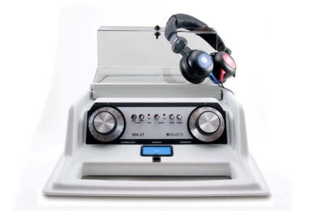
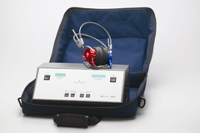
Pure Tone Audiometry Equipment
Maico 27
Maico 39
Section of Women’s Children’s & Family Health
Notes:
The Maico 27 and 39 are commonly used portable audiometers. They have all of the necessary features and are electric powered, so they do require a wall outlet for plug-in.

Slide 26
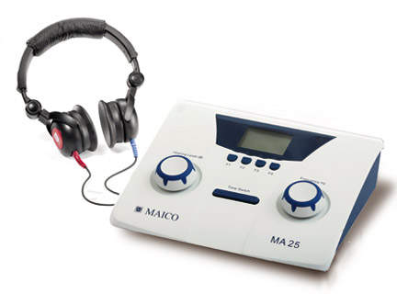
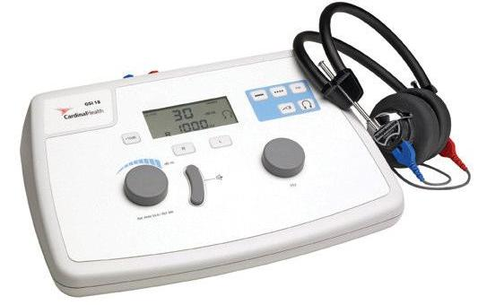
Pure Tone Audiometry Equipment
Maico 25
GSI 18
Section of Women’s Children’s & Family Health
Notes:
The Maico 25 and GSI 18 are also appropriate audiometers and are kind of handy because they can either be plugged in or battery powered.

Slide 27
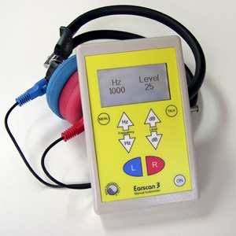
Pure Tone Audiometry Equipment
Earscan 3M
Section of Women’s Children’s & Family Health
Notes:
The EarScan is a small, hand-held audiometer which can be plugged in or battery powered.
There are some hand-held screeners which are actually held up to the ear for screening. These generally are not recommended as the student may pick up on physical clues inadvertently provided while the examiner holds the equipment in the ear. Placement of the earphone may also be questionable for these types of screeners.

Slide 28
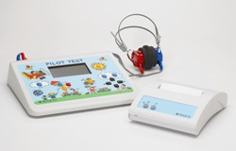
Pure Tone Audiometry Equipment
Maico Pilot Audiometer (this is more than you need)
Section of Women’s Children’s & Family Health
Notes:
The Maico Pilot audiometer is a great little screening audiometer except that it is actually more than you will need and contains some additional features that really aren’t appropriate for the purpose of school hearing screening.
The pure tone function of this audiometer is totally fine and appropriate for school hearing screening, however, the spondee word speech test should not be used. It is tempting to use this function because it is much easier for children to repeat words or point to pictures, however, a child with slight, mild, or even moderate hearing loss for portions of the speech frequencies can actually pass the spondee word test, rendering it inaccurate for the purpose of school hearing screening.

Slide 29
Audiometer Check
Examine headphones and cords for cracks, splits, correct connection to audiometer (i.e., red/right, blue/left)
Look for calibration sticker- date must be current
Perform listening check
  Check screening levels in both right and left ear twice
  Hold presentation button while changing decibel level from 0-50 dB at 1000 Hz- listen for “dead spots,” abrupt volume changes and audible clicks
  Press tone button and listen for static when cords moved
Section of Women’s Children’s & Family Health
Notes:
It is critical to ensure that the audiometer is functioning properly prior to screening.
It should be checked daily at minimum when screening, and again any time the audiometer is moved to a different location or if there is a concern that it might not be working well.
The audiometer check involves visual inspection of the unit, making sure all cords are connected properly with no cracks, kinks, or exposed wires.
The calibration sticker should be present and current.
A listening check should be performed by a person with known normal hearing.
All tones should be heard at the 20 dB screening level.
After that, the volume should be raised slowly to about 50 dB to listen for audible clicks, static, dead spots, or other abnormalities.
Move the cords while holding the tone button down to listen for static.
Cords are often the first part to go on an audiometer.
Repair of the audiometer may be needed when any type of abnormality is observed.

Slide 30
Environment Check
Quiet environment is critical
Perform environment listening check before each day of screening and whenever the audiometer is moved
Perform listening check on a person with known, normal hearing
If necessary, move to an area with less noise and repeat
Do not increase decibel level to overcome noise
Postpone screenings if necessary- find an appropriate space.
Section of Women’s Children’s & Family Health
Notes:
Locating an appropriate, quiet environment is also critical for hearing screening.
Perform the audiometer listening check in the environment that is selected for screening to insure that background noise levels do not interfere with the screening process.
Again, if the listening check is performed by a person with known normal hearing, all screening tones should be heard.
If all tones are not heard, it may be necessary to move to another location and then the listening check should be repeated.
If a quiet space is not available, postpone screenings until an appropriate environment is found.
It is never okay to raise the screening level to account for background noise!

Slide 31
Protocols
Pure Tone Audiometry
Preparation:
Set up chair for student in position facing away from audiometer.
Wash hands, clean headphones.
Confirm student identity.
Remove large earrings, glasses, and tuck hair behind ears
Perform Visual Inspection.
Section of Women’s Children’s & Family Health
Notes:
Now that the equipment and environment are ready, the screening process may begin.
The student should be seated, facing away from the audiometer so visual cues aren’t seen during the screening.
Infection control measures should be in place and the child’s identity confirmed for accurate record keeping.
It is helpful to remove larger earrings, glasses, and headbands that may interfere with headphone placement.
A visual inspection of the ear includes observation of the outer ear prior to placing the headphones.

Slide 32
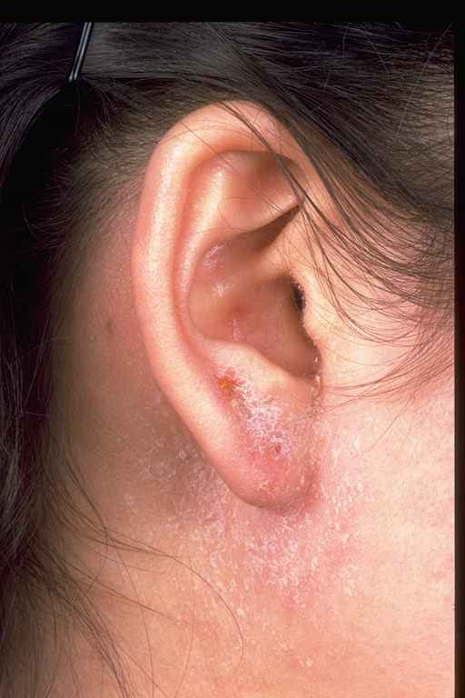
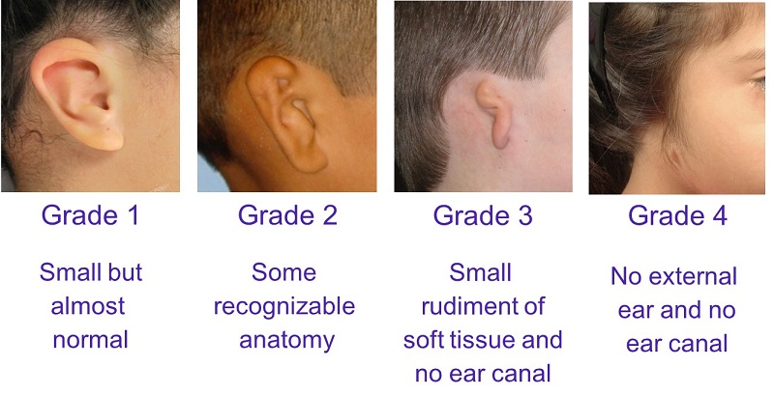
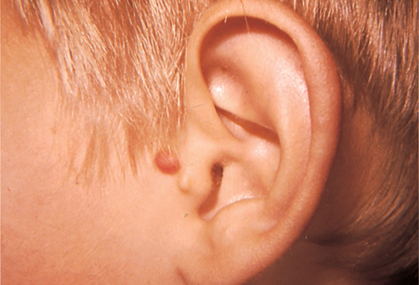
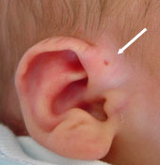
Protocols
Visual Inspection (External)
Microtia and Atresia
Dermatitis
Skin tag
Preauricular sinus or pit
Section of Women’s Children’s & Family Health
Notes:
If no abnormalities are noted, headphones may be placed and the screening can begin.
Here are pictures of some abnormal conditions that may be noted.
Dermatitis, as shown here, may indicate the need for medical referral and postponement of the hearing screening, especially if the area is tender or painful.
Other reasons to postpone the screening and refer for medical care include: Redness, swelling or drainage from the ear.
Some physical abnormalities are red flags for potential hearing loss and when found should heighten awareness for a possible referral:
Microtia is the underdevelopment or complete absence of the outer portion of the ear.
Atresia is the closure or absence of the ear canal.
Skin tags may be present.
Pre-auricular pits can be the size of a tiny pinhole.
Hopefully, these physical abnormalities have been previously noted by medical providers with referral for comprehensive audiological evaluation but sometimes they are overlooked and not really addressed until a child’s first school screening so it is important to take note and make appropriate referrals.

Slide 33
Protocols
Pure Tone Audiometry
Preparation:
Explain procedure
Consider conditioning without headphones on
Stand in front of student to place headphones – red/right, blue/left
Place diaphragm of headphones over ear canals
Adjust headband for snug fit
Consider pulsed or warble tones
“I am going to put headphones on your ears (show them the headphones). You are going to hear some beeps in your right ear and then in your left ear, raise either hand every time you hear a beep, even if it is very soft. Put your hand down when the beep goes away.”
Section of Women’s Children’s & Family Health
Notes:
If visual inspection is clear, the hearing screening may proceed.
Explain or demonstrate the procedure to the child. Sample language is shown here.
It may help to practice the listening task before putting the headphones on.
This can be done by placing the headphones near the child, turning the volume up the maximum level, and presenting the tone so the child can raise his/her hand when the tone is heard.
Other response options may be agreed upon such as: thumbs up, saying “beep,” clapping hands, etc.
It can be helpful to use either a pulsed or warble tone if either option is available on the audiometer. Research suggests that children tune into these types of tones better and using one of these options may increase a child’s ability to respond reliably. If your audiometer is equipped with both options, choose only one or the other, not both.
If you condition at a louder volume with headphones off, MAKE SURE TO TURN THE VOLUME BACK DOWN BEFORE PLACING HEADPHONES ON THE CHILD!

Slide 34
Protocols
Pure Tone Audiometry
Conditioning steps:
Set selector switch to “right” ear and present 40 dB at 1000 Hz for 2-3 seconds and then release.
If there is no response, re-instruct and try again.
If there is a response, reduce the dB level to 20 and proceed with the screening steps.
Section of Women’s Children’s & Family Health
Notes:
Once the headphones are placed, double check that the child is conditioned to the task.
Starting at 1000 Hz, present the tone to the right ear at 40 dB.
If the child responds, drop to the 20 dB screening level and move through the screening frequencies.
If the child does not respond, re-instruct, try a different frequency or switch to the left ear.
A conditioned play audiometry game may be needed for younger children or those with younger developmental levels where the child may drop a block in a bucket, stack rings, or put pegs in a peg board as a response to each tone.

Slide 35
Protocols
Pure Tone Audiometry
Screening steps:
Right Ear 1000 Hz 20 dB
2000 Hz 20 dB
4000 Hz 20 dB
Left Ear 4000 Hz 20 dB
2000 Hz 20 dB
1000 Hz 20 dB
Section of Women’s Children’s & Family Health
Notes:
Screen 1000, 2000, and 4000 in the right ear then switch to the left ear and screen 4000, 2000, and 1000. The reverse order saves time.
Tones should be presented for 2-3 seconds without using a predictable pattern.
Tones can be repeated once at each test frequency.

Slide 36
Protocols
Pure Tone Audiometry
Pass: The student must respond to all tones at all frequencies in each ear.
Rescreen:
Immediately rescreen any student who does not pass.
Perform otoscopy * if child continues to miss any frequency either ear.
Rescreen again (3rd screening) in 2-4 weeks if otoscopic exam is normal or not performed. **
*If trained and experienced.
**Abnormal otoscopic exam is an immediate referral.
Section of Women’s Children’s & Family Health
Notes:
A student passes the screening by responding to the 20 dB tones at each frequency in each ear.
If a student does not pass the first time, remove headphones, re-instruct and immediately rescreen.
**Immediate rescreen may be a change for some of you but it has been found to be effective in cutting down on false positive referrals based on the research reviewed.
Otoscopy may be performed by those who are trained to do so, if screening is not passed.
If abnormality is noted on otoscopy, medical referral should be made.
If no concern is noted on otoscopy, or if otoscopy is not available, another screening should be performed in 2-4 weeks which may allow time for middle ear issues to resolve.

Slide 37
Protocols
Pure Tone Audiometry
Refer:
To healthcare provider: any student with abnormal visual inspection/otoscopic exam
To audiologist and/or healthcare provider:
  Any student who fails the second rescreen (i.e., 3rd screening)
  Any student who is unable to perform audiometry
  Any student with known risk factors for hearing loss or who, in the judgement of the screener, may require further evaluation (regardless of screening outcomes)
Section of Women’s Children’s & Family Health
Notes:
Referral should be made to a healthcare provider for any visual abnormality noted.
A child who does not pass the screening after the 2-4 week rescreen should be referred for further testing.
A child who cannot perform the screening should be referred to an audiologist for testing because of the training, expertise, and additional testing options they have.
It is better to refer than to assume a child has normal hearing!

Slide 38
Protocols
Conditioned Play Audiometry
Use for younger students who are difficult-to-test, those who are developmentally delayed or who are non-English speaking.
Use a play task such as:
  Drop block in box
  Place peg in pegboard
  Place ring on tower
Section of Women’s Children’s & Family Health
Notes:
Returning to the topic of conditioned play audiometry, it may be helpful to use this method for many younger or difficult-to-test students.
Playing a listening game may help improve attention and reliability of a child’s responses.

Slide 39
Protocols
Conditioned Play Audiometry
Condition first with headphones off.
Explain the “listening game.”
Teach task at elevated intensity (i.e., 2000 at 70 dB)
Be sure child can perform task on own before attempting screening with headphones on at 20 dB.
“We’re going to play a listening game. When you hear a beep (any way you want to describe the test stimulus such as “whistle”, “bird”, “silly sound”, etc.), drop the block into the box (peg in pegboard, ring on tower, etc.).”
Section of Women’s Children’s & Family Health
Notes:
Condition to play audiometry without headphones first, as previously mentioned.
This task can easily be demonstrated without using any language at all. Show the child how to do it and see if he or she can understand just by watching and listening.

Slide 40
State of Alaska Hearing Screening Recommendations
Additional Screening Considerations*:
Otoscopy – for those failing hearing screening
Otoacoustic Emissions (OAE) – for preschool and developmentally delayed
Tympanometry – as immediate next step and 2nd stage screening method for those failing PTA or OAE
Threshold – as instructed by district audiologist and only as additional information for referral
*If screener is trained and experienced
Section of Women’s Children’s & Family Health
Notes:
There are numerous optional, additional screening protocols that may be considered.
Each of these requires additional equipment and training; they are recommended in the guidelines as optional tests for targeted reasons. School districts may decide to use these screening tests according to the need of their student population.
These options are discussed in more detail in the screening guidelines.

Slide 41
Role of the School Nurse/Program Manager
Program Planning
 | District Level | School Level
Accountability | Developing policies, training, supervising | Coordinating, implementing, tracking referrals
Risk Management | Equipment calibration, supplies | Infection control, parental notification, errors in referrals/follow up
Program Evaluation | District aggregate data | School level data
Section of Women’s Children’s & Family Health
Notes:
Planning should occur with school administration and include collaboration with key school and district personnel as well as community providers.
Program management responsibilities for hearing screening may fall to various personnel in a district such as staff audiologists, school nurses, special services, PHNs, depending on the district’s resources.
Program planning should target:
Accountability – who is responsible for policy development, training, tracking referrals, etc. all needs to be clearly delineated
Risk Management – refers to managing the potential for negative outcomes, such as equipment malfunction, infection control concern, dissatisfied or confused parents due to lack of notification
Program Evaluation – refers to the responsibility to monitor the effectiveness of the program. Data should be collected and reviewed to:
Identify gaps in the program’s reliability and validity
Assure quality results and appropriate referrals
Provide pertinent information to improve the hearing screening program

Slide 42
Role of the School Nurse/Program Manager
Planning Timeline
  Screen younger students, new-to-district, known risk factors first.
  Take into account
    Number of students and grades to screen
    Grade-level, school-wide assessment periods
    School activities, events, vacation days
    Availability of support personnel and volunteers
    Weather related factors
    Times of higher absenteeism (i.e., flu or allergy seasons)
    Adequate time for follow up screening and evaluations
Section of Women’s Children’s & Family Health
Notes:
It is important to work with administration and other screening personnel to identify the schedule for screening.
Remember to schedule screenings of younger students, new-to-district, and those with known risk factors first.
A number of items should be taken into account when scheduling screenings including availability of personnel, weather-related factors if you are flying to a school site, flu season, etc.
Screening in the first part of the school year allows time needed for adequate follow up of screenings and evaluations.

Slide 43
Role of the School Nurse/Program Manager
Additional Screening Considerations
  Educate teachers, staff and parents to identify those at risk.
  Inform parents of process prior to screening date.
  Orient young children to equipment and procedure.
  Avoid using the word “fail” when describing results.
  Apprise parents of normal as well as abnormal results, when possible.
  Provide education for hearing conservation to prevent noise-induced hearing loss, when feasible.
Section of Women’s Children’s & Family Health
Notes:
Here are some additional considerations as you plan your hearing screening program:
Educate about hearing risk factors. The classroom hearing observation checklist in the appendices, mentioned earlier, could be utilized as an education tool to identify children at risk who should be given priority screening.
Inform parents ahead of time as this fosters a better understanding as well as allows an opportunity for them to refuse screening for their child. There is a sample letter in the appendices.
Meet with preschool, kindergarten and younger students ahead of the screening date as this provides an opportunity for familiarizing them with the equipment and the process which is a time saver on screening day.
Reframe from using the word “fail” when describing results as this has a negative connotation.
Consider informing all parents of their child’s results, even when normal, as this can reassure them that the screening did take place and that their child does not currently have any concerns. In the appendices is a sample notice.
Provide education about noise-induced hearing loss. Hearing conservation should be part of a comprehensive hearing screening program as the potential for noise-induced loss is of particular concern in the older student population.

Slide 44
Role of the School Nurse/Program Manager
Referrals and Follow Ups
  Notify parents in writing, include referral form, follow up with phone call
  Request written report from hearing professional
  Track referrals
  Follow up within one month
Section of Women’s Children’s & Family Health
Notes:
When providing referrals:
A written explanation of why the child needs further evaluation should be provided to parents in simple terminology. A sample is in appendices.
A hearing healthcare provider referral form, like the one in the appendices, should be included. The return of the report from the evaluation should be stressed so recommendations can be followed at school.
Following up with a phone call allows for assurance of parent’s understanding of the referral and allows for parents to ask questions or voice concerns about affordable care or other assistance needed.
A system of tracking referrals should be in place. A sample tracking worksheet is in the appendices.
Following up the referral within a month is recommended. It is actually not unreasonable to expect a response from the parent within 2 weeks acknowledging they have made an appointment for the evaluation.

Slide 45
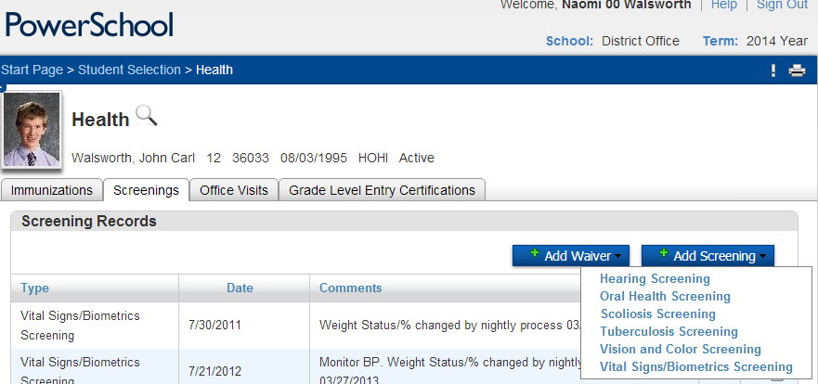
Role of the School Nurse/Program Manager
Documentation
  Transfer screening results to permanent record
  Record right and left ear separately
  Screening tests given, when and by whom
  FERPA protected information
Section of Women’s Children’s & Family Health
Notes:
Documentation considerations include:
Transfer of screening results to the permanent record should be done in timely manner as notes or worksheets are not considered legal health records.
Record right ear/left ear separately, what screening test was used, who gave it and when
Remember that hearing screening data is subject to FERPA (Family Education Rights and Privacy Act of 1974) and, as such, are disclosed to outside parties only on a need-to-know basis with written parental authorization.

Slide 46
Role of the School Nurse/Program Manager
Communication
  Notify teacher(s) and special education personnel, if indicated, of referral, evaluation results, and classroom accommodations
    Examples include:
      Preferential seating near the source of instruction with better hearing ear nearest teacher, away from noise sources (i.e., hallways, playground noise)
      Gain attention (i.e., “secret sign”, tap desk)
      Give visual cues
      “Peer buddy”
      Provide longer processing time for responses
Section of Women’s Children’s & Family Health
Notes:
The teacher(s) and other pertinent school staff should be notified of the initial hearing referral and the results of the evaluation to accommodate the child in the classroom and offer strategies for the classroom.
Here are few examples of accommodations that could be made. The guidelines contain some further examples.

Slide 47
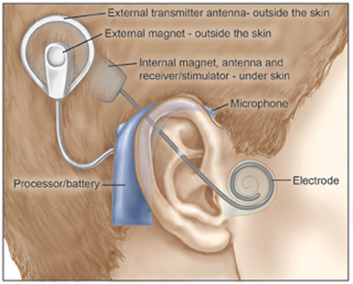
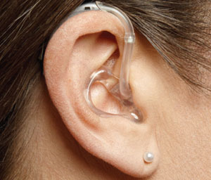
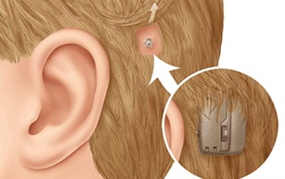
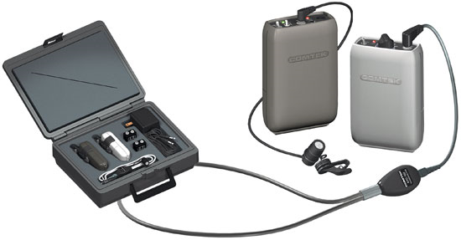
Role of the School Nurse/Program Manager
Hearing aids and other assistive devices
  Hearing aids
  Bone conduction hearing aids
  Cochlear implants
  Personal FM systems
Section of Women’s Children’s & Family Health
Notes:
While exempt from hearing screening, the school nurse may need to play an active role for supporting students who wear hearing aids or other assistive devices.
Be familiar with these devices.
Ensure routine hearing health care is current with their hearing specialist.
Collaborate with other staff members to ensure a clear plan is in place to support the needs of these students.
See the section in guidelines with other information about care for students with these devices.

Slide 48
Appendices
Section of Women’s Children’s & Family Health
Notes:
Here is the list of what is included in the appendices, most documents of which have already been mentioned in in this PPT.
One worth pointing out here is the list of common testing errors and equipment troubleshooting which is a good review of what can go wrong.

Slide 49
Resources
American Academy of Audiology (AAA) – http://www.audiology.org
American Speech-Language-Hearing Association (ASHA) – http://asha.org
Early Childhood Hearing Outreach (ECHO) videos: http://www.infanthearing.org/earlychildhood/index.html
  Pure Tone Hearing Screening in Schools (20 min)
  Common Mistakes (16 min)
  Commonly Asked Questions (15 min)
Noise Induced Hearing Loss Prevention Resources
  Centers for Disease Control and Prevention (CDC) - Promoting Hearing Health in Schools. http://www.cdc.gov/healthyyouth/noise/promoting.htm
  Dangerous Decibels Classroom Presentation Materials - http://www.dangerousdecibels.org/
Alaska Division of Public Health, School Nursing/Health Services. Alaska Hearing Screening Guidelines for Preschool/School Population and PowerPoint. http://dhss.alaska.gov/dph/wcfh/Pages/school/default.aspx
Section of Women’s Children’s & Family Health
Notes:
The resources section in the guidelines has a listing of national and state resources as well as equipment and calibration vendors.
The Early Childhood Hearing Outreach (ECHO) initiative has three videos on Pure Tone Audiometry which are excellent resources for gaining more knowledge. The video titled ‘Commonly Asked Questions’ contains a helpful demonstration of play audiometry. There are also videos on OAE screening at this website.
For hearing conservation, here are a couple resources:
CDC has some good information about establishing policies that promote hearing health of students and staff and on implementing hearing loss prevention education.
“Dangerous Decibels” offers a classroom program with materials and resources on noise-induced hearing loss prevention.
And, finally, this PPT is available on the SN/SHS Program website to use for district trainings, school nurse orientation, or self-study.

Slide 50
Summary
DO’s and DON’Ts
DO perform listening checks and find a quiet room.
DO place headphones properly.
DO screen at 20 dB HL.
DO present tone for 2-3 seconds.
DO use pulsed tones, if possible, especially with young children.
DON’T require students to raise right or left hand.
DON’T get into a pattern when presenting tones.
DON’T give visual cues.
DON’T screen student with known hearing loss.
DON’T switch headphones from one audiometer to another.
Section of Women’s Children’s & Family Health
Notes:
In summary, here are a list of Do’s and Don’ts based on the recommendations in these guidelines.
DO perform listening check and find a quiet room, place the headphones properly, screen at 20 dB, present the tone for 2-3 seconds, and use pulsed tones, if possible.
DON’T require right or left hand responses, get into a predicable pattern, give visual cues, screen student with known hearing loss, or switch headphones from one audiometer to another without recalibrating the equipment.

Slide 51

Thank you!
Contact information:
School Health Nurse Consultant
Section of Women’s, Children’s, and Family Health
3601 C Street, Suite 322
Anchorage, AK 99503
main office - 907-269-3400
School Nursing/School Health Services Program -
907-269-7368
Section of Women’s Children’s & Family Health

