Slide 1


Bringing Delegation into Practice: The How To’s
Alaska Division of public health
School nursing/school health services program
October 2015

Slide 2
Objectives
Describe how approved delegation parameters can protect the school nurse’s practice and meet the health needs of students.
Describe how the Medication Delegation Decision Tree is applied in practice.
Differentiate the appropriate level of training needed for various scenarios in the school setting.
Section of Women’s, Children’s & Family Health

Slide 3
Delegation Defined
  The act of transferring to a competent individual the authority to perform a selected nursing task in a selected situation. The nurse retains accountability for the delegation.
  National Council of State Boards of Nursing 2005
  The ability of the nurse to transfer the responsibility of a nursing task to an unlicensed person while the nurse continues to be accountable for the outcomes.
  American Nurses Association 2007
Section of Women’s, Children’s & Family Health

Slide 4
Delegation Defined
  Delegation in school nursing is a complex process in which the authority to perform a selected nursing task is transferred to a competent unlicensed individual (UAP) in a specific situation. National Association of School Nurses
  The assignment of the performance of a nursing activity to a non-nurse. Accountability remains with the registered nurses; state laws and regulations and school regulations must be followed; and standards of school nursing practice must be upheld. ANA & NASN SN Scope & Standards of Practice
Section of Women’s, Children’s & Family Health

Slide 5
The need for delegation
The need for delegation of nursing tasks in the school setting is greater today than ever before
more school nurse responsibilities
limited number of qualified school nurses
unfunded mandates
budgetary concerns
staffing patterns where school nurses cover multiple schools
Federal and state requirements (e.g. IDEA, Section 504 and the American Disabilities Act) requiring school health services for complex student health needs
REALITY
Section of Women’s, Children’s & Family Health
Notes:
The number of children with chronic and complex health care needs in schools is rising significantly and rapidly (NCES 2012).
Children are surviving extreme complications of pregnancy, severe congenital anomalies and significant birth trauma.
Chronic conditions (asthma, severe allergies, diabetes, autism spectrum disorders) are affecting children at increasingly alarming rates. (CDC 2011, NCES 2012)
School districts are obligated to protect the civil rights of children with special medical needs to receive health related services in order to access their education.
FROM:
Delegation in the School Setting: Is it Safe Practice? Published in the Online Journal of Issues in Nursing, May 2010
Developing a Policy for Delegation of Nursing Care in the school Setting published in the Journal of School Nursing April 2009

Slide 6
Delegation Literature
  Delegation is a core nursing competency requiring critical thinking and nursing judgment that must be taught and practiced. (NCSBN, ANA, NASN School Nurse)
  Appropriately implemented delegation:
    Ensures safe efficient delivery of nursing tasks
    Frees the school nurse to attend to more complex student health care needs
    Enhances skill development for assistive personnel
    Promotes cost containment for schools
Literature provides support for the contribution unlicensed assistive personnel make in schools when there is adequate training and supervision.
Section of Women’s, Children’s & Family Health
Notes:
FROM:
National Council of State Boards of Nursing (Working with Others: A Position Paper)
Joint Statement on Delegation American Nurses Association and NCSBN
If I Delegate Am I at Risk? NASN School Nurse Sept 2009
Delegation in the School Setting: Is it Safe Practice? Published in the Online Journal of Issues in Nursing, May 2010
Developing a Policy for Delegation of Nursing Care in the school Setting published in the Journal of School Nursing April 2009
Delegation in the School Setting: Is it Safe Practice? Published in the Online Journal of Issues in Nursing, May 2010
Developing a Policy for Delegation of Nursing Care in the school Setting published in the Journal of School Nursing April 2009

Slide 7
How Do I Delegate Safely & Successfully?
Five Rights of Delegation
Right Task
Right Person
Right Direction/Communication
Right Supervision
Right Circumstance
Section of Women’s, Children’s & Family Health
Notes:
Delegation is not appropriate for all students, all nursing tasks, and/or for all school settings.

Slide 8

How Do I Delegate Safely & Successfully?
RIGHT TASK
Within nurse’s scope of practice?
Reasonably routine and predictable?
Based on written medical orders?
Repeated frequently?
Performed according to established steps?
Does not involve assessment, interpretation, decision-making?
Section of Women’s, Children’s & Family Health
Notes:
1. Right Task –
Task in nurse’s scope of practice?
Task reasonably routine and predictable outcome?
Based on written medical orders?
Repeated frequently?
Performed according to an established sequence of steps without modification?
Does not involve assessment, interpretation or decision-making?

Slide 9

How Do I Delegate Safely & Successfully?
RIGHT PERSON
Who is immediately available to the student?
Who is willing and competent to do the task at the required time?
Section of Women’s, Children’s & Family Health
Notes:
2. Right Person
Who is immediately available to the student, willing and competent to do the task at the required time? No staff person can or should be forced to accept a delegation.

Slide 10

How Do I Delegate Safely & Successfully?
RIGHT DIRECTION/COMMUNICATION
How much training will be required?
How many tasks will the unlicensed staff need to learn?
What other duties does she/he have?
Section of Women’s, Children’s & Family Health
Notes:
3. Right Direction
How much training will be required by the UAP to perform the task in a safe and appropriate way?
How many tasks will the UAP need to learn?
What other duties does she/he have?

Slide 11

How Do I Delegate Safely & Successfully?
RIGHT SUPERVISION
How much initial training is needed?
What type of ongoing supervision will be needed?
  Onsite
  Periodic
  Episodic
Section of Women’s, Children’s & Family Health
Notes:
4. Right Supervision
How much initial training will the nurse need to provide to the UAP for the performance of this task?
What type of ongoing supervision will be needed (onsite, periodic, episodic)?

Slide 12

How Do I Delegate Safely & Successfully?
RIGHT CIRCUMSTANCE
Is the student particularly vulnerable?
Is the environment safe for UAP to perform the delegated task as planned?
Section of Women’s, Children’s & Family Health
Notes:
5. Right Circumstance
Is the child particularly vulnerable due to age, developmental level, cognitive abilities, gender, or specific health issues?
Is the environment safe for UAP to perform the delegated task as planned?
WHEN ANY OF THE CONDITIONS ARE NOT RIGHT, THEN DELEGATION IS NOT APPROPRIATE UNTIL THE CONDITIONS HAVE CHANGED. In the circumstance that any of these conditions cannot be satisfied despite due diligence, the decision should be to withhold delegation and plans for direct nursing care should be implemented.

Slide 13
How Do I Delegate Safely & Successfully?
Requires school nurses to work with school administrators to develop and implement proper delegation polices and guidelines.
Requires school nurses to develop comprehensive training and supervision protocol for UAP.
Depends on the school nurse developing dynamic relationships with family members, administrators, the educational team and UAPs.
Section of Women’s, Children’s & Family Health
Notes:
Developing these relationships foster confidence and communication and instill the values of knowledge, trust and empowerment on behalf of meeting the student’s better health and education goals.
FROM:
Reducing the Risks of Delegation: Use of Procedure Skills Checklists for UAP in Schools Part 1 and 2 in NASN School Nurse (July & Sept 2013)

Slide 14
How Do I Delegate Safely & Successfully?
Requires school nurses to follow their scope and standards of practice.
Requires school nurses to follow Alaska Board of Nursing delegation regulations.
Requires school nurses to follow school district policies and procedures.
School nurse accountability is for the quality of nursing care given to the student.
Section of Women’s, Children’s & Family Health
Notes:
Nurses have legitimate concerns regarding their liability when delegating to others especially when the “accountability remains with the nurse.” What protects the nurse in this situation is to follow accepted school nursing scope and standards of practice, AK BON regulations and school district policies/procedures.
When a registered nurse delegates a nursing task, she/he is responsible for the act of delegating and for supervising and evaluating the delegated tasks. School nurses delegate responsibly when they determine that the trained staff person has the appropriate training and competency to perform a task safely before delegating these tasks and has continued competency upon subsequent supervision and evaluation. Appropriate supervision and evaluation of trained unlicensed personnel assures quality of nursing care for the student. Documentation of the delegation process, including evaluation, is imperative as evidence that each step of the process was appropriately fulfilled.
Schwab and Gelfman (2001) have noted:
If the nurse fulfills his/her responsibilities as a supervisor (e.g., makes an appropriate assignment or delegation, trains, and supervises the UAP, and evaluates student outcomes and UAP performance on a periodic basis), the supervising nurse should not be liable for the unpredictable errors of the UAP.
In addition, an Alaska Statute provides indemnification for school employees acting within their scope of duties and following school district policies and procedures:
AS 14.12.115. Indemnification. A school board is responsible for insuring or indemnifying and protecting a school district employee, including paying legal fees and costs arising out of any claim, demand, suit or judgment by reason of alleged negligence, alleged violation of civil rights, or alleged wrongful act resulting in death or bodily injury to any person IF the employee was acting under the direction of the school board and within the course or scope of the duties of the employee.

Slide 15

Alaska Board of Nursing Regulations
12 AAC 44.950 – 12 AAC 44.975
http://commerce.alaska.gov/dnn/cbpl/ProfessionalLicensing/BoardofNursing.aspx
Section of Women’s, Children’s & Family Health
Notes:
The mission of the Alaska Board of Nursing (AK BON) is to actively promote and protect the health of citizens of Alaska through the safe and effective practice of Nursing as defined by law.
AK BON delegation regulations 12 AAC 44.950 - 12 AAC 44.975 are found at: https://www.commerce.alaska.gov/web/cbpl/ProfessionalLicensing/BoardofNursing.aspx. These regulations will be reviewed in the following set of slides.
In addition to the delegation regulations found at this web-link, AK BON Advisory Opinions are also posted. An advisory opinion adopted by the BON is an interpretation of what the law says. While an advisory opinion is not law, it is more than a recommendation. An advisory opinion is an official opinion of the AK BON regarding the practice of nursing as it relates to the health and safety of the Alaska healthcare consumer. Facility policies (school district) may restrict practice further in their setting and/or require additional expectations related to competency, validation, training and supervision to assure safety of their patient. There are several AK BON advisory opinions, particularly RN scope of practice opinions, that reference school nursing and delegation including adoption of the Medication Administration in the School Setting Delegation Decision Tree and training guides referenced later in this PPT.

Slide 16
Alaska Delegation Regulations
12 AAC 44.950. STANDARDS FOR DELEGATION OF NURSING DUTIES TO OTHER PERSONS
  Duty must be within scope of practice of delegating nurse
  Nurse must assess patient
  Patient’s medical condition must be stable/predictable
  UAP is competent to perform duty and person accepts delegation and accountability
  Duty does not require nursing judgment or complex nursing skills
  UAP receives written instructions
  Nurse will provide direction and supervision, including evaluation
  Delegation specific to UAP and student
  Nurse remains responsible for quality of nursing care
Section of Women’s, Children’s & Family Health
Notes:
12 AAC 44.950. STANDARDS FOR DELEGATION OF NURSING DUTIES TO OTHER PERSONS.
(a) A nurse licensed under AS 08.68 may delegate the performance of nursing duties to other persons, including unlicensed assistive personnel, if the following conditions are met:
(1) the nursing duty to be delegated must be within the scope of practice of the delegating nurse;
(2) a registered nurse must assess the patient’s medical condition and needs to determine if a nursing duty for that patient may be safely delegated to another person;
(3) the patient’s medical condition must be stable and predictable;
(4) the person to whom the nursing duty is to be delegated has received the training needed to safely perform the delegated duty, and this training has been documented;
(5) the nurse determines that the person to whom a nursing duty is to be delegated is competent to perform the delegated duty correctly and safely and accepts the delegation of the duty and the accountability for carrying out the duty correctly;
(6) performance of the delegated nursing duty would not require the person to whom it was delegated to exercise professional nursing judgment or knowledge or complex nursing skills;
(7) the nurse provides to the person, with a copy maintained on record, written instructions that include
(A) a clear description of the procedure to follow to perform each task in the delegated duty;
(B) the predicted outcomes of the delegated nursing task;
(C) how the person is to observe and report side effects, complications, or unexpected outcomes in the patient, and the actions appropriate to respond to any of these; and
(D) the procedure to document the performance of the nursing duty in the patient’s record.
(b) A nurse who has delegated a nursing duty to another person shall provide appropriate direction and supervision of the person, including the evaluation of patient outcomes. Another nurse may assume delegating responsibilities from the delegating nurse if the substitute nurse has assessed the patient, the skills of the person to whom the delegation was made, and the plan of care. Either the original delegating nurse or the substitute nurse shall remain readily available for consultation by the person, either in person or by telecommunication.
(c) The delegation of a nursing duty to another person under this section is specific to that person and for that patient, and does not authorize any other person to perform the delegated duty.
(d) The nurse who delegated the nursing duty to another person remains responsible for the quality of the nursing care provided to the patient.
Authority: AS 08.68.100 AS 08.68.805 AS 08.68.850 AS 08.68.340

Slide 17
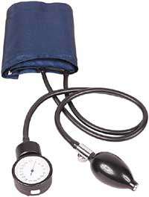
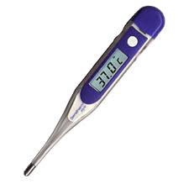
Alaska Delegation Regulations
12 AAC 44.955. DELEGATION OF ROUTINE NURSING DUTIES
  Occur frequently
  Do not involve nursing knowledge or judgment
  Do not involve complex nursing skills
  Have standard procedure and predictable results
  Present minimal potential risk
Section of Women’s, Children’s & Family Health
Notes:
12 AAC 44.955. DELEGATION OF ROUTINE NURSING DUTIES.
(a) Routine nursing duties may be delegated to another person under the standards set out in 12 AAC 44.950. Routine nursing duties are those that
(1) occur frequently in the daily care of a patient or group of patients;
(2) do not require the person to whom the duty is delegated to exercise professional nursing knowledge or judgment;
(3) do not require the exercise of complex nursing skills;
(4) have a standard procedure and predictable results; and
(5) present minimal potential risk to the patient.
(b) Routine nursing duties that may be delegated include
(1) monitoring bodily functions;
(2) taking and recording vital signs;
(3) transporting patients;
(4) non-invasive collection and testing of physical specimens;
(5) measuring and recording fluid and food intake and output; and
(6) personal care tasks such as bathing, oral hygiene, dressing, toileting, assisting with eating, hydrating, and skin care.
Authority: AS 08.68.100, AS 08.68.805, AS 08.68.850

Slide 18
Alaska Delegation Regulations
12 AAC 44.960. DELEGATION OF SPECIALIZED NURSING DUTIES
Duties that require more training and skill than routine duties:
Changing simple dressings
Assisting student with self-medication
Obtaining blood glucose levels
Suctioning oral pharynx
Giving tracheostomy care (stable patients)
Removing urinary catheters
Adding fluid to gastrostomy tube feedings
Develop a delegation plan. Evaluate on-site at least once every 90 days. Keep a record of the evaluations conducted.
Section of Women’s, Children’s & Family Health
Notes:
12 AAC 44.960. DELEGATION OF SPECIALIZED NURSING DUTIES.
(a) Specialized nursing duties are those duties that do not require professional nursing education to correctly perform, but require more training and skill than routine nursing duties. Specialized nursing duties may be delegated to another person under the standards set out in 12 AAC 44.950.
(b) Specialized nursing tasks that may be delegated include
(1) changing simple, nonsterile dressings using aseptic technique when no wound debridement or packing is involved;
(2) assisting patients with self-medication;
(3) obtaining blood glucose levels;
(4) suctioning of the oral pharynx;
(5) providing tracheostomy care in established, stable patients;
(6) removal of internal or external urinary catheters;
(7) adding fluid to established gastrostomy tube feedings and changing established tube feeding bags; and
(8) placing electrodes and leads for electrocardiogram, cardiac monitoring, and telemetry.
(c) A nurse who delegates a nursing duty to another person under this section shall develop a nursing delegation
plan that describes the frequency and methods of evaluation of the performance of the delegated duty by the other person. The delegating nurse shall evaluate a continuing delegation as appropriate, but must perform an evaluation on-site at least once every 90 days after the delegation was made. The delegating nurse shall keep a record of the evaluations conducted.
Authority: AS 08.68.100 AS 08.68.805 AS 08.68.850

Slide 19
Alaska Delegation Regulations
12 AAC 44.965. DELEGATION OF THE ADMINISTRATION OF MEDICATION
  The administration of medication is a specialized nursing task that may be delegated to…a school setting provider.
  The person must successfully complete a training course approved by the BON.
  Routinely scheduled oral, topical, transdermal, nasal, inhalation, optic, otic, vaginal, rectal medications may be delegated with written instructions
  PRN medications, other than controlled substances, may be delegated if the nurse assesses the student to determine if assessment is required before each dose.
Injectables, PRN controlled substances, and medications given via gastrostomy tube are not delegable by a registered nurse
Section of Women’s, Children’s & Family Health
Notes:
12 AAC 44.965. DELEGATION OF THE ADMINISTRATION OF MEDICATION.
(a) The administration of medication is a specialized nursing task that may be delegated under the standards set out in 12 AAC 44.950, 12 AAC 44.960, and this section.
(b) Administration of medication may be delegated only to a
(1) “home and community-based services provider” as defined in 7 AAC 43.1110(8);
(2) “residential supported living services provider” as defined in 7 AAC 43.1110(15); or
(3) school setting provider; in this paragraph, “school setting provider” means a person who is employed at a school that provides educational services to students age 21 or younger.
(c) The person to whom the administration of medication is to be delegated must successfully complete a training course in administration of medication approved by the board.
(d) To delegate to another person the administration of routinely-scheduled oral, topical, transdermal, nasal, inhalation, optic, otic, vaginal, or rectal medications to a patient the written instructions provided to the person under 12 AAC 44.950(a)(7) must also include
(1) directions for the storage and administration of medication, including the brand and generic name of the medication, the dosage amount and proper measurement, timing of the administration, recording the administration, the expected outcome of administration, and any contraindications to administration;
(2) possible interactions of medications;
(3) how to observe and report side effects, complications, errors, missed doses, or unexpected outcomes of the medications and appropriate response to such developments; and
(4) if the delegating nurse is not available on-site, the action that the person must take when medications are changed by order of a health care provider, including how to notify the delegating nurse of the change, how the delegating nurse will receive verification from the health care provider of the medication change, and how the nurse is to notify the other person if the administration of the change of medication is delegated.
(e) The administration of PRN medication, other than controlled substances, may be delegated under this section if a nurse is not available on-site. Before the administration of PRN medications may be delegated, the nurse shall first assess the patient to determine whether on-site patient assessment will be required before the ongoing administration of each dose of PRN medication. The written instructions provided to the person under 12 AAC 44.950(a)(7) must meet the requirements of (d) of this section, and must also include
(1) when to administer the PRN medication to the patient;
(2) the procedure to follow for the administration of the PRN medication, including dosage amount, frequency, and duration; and
(3) the circumstances under which the person should contact the delegating nurse.
Authority: AS 08.68.100 AS 08.68.805 AS 08.68.850

Slide 20
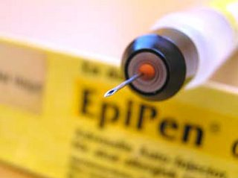
Alaska Delegation Regulations
12 AAC 44.966. DELEGATION OF THE ADMINISTRATION OF INJECTABLE MEDICATION
Injectable medications may be delegated only by an advanced nurse practitioner to a certified medical assistant
Section of Women’s, Children’s & Family Health
Notes:
12 AC 44.966. DELEGATION OF THE ADMINISTRATION OF INJECTABLE MEDICATION.
(a) The administration of injectable medication is a specialized nursing task that may be delegated under the standards set out in 12 AAC 44.950(a), (c), and (d) and this section.
(b) The administration of injectable medication may be delegated only by an advanced nurse practitioner to a certified medical assistant. The certified medical assistant may only perform the delegated duty in a private or public ambulatory care setting, and the advanced nurse practitioner must be immediately available on site when the certified medical assistant is administering injectable medication.
(c) The certified medical assistant to whom the administration of an injectable medication is to be delegated must successfully complete a training course in administration of medication approved by the board.
(d) To delegate to a certified medical assistant the administration of an injectable medication to a patient the written instructions provided to the certified medical assistant under 12 AAC 44.950(a)(7) must also include the information required in 12 AAC 44.965(d)(1) – (3).
(e) The delegating advanced nurse practitioner is responsible for ensuring that the certified medical assistant maintains a national certification and for reviewing a current criminal background check upon hire, to be reviewed at five-year intervals. If the certified medical assistant has been convicted of a crime that, under AS 08.68.270 and 12 AAC 44.705, is substantially related to the qualifications, functions, or duties of a certified nurse aide, registered nurse, or practical nurse, the advanced nurse practitioner may not delegate the administration of injectable
medications to that certified medical assistant.
(f) In this section,
(1) "certified medical assistant" means a person who is currently nationally certified as a medical assistant by a national body accredited by the National Commission for Certifying Agencies (NCCA) and meets the
requirements of this section;
(2) "immediately available on site" means that the advanced nurse practitioner is present on site in the unit of care and not otherwise engaged in a procedure or task that the nurse practitioner may not immediately leave when needed;
(3) "injectable medication" means
(A) B vitamins;
(B) diphenhydramine;
(C) medroxyprogesterone acetate;
(D) epinephrine delivered by autoinjector;
(E) ketoralac;
(F) vaccines;
(G) purified protein derivative (PPD).
Authority: AS 08.68.100 AS 08.68.805 AS 08.68.850

Slide 21
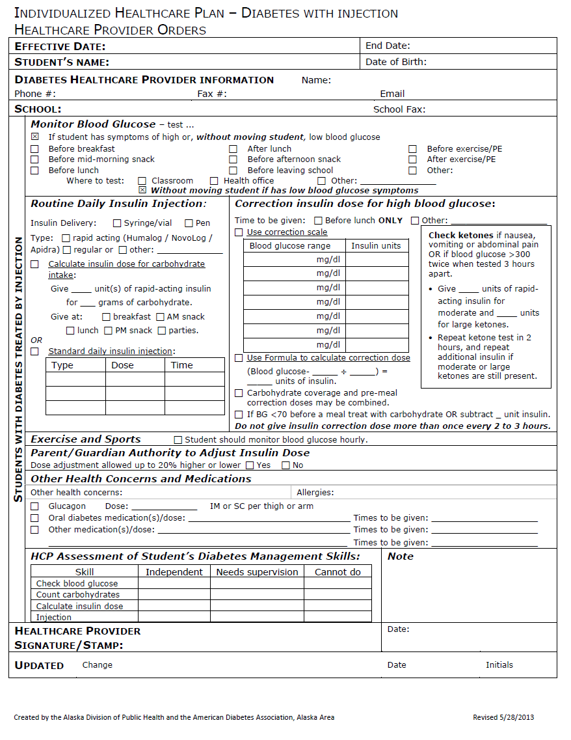

Alaska Delegation Regulations
12 AAC 44.970. NURSING DUTIES THAT MAY NOT BE DELEGATED
Nursing duties that require nursing knowledge or judgment or complex nursing skills may not be delegated.
Section of Women’s, Children’s & Family Health
Notes:
12 AAC 44.970. NURSING DUTIES THAT MAY NOT BE DELEGATED. Nursing duties that require the exercise of professional nursing knowledge or judgment or complex nursing skills may not be delegated. Nursing duties that may not be delegated include
(1) the comprehensive assessment of the patient by a registered nurse, and referral and follow-up;
(2) the focused assessment of the patient by a licensed practical nurse;
(3) formulation of the plan of nursing care and evaluation of the patient’s response to the care provided;
(4) health education and health counseling of the patient and the patient’s family or significant others in promoting the patient’s health;
(5) receiving or transmitting verbal, telephone, or written orders from the patient’s health care provider;
(6) the initiation, administration, and monitoring of intravenous therapy, including blood or blood products;
(7) providing and assessing sterile wound or decubitus ulcer care;
(8) managing and monitoring home dialysis therapy;
(9) oral tracheal suction;
(10) medication management for unstable medical conditions requiring ongoing assessment and adjustment of dosage or timing of administration;
(11) placement and administration of nasogastric tubes and fluids;
(12) initial assessment and management of newly-placed gastrostomy tubes and the patient’s nutrition;
(13) except as provided in 12 AAC 44.966, the administration of injectable medications; and
(14) administration of a non-herbal nutritional supplement.
Authority: AS 08.68.100 AS 08.68.805 AS 08.68.850

Slide 22

Alaska Delegation Regulations
12 AAC 44.975. EXCLUSIONS
The provisions of nursing delegation regulations do not apply when nursing duties have not been delegated including when a person is acting under other legal authority (e.g., PARENTS)
Section of Women’s, Children’s & Family Health
Notes:
12 AAC 44.975. EXCLUSIONS. The provisions of 12 AAC 44.950 – 12 AAC 44.970 apply only to the delegation of nursing duties by a nurse licensed under AS 08.68; they do not apply when nursing duties have not been delegated, including when a person is acting
(1) within the scope of the person’s own license;
(2) under other legal authority; or
(3) under the supervision of another licensed health care provider.
Authority: AS 08.68.100 AS 08.68.805 AS 08.68.850
OF NOTE: This section in the regulations recognizes parents, as “other legal authority”, who may delegate to family members, caretakers and other persons, including school staff, any health care needs their child might have when the child is in their care and the parent is not present.

Slide 23
Alaska Delegation Regulations
RECAP
School nurses MAY delegate:
Routine nursing duties such as taking vital signs and personal care tasks.
Specialized nursing duties such as assisting a student with self-medication, obtaining blood glucose levels, oral pharynx suctioning, trach care, and G-tube feedings.
Specialized nursing duty of routine oral, topical, transdermal*, nasal, inhalation, optic, otic, vaginal*, and rectal* medications.
*routine administration of these medications in the school setting is rare
Section of Women’s, Children’s & Family Health
Notes:
Delegation of any these tasks must meet 12 AAC 44.950 Standards for Delegation of Nursing Duties to Other Persons. Delegation of specialized nursing duties, including medication administration, must have a delegation plan that describes the frequency and methods of evaluation of the performance of the delegated duty by the trained person. Evaluation must take place on-site at least every 90 days and the delegating nurse must keep a record of these evaluations.

Slide 24
Alaska Delegation Regulations
RECAP
School nurses may NOT delegate:
Nursing assessment
Individualized healthcare plan development and evaluation
Health education or health counseling
Receiving or transmitting healthcare provider orders
Oral tracheal suctioning
Medication management for unstable medical conditions
NG tube feedings or medications
G-tube feedings when newly placed, G-tube medications
Injectable medications
Non-herbal nutritional supplements
PRN controlled substances
Section of Women’s, Children’s & Family Health
Notes:
Refer to 12 AAC 44.970 for further duties that may not be delegated (the ones on the slide are the ones most typically seen in schools).
Injectable medications may NOT be delegated; this includes epinephrine delivered by auto-injector, vaccines and purified protein derivative (PPD).

Slide 25
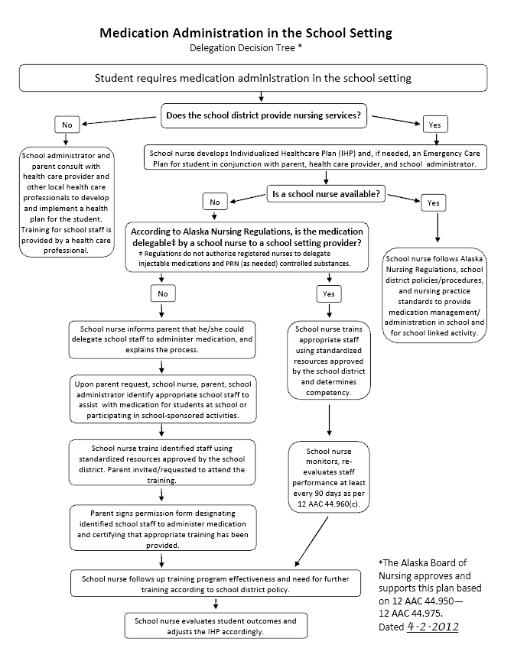
Board of Nursing
Medication Administration in the School Setting: Delegation Decision Tree approved and supported by the Alaska Board of Nursing April 2012
Section of Women’s, Children’s & Family Health
Notes:
As described in an earlier slide, the number of children with chronic and complex health care needs in schools is increasing and school districts must assure these children have their health care needs met in order to access their education and be safe at school. Currently these needs include epinephrine administration for anaphylactic reactions, glucagon for hypoglycemic reactions, diazepam rectal gel for seizure emergencies, and management of diabetes tasks, including insulin administration, at school, among others. In Alaska, schools may not have a full-time school nurse and school nurses may not always be available for field trips or extracurricular activities. For this reason, school nursing leaders worked with the AK BON over the process of two years to develop the Medication Administration in the School Setting: Delegation Decision Tree. The decision tree provides school districts with guidance and steps for safe provision of necessary medications, particularly when school nurses, by law, cannot delegate these medications to unlicensed school staff. Though some medications may not be delegable by a registered nurse, a quality, evidence-based training of the school staff administering them is imperative for student safety. The AK BON recognizes school nurses are the qualified professionals likely to provide the appropriate, standardized training. The decision tree provides the structure to determine the appropriate course, delegation or training.
The decision tree was approved and supported by the AK BON in April 2012. In August 2013, guidelines were written to further define the decision tree. The guidelines contain a summary of school nurse responsibilities, definition of delegable and non-delegable medications by a school nurse, discussion of liability issues, discussion of field trip and extracurricular activity responsibilities, a sample standard (policy/procedure) and sample forms.
Both the Medication Administration in the School Setting: Delegation Decision Tree and the accompanying guidelines are available on the Alaska Division of Public Health School Nursing/School Health Services website: http://dhss.alaska.gov/dph/wcfh/Pages/school/resources.aspx.

Slide 26



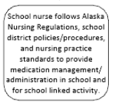
Medication Administration:
Delegation Decision Tree Guidelines
STEP 1
STEP 2
Step 3
Section of Women’s, Children’s & Family Health
Notes:
It may be helpful to have a copy of the Medication Administration in the School Setting Delegation Decision Tree available to follow along with the steps in the next few slides.
Steps in determining safe administration of medication in the school setting:
School nursing services in district? YES
School nurse develops IHP/ECP
Is school nurse available? Available means: School nurse is present and accessible to provide the necessary care and assistance that a student requires when the student is at school or engaged in a school-sponsored activity.
NOTE: definition of school-sponsored activity: academic, nonacademic and extracurricular activities that may include field trips, special interest groups or clubs, physical recreational athletics and other recreational activities sponsored by the school and/or school district. (34 DFR 104.34 (b) and 104.37 (a)(2)). In a guidance document dated January 2013 by the US Dept of Education Office for Civil Rights, clarification is made for obligations of public elementary and secondary schools for ensuring students with disabilities have equal opportunity to participated in extracurricular athletics. An example is given regarding a student with diabetes who is determined to have a disability under Section 504, the student needs glucose testing and insulin administration from trained school staff during the school day and is afforded this same access for after school extracurricular activity, a school sponsored gymnastics club.
If answer is YES:
School nurse follows nursing regulations, district policies/procedures, nursing practice standards to deliver care

Slide 27


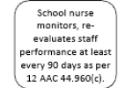
Medication Administration:
Delegation Decision Tree Guidelines
STEP 2
Step 3
Section of Women’s, Children’s & Family Health
Notes:
If answer is NO (school nurse is not present and/or is not accessible to provide the necessary care and assistance that a student requires when the student is at school or engaged in a school-sponsored activity):
Is the medication delegable?
If answer is YES:
School nurse follows the AK BON delegation regulations, trains using standardized resources approved by the BON and school district, determines competency, documents the delegation plan and evaluates every 90 days.

Slide 28




Medication Administration:
Delegation Decision Tree Guidelines
STEP 3
Section of Women’s, Children’s & Family Health
Notes:
Is the medication delegable by a school nurse? (REMINDER: registered nurses cannot delegate injectable medications, PRN as needed controlled substances and medication administration via gastrostomy)
If answer is NO:
School nurse informs parent they could delegate to school staff
Per parent request….school nurse, parent, school administrator identify appropriate staff who are willing to be trained
School nurse trains using standardized resources; parent should be invited/requested to attend the training
Parent signs permission designating specific staff person(s) to administer the medication(s) and certifies that the appropriate training has occurred

Slide 29

Medication Administration:
Delegation Decision Tree Guidelines
FINAL STEP (either path, whether school nurse or parent is delegating)
Section of Women’s, Children’s & Family Health
Notes:
For either pathway, whether school nurse delegation or parent delegation:
School nurse follows up the training program effectiveness, need for further training
School nurse evaluates student outcomes and adjusts IHP/ECP accordingly.

Slide 30
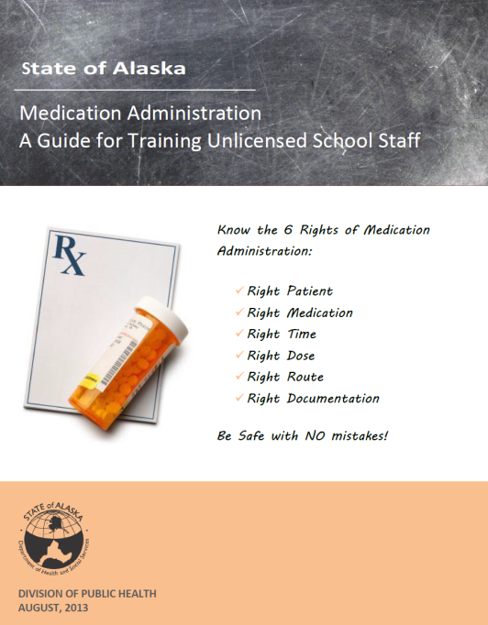


Standardized Curricula
AK Board of Nursing must approve training course in administration of medication that is used by registered nurse when delegating administration of medication. (12 AAC 44.965 (c).
Section of Women’s, Children’s & Family Health
Notes:
The Alaska Division of Public Health School Nursing/School Health Services Program in collaboration with the Alaska School Health Nurse Advisory Committee, the AK BON and many other stakeholders developed the following training guides to provide school nurses with standardized curricula to utilize when training unlicensed school staff, including the necessary documentation. Each of these guides has been approved by the AK BON and are available for districts to adopt/adapt into their policy/procedures. Each contain information the school nurse needs to know before training, the materials and resources needed, pre/post tests, checklists and sample forms. These guides are available on the School Nursing/School Health Services website at: http://dhss.alaska.gov/dph/wcfh/Pages/school/resources.aspx
Medication Administration: Guide for Training Unlicensed School Staff is a basic medication administration guide in training school staff on medications delegable by registered nurses (i.e., routinely scheduled oral, topical, transdermal*, nasal, inhalation, optic, otic, vaginal*, or rectal* medications).
Emergency Medication Administration: Guide for Training Unlicensed School Staff is a guide for training school staff in epinephrine, glucagon and diazepam rectal gel. These medications are not delegable to staff by a registered nurse but are by the parent of the student. (See 12 AAC 44.975 Exclusions)
Diabetes Management: Guide for Training Unlicensed School Staff is an intensive course in diabetes management intended for training school staff in schools where the nurse is not on site full-time and there is a student(s) with diabetes. Skills training needed will depend on the individual student situation.
*Rarely, if ever, given in a school setting on a routine basis so not included in this guide.

Slide 31
More Alaska Resources
Medication Administration
Training/Delegation Checklists: to assist in determining level of training needed in various situations, forms to include, evaluation and follow up required.
Daily, frequent and/or emergency meds
Field trips
Extracurricular activities
Section of Women’s, Children’s & Family Health
Notes:
Training unlicensed staff with the entire training curriculum may not be necessary in all situations. The Alaska Board of Nursing recognizes that training and delegation should be customized to the individual student and that content may vary according to the situation. Below are three common scenarios seen in schools:
Daily, Frequent and/or Emergency Medications: For unlicensed school staff administering medications on a regular basis when the school nurse is not on-site or available full-time.
Field Trip: For school staff that are only administering medications for a short-term purpose such as a singular or after-school event.
Extracurricular, School-Sponsored Activity: For staff who are responsible for administering medications for regular activities related to school but outside the normal school hours.
Medication Administration Training/Delegation Checklists were created to determine the level of training needed for the above scenarios. School nursing administrators and school nurse leaders may use these checklists to develop district level policies, standards, procedures/protocols around delegation and medication administration training based on the approved training guides. It is important to follow district policy and use the approved district forms.
The checklists are available on the School Nursing/School Health Services website at: http://dhss.alaska.gov/dph/wcfh/Pages/school/resources.aspx#pubs.

Slide 32
More Alaska Resources
Department of Education & Early Development eLearning module:
State of Alaska Medication Administration: Training for Unlicensed School Staff
Register here:
http://education.alaska.gov/ELearning/
Section of Women’s, Children’s & Family Health
Notes:
The eLearning course, Medication Administration: Training for Unlicensed School Staff, was developed to provide basic information for safe administration and storage of medications in the school setting. This training is offered as a companion piece to the Medication Administration: Guide for Training Unlicensed Staff. This eLearning module will supplement the guide with demonstrations and important information including the roles and responsibilities of trained staff in administering medications, legal requirements and the general rules, steps and forms of medication administration.
The module is intended to provide the training portion of the delegation process for school nurses delegating oral, eye, ear, skin, nasal and inhaled medications to unlicensed school staff. School nurses must complete the delegation process by giving individual student-specific instructions, evaluating trainee knowledge and competency and developing a nursing delegation plan for each student that includes evaluating the continued delegation on-site at least once every 90 days after the delegation was made.
This module does not include training for administration of injectable medications, such as epinephrine or glucagon, or for PRN controlled substances, such as diazepam rectal gel. Trainings for these emergency medications are found in a separate training guide.

Slide 33
Scenario Practice
What process will you use to plan for the situation?
What resources will assist you in your planning?
What are the steps you will take?
Is/are the medication(s) delegable by a school nurse?
Is the delegation nurse-directed or parent-directed?
What forms will need to be used?
What other safety measures will need to be put in place?
How often will you need to re-evaluate the trained staff person’s competency and further training needs?
Section of Women’s, Children’s & Family Health
Notes:
What follows are several scenarios providing an opportunity to practice delegation principles and protocols. For each, use the Medication Administration Training/Delegation Checklists to answer the above questions on your own before referencing the answer key in the note section of the slide.

Slide 34
Scenario Practice: Scenario 1
Clem is a 13 year old seventh grader. She loves sports, and is planning on playing intramural basketball, which starts in two weeks. Intramurals at her middle school are held after school starting at 3:30, at which time the nurse is no longer in the building.
Clem has diabetes. During the day, she is becoming more and more independent, but still has some pretty severe spikes and drops in her blood sugar. She uses an insulin pen, and checks her blood sugars independently. She’s pretty good at counting carbs, but not always right on her calculations, especially when her blood sugar is dropping and her brain is “fuzzy.”
Mom and Dad both work and are not available to help until they pick Clem up after practice at 5:30 pm, but usually quick to answer their cell phones as long as they are in an area that has service. Glucagon is available in the nurse’s office, but that gets locked when the office closes at 3:30. The school secretary is there until 4:00pm.
Section of Women’s, Children’s & Family Health
Notes:
What process will you use to plan for the situation? Parent directed delegation for emergency glucagon for extracurricular, school-sponsored activity following the Medication Administration in the School Setting: Delegation Decision Tree
What resources will assist you in your planning? Module 2, Emergency Medication Administration: Guide for Training Unlicensed School Staff; may need to train using portions of Diabetes Management: Guide for Training Unlicensed School Staff depending on the needs of the student and the skills of the unlicensed staff person.
What are the steps you will take? Collaborate with parents, school administrator and, as needed, HCP to develop/amend IHP/ECP. Provide nursing assessment. Offer to train willing coach or other school staff involved in the intramural activity in glucagon administration and other needed diabetes skills. Determine appropriate, willing staff with parent and school administrator and obtain parent request for training. Provide training, document competency. Obtain parent authorization for trained staff to administer glucagon as needed. Review written instructions (IHP/ECP, medication forms) with trained staff. Determine plan for follow-up evaluation.
Is/are the medication(s) delegable by a school nurse? No, glucagon is an injectable and therefore not delegable by a registered nurse.
Is the delegation nurse-directed or parent-directed? Parent-directed.
What forms will need to be used? Medication Administration: Parental Request for Training Unlicensed School Staff to Administer, Medication Administration: Parental Authorization for Trained Unlicensed School Staff to Administer, pre/post-test, competency checklists
What other safety measures will need to be put in place? When and how to call 911, how to contact the parent, cell phone available on site
How often will you need to re-evaluate the trained staff person’s competency and further training needs? The frequency of evaluation is determined by using nursing judgment for student/trainee needs and per school district policy.

Slide 35
Scenario Practice: Scenario 2
There are 5 students in the school building with a history of allergies causing anaphylaxis that require immediate emergency Epinephrine administration in case of exposure and anaphylactic response. This elementary school is in a rural area and all parents work in the nearest city about 45 minutes from the school but the school has their cell numbers in case of emergency. Local EMS is staffed by volunteers and may take up to 20 min to respond.
The school employs a half-time school nurse who works half-time at another school a distance away. This school has a rather high rate of staff turnover due to its remote location. Classes enjoy lots of hands-on nature activities and field trips are planned accordingly.
Section of Women’s, Children’s & Family Health
Notes:
What process will you use to plan for the situation? Parent-directed delegation of epinephrine administration in an emergency at school following the Medication Administration in the School Setting: Delegation Decision Tree
What resources will assist you in your planning? Module 1, Emergency Medication Administration: Guide for Training Unlicensed School Staff
What are the steps you will take? Collaborate with parents, HCP and school administrator to develop ICP/ECP at the beginning of the school year. Provide nursing assessment. Determine appropriate staff to administer epinephrine (likely those involved in the education and care of the individual students) – work with administrator, parents and, as needed, the HCP. Obtain parent request for training. Train multiple willing staff members in epinephrine administration and determine competency. Obtain parent authorization for specified trained staff to administer epinephrine as needed. Review individual IHP/ECPs, medication forms and instructions with trained staff. Develop a plan for follow up evaluation. Consider providing a general training on overview of anaphylaxis for all staff including who and how to call for help.
Is/are the medication(s) delegable by a school nurse? No, epinephrine is injectable and therefore not delegable by a registered nurse.
Is the delegation nurse-directed or parent-directed? Parent- directed.
What forms will need to be used? Medication Administration: Parental Request for Training Unlicensed School Staff to Administer, Medication Administration: Parental Authorization for Trained Unlicensed School Staff to Administer, pre/post-test, competency checklists
What other safety measures will need to be put in place? When and how to call 911, how to contact the parent and school nurse, field trip and extracurricular activities planning
How often will you need to re-evaluate the trained staff person’s competency and further training needs? The frequency of evaluation is determined by using nursing judgment for student/trainee needs but likely at least every 90 days and per school district policy.

Slide 36
Scenario Practice: Scenario 3
Sixth grade (11-12 year olds), end of school camping trip is scheduled for 3 days. Location: 30-45 minutes away via boat from any EMS. Phone service is available, but unsure of cell phone service. Camping facilities include in-door plumbing, bunk house style sleeping facilities). Adult assigned to each building. Kitchen fully equipped for home cooked meals served in the dining room; three meals with snacks in between. Sack lunches for the hiking day. Variety of activities might include: hiking around the island, playing on the beach, arts/crafts, games, etc.
Adults include teachers, parents, and other adult volunteers. Camp site coordinator (not employed by school) is a registered nurse with school nurse and ER experience.
Four students may need specialized care (asthma, anaphylaxis, prescription medications)
Section of Women’s, Children’s & Family Health
Notes:
What process will you use to plan for the situation? Both parent and nurse directed delegation for multiple health needs on 3 day field trip following the Medication Administration in the School Setting: Delegation Decision Tree
What resources will assist you in your planning? Medication Administration: Guide for Training Unlicensed School Staff, Emergency Medication Administration: Guide for Training Unlicensed School Staff
What are the steps you will take? Collaborate with parents, HCP and school administrator at beginning of school year to develop IHP/ECP which includes planning for field trips during the school year. Provide nursing assessment. Determine appropriate staff to administer medications – work with administrator, parents and, as needed, HCP. For nurse-delegable medications, train willing school staff to administer the medications using a focused training from the Medication Administration: Guide for Training Unlicensed School Staff covering only the content needed for the field trip specific to each student. Review medication forms for time scheduled, side effects, storage instructions and where to document administration. Develop delegation plan for each student. For parent delegated emergency medications (in this case, epinephrine), obtain parent request to train, train willing school staff utilizing Module 1 of the Emergency Medication Administration: Guide for Training Unlicensed School Staff and determine competency. Obtain parent authorization for specified trained staff to administer epinephrine as needed. Review individual IHP/ECP instructions with trained staff. Determine follow-up evaluation plan.
Is/are the medication(s) delegable by a school nurse? Routine oral, topical, nasal, transdermal, nasal, inhalation, optic, otic vaginal, or rectal medications are delegable by school nurse; epinephrine is not. For PRN asthma medication, the school nurse must first assess the student to determine whether on-site patient assessment will be required before the ongoing administration of each dose of PRN medication.
Is the delegation nurse-directed or parent-directed? Both are represented in this scenario, depending on the medication
What forms will need to be used? Medication forms and Medication Administration Delegation Plan for nurse delegable prescription medications; IHP/ECP for asthma and anaphylaxis; for parent-directed delegation of epinephrine, Medication Administration: Parental Request for Training Unlicensed School Staff to Administer, Medication Administration: Parental Authorization for Trained Unlicensed School Staff to Administer, pre/post-test, competency checklists
What other safety measures will need to be put in place? When and how to call 911, backup plan for phone service limitations, how to contact the parent and school nurse; with parent permission, communication regarding student needs with camp site coordinator RN.
How often will you need to re-evaluate the trained staff person’s competency and further training needs? Review and input the event documentation upon completion. Evaluate student outcomes and adjust the IHP for future field trip plans as needed.

Slide 37
Scenario Practice: Scenario 4
Jimmy is 6 years old and diagnosed with ADHD. His parents don’t believe in the use of Ritalin or other prescribed medications, and prefer to handle things “naturally.” After a visit to his family naturopathic doctor, he comes to school with some homeopathic drops in his backpack, which his mom told him to take to the office, since they only have a nurse on Friday. The office calls you and you are able to head over to assess the situation.
The drops contain several herbs which were compounded specifically for him by his local natural foods store. The drops are labeled for him, and specify the dose he is to take orally and identify the different components.
A folded piece of paper from the mom requesting that this preparation be given at school has directions stapled to it to give 2 drop of tincture to Jimmy at lunch every day signed by the naturopath.
Section of Women’s, Children’s & Family Health
Notes:
What process will you use to plan for the situation? Review the Alaska Board of Nursing Delegation Regulations 12 AAC 44.950- 12 AAC 44.975 and Administration of a Non-Herbal Nutritional Supplement 12 AAC 44.945 and general advisory opinion dated March-99 (Administering homeopathic remedies is not within a nurse’s scope of practice) and school district policy
What resources will assist you in your planning? School Nursing/School Health Program Best Practice Statement: Use of Alternative Medications and Essential Oils available at: http://dhss.alaska.gov/dph/wcfh/Pages/school/default.aspx
What are the steps you will take? Explain to the parent that, by law, you may not administer or delegate herbal or homeopathic preparations. Provide further information as needed. Inform the building administrator. Inform the parent that they may come to school to administer the drops.
Is/are the medication(s) delegable by a school nurse? No
Is the delegation nurse-directed or parent-directed? Follow school district policy. Best practice would prohibit parent delegation to other school personnel.
What training(s) will need to be done? None.
What forms will need to be used? None.
What other safety measures will need to be put in place? Educate students, parents and school staff about the risks involved in administering products for which no safety parameters have been established, the importance of adequate research to determine the effect of herbals preparations and the rationale for schools to establish guidelines intended to ensure safety of all students. Avoid dismissal of complementary or alternative medical treatments in ways that communicate a lack of sensitivity or concern for the family’s perspective. It is important to support parents in their preferences for health care and help them find safe solutions to such dilemmas.
How often will you need to re-evaluate the trained staff person’s competency and further training needs? N/A

Slide 38
Scenario Practice: Scenario 5
Fred is in second grader at Rural Elementary School and has a seizure disorder. He has a Seizure Care Plan in place that requires PRN rectal diazepam for control of his seizures. The school has a nurse who is part-time, once a week. Fred has had only two seizures at school in the past year, but they often follow stressful situations or activities. Diazepam was used for the first, but not the second event.
The class has several field trips planned with one coming up in a week. The mother works and cannot attend the trip with the class but can be reached by telephone in case of emergency and requests that someone be prepared to give Fred’s diazepam, if needed.
Section of Women’s, Children’s & Family Health
Notes:
What process will you use to plan for the situation? Parent-directed delegation for diazepam rectal gel as needed at school and for field trips following the Medication Administration in the School Setting: Delegation Decision Tree
What resources will assist you in your planning? Module 3 of the Emergency Medication Administration: Guide for Training Unlicensed School Staff
What are the steps you will take? Collaborate with parents, HCP, and school administrator at beginning of school year to develop IHP/ECP including field trip planning. Provide nursing assessment. Determine appropriate staff to administer diazepam – work with administrator, parents, and, as needed HCP. Obtain parent request to train willing staff (at least 2, if possible). Provide training and determine competency. Obtain parent authorization for specified staff to administer diazepam in an emergency at school and on field trips. Review individual IHP/ECP, medication forms, and instructions with trained staff. Develop plan for follow-up evaluation. Consider general staff training on overview of seizure management, including who and how to get help for a seizure emergency requiring diazepam.
Is/are the medication(s) delegable by a school nurse? No, diazepam rectal gel is a controlled substance, not delegable by the school nurse on a PRN basis.
Is the delegation nurse-directed or parent-directed? Parent-directed.
What forms will need to be used? Medication Administration: Parental Request for Training Unlicensed School Staff to Administer, Medication Administration: Parental Authorization for Trained Unlicensed School Staff to Administer, pre/post-test, competency checklists
What other safety measures will need to be put in place? Training of more than one staff member, when to call 911, when and how to contact the parent and school nurse, cell phone availability on field trips
How often will you need to re-evaluate the trained staff person’s competency and further training needs? The frequency of evaluation is determined by using nursing judgment based on student/trainee needs but likely at least every 90 days and per school district policy.

Slide 39
Scenario Practice: Scenario 6
Charlene and Diane are in 2nd and 3rd grade respectively and have signed up to participate in the school sponsored cross country ski program. They both have asthma and have current Asthma Action Plans in place with PRN albuterol inhalers locked up in the nurse’s office. Neither have permission to self-administer their asthma medicine but both do know when they need their inhalers and respond well to treatment.
The ski program lasts 2 months, is from 3:00-4:00pm on Monday and Wednesday afternoon, and they go from the school on a 3-5 mile ski route then are picked up by the parent at a secondary location.
The responsible staff carries a cell phone but the cell reception is sketchy while they are on the route.
Section of Women’s, Children’s & Family Health
Notes:
What process will you use to plan for the situation? Nurse delegated inhaler administration for extracurricular, school sponsored activity following Medication Administration in the School Setting: Delegation Decision Tree and AK BON delegation regulations
What resources will assist you in your planning? Medication Administration: Guide for Training Unlicensed School Staff
What are the steps you will take? Collaborate with parents, HCP and school administrator to develop IHP/ECP at beginning of school year that includes field trips and extracurricular activity planning. Provide nursing assessment - determine whether it will be necessary for on-site assessment for each PRN inhaler dose. If not, offer to train a willing school staff person who is involved in the ski program to assist the students with their asthma inhalers – work with administrator, parents and, as needed HCP. Obtain parent request to train specified staff and request a separate asthma inhaler for the ski program, leaving the school inhalers in place in the health office. Train staff person(s) using a focused training for medication administration of inhalers. Review IHP/ECP, medication forms and instructions with trained staff. Develop a delegation plan for each student. Determine plan for follow-up evaluation.
Is/are the medication(s) delegable by a school nurse? Yes, as long as the nurse has assessed the student to ensure they do not need on-site assessment for each dose of medication.
Is the delegation nurse-directed or parent-directed? Nurse-directed.
What forms will need to be used? Prescription medication forms, Medication Administration Delegation Plan, IHP/ECP
What other safety measures will need to be put in place? Ensure an inhaler specific for the ski program is available; if not, determine plan to be sure the school inhaler is returned to school on Tuesday and Thursday mornings. Review when and how to call 911 and what to do if cell service is not available.
How often will you need to re-evaluate the trained staff person’s competency and further training needs? Because the ski program only last 2 months, it would be important to follow up using nursing judgment for student/trainee needs (requirements are for on-site evaluation every 90 days as per AK BON regulations) and per school district policy.

Slide 40
Scenario Practice: Scenario 7
The local Charter School, New Beginnings, is a growing school that has attracted many families with its “can-do” attitude. The school has 445 students but only a part time nurse, once a week. There are 7 students who need meds during the day. 4 students take Ritalin at school, 2 for inhalers before PE/Recess, and 1 for a long term cardiac problem. On occasion, students have brought in antibiotics and other short term medications.
The teachers and staff are fairly experienced and are dedicated to student achievement and working as a team. The school secretary is the glue holding the school together but is quite busy with multiple assignments and cannot possibly take on another task.
Section of Women’s, Children’s & Family Health
Notes:
What process will you use to plan for the situation? Nurse directed delegation for various medications at school following Medication Administration in the School Setting: Delegation Decision Tree and the AK BON delegation regulations.
What resources will assist you in your planning? Medication Administration: Guide for Training Unlicensed School Staff
What are the steps you will take? Collaborate with parents, HCP and school administrator to develop IHP/ECPs at the beginning of the school year for those students with long-term medications and chronic conditions. Provide nursing assessment. Obtain authorizations. Determine the appropriate and willing staff to administer medications (preferably at least 2; this may or may not be the school secretary) – work with the administrator, parents and, as needed, HCP. Train the staff in the entire course of medication administration and determine competency. Develop individual delegation plan for each student. Determine plan for follow-up evaluation.
Is/are the medication(s) delegable by a school nurse? Yes.
Is the delegation nurse-directed or parent-directed? Nurse-directed.
What forms will need to be used? IHP/ECP, medication authorizations, Medication Administration Delegation Plan
What other safety measures will need to be put in place? System for counting medications, regular and as needed communication with school nurse, regular review of appropriate delegation
How often will you need to re-evaluate the trained staff person’s competency and further training needs? On site evaluation at least every 90 days as required by AK BON regulations.

Slide 41
Scenario Practice: Scenario 8
You are a nurse at the Last Frontier Elementary School as well as the middle school. Once a month you also must travel to an outlying school with 30 students. You have arranged your workload to prioritize the elementary school in the mornings leaving for the middle school at 12:30 pm. Your travel day is flexible.
In the elementary school two 1st grade students, Alicia and Stephanie, have Type 1 diabetes. Stephanie’s blood sugars are well controlled. Alicia has frequently documented blood glucose in the 50-60 mg/dL range but she responds well to treatment. Neither students are able to count their carbs and both have insulin pumps.
Several field trips are planned for spring and both Alicia and Stephanie’s parents work full-time and cannot attend these functions.
Section of Women’s, Children’s & Family Health
Notes:
What process will you use to plan for the situation? Parent directed delegation of diabetes medications and care tasks following Medication Administration in the School Setting: Delegation Decision Tree
What resources will assist you in your planning? Diabetes Management: Guide for Training Unlicensed School Staff
What are the steps you will take? Collaborate with parents, HCP and school administrator to develop IHP/ECP at beginning of school year including planning for field trips and extracurricular activities. Provide nursing assessment. Determine appropriate and willing staff to assist with diabetes care tasks (2 or more) – work with administrator, parents and, if needed, HCP. Obtain parent request to train specified staff. Train staff in diabetes care tasks and determine competency. Obtain parent authorization for trained staff to administer needed medications and diabetes care tasks. Review individual IHP/ECP, medication forms and instructions with trained staff. Determine plan for follow up evaluation.
Is/are the medication(s) delegable by a school nurse? No, insulin and glucagon are injectables and are not delegable.
Is the delegation nurse-directed or parent-directed? Parent-directed.
What forms will need to be used? Medication Administration: Parental Request for Training Unlicensed School Staff to Administer, Medication Administration: Parental Authorization for Trained Unlicensed School Staff to Administer, pre/post-test, competency checklists
What other safety measures will need to be put in place? Contact information for parent and school nurse, planning ahead for field trip and any extracurricular activities.
How often will you need to re-evaluate the trained staff person’s competency and further training needs? Frequency to be determined by nursing judgment based on student/trainee needs and school district policy.

Slide 42
Thank You
Section of Women’s, Children’s, and Family Health
3601 C Street, Suite 322
Anchorage, AK 99503
main office 907-269-3400
School Nursing/School Health Services Program
907-269-7368

